Slide 1
The Present Perfect Simple Tense

Slide 2
The form is:
subject (has/have) + (past participle)

Slide 3
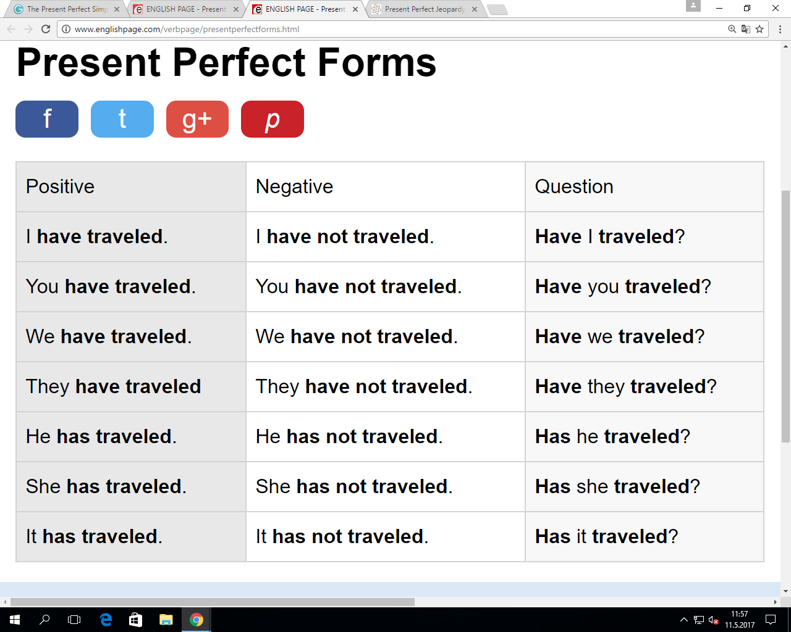

Slide 5
What is the difference between Present Perfect Simple and Simple Past?

Slide 6
Present Perfect Simple:
Simple Past:
Past Events
Recent Past Events
Unfinished States
For events that were in the past, are over now, and we know the time.

Slide 7
When do we use present perfect simple?
Past events
For example:
I have lived in Australia.
*this means that some time in the past, I have lived in Australia.
2. Recent past events
For example:
Mom has finished cooking dinner.
*this means mom just finished cooking dinner right now.

Slide 8
When do we use present perfect simple?
3. Unfinished states
For example:
We have known each other for 2 years.
*this means we met 2 years ago and still know each other now.

Slide 9
Use the words to create positive present perfect simple sentences.

Slide 10
I / study / English.

Slide 11
She / eat / rabbit.

Slide 12
They / go / to England.

Slide 13
We / read / that book.

Slide 14
He / live / here for three years.

Slide 15
You / know / David for ten years.

Slide 16
We / be / here for two weeks.

Slide 17
I / lose / my keys.

Slide 18
They / miss / the train.

Slide 19
We / eat / too much chocolate.

Slide 20
Lucy / cook / breakfast.

Slide 21
You / find / your wallet.

Slide 22
She / pass / the exam.

Slide 23
Use the words to create negative present perfect simple sentences.

Slide 24
We / not / go / to Paris.

Slide 25
She / not / see / “The Lord of the Rings.”

Slide 26
He / not / meet / my mother.

Slide 27
They / not / visit / their grandparents.

Slide 28
I / not / know / him for three months.

Slide 29
You / not / study / French for three years.

Slide 30
They / not / been / to France.

Slide 31
He / not / hurt / his leg.

Slide 32
I / not / read / that book.

Slide 33
He / not / live / in Berlin.

Slide 34
Honza / not / buy / any food.

Slide 35
You / not / call / me.

Slide 36
They / not / sleep / well.

Slide 37
She / not / clean / the kitchen.

Slide 38
Use the words to create present perfect simple sentences.

Slide 39
I (not/work) _____ today.

Slide 40
We (buy) _____ a new lamp.

Slide 41
We (not/plan) _____ our holiday yet.

Slide 42
He (read) _____ five books.

Slide 43
She (write) _____ an email.

Slide 44
Tom (not/see) _____ Kate for a long time.

Slide 45
(be/you) _____ at school?

Slide 46
School (not/start) _____ yet.

Slide 47
(speak/he) _____ to his teacher?

Slide 48
https://jeopardylabs.com/play/present-perfect-jeopardy

