Slide 1
Objective: activate students' English by discussing relevant topics on environmental issues
First, play the word guessing game. Split students into groups of 4 or 5. Each slide on the powerpoint has a picture of a natural disaster -- most students should be able to guess the word. (15 - 20 minutes). Some words are more challenging than others so the teacher should use a bit more time to describe the word for students. The last slide should have the topic that will be covered in the lesson: global warming and climate change.
Second, teach mini lesson on climate change effects in Korea. (15 min)
Explain to students their project: create a poster to help prevent climate change.
**I can send some photos over for reference**
Students can start this but will need to finish in the next class period. Then, they should receive some time to practice with their group about their presentation.
Presentations usually take the whole class period.
- Mai Tong Yang

Slide 2

Please get into your groups.

Slide 3

Please take out your English notebooks.

Slide 4
What kinds of natural disasters did we talk about in class?

Slide 5
In your team please write down all the natural disasters that were mentioned in class.

Slide 6
Do you cough more than before?

Slide 7
Do you wear masks more than before?

Slide 8
Please look outside. What kind of weather do you see today?

Slide 9
Do you think last summer was hotter than usual?

Slide 10
Do you notice more smog than before?

Slide 11
Do you think last winter was warmer than usual?

Slide 12
Do you think humans are causing more natural disasters?

Slide 13
What is climate change?

Slide 14
Climate change
The pattern of the weather is changing around the world -- causing more floods, droughts, wildfires, and typhoons.

Slide 15
Where is the smog in South Korea coming from?

Slide 16
What do you think causes climate change?

Slide 17
Some effects of having smog:
Bad air quality -- hard to breathe
More coughing
Lung damages

Slide 18
Save planet Earth!
The world is depending on you to stop climate change. You must now try to save the world or else the human race will not survive.

Slide 19
You have $10,000...
Your team must create a plan to stop climate change. You will each have a poster to present in front of the class.

Slide 20
Example plan 1:
Decrease coal burning plants in South Korea to prevent smog.

Slide 21
Example plan 2:
Have the Korean government work with the Chinese government to decrease air pollution.

Slide 22
Example plan 3:
People should drive less, and use more public transportation.

Slide 23
Use your poster to help explain your idea on how to stop climate change.

Slide 24
How you will be graded:
Speaking -- everyone must speak, use a loud voice
Teamwork - work together
Poster
Climate change idea

Slide 25


Slide 26


Slide 28
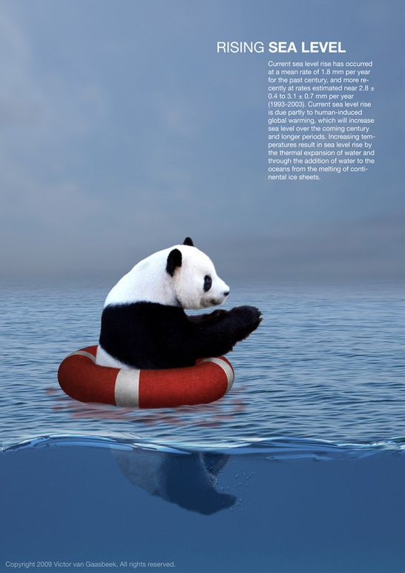

Slide 29


Slide 30
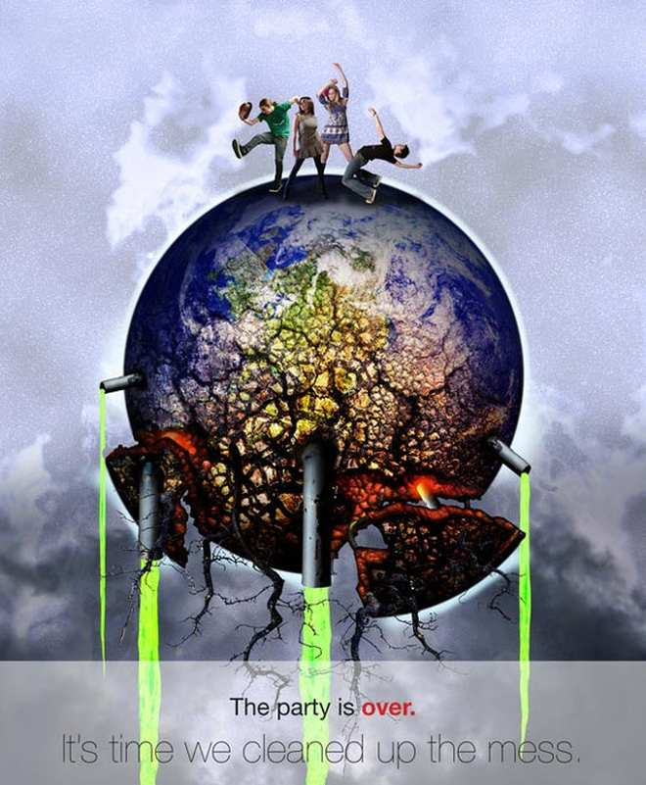

Slide 31


Slide 32


