Slide 1
Homophones
English Lesson

Slide 2
What’s a Homophone?
One of two or more words pronounced alike but different in meaning or derivation or spelling

Slide 3
Do you already know some homophones in English? Name a few.

Slide 4
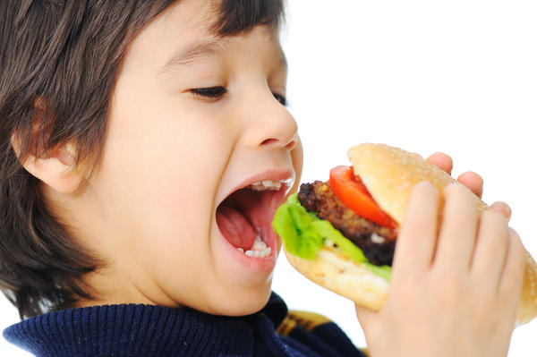
Ate vs. Eight
I ate a cheeseburger yesterday.
My favorite number is eight.

Slide 5
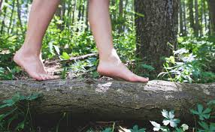
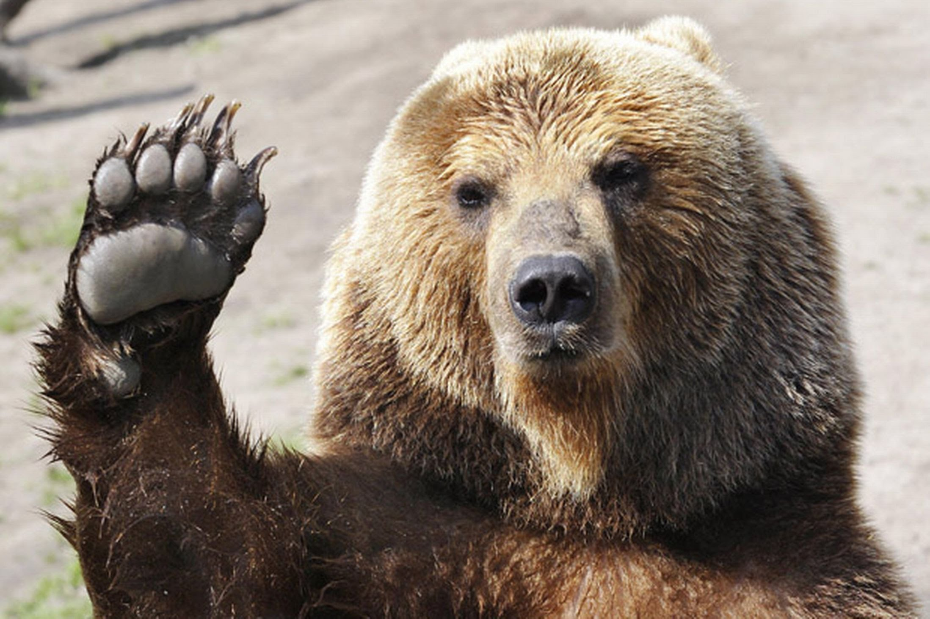
Bare vs. Bear
I like to walk around in my bare feet.
Look! That’s a big bear.

Slide 6
Son vs. Sun
This mother’s son has short hair.
The sun is shining.

Slide 7
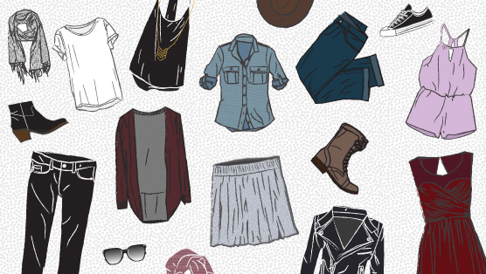
Wear vs. Where
I don’t know what clothes to wear!
Where do you want to visit in the world?

Slide 8
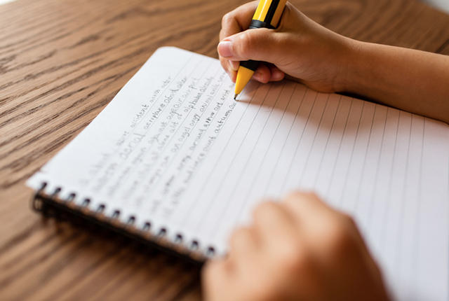
Right vs. Write
In a car, you can turn right or turn left.
In school, we write in our notebooks.

Slide 9
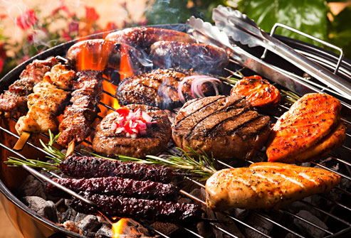
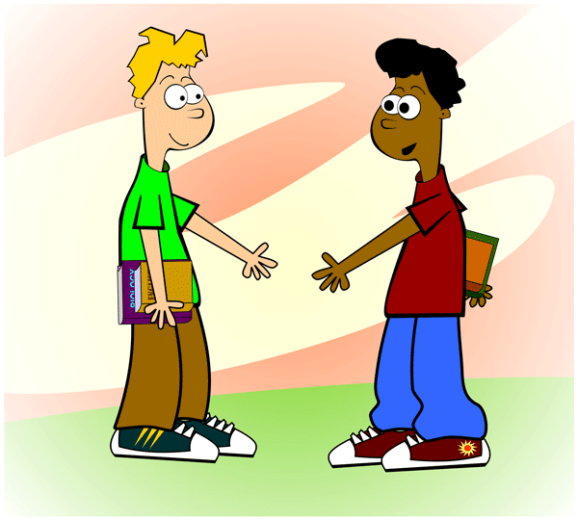
Meat vs. Meet
Do you like to eat meat?
Hello, it’s nice to meet you!

Slide 10
Mail vs. Male
Your mail is delivered in your mailbox.
He is male, not female.

Slide 11
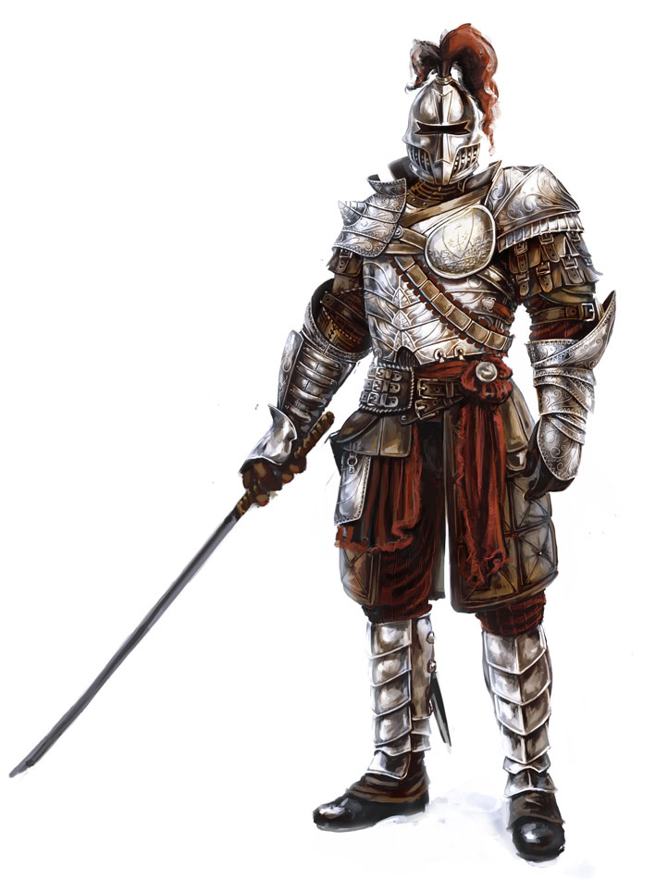
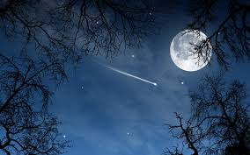
Knight vs. Night
The knight protects the King.
The moon is bright at night.

Slide 12
Hour vs. Our
It is the 12 o’clock hour.
These are our hands, we work together.

Slide 13
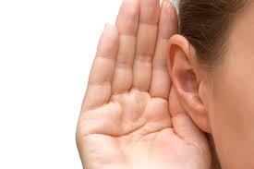
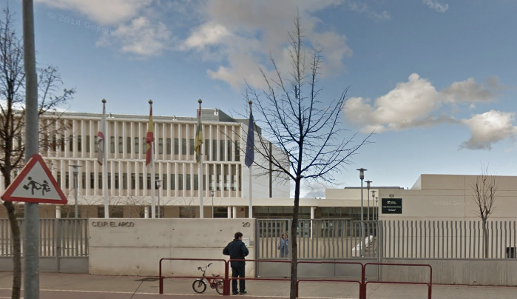
Hear vs. Here
We hear with our ears.
You go to school here.

Slide 14
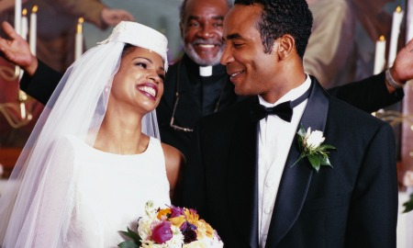
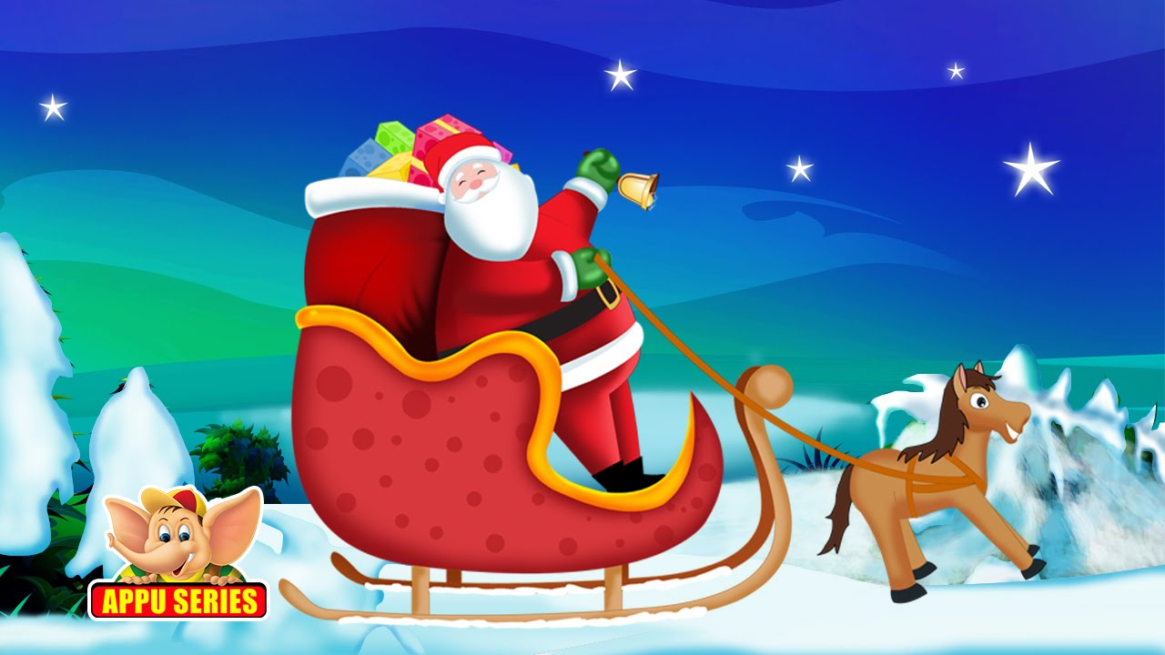
Marry vs. Merry
Today they are getting married.
Have a Merry Christmas!

Slide 15
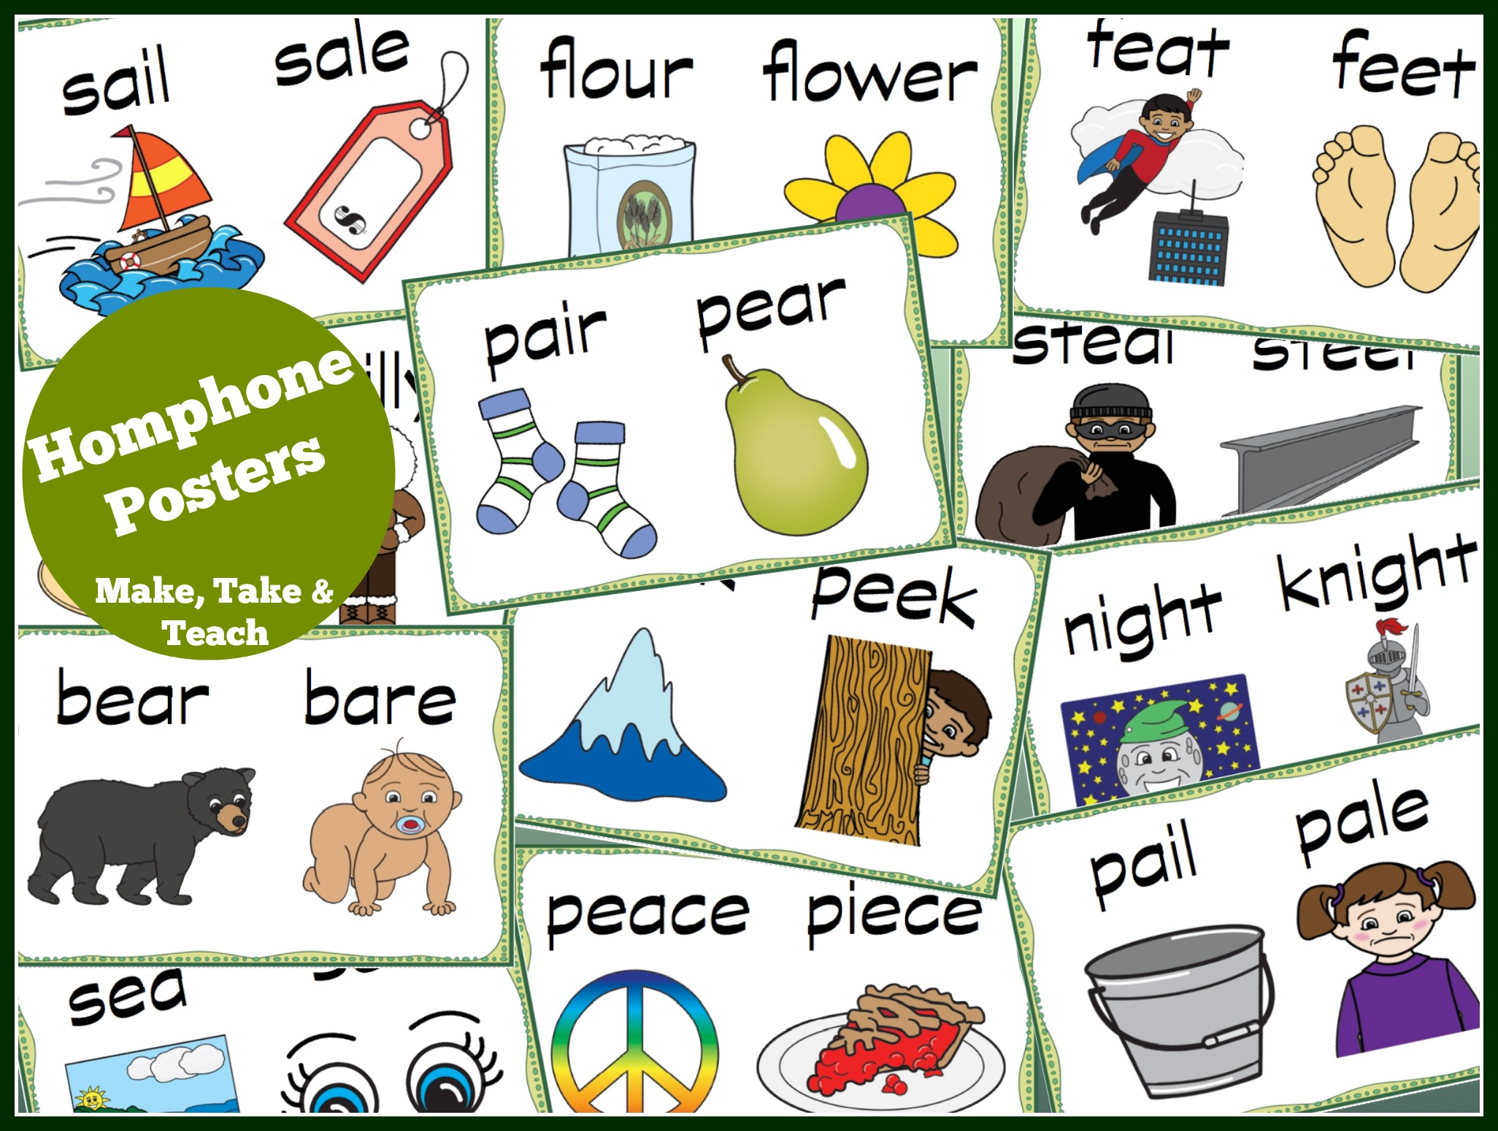
DIY Homophones Poster
Pick your favorite homophone pair
Divide your paper in half
Illustrate (with words, pictures, numbers, colors, etc.) the contextual differences between the two
You may have a partner for this activity
Here is a list of ideas of homophones to choose from: http://www.teachingtreasures.com.au/teaching-tools/Basic-worksheets/worksheets-english/upper/homophones-list.htm
A bit of homophone inspiration

