Slide 1
Post Card Project
Pen pal program

Slide 2
What is a post card
A simple, short letter to a friend or family member.
Post cards are cool because many of them can be personalized or have pictures from popular tourists attractions around the world.

Slide 3
Why do you send a postcard?
Some people think it is more fun to receive a physical letter instead of an email, SMS, FB, IG, etc.
Taking the time to send an actual letter makes the other person know that you care about them.

Slide 4
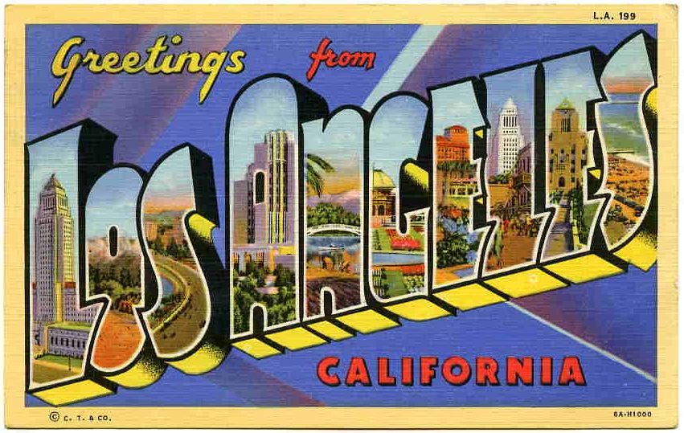
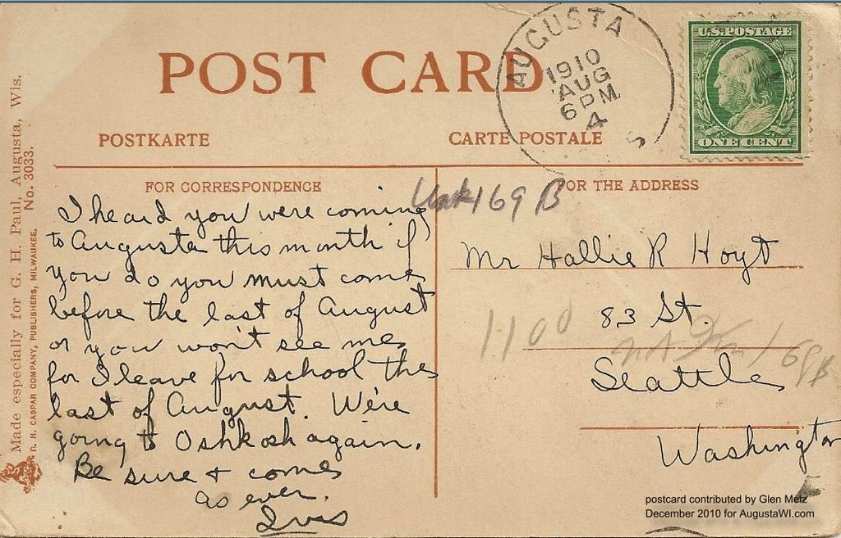
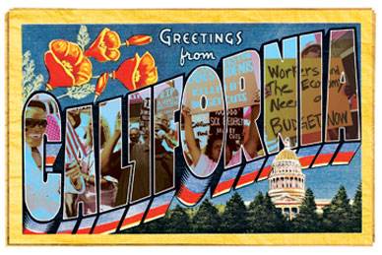

Slide 5
Benefits of writing to a Pen Pal
https://www.youtube.com/watch?v=75iB6862q1M&ab_channel=PBSParents
This is a nice short video that you can show your students about writing a Pen Pal.

Slide 6
What are we going to do?
We are going to send letters to a school in South Korea!
First, we are going to create our own postcards to send to your new pen pals!
Afterwards, you can add them on FB, IG, etc.

Slide 7
Write a short letter and ask a few questions
Introduce yourself and tell your pen pal something interesting about yourself and where you live?
Example Questions:
What do you like to do?
What are your hobbies?
What movies/books/music/TV shows do you like?
What is your favorite food from your country?
What do you know about your Pen Pal’s country? Anything you want to know more about?
Ask your pen pal a question about themselves and where they live.

Slide 8
What will we need?
We are going to be making
We need a smartphone (iPhone or Android phone) / or we can use the school’s iPads.
A postcard printer!
One selfie and two photos from your favorite spots on campus (your classroom, the library, the gym) etc.

Slide 9
And then…
We will take turns using the iPads or your own app to arrange the photos so we can print them out on the postcards. Afterwards, you will be able to write your letter to your new friend, and we will send it off to them!
And then…we wait!

