Slide 1
What do you want to learn / do in my class the most?
American Culture
New York Culture
Music / Pop Song
Games / Word game / Quiz
American Sports
Practical English / Conversation
Cooking / Food / Baking
Important things in life
Spanish
Soccer
Listening / Writing / Speaking / Grammar

Slide 2
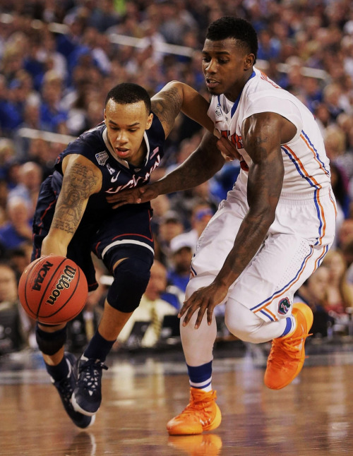
What will we do today?
Slang of the Day
GIF of the Day
Spanish of the Day
American Sports!!

Slide 3
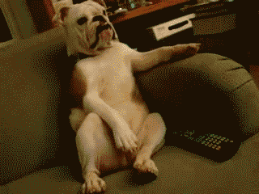
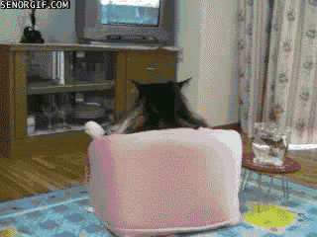
just chillin’
“What’s up? What are you doing?”
“Nothing. I’m just chillin’!”
(Just relaxing)

Slide 4
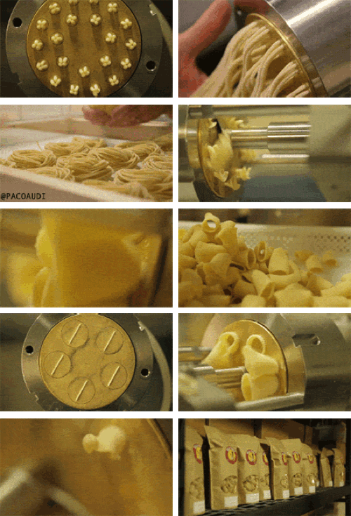
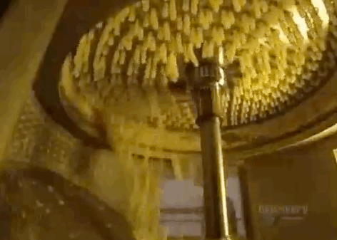
GIF of the Day
How is spaghetti made?

Slide 5
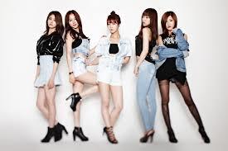
Spanish of the Day
Loco (로코)
Crazy
“Then I feel loco”
EXID- Up & Down

Slide 6
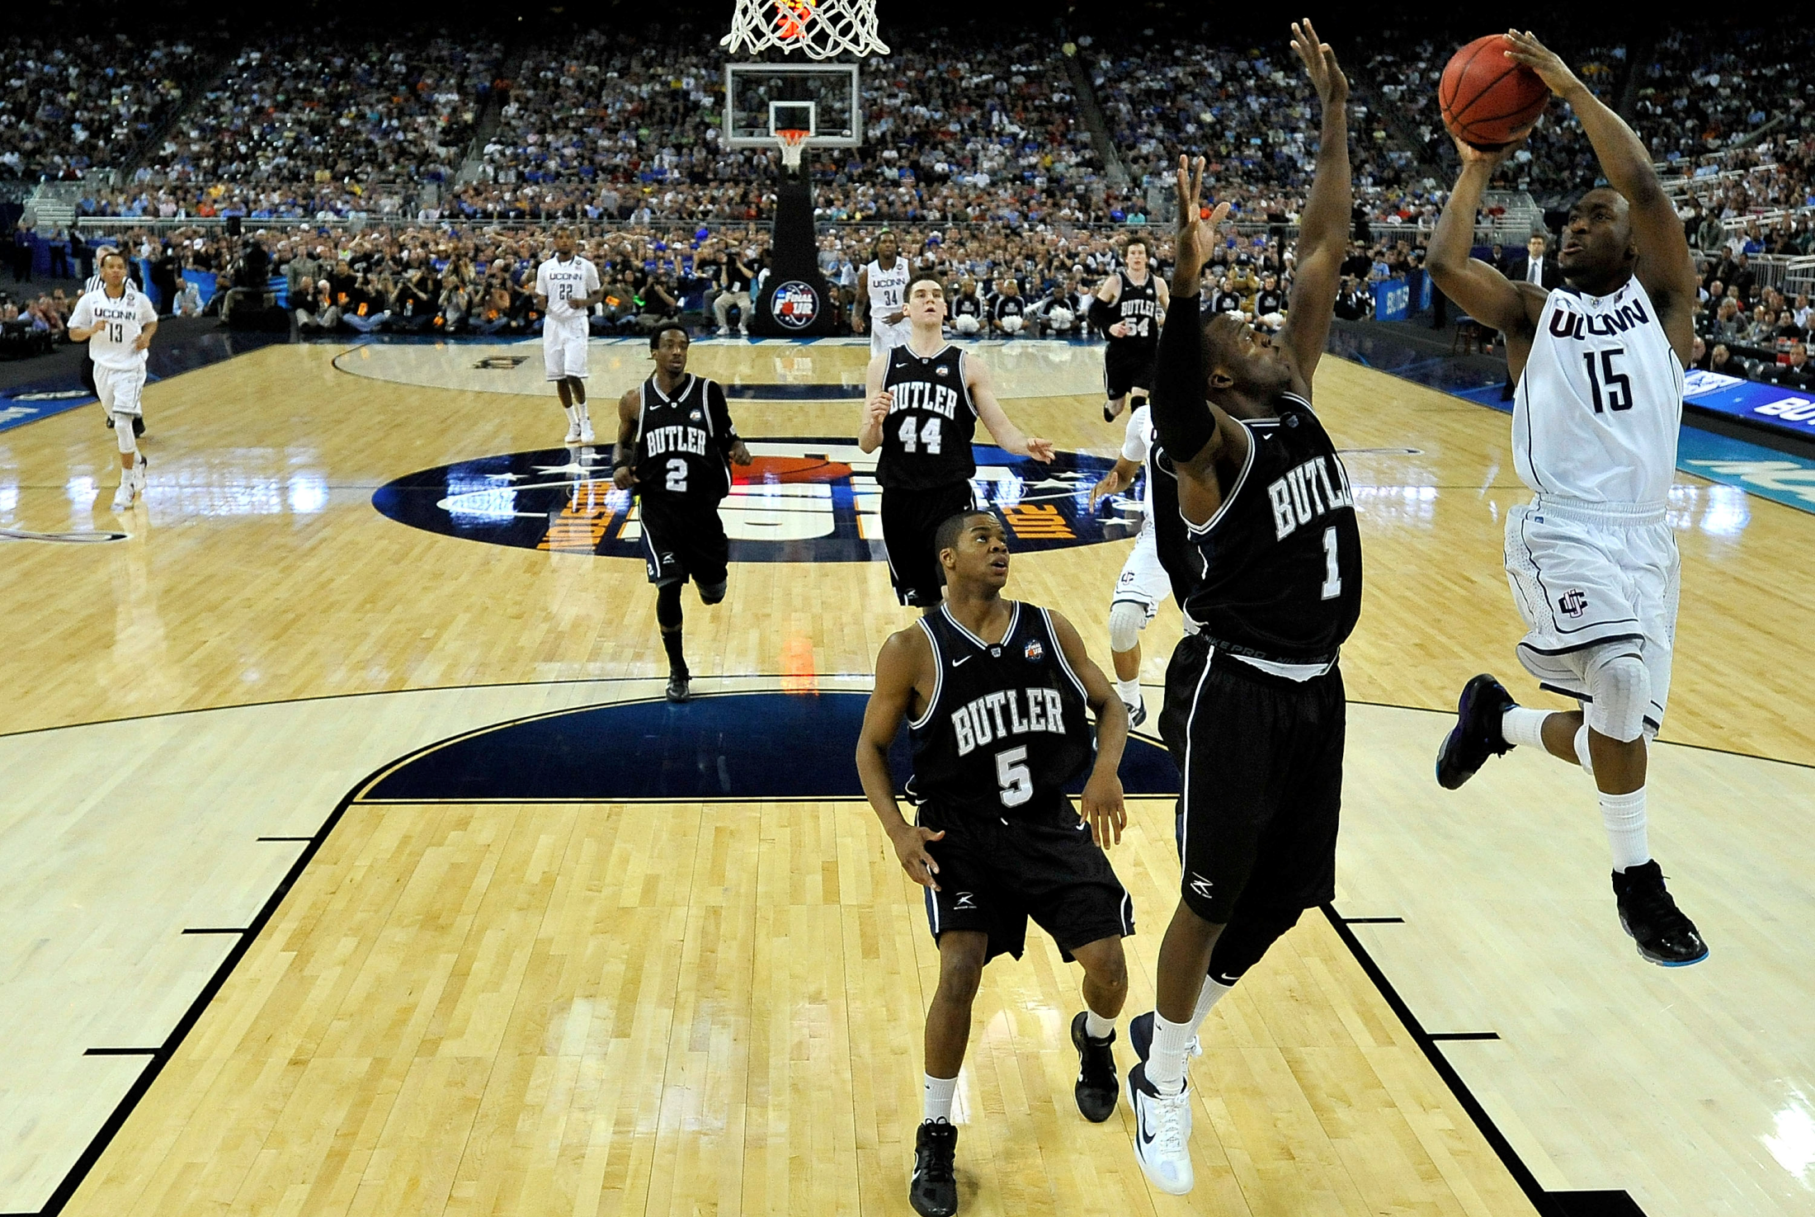

Slide 7
Word Game
Unscramble the Phrase
MSAL UKND
SLAM DUNK

Slide 8
Word Game
Unscramble the Phrase
SUINSEVSETII
UNIVERSITIES

Slide 9
Word Game
Unscramble
TALIONNA
NATIONAL

Slide 10
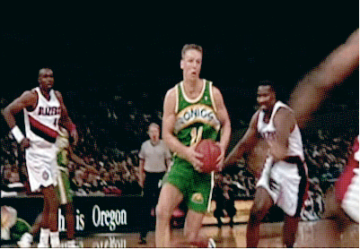
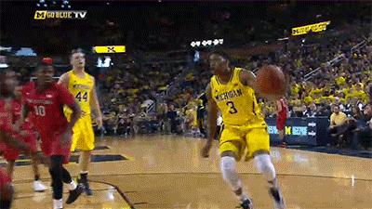
Basketball
NBA
NCAA
National Basketball Association
Pro league (professional)
National Collegiate Athletic Association
Colleges / Universities

Slide 12
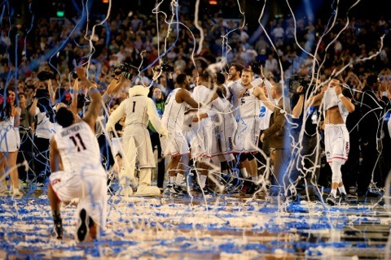
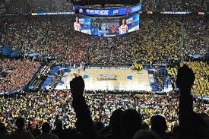
This is one of the biggest American sports tournaments of the year.

Slide 13
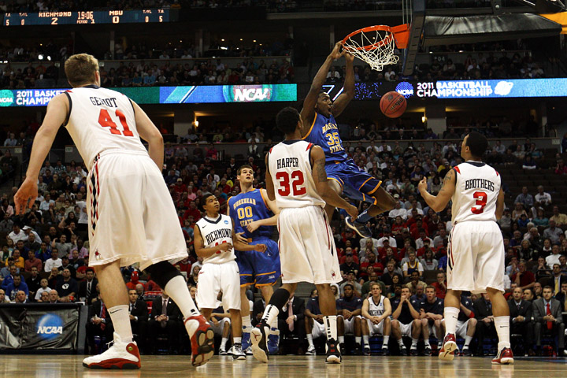
It is a college basketball final tournament.

Slide 14
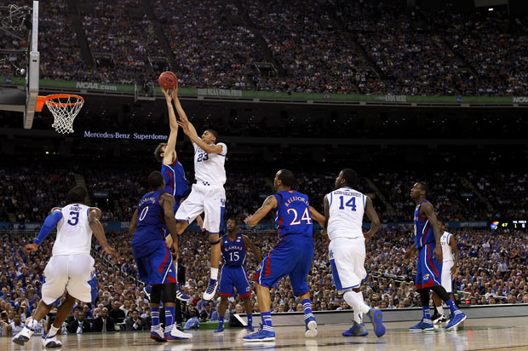
The tournament always takes place in March.

Slide 15
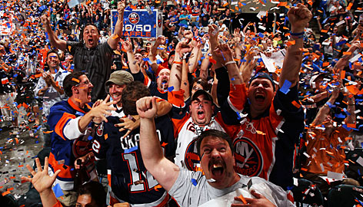
“Madness” means
craziness

Slide 16
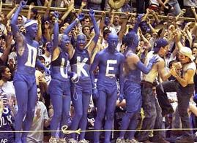
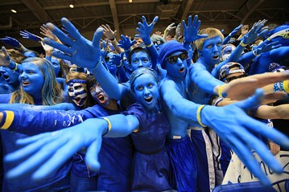
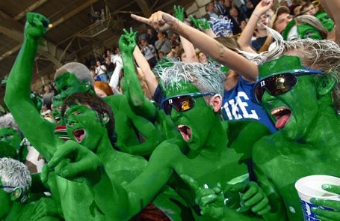
Some March Madness Fans

Slide 17
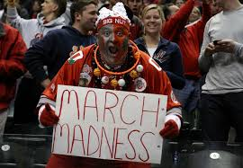
Some March Madness Fans

Slide 18
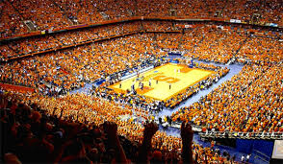
Some March Madness Fans

Slide 19
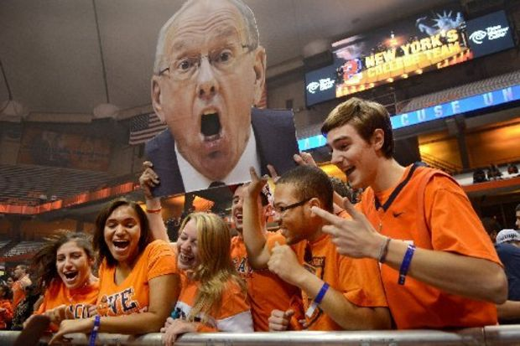
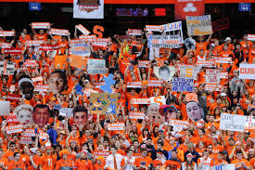
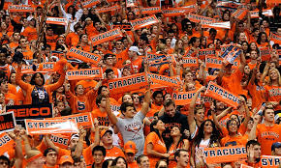
Some March Madness Fans

Slide 20
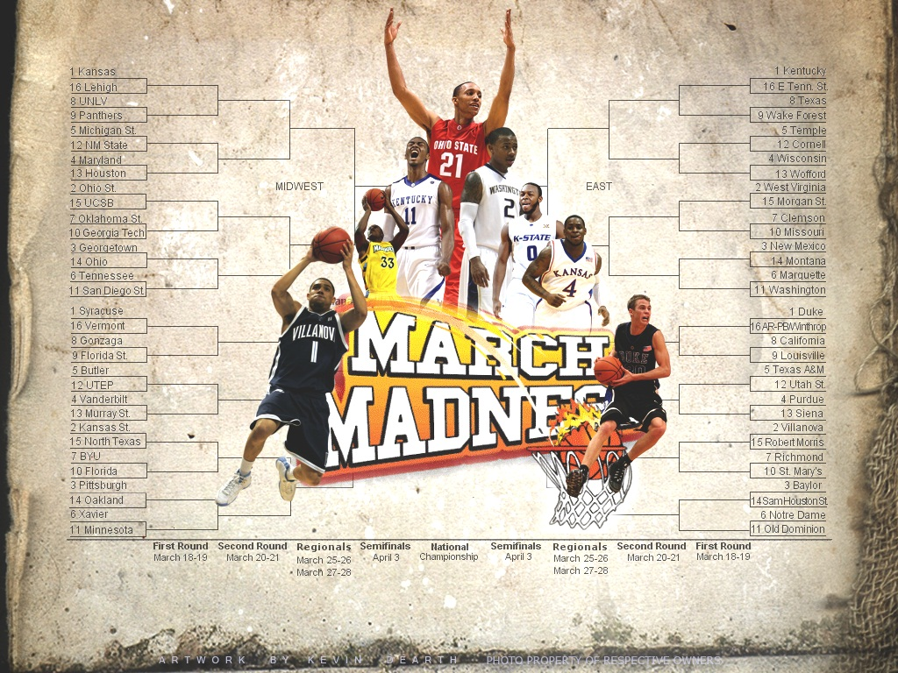
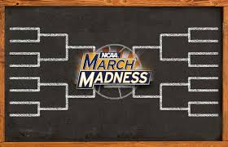
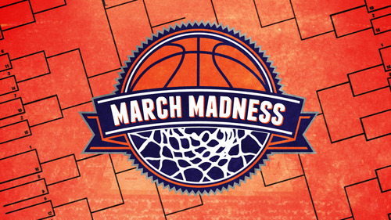
There are 64 college basketball teams that participate.

Slide 21
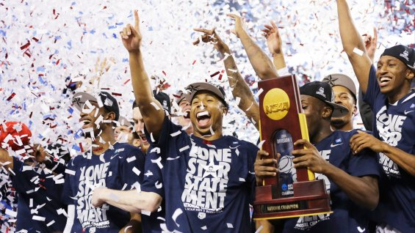
64 college teams play to be the best in the USA Teams are Ranked

Slide 22
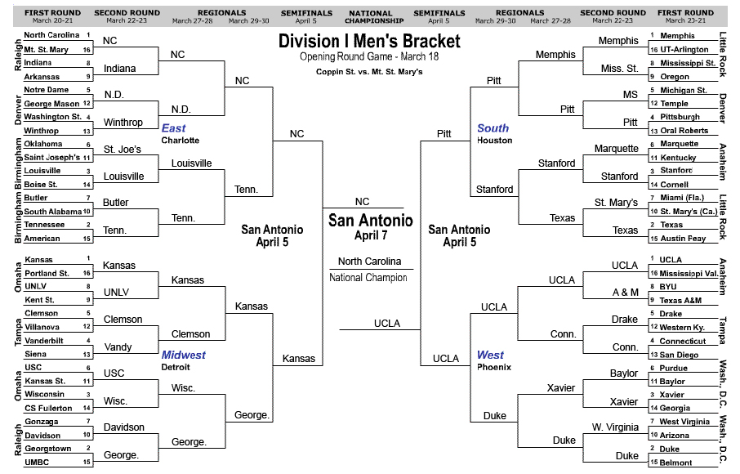
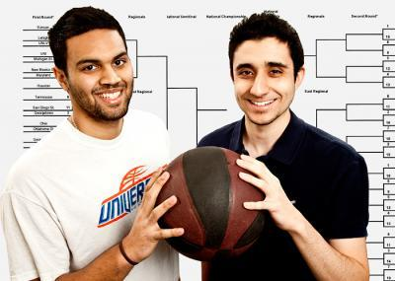
Americans Make A Bracket
A Bracket is how
we guess which team will win
the NCAA tournament
(승자들 알아맞추기 경연대회)

Slide 23
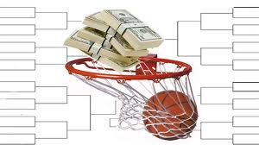
Americans Make A Bracket
Many Americans bet money $$$$
Among friends
At company
On Internet
If their bracket is right, they win $$$$$!!! (the most 정학한 알아맞추기 wins $$$)

Slide 24
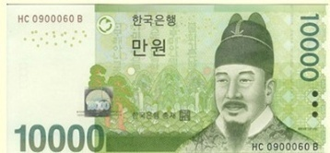
If all of my friends gave 10,000 and made a bracket…

Slide 25
The most accurate bracket keeps all!

Slide 26
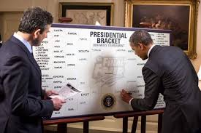
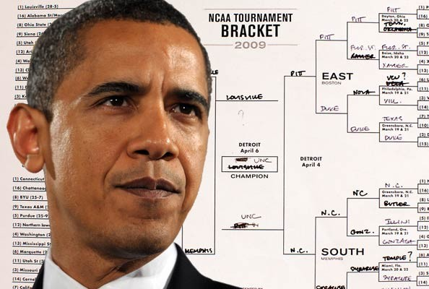
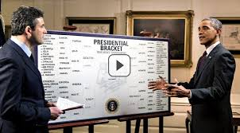
Even President Obama makes a bracket!

Slide 27
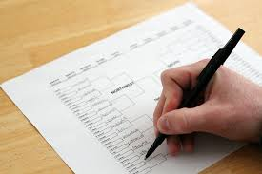
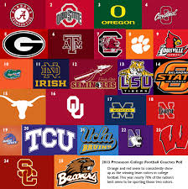
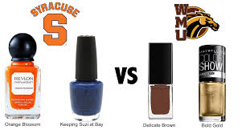
How do you fill out a bracket?
Study ranking and statistics
Use instinct/feel (삘링)
Guess!!
Girls: sometimes do by team colors

Slide 28
Every School Has a Color

Slide 29
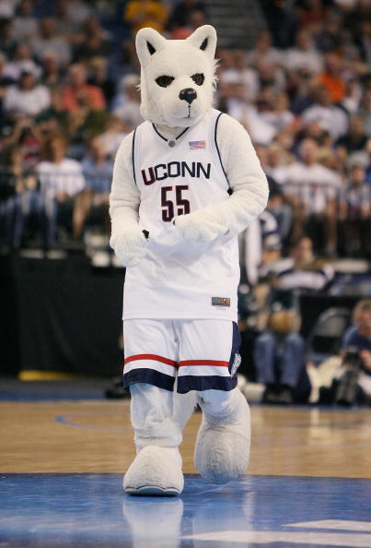
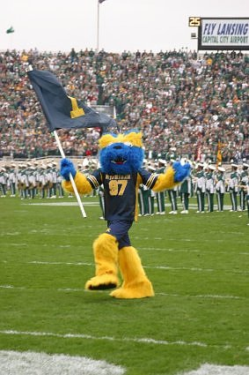
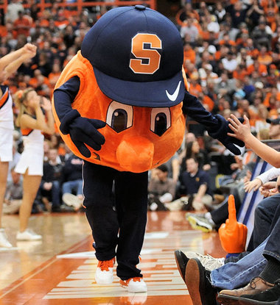
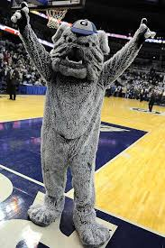
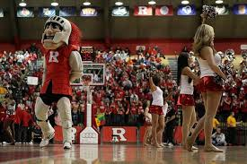
Every School Has a Mascot

Slide 30
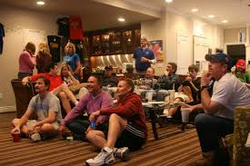
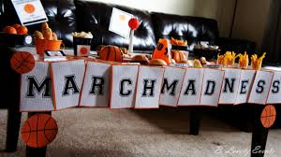
Then you watch the games and see who wins!!!

Slide 31
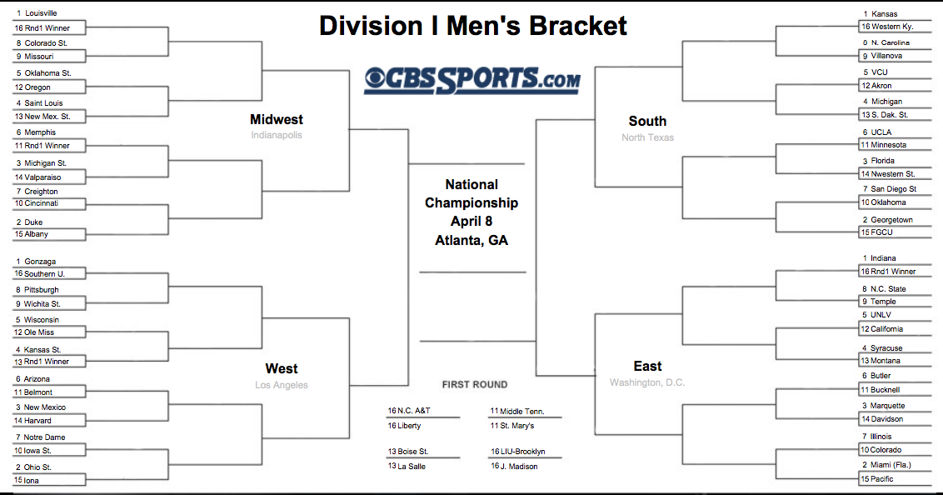
[ bracket ]

Slide 32
64 teams

Slide 33
4 regions in the U.S.A.

Slide 34
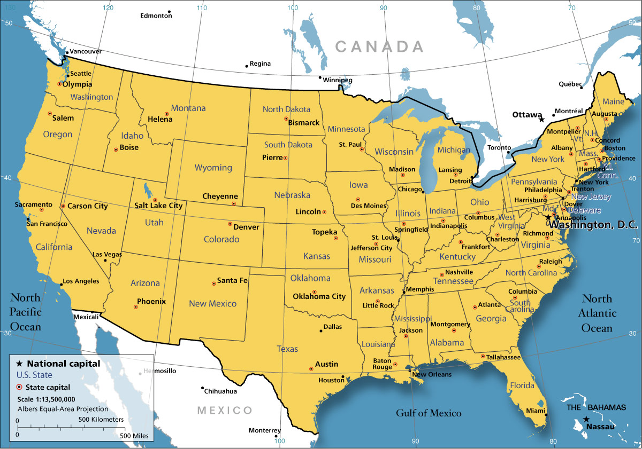
West
Midwest
East
South

Slide 35
ranking (seed)

Slide 36
ranking = seed
1 = best
16 = worst
1 vs. 16
2 vs. 15
3 vs. 14
4 vs. 13
5 vs. 12
6 vs. 11
7 vs. 10
8 vs. 9

Slide 37
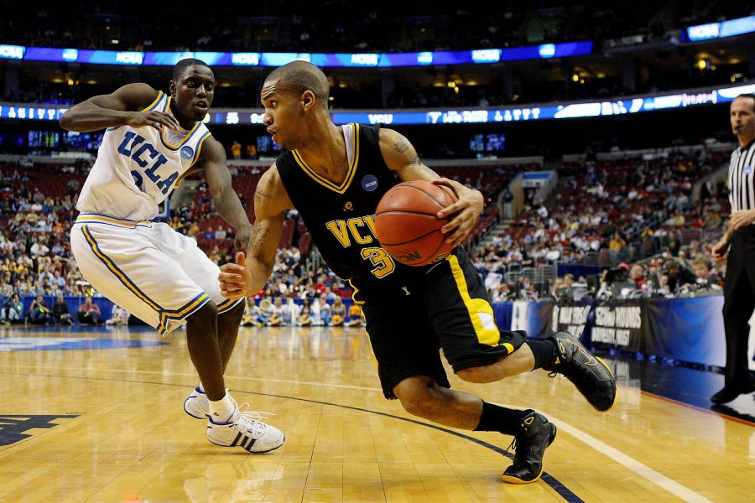

Slide 38
Round 1

Slide 39
Round 2

Slide 40
Round 3

Slide 41
Sweet 16

Slide 42
Elite 8

Slide 43
Final 4

Slide 44
Championship Game

Slide 45
Let’s Play!!!
March Madness English Version

Slide 46
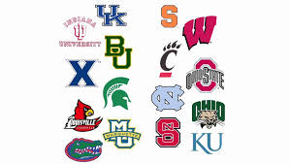
First,
I will give you a team.

Slide 47
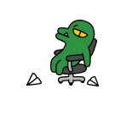
There are 16 teams
Apeach
Muzi
Jay G
Neo
Frodo
Con
Tube
Face
Squirtle (꼬부기)
Charmander (파이리)
Venusaur (이상해꽃)
Jigglypuff (푸린)
Machamp (괴력몬)
Pikachu
Jolteon (쥬피썬더)
Mewtwo (뮤츠)

Slide 48
Secondly,
You will fill out a bracket
Who do you think will win?
Your team doesn’t have to win.
Remember: The best prediction gets a prize too!
제일 정학한 예상이 도 이간다

Slide 49
Let’s Play!!!!
We will skip Round 1, 2 and 3
→
Sweet Sixteen
Notes:
2013 Top Seed Overall – Louisville
2012 Champion – Kentucky (not on 2013 bracket)
2011 Champion – Connecticut
2010 Champion – Duke
2009 Champion – North Carolina
2008 Champion - Kansas

Slide 50
Sweet 16

Slide 51
There are 16 teams
Apeach
Muzi
Jay G
Neo
Frodo
Con
Tube
Face
Squirtle (꼬부기)
Charmander (파이리)
Venusaur (이상해꽃)
Jigglypuff (푸린)
Machamp (괴력몬)
Pikachu
Jolteon (쥬피썬더)
Mewtwo (뮤츠)

Slide 52
Games
1st Game = Persuade me who should win
설득 – I will choose the best team
2nd Game = Rock Paper Scissor
3rd Game = Quiz Game
4th Game = Basketball

Slide 53
English March Madness
2 ways to win

Slide 54
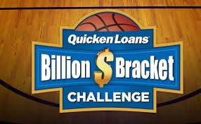
The MOST ACCURATE Bracket
Wins!
Perfect bracket = extra prize

Slide 55
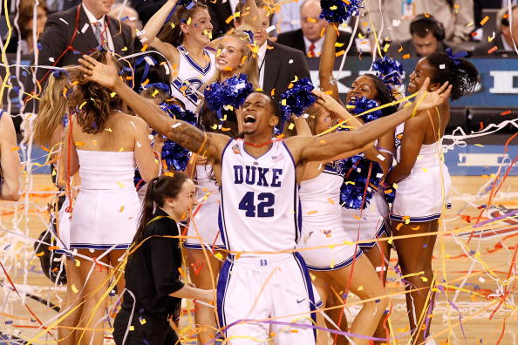
Championship Team
Wins!!

Slide 56
Sweet Sixteen (Game 1)
Which team should win?
Best reasons will advance to next level!!
I think _________ should win because ____________________.
Who will level up to Elite 8???

Slide 57
Best Bracket
Make an X if your prediction was wrong
Make an O if your prediction was right
O
O
X
O

Slide 58
Elite Eight (Game 2)
Rock Paper Scissors
Best out of 3 Games

Slide 59
Final Four (Game 3)
Quiz Game
First team to have 3 points

Slide 60
March Madness Quiz
1. What is March Madness?

Slide 61
March Madness Quiz
2. How many teams play in March Madness?

Slide 62
March Madness Quiz
3. When is March Madness?

Slide 63
March Madness Quiz
4. Fill in the blanks:
_____________ 16
_____________ 8
_____________ 4

Slide 64
March Madness Quiz
5. What is the difference
between NBA and NCAA?

Slide 65
March Madness Quiz
6. What was Christine’s school’s name?

Slide 66
March Madness Quiz
7. What does Madness mean?

Slide 67
March Madness Quiz
8. What was Christine’s school’s school color?

Slide 68
National Championship (Game 4)
Basketball!!
In = 2 points
Rim = 1 point

Slide 69
Best Bracket
Who has the most accurate bracket?
가장 정학한
Count how many O
?/16

Slide 70
Let’s watch
https://www.youtube.com/watch?v=yujtQozFHe8

