Slide 1
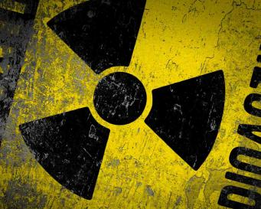
Radioactive!
Week 6

Slide 2
Simulation Game!
Today we will be doing a simulation activity.
We are pretending we are somewhere else.
Today you must make difficult choices.

Slide 3
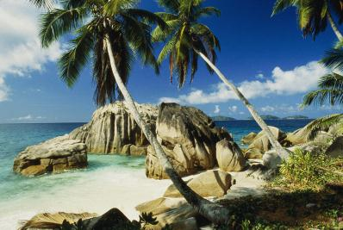
Location: Tropical Island
Located far away from any land
There is no boat or plane.
15 people are on the island for vacation.

Slide 4
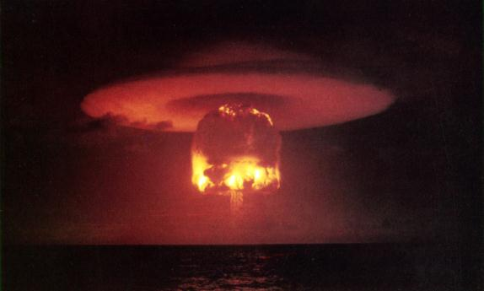
SUDDEN WAR!!
But suddenly war begins! And an atomic apocalypse (파멸) will occur.

Slide 5
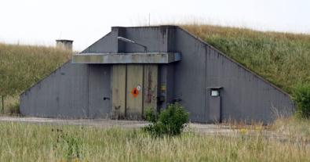
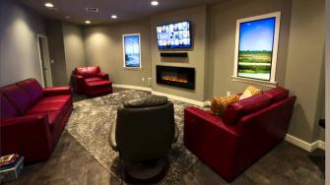
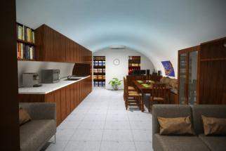
The Bunker
There is a bunker on the island where people can live up to a year with food, water and beds.
But only 8 people can survive in the bunker.

Slide 6
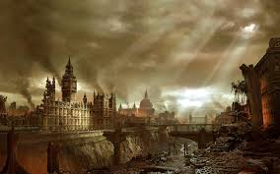
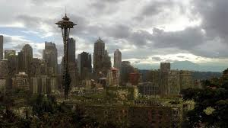
You Must Think of…
After the apocalypse, you must rebuild the world.
You must recreate society.
Choose people who will help you rebuild.

Slide 7
Example
Who | Why
Korean Teacher | To teach Korean to future students

Slide 8
Important phrases to use
“In the bunker, we need someone who can __________.”
“To survive after the war, we need a_________.”
“To rebuild, we need a_________.”

Slide 9
Who goes in the bunker?

Slide 10
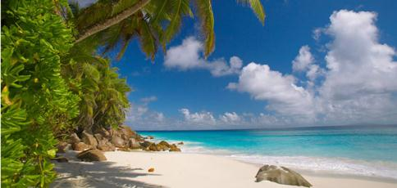
Scenario #2
New information for each person.
It will change who you let in the bunker!

Slide 11
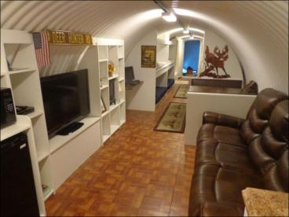
Who changed?
Was your second time different?
Who did you choose?
Who did you not choose?

Slide 12
Journal Question
Does a person’s job/position in society make them more valuable and important than someone else?

