Slide 1
How to introduce hot springs
Taiwan springs and American springs

Slide 2
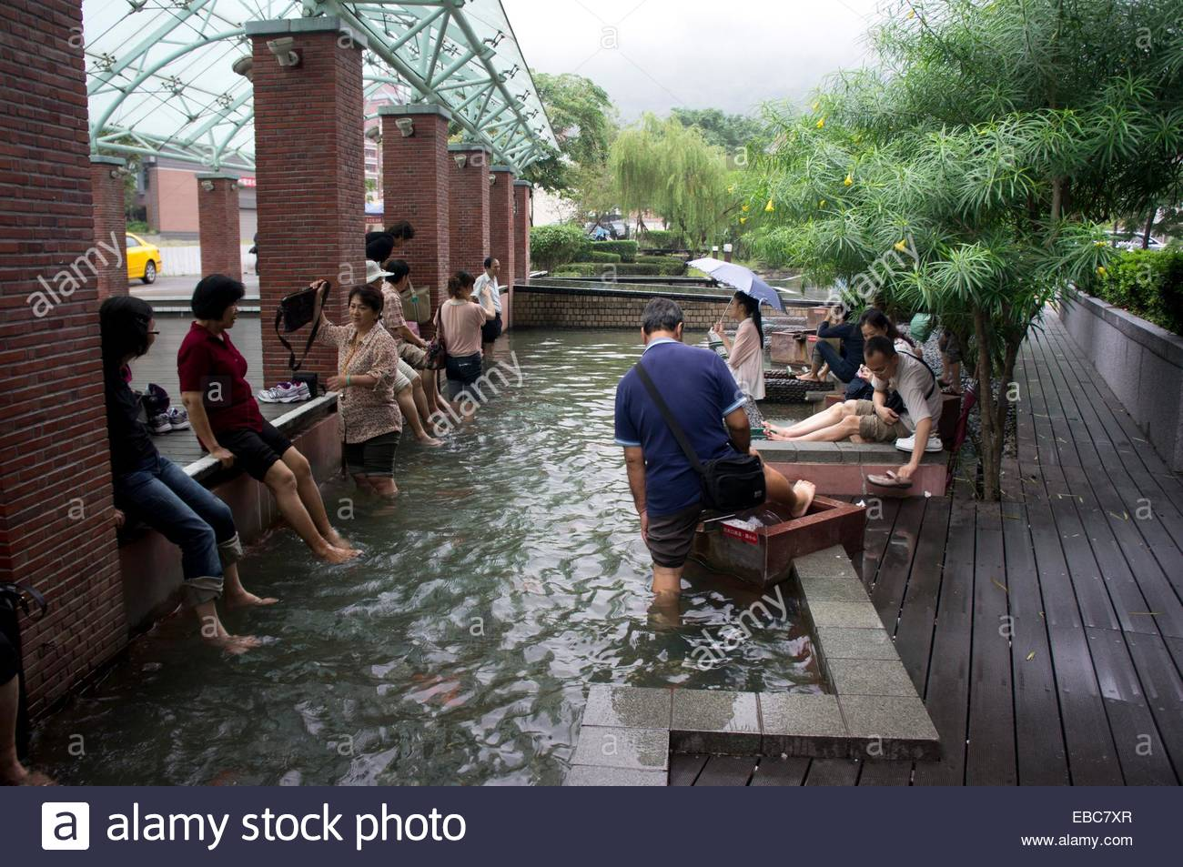
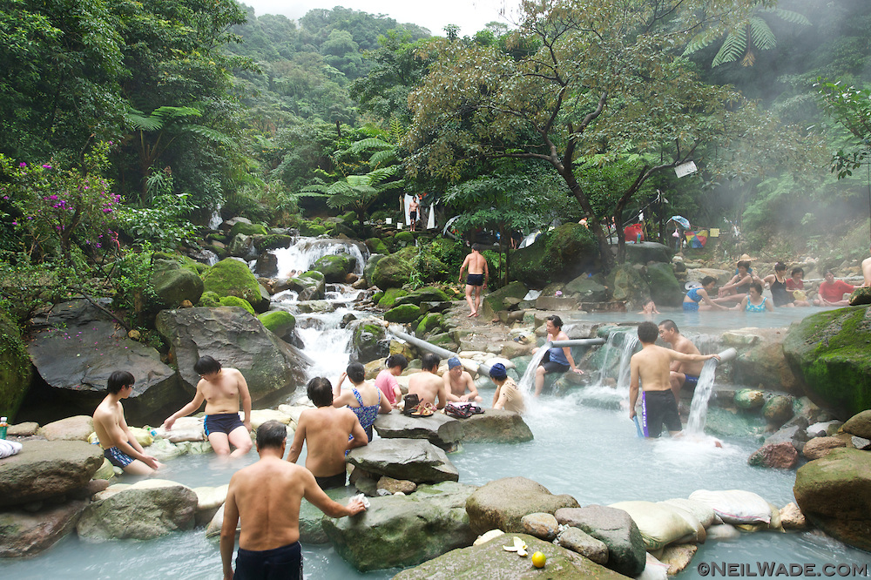
Hot Springs
Top 15 Worldwide Destination For Hot Springs, Cold Spring, Mud Springs, And Seabed Springs

Slide 3
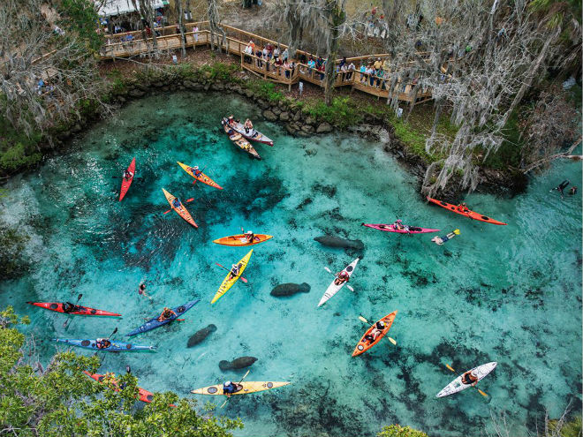
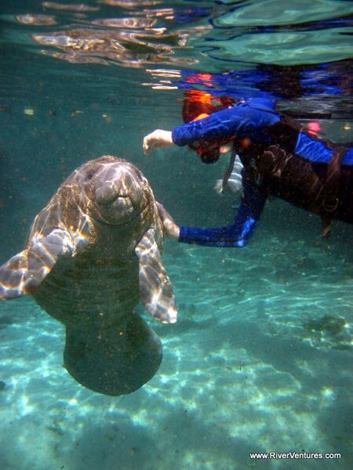
Natural Fresh Water Springs In Florida
海牛
Water temperature is always 73 F degrees 22 C
102,000,000 gallons of water everyday!
Notes:
Alligators in Blue Spring
https://www.youtube.com/watch?v=FL5kn4ljywE&ab_channel=SalaseivästäjätSpearfishing
Manatee attack
https://www.youtube.com/watch?v=yLmfgK8adXk&ab_channel=KatieGingrich
Diving into blue springs boil
https://www.youtube.com/watch?v=kUGk01zvSkk&ab_channel=MysteriousDivers

Slide 4
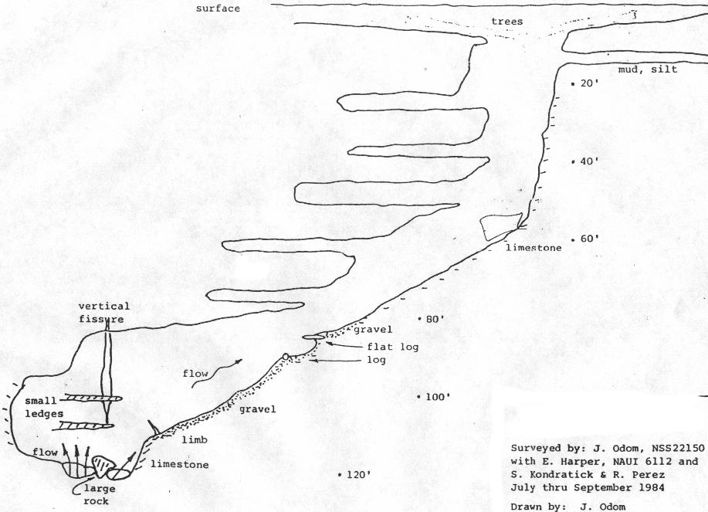
Scuba Diving In Blue Springs
Diving in Blue Springs

Slide 5
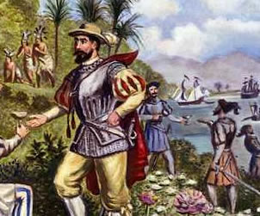
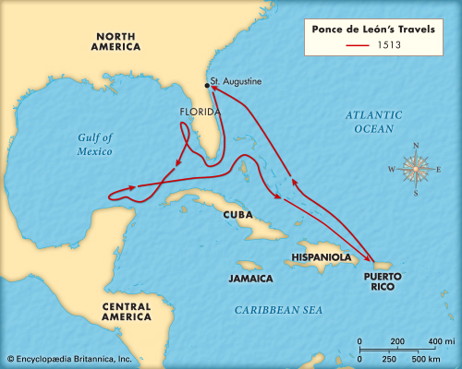
Florida Was Owned By Spain Before America

Slide 6
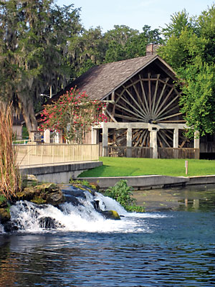
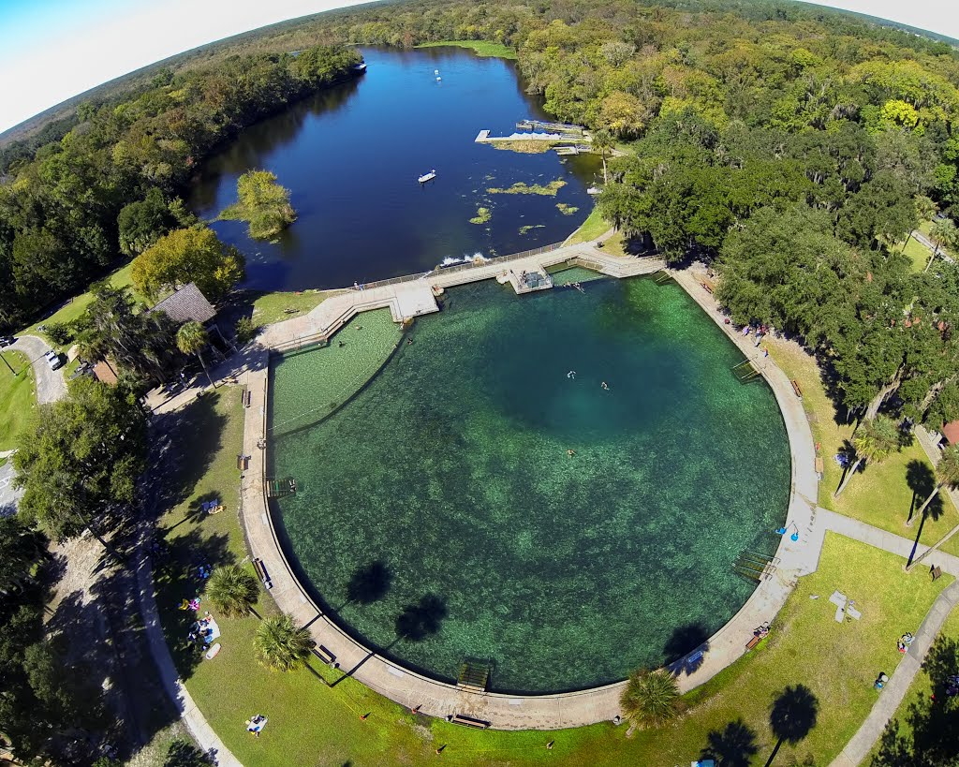
Ponce Deleon Springs

Slide 7
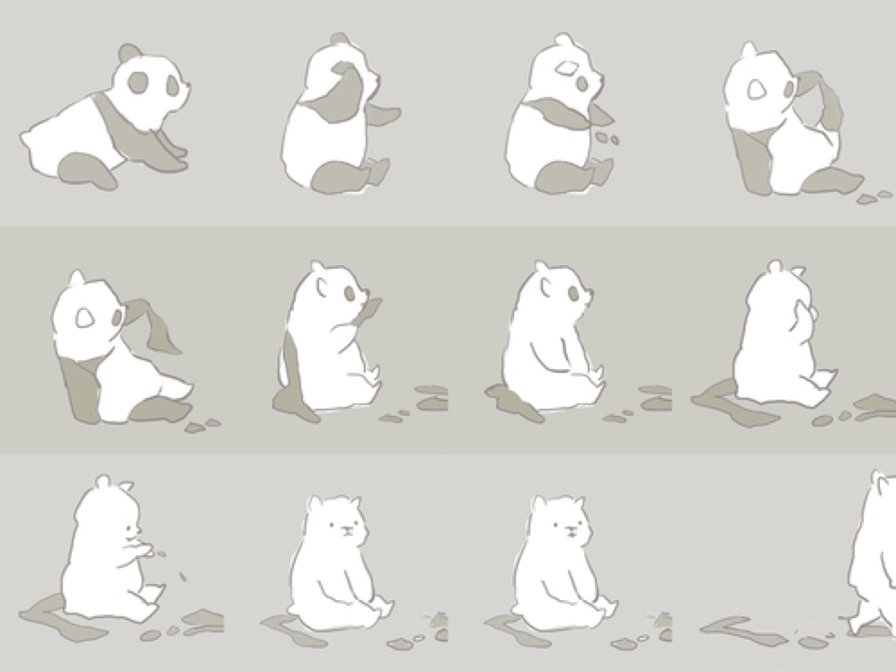
Take Off (Your Clothes, Shoes, Jewelry)

Slide 8
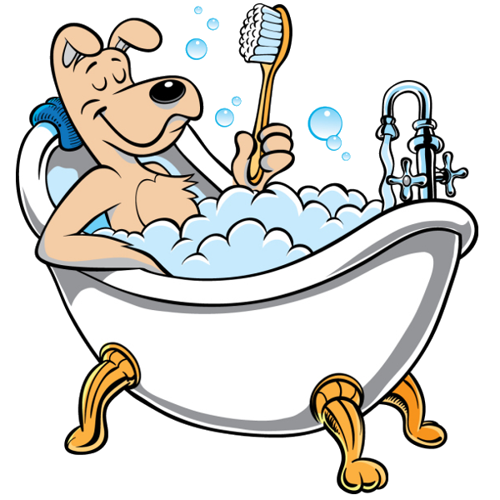
Bath

Slide 9
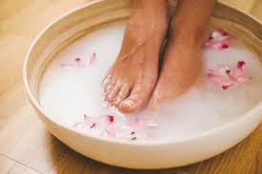
Soak

Slide 10
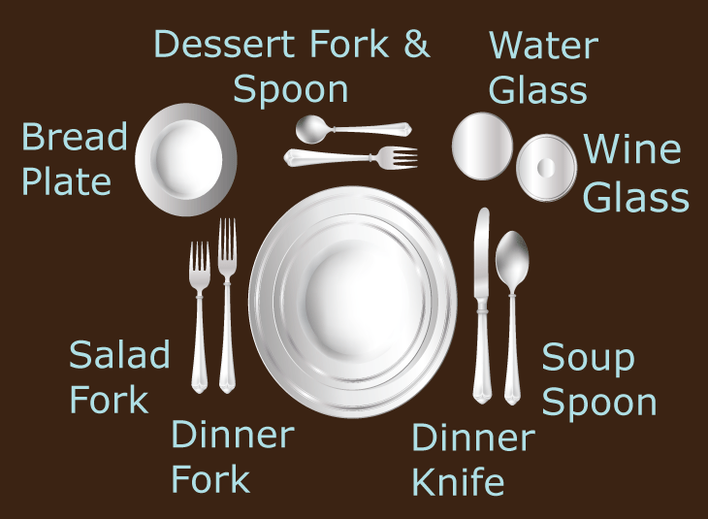
Etiquette
Bath before entering the hot spring
Don’t splash or be too noisy
Keep a small towel with you
Drink water and stay hydrated
Take off jewelry

Slide 11

No (Smoking)

Slide 12

For A While

Slide 13
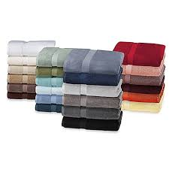
Towel

Slide 14
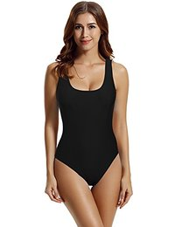
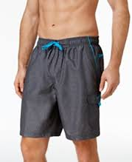
Bathing Suit
Notes:
Make sure to note that many guys in America do not like wearing speedos or short bathing suits, and that many Americans are not afraid of the sun, and so girls like to wear bikinins.

Slide 15
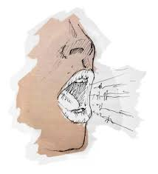
Keep Your (Voice) Down

Slide 16


Take A Rest (Relax)

Slide 17
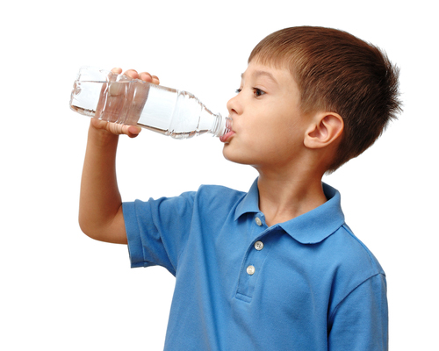
Drink Water

Slide 18
Go fish
Go Fish. Each player gets five cards. If you are dealt a four of a kind, or get four of a kind during game play, those cards are removed from your hand, and you get a point. Moving clockwise, players take turns asking a specific player for a given rank of card.

Slide 19
Use The Vocabulary Words In A Sentence
Write as many sentences as you can using the vocabulary word
Or use as many words as you can in a sentence.

