Slide 1
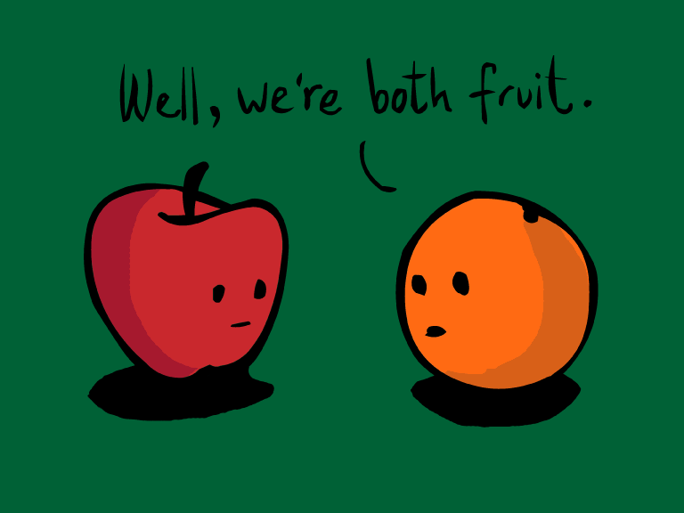
Compare = 비교하다 (Lesson 9 p.153)

Slide 2
How do we compare?
“X is _____ than Y.”
Add +er to the word when comparing
“X is _____er than Y.”
Example: Candy teacher is older than Min Suh.

Slide 3
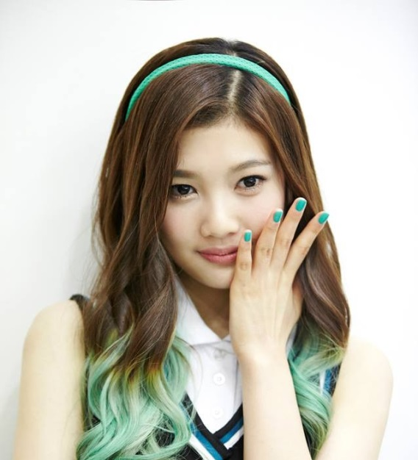
Age = 나이
Old + er = older
Young + er = younger
Name: Adele
Birthday: May 5, 1988
Name: Joy
Birthday: September 3, 1996
Adele is older than Joy.
Joy is younger than Adele.

Slide 4
Older/ Younger
Name: Taeyeon
Birthday: March 9, 1989
Name: Chen
Birthday: September 21, 1992
Chen is younger than Taeyeon.
Taeyeon is older than Chen.

Slide 5
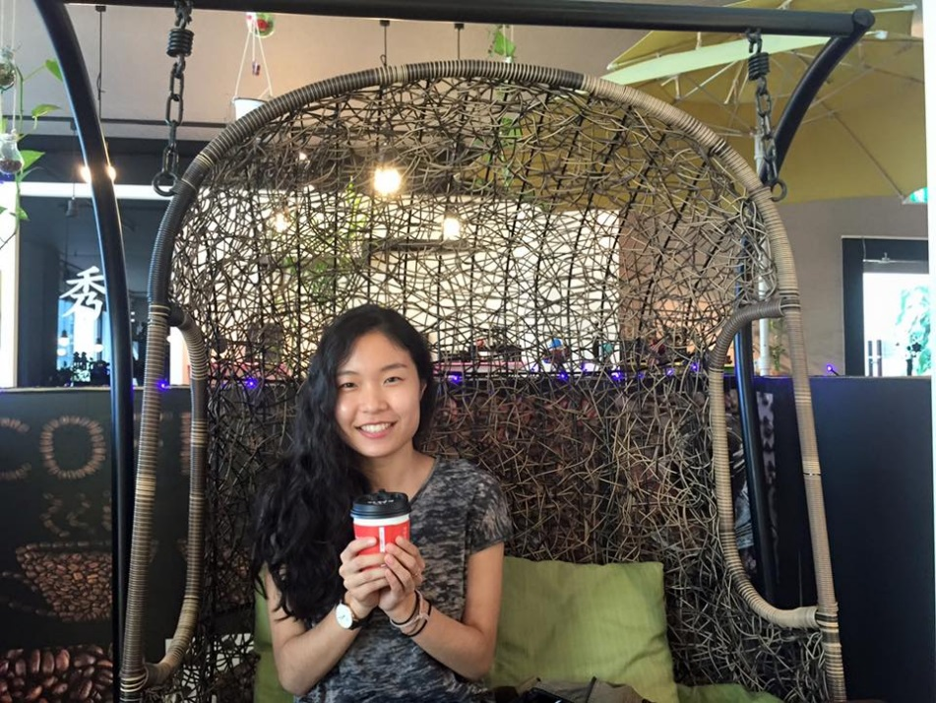
Older/ Younger
Name: Chen
Birthday: September 21, 1992
Name: Candy
Birthday: October 16, 1993
Chen is older than Candy.
Candy is younger than Chen.

Slide 6
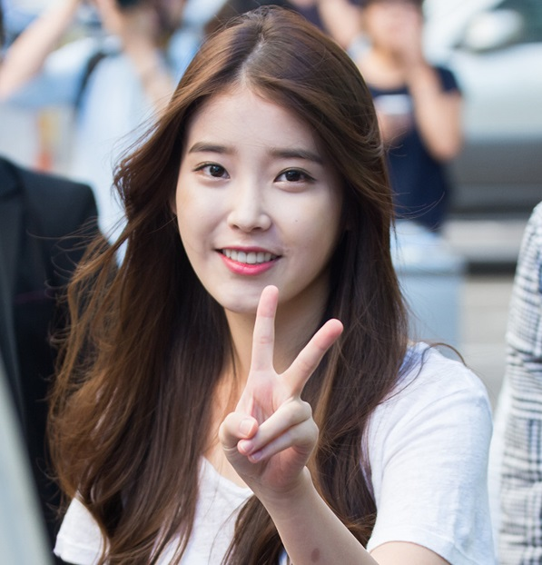
Older/ Younger
Name: Candy
Birthday: October 16, 1993
Name: IU
Birthday: May 16, 1993
IU is older than Candy.
IU and Candy are the same age.

Slide 7
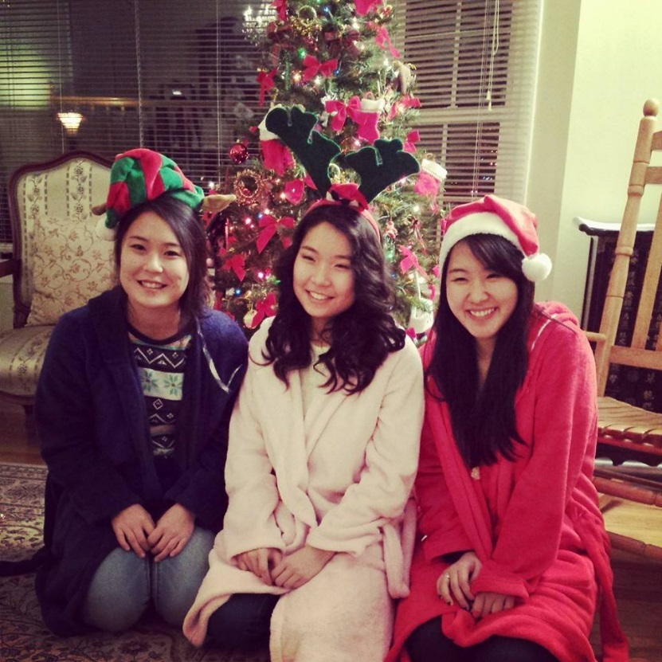
Compare more than 2 people
Cindy was born in 1996.
Candy was born in 1993.
Sarah was born in 1992.
Who is the oldest?
Who is the youngest?
Sarah is the oldest.
Cindy is the youngest.

Slide 8
Review Numbers
11, 12, 13, 14, 15, 16, 17, 18, 19
TEEN
10, 20, 30, 40, 50, 60, 70, 80, 90
DEE
1990 = nineteen-ninety
1993= nineteen-ninety-three
2000= two-thousand
2002= two-thousand and two

Slide 9
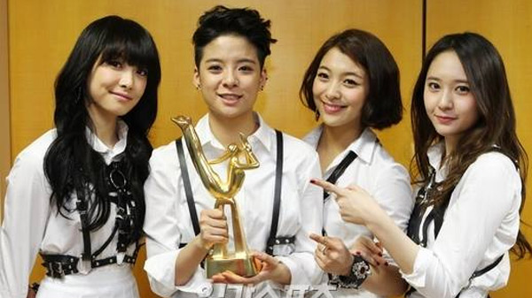
Victoria was born in 1987.
Amber was born in 1992.
Luna was born in 1993.
Krystal was born in 1994.
Who is the oldest?
Who is the youngest?

Slide 10
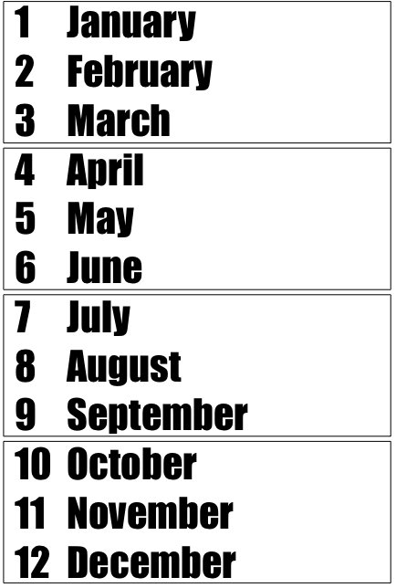
Q: “When is your birthday?”
A: “My birthday is (Month/달) (Day/날), (Year/년).”
Candy Teacher: “My birthday is October 16, 1993.
Treasure Hunt!
Find TWO people who are younger than you.
“I am older than (Name/이름).”
Find ONE person who is older than you.
“I am younger than (Name/이름).”
Notes:
https://www.youtube.com/watch?v=QMFSbHfHKds

Slide 11
Height = 키
Short + er = shorter
Tall + er = taller

Slide 12
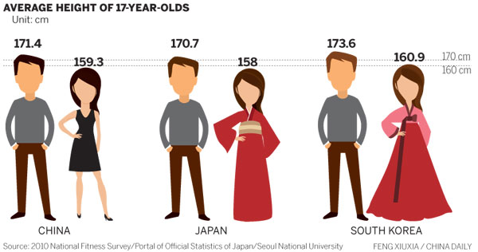
Height = 키
Chinese men are ____ than Japanese men.
Chinese women are _____ than Korean women.
*If more than 1 person, use “are” instead of “is”

Slide 13
Height = 키
Korean men are ____ than Chinese men.
Japanese women are _____ than Korean women.
*If more than 1 person, use “are” instead of “is”

Slide 14
How tall are you?
“How tall are you?”
“I am ___ c.m.”
Treasure Hunt!
Find ONE person shorter than you.
“I am taller than (Name).” OR
“(Name) is shorter than me.”
Find ONE person taller than you.
“I am shorter than (Name).” OR
“(Name) is taller than me.”

Slide 15
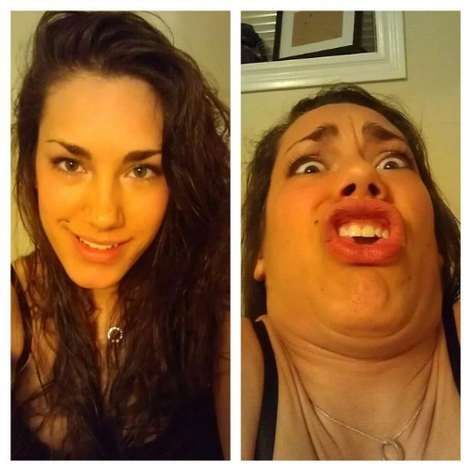
+er
Ugly + er →
Pretty + er →
Smart + er→
Dumb + er →
Rich + er →
Strong + er→
Weak + er→
Happy + er→
Funny + er →
Friendly +er →
Kind + er →
Cute + er→

Slide 16
Who is stronger?
Big Bang’s Taeyang
Miss A’s Suzy

Slide 17
Who is prettier?
Big Bang’s Taeyang
Miss A’s Suzy

Slide 18
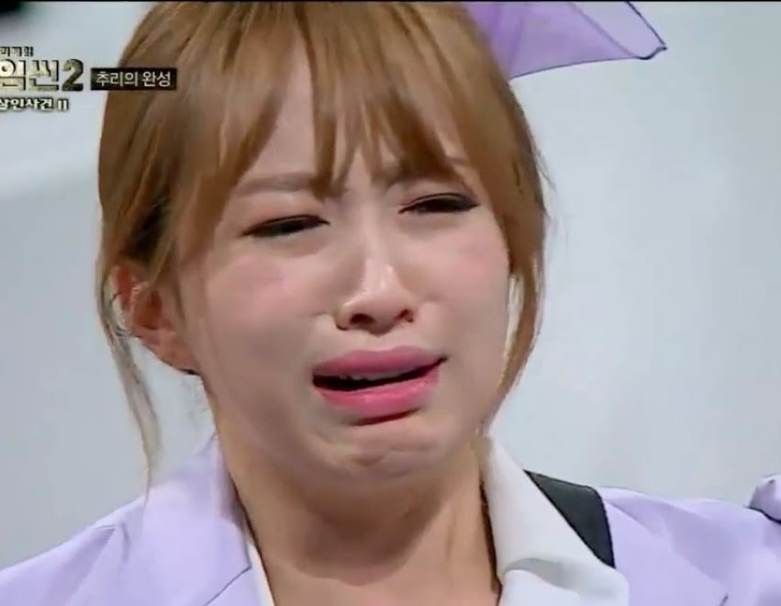
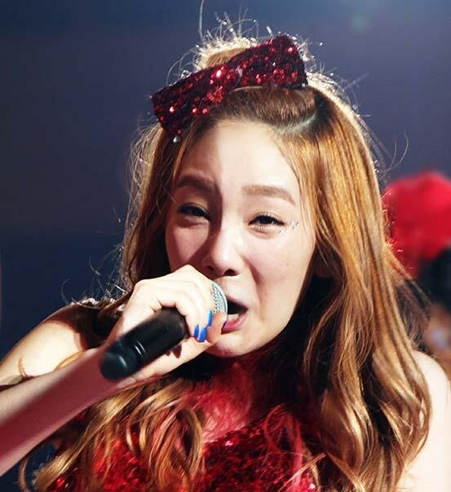
Who is prettier?
Hani
Taeyeon

Slide 19
Who is funnier?
Hani
Taeyeon

Slide 20
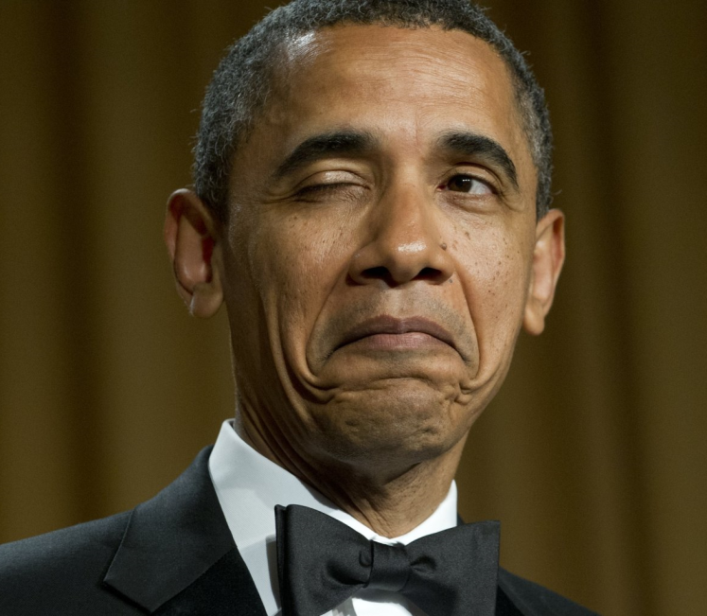
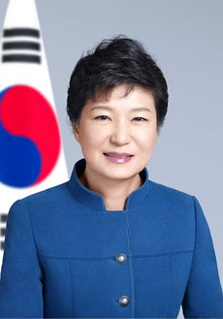
Who is smarter?
President Obama
President Park Guen Hye

Slide 21
Bill Gates– 79 billion USD
Bill Gates is richer than me.

Slide 22
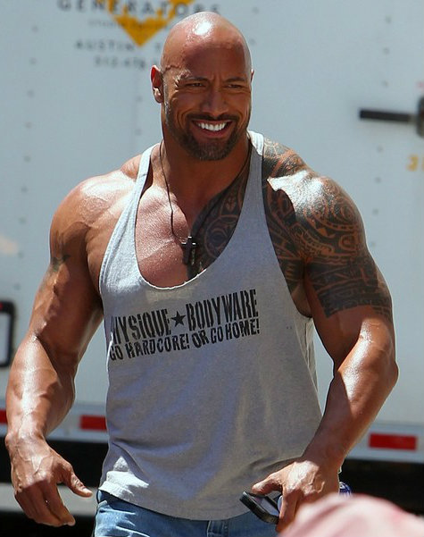
Dwayne “The Rock” Johnson
The Rock is stronger than me.

Slide 23
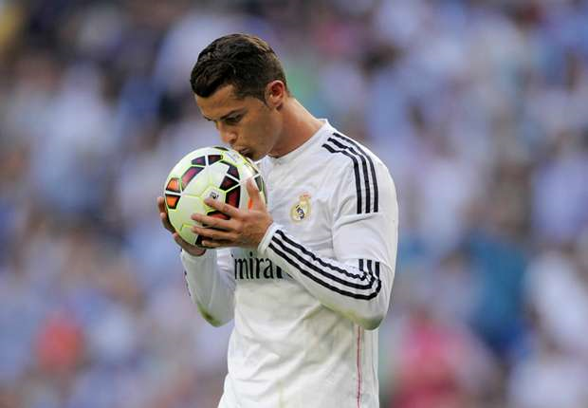
Good → ?
I am good at soccer.
I am ___________ than (______).

Slide 24
“better”
If we want to talk about an activity, use “better.”
I am better at English than (______).
I am better at _____ than (_______).

Slide 25
I am better at ____ than Candy teacher!
What is your talent?
Soccer
Basketball
Computer games
Speaking Korean
Piano
Dancing
Drumming

Slide 26
Who is better at singing?
Hani
Taeyeon

Slide 27
Who is better at dancing?
Hani
Taeyeon

Slide 28
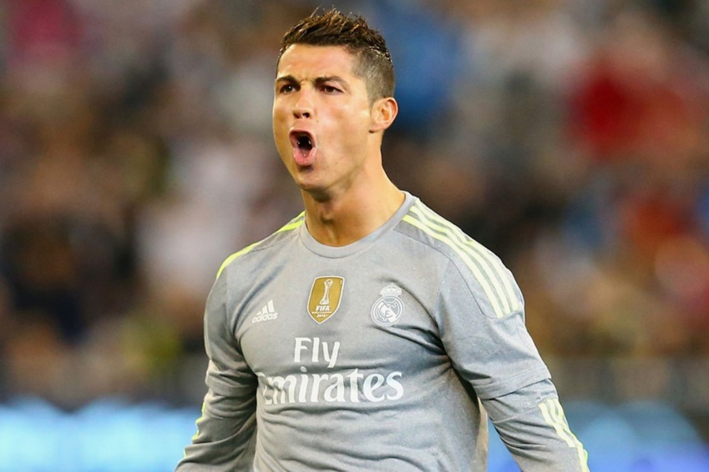
Who is better at soccer?
Cristiano Ronaldo
Lionel Messi

Slide 29
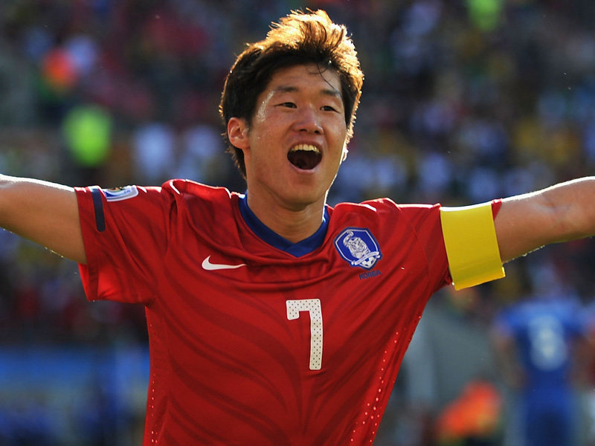
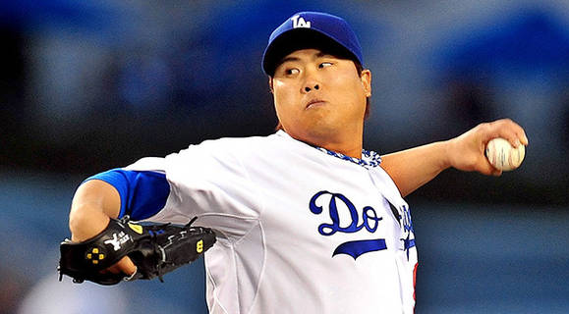
Who is better at soccer?
Ryu Hyun Jin
Park Ji Sung

Slide 30
Who is better at baseball?
Ryu Hyun Jin
Park Ji Sung
Park Ji Sung is better at soccer, but Ryu Hyun Jin is better at baseball.

Slide 31
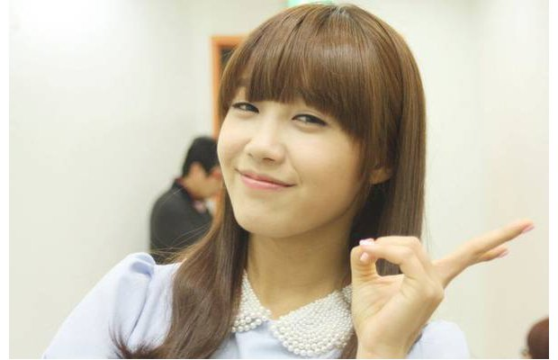
Who is better looking?
SNSD’s Yoona
Apink’s Eunji

Slide 32
Who is better at acting?
SNSD’s Yoona
Apink’s Eunji

Slide 33
Who is your ideal type?
Rules: Pick a person.
Tell me WHY you picked your person.
Example: I picked Eunji because she is better at acting than Yoona.
Whoever wins is our class’s ideal type!
Let’s GO!

Slide 34
Round one: Pick one
Apink’s Naeun
SNSD’s Tiffany

Slide 35
Round two: Pick one
Apink’s Naeun
EXID’s Solji

Slide 36
Round two: Pick one!
EXID’s Solji
SNSD’s Tiffany

Slide 37
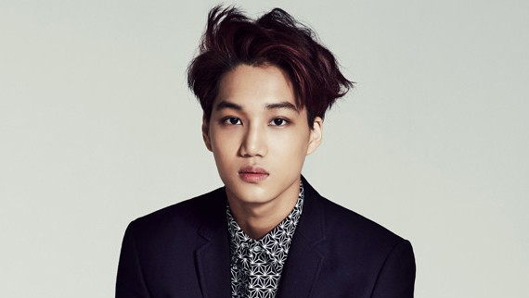
Round three: Pick one!
EXO’s Kai
EXID’s Solji

Slide 38
Round three: Pick one!
EXO’s Kai
Apink’s Naeun

Slide 39
Round three: Pick one!
EXO’s Kai
SNSD’s Tiffany

Slide 40
Round four: Pick one!
EXID’s Solji
IU

Slide 41
Round four: Pick one!
EXO’s Kai
IU

Slide 42
Round four: Pick one!
Apink’s Naeun
IU

Slide 43
Round four: Pick one!
SNSD’s Tiffany
IU

Slide 44
Round five: Pick one!
IU
Yoo Ah In

Slide 45
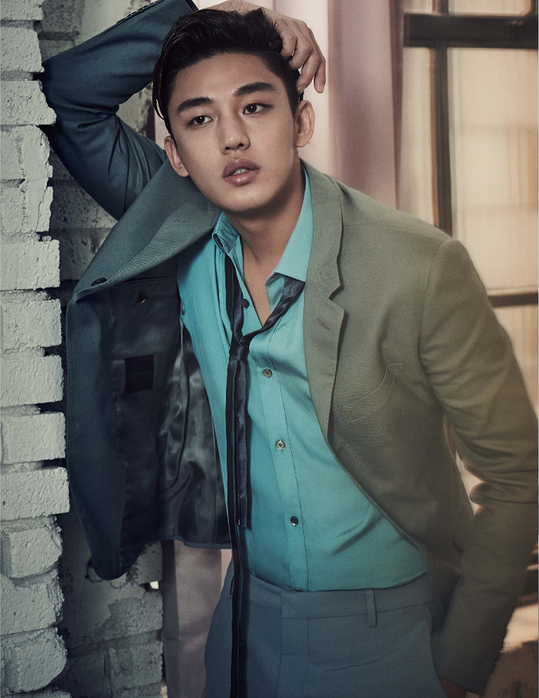
Round five: Pick one!
EXID’s Solji
Yoo Ah In

Slide 46
Round five: Pick one!
EXO’s Kai
Yoo Ah In

Slide 47
Round five: Pick one!
SNSD’s Tiffany
Yoo Ah In

Slide 48
Round five: Pick one!
Apink’s Naeun
Yoo Ah In

Slide 49
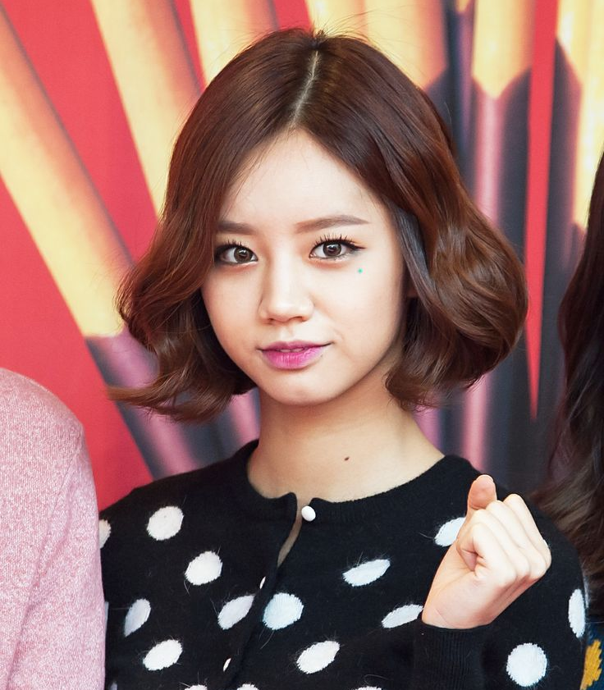
Round six: Pick one!
IU
Girls Day Hyeri

Slide 50
Round six: Pick one!
Girls Day Hyeri
Yoo Ah In

Slide 51
Round six: Pick one!
EXID’s Solji
Girls Day Hyeri

Slide 52
Round six: Pick one!
EXO’s Kai
Girls Day Hyeri

Slide 53
Round six: Pick one!
SNSD’s Tiffany
Girls Day Hyeri

Slide 54
Round six: Pick one!
Apink’s Naeun
Girls Day Hyeri

Slide 55
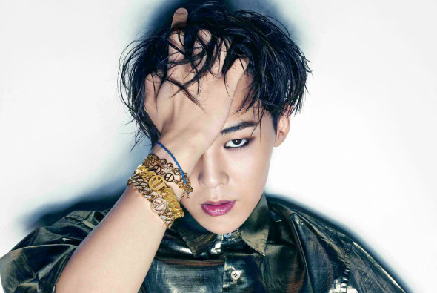
Round seven: Pick one!
G-Dragon
Girls Day Hyeri

Slide 56
Round seven: Pick one!
G-Dragon
IU

Slide 57
Round seven: Pick one!
G-Dragon
Yoo Ah In

Slide 58
Round seven: Pick one!
G-Dragon
EXID’s Solji

Slide 59
Round seven: Pick one!
EXO’s Kai
G-Dragon

Slide 60
Round seven: Pick one!
G-Dragon
SNSD’s Tiffany

Slide 61
Round seven: Pick one!
G-Dragon
Apink’s Naeun

Slide 62
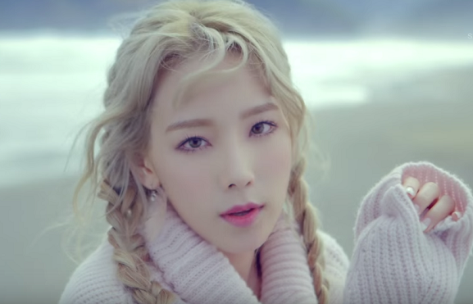
Round eight: Pick one!
Taeyeon
G-Dragon

Slide 63
Round eight: Pick one!
Taeyeon
Girls Day Hyeri

Slide 64
Round eight: Pick one!
Taeyeon
IU

Slide 65
Round eight: Pick one!
Taeyeon
Yoo Ah In

Slide 66
Round eight: Pick one!
Taeyeon
EXID’s Solji

Slide 67
Round eight: Pick one!
EXO’s Kai
Taeyeon

Slide 68
Round eight: Pick one!
Taeyeon
SNSD’s Tiffany

Slide 69
Round eight: Pick one!
Taeyeon
Apink’s Naeun

Slide 70
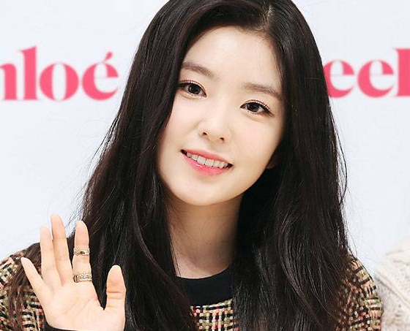
Round nine: Pick one!
Red Velvet’s Irene
Taeyeon

Slide 71
Round nine: Pick one!
Red Velvet’s Irene
G-Dragon

Slide 72
Round nine: Pick one!
Red Velvet’s Irene
Girls Day Hyeri

Slide 73
Round nine: Pick one!
Red Velvet’s Irene
IU

Slide 74
Round nine: Pick one!
Red Velvet’s Irene
Yoo Ah In

Slide 75
Round nine: Pick one!
Red Velvet’s Irene
EXID’s Solji

Slide 76
Round nine: Pick one!
EXO’s Kai
Red Velvet’s Irene

Slide 77
Round nine: Pick one!
Red Velvet’s Irene
SNSD’s Tiffany

Slide 78
Round nine: Pick one!
Red Velvet’s Irene
Apink’s Naeun

Slide 79
Round ten: Pick one!
Red Velvet’s Irene
EXID’s Hani

Slide 80
Round ten: Pick one!
Taeyeon
EXID’s Hani

Slide 81
Round ten: Pick one!
G-Dragon
EXID’s Hani

Slide 82
Round ten: Pick one!
Girls Day Hyeri
EXID’s Hani

Slide 83
Round ten: Pick one!
IU
EXID’s Hani

Slide 84
Round ten: Pick one!
EXID’s Hani
Yoo Ah In

Slide 85
Round ten: Pick one!
EXID’s Solji
EXID’s Hani

Slide 86
Round ten: Pick one!
EXO’s Kai
EXID’s Hani

Slide 87
Round ten: Pick one!
SNSD’s Tiffany
EXID’s Hani

Slide 88
Round ten: Pick one!
Apink’s Naeun
EXID’s Hani

Slide 89
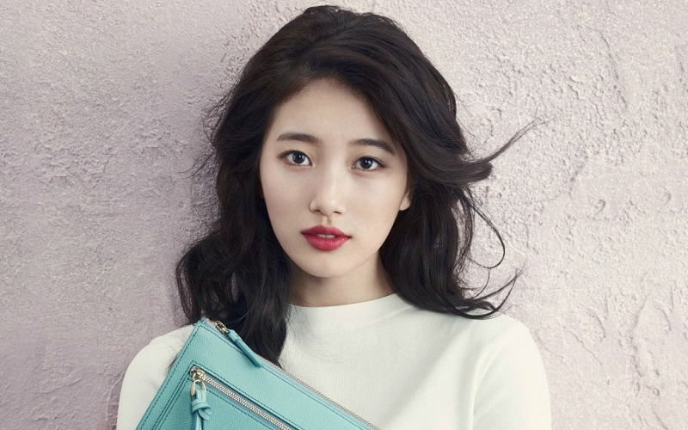
Round eleven: Pick one!
Miss A’s Suzy
EXID’s Hani

Slide 90
Round eleven: Pick one!
Miss A’s Suzy
Red Velvet’s Irene

Slide 91
Round eleven: Pick one!
Miss A’s Suzy
Taeyeon

Slide 92
Round eleven: Pick one!
Miss A’s Suzy
G-Dragon

Slide 93
Round eleven: Pick one!
Miss A’s Suzy
Girls Day Hyeri

Slide 94
Round eleven: Pick one!
Miss A’s Suzy
IU

Slide 95
Round eleven: Pick one!
Miss A’s Suzy
Yoo Ah In

Slide 96
Round eleven: Pick one!
Miss A’s Suzy
EXID’s Solji

Slide 97
Round eleven: Pick one!
EXO’s Kai
Miss A’s Suzy

Slide 98
Round eleven: Pick one!
Miss A’s Suzy
SNSD’s Tiffany

Slide 99
Round eleven: Pick one!
Miss A’s Suzy
Apink’s Naeun

Slide 100
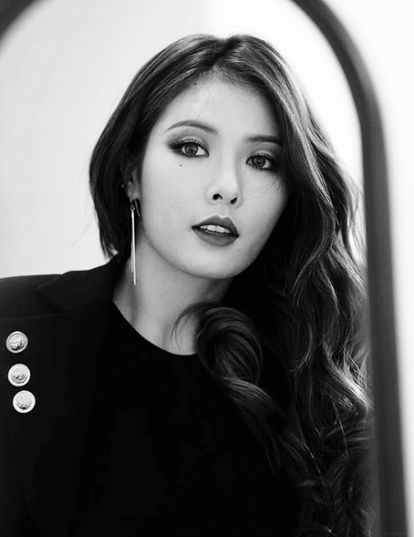
Round twelve: Pick one!
Miss A’s Suzy
Hyuna

Slide 101
Round twelve: Pick one!
Hyuna
EXID’s Hani

Slide 102
Round twelve: Pick one!
Red Velvet’s Irene
Hyuna

Slide 103
Round twelve: Pick one!
Taeyeon
Hyuna

Slide 104
Round twelve: Pick one!
G-Dragon
Hyuna

Slide 105
Round twelve: Pick one!
Girls Day Hyeri
Hyuna

Slide 106
Round twelve: Pick one!
IU
Hyuna

Slide 107
Round twelve: Pick one!
Hyuna
Yoo Ah In

Slide 108
Round twelve: Pick one!
EXID’s Solji
Hyuna

Slide 109
Round twelve: Pick one!
EXO’s Kai
Hyuna

Slide 110
Round twelve: Pick one!
SNSD’s Tiffany
Hyuna

Slide 111
Round twelve: Pick one!
Apink’s Naeun
Hyuna

Slide 112
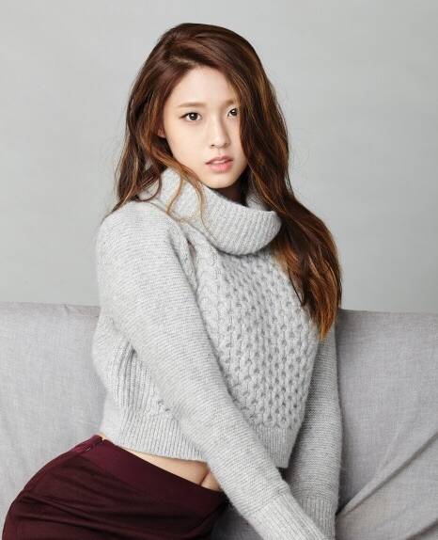
Round thirteen: Pick one!
Hyuna
AOA’s Seolhyun

Slide 113
Round thirteen: Pick one!
Miss A’s Suzy
AOA’s Seolhyun

Slide 114
Round thirteen: Pick one!
EXID’s Hani
AOA’s Seolhyun

Slide 115
Round thirteen: Pick one!
Red Velvet’s Irene
AOA’s Seolhyun

Slide 116
Round thirteen: Pick one!
Taeyeon
AOA’s Seolhyun

Slide 117
Round thirteen: Pick one!
G-Dragon
AOA’s Seolhyun

Slide 118
Round thirteen: Pick one!
Girls Day Hyeri
AOA’s Seolhyun

Slide 119
Round thirteen: Pick one!
IU
AOA’s Seolhyun

Slide 120
Round thirteen: Pick one!
AOA’s Seolhyun
Yoo Ah In

Slide 121
Round thirteen: Pick one!
EXID’s Solji
AOA’s Seolhyun

Slide 122
Round thirteen: Pick one!
EXO’s Kai
AOA’s Seolhyun

Slide 123
Round thirteen: Pick one!
SNSD’s Tiffany
AOA’s Seolhyun

Slide 124
Round thirteen: Pick one!
Apink’s Naeun
AOA’s Seolhyun

Slide 125
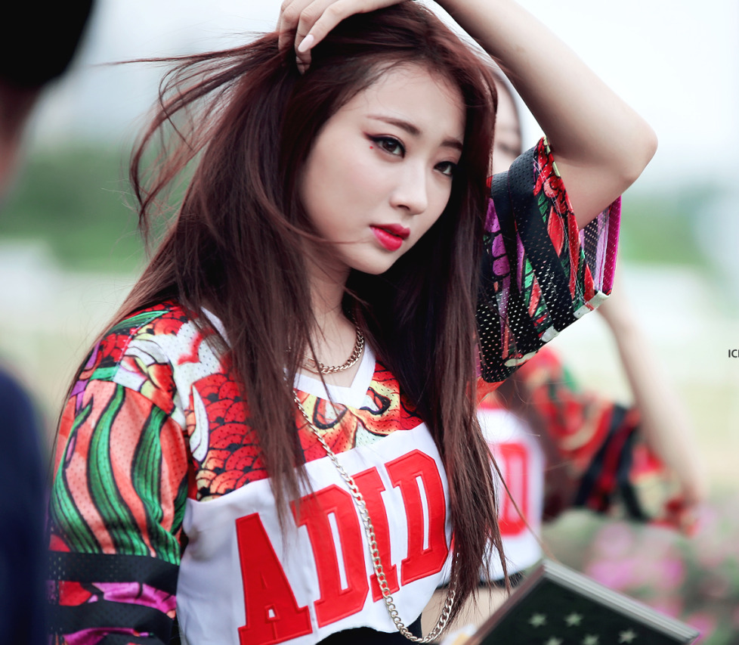
Round fourteen: Pick one!
Nine Muses’ Kyungri
AOA’s Seolhyun

Slide 126
Round fourteen: Pick one!
Nine Muses’ Kyungri
Hyuna

Slide 127
Round fourteen: Pick one!
Miss A’s Suzy
Nine Muses’ Kyungri

Slide 128
Round fourteen: Pick one!
Nine Muses’ Kyungri
EXID’s Hani

Slide 129
Round fourteen: Pick one!
Red Velvet’s Irene
Nine Muses’ Kyungri

Slide 130
Round fourteen: Pick one!
Taeyeon
Nine Muses’ Kyungri

Slide 131
Round fourteen: Pick one!
G-Dragon
Nine Muses’ Kyungri

Slide 132
Round fourteen: Pick one!
Girls Day Hyeri
Nine Muses’ Kyungri

Slide 133
Round fourteen: Pick one!
IU
Nine Muses’ Kyungri

Slide 134
Round fourteen: Pick one!
Nine Muses’ Kyungri
Yoo Ah In

Slide 135
Round fourteen: Pick one!
Nine Muses’ Kyungri
EXID’s Solji

Slide 136
Round fourteen: Pick one!
EXO’s Kai
Nine Muses’ Kyungri

Slide 137
Round fourteen: Pick one!
Nine Muses’ Kyungri
SNSD’s Tiffany

Slide 138
Round fourteen: Pick one!
Apink’s Naeun
Nine Muses’ Kyungri

Slide 139
LAST ROUND: Pick one!
Apink’s Eunji
Nine Muses’ Kyungri

Slide 140
LAST ROUND: Pick one!
Apink’s Eunji
AOA’s Seolhyun

Slide 141
LAST ROUND: Pick one!
Apink’s Eunji
Hyuna

Slide 142
LAST ROUND: Pick one!
Apink’s Eunji
Miss A’s Suzy

Slide 143
LAST ROUND: Pick one!
Apink’s Eunji
EXID’s Hani

Slide 144
LAST ROUND: Pick one!
Apink’s Eunji
Red Velvet’s Irene

Slide 145
LAST ROUND: Pick one!
Apink’s Eunji
Taeyeon

Slide 146
LAST ROUND: Pick one!
Apink’s Eunji
G-Dragon

Slide 147
LAST ROUND: Pick one!
Apink’s Eunji
Girls Day Hyeri

Slide 148
LAST ROUND: Pick one!
Apink’s Eunji
IU

Slide 149
LAST ROUND: Pick one!
Apink’s Eunji
Yoo Ah In

Slide 150
LAST ROUND: Pick one!
Apink’s Eunji
EXID’s Solji

Slide 151
LAST ROUND : Pick one!
Apink’s Eunji
EXO’s Kai

Slide 152
LAST ROUND : Pick one!
Apink’s Eunji
SNSD’s Tiffany

Slide 153
LAST ROUND: Pick one!
Apink’s Eunji
Apink’s Naeun

Slide 154
Apink’s Eunji

Slide 155
Nine Muses’ Kyungri

Slide 156
AOA’s Seolhyun

Slide 157
Hyuna

Slide 158
Miss A’s Suzy

Slide 159
EXID’s Hani

Slide 160
Red Velvet’s Irene

Slide 161
Taeyeon

Slide 162
G-Dragon

Slide 163
Girls Day Hyeri

Slide 164
IU

Slide 165
Yoo Ah In

Slide 166
EXID’s Solji

Slide 167
EXO’s Kai

Slide 168
SNSD’s Tiffany

Slide 169
Apink’s Naeun

