Slide 1
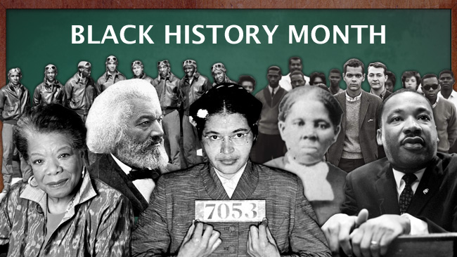
Black History Month and The Reverend Dr. Martin Luther King JR.
An Introduction to Black History and the Importance of
Notes:
Photo from: https://pdjeliclark.files.wordpress.com/2015/02/blackhistorymonth.jpg

Slide 2
Warm-Up Questions
Why is understanding history important?
Why is it important to celebrate people of all cultural backgrounds?
Why do you think the U.S. celebrates Black History Month every year?

Slide 3
What is Black History month?
A yearly observance of contributions of people from the African Diaspora
African Diaspora: The unwanted enslavement of African people to the Americas during the Atlantic Slave Trade from the 16th century to the 19th century that displaced generations of Africans
This holiday is celebrated in the United States (U.S), Canada and the United Kingdom (UK)

Slide 4
When is black history Month?
It is a month-long celebration in February of every year
However, the contributions should be taught all year for students to be fully educated on the importance of black people in the history of these countries
First celebrated in 1976 in the U.S., 1987 in the U.K and 1995 in Canada
Notes:
Sources:
https://en.wikipedia.org/wiki/Black_History_Month#United_States:_Black_History_Month_.281976.29

Slide 5
Why Do We Celebrate It?
To remember the history of our black ancestors and how they shaped the history of these countries
To remember how far we have come as a people, but also how far we have to go
To embrace people of African descent and learn from about their accomplishments to society that are often left out of history books

Slide 6
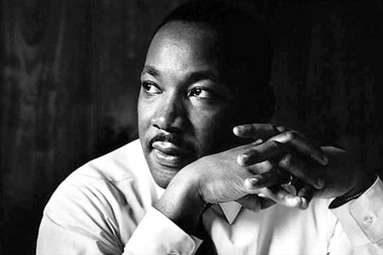
Who Is The Reverend Dr. Martin Luther King Jr.
Born on January 15th, 1929 in Atlanta, Georgia
Skipped the 9th and 11th grades, received his doctorate (Ph.D) at 25 years old
One of the leaders of the Civil Rights Movement, a social activist who fought against racism
Believed in non-violent approach to fighting racial prejudice
Received the Nobel Peace Prize in 1964 for his non-violent approach to equality
Died (by assassination) on April 4th, 1968
Notes:
Source: http://www.biography.com/people/martin-luther-king-jr-9365086#assassination-and-legacy

Slide 7
WHY does he have multiple titles?
Reverend: He was an ordained, Baptist minister who attended and graduated from Morehouse College and Crozer Theological Seminary
Dr.: Earned a Ph.D
Martin Luther King: The name of his father
Jr: He was the second of his name (see above)
We say all the titles to honor his legacy and his accomplishments in his life
Notes:
Source: http://www.biography.com/people/martin-luther-king-jr-9365086#early-years

Slide 8
His Importance and legacy
Activist who fought against an oppressive government and society with non-violence and Christian values
Believed in equality and de-segregation of white people and black people in the U.S.
The U.S. celebrates his legacy every year on January 17th with an official holiday called “Martin Luther King Jr. Day”
Notes:
Source: http://www.biography.com/people/martin-luther-king-jr-9365086#early-years

Slide 9
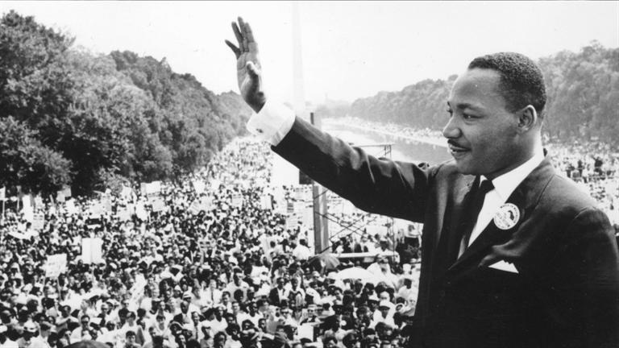
“I Have A Dream”
Link to his most famous speech (copy and paste):
https://www.youtube.com/watch?v=3vDWWy4CMhE

Slide 10
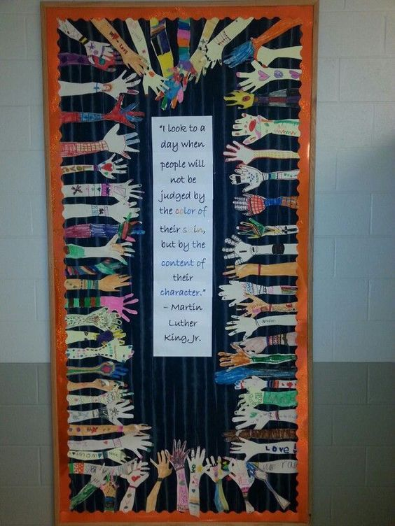
Activity: “Door of Diversity” – Embracing the dream
Steps for Activity
Trace your hand
Color and design your hand
Cut out your paper hand
Glue or tape your hand to the door (or wall)
Cut out the quote
Glue or tape the quote to the center of the door (or wall)

Slide 11
Quote for Diversity DOor
“I look to a day when people will not be judged by the color of their skin, but by the content of their character.” – The Reverend Dr. Martin Luther King Jr.

Slide 12
How can you Live his dream?

