Slide 1
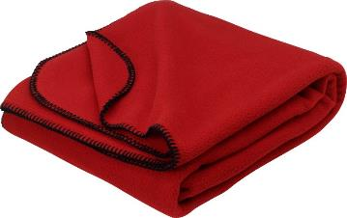
Movie Party!!!
Thursday, December 24th during class
Bring your own snack, drink, and blanket

Slide 2
Daily Activity #12:
What are your winter break plans?

Slide 3
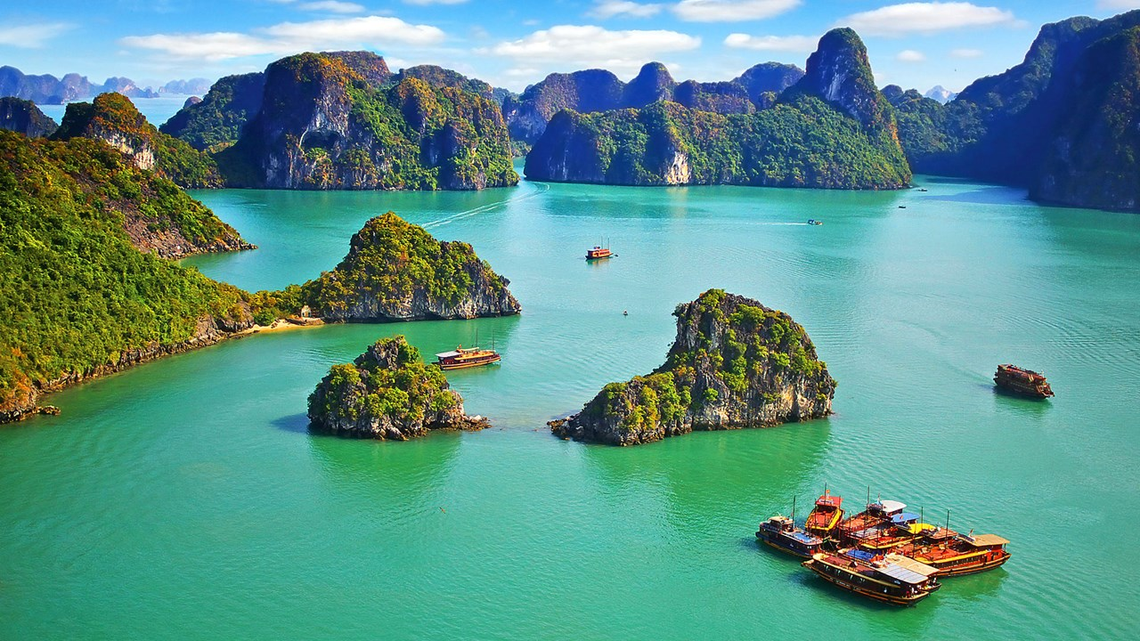
I will be visiting Cambodia and Vietnam

Slide 4
Last Journal Post #10: Dreams
What is your dream when you grow up? Why? Explain in a minimum of 2 sentences.
For example: My dream is to become a doctor. I want to help people who are sick.
Assignment due Wednesday, December 16th at 11:59pm.

Slide 5
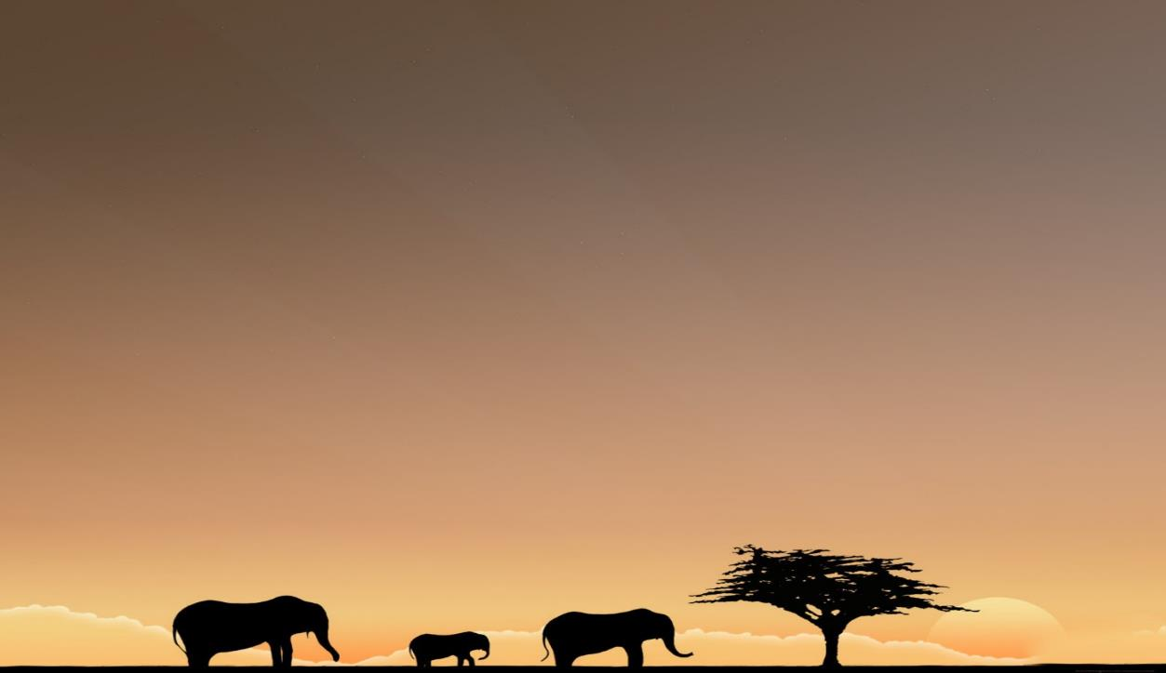
Traveling to
(탄자니아)
6th Grade
Grace Teacher

Slide 6
“Circle of Life” from Lion King
https://www.youtube.com/watch?v=HwSKkKrUzUk&list=PLdSMQMuTYK4A2e67n5JcmjQQODoRK4S-6

Slide 7
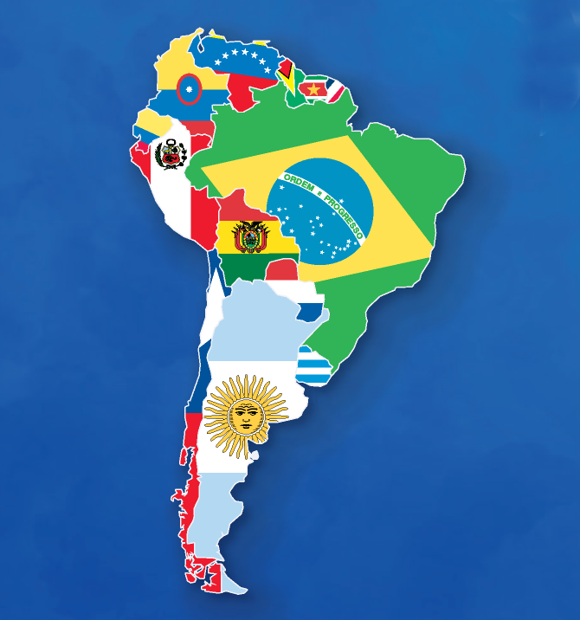
Where is Tanzania (탄자니아)?
South America

Slide 8
Tanzania is in Africa!

Slide 9
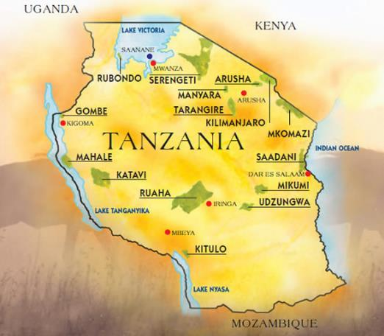
Facts about Tanzania
49 million people

Slide 10
Arusha, Tanzania
May 2015
Volunteer trip
(자원 봉사 여행)

Slide 16
VOCABULARY

Slide 17
Travel (여행)

Slide 18
Safari (사파리 여행)

Slide 19
Jambo = “Hi” in Swahili

Slide 20
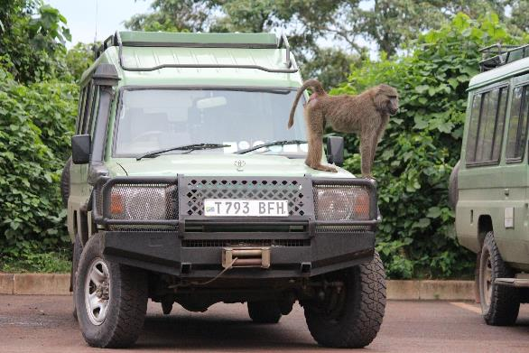
How did I travel?
Airplane
Car

Slide 21
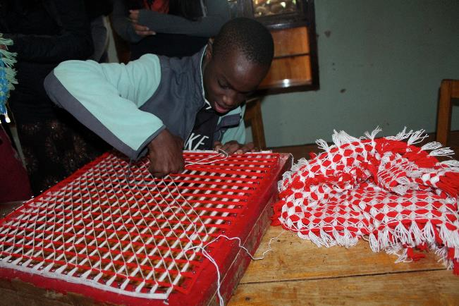
What did I see?

Slide 22
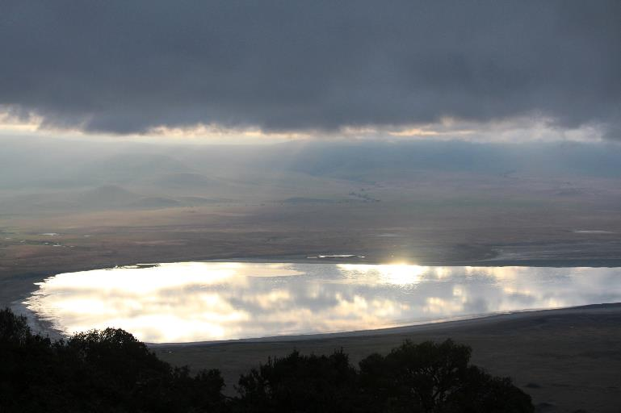
What did I see?
Crater (분화구)

Slide 23
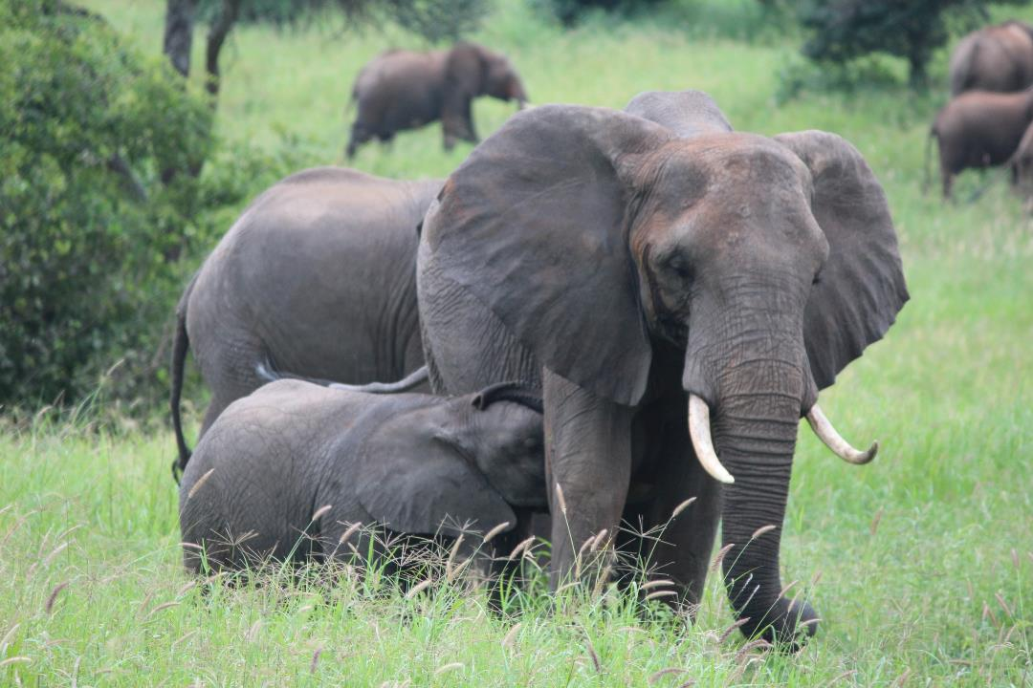
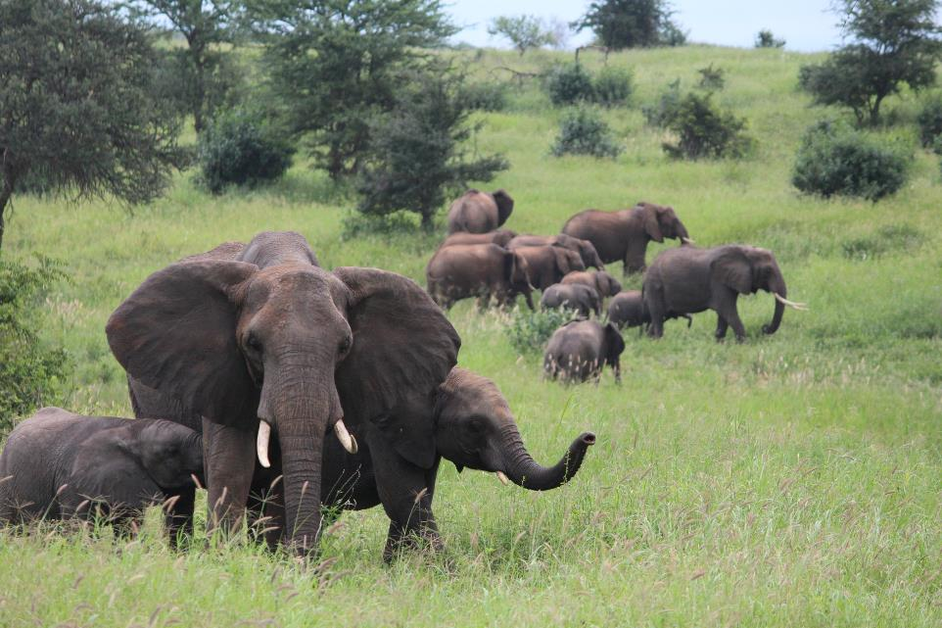
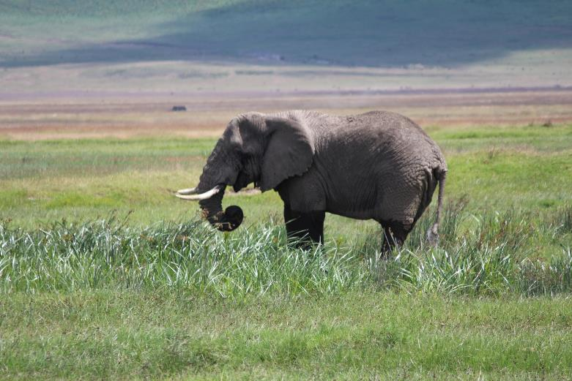
What did I see?
I saw elephants

Slide 24
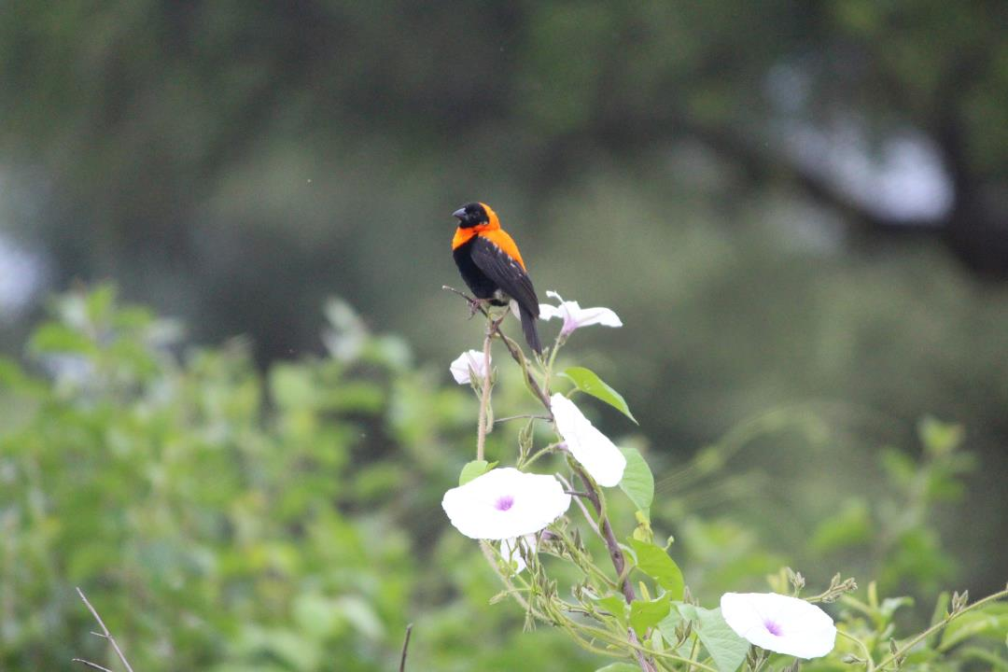
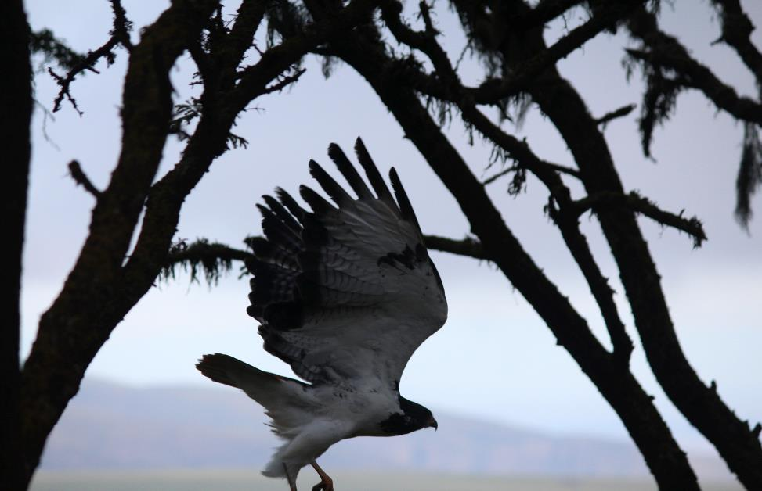
What did I see?
I saw lots of birds!

Slide 25
What did I see?
I saw monkeys.

Slide 26
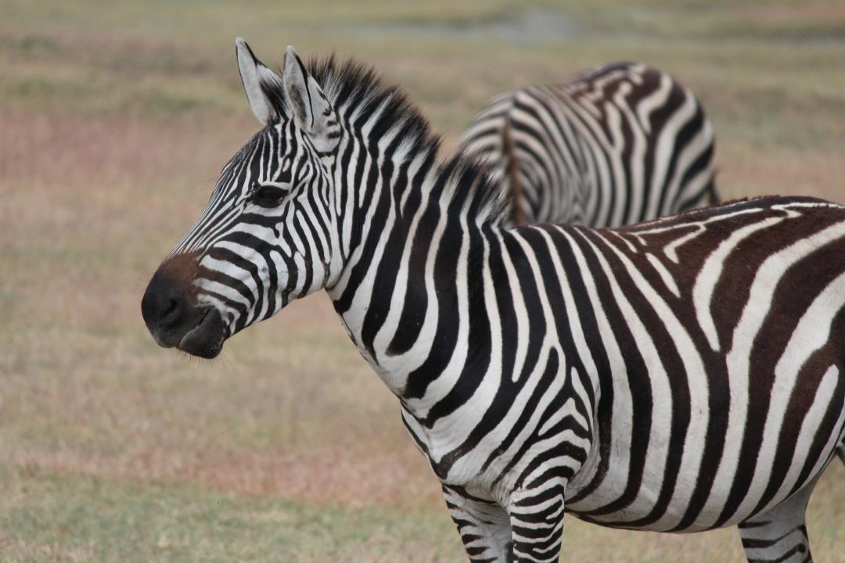
What did I see?
I saw zebras.

Slide 27
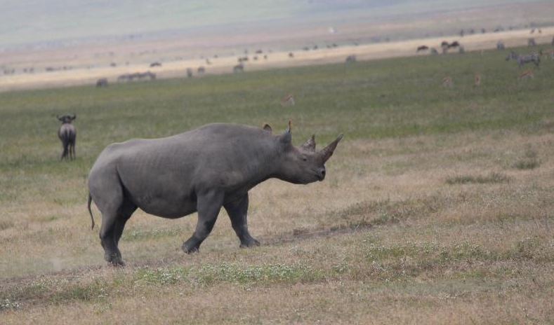
What did I see?
I saw a rhino.

Slide 28
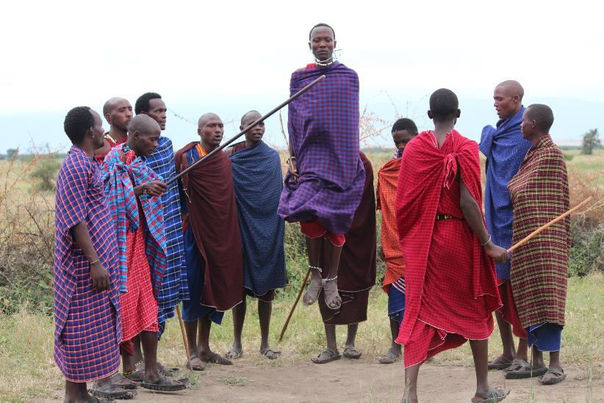
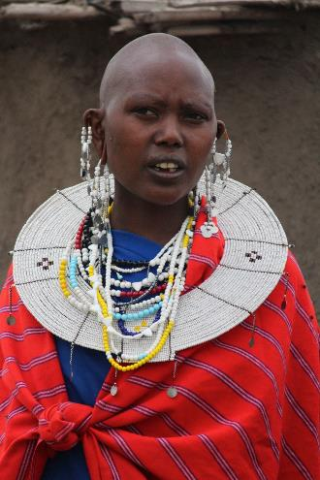
What did I see?
I saw Maasai People.

Slide 29
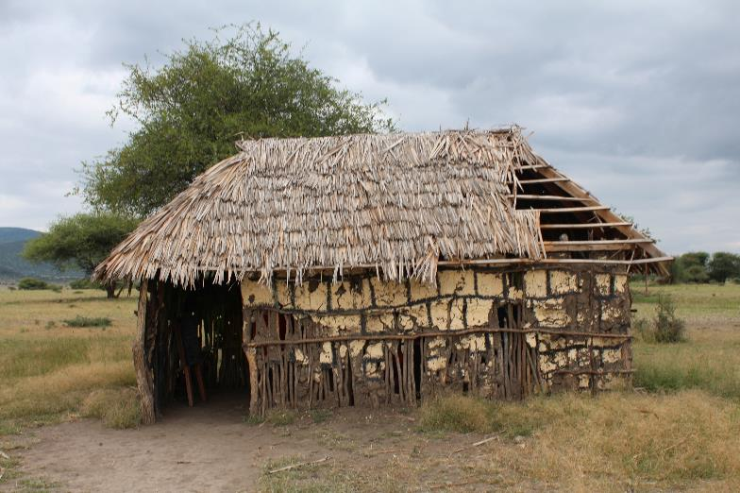
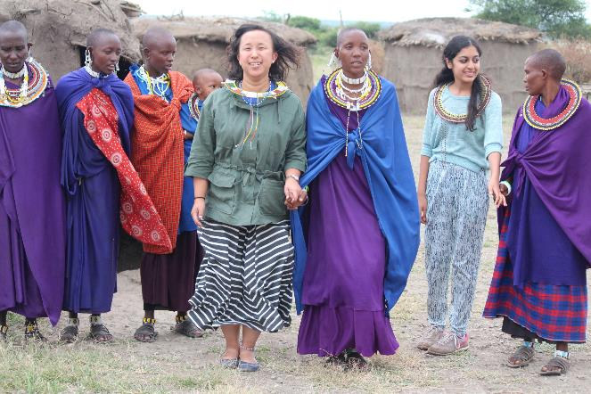
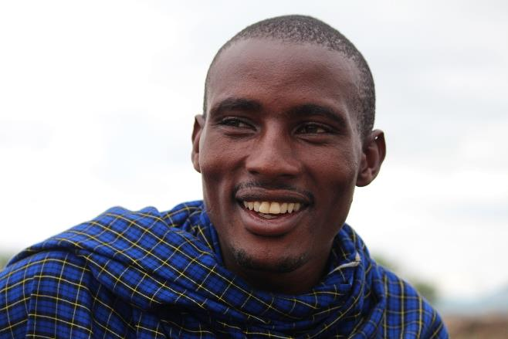
What did I see?
I saw Maasai People.

Slide 30
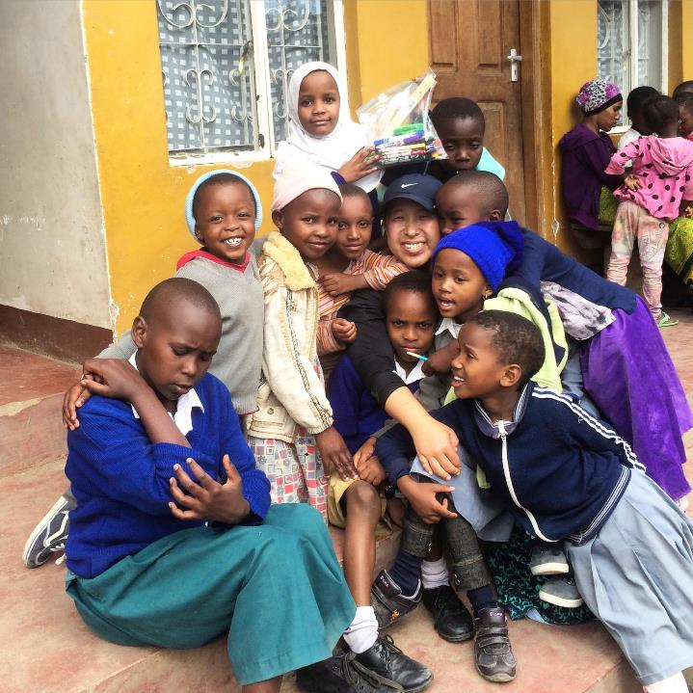
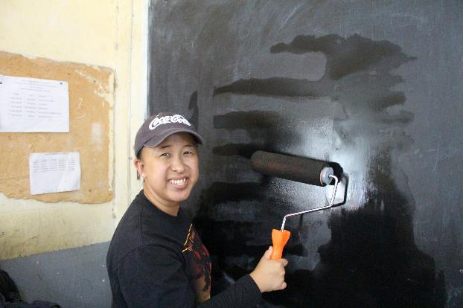
What did I like?
I liked visiting elementary school kids

Slide 31
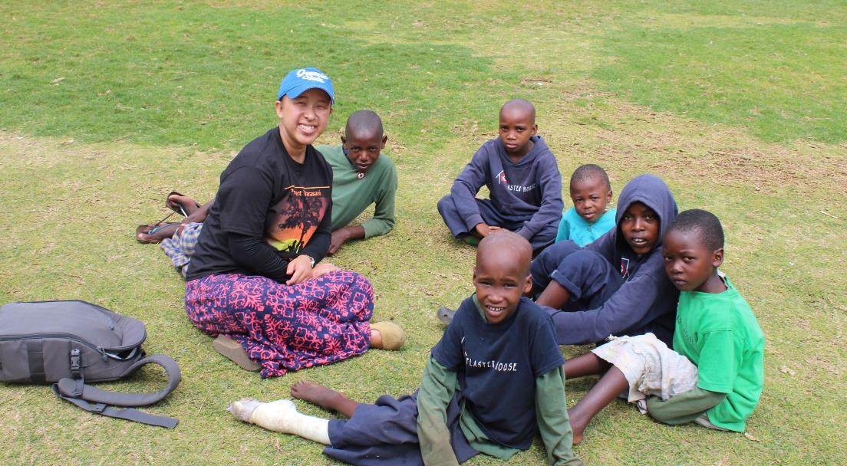
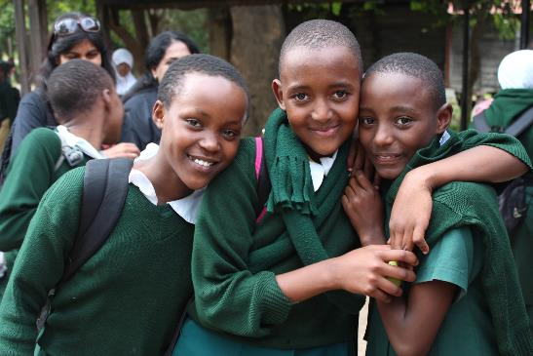
What did I like?
I liked playing with the kids.

Slide 32
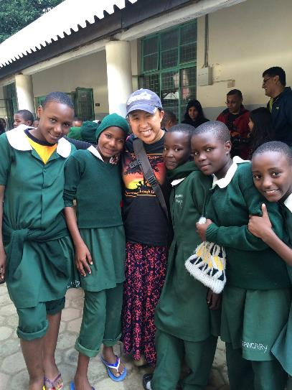
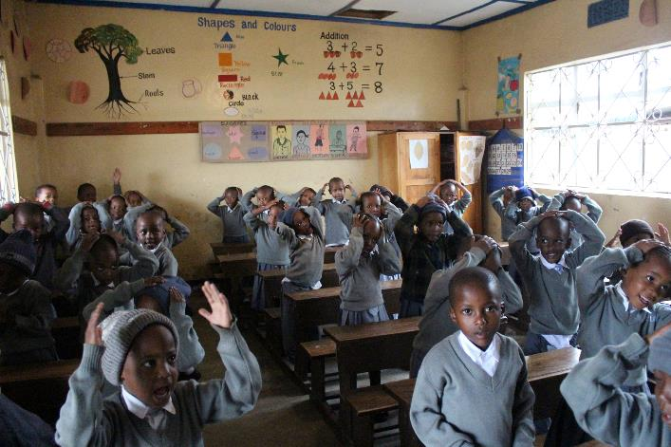
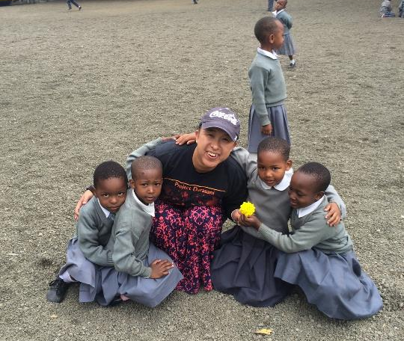
What did I like?
I liked their beautiful smiling faces!

Slide 33
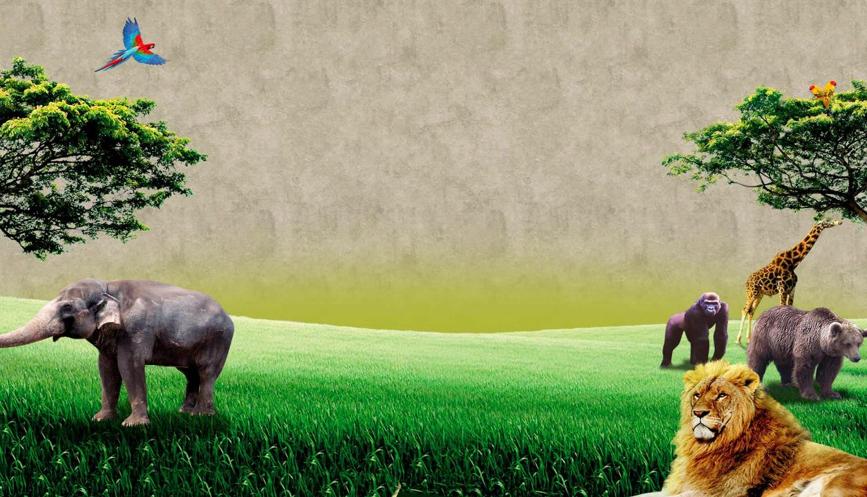
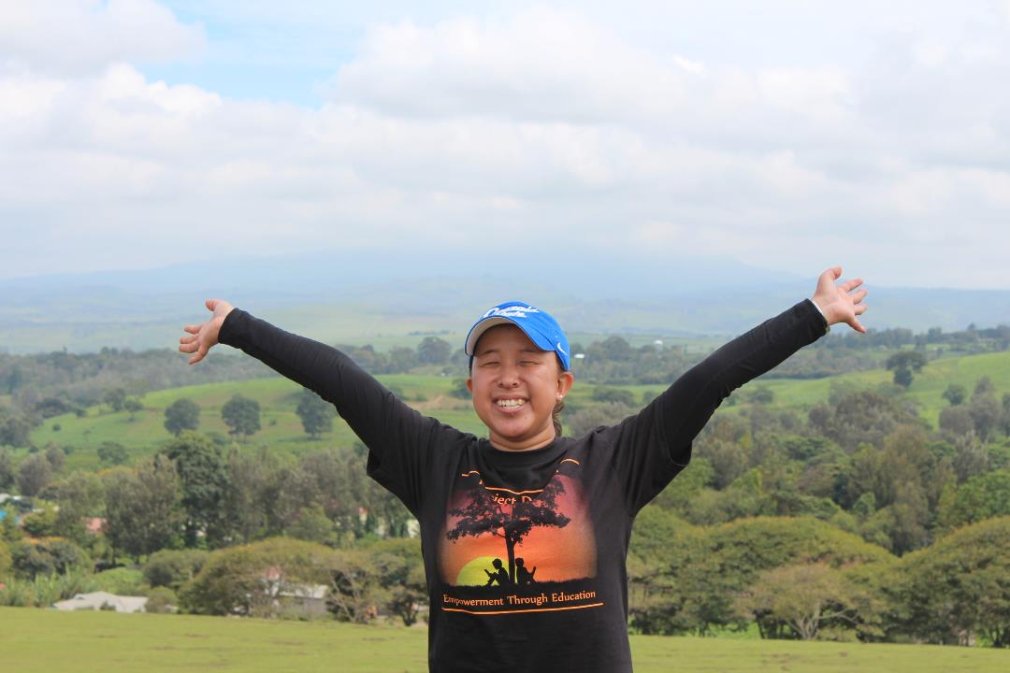
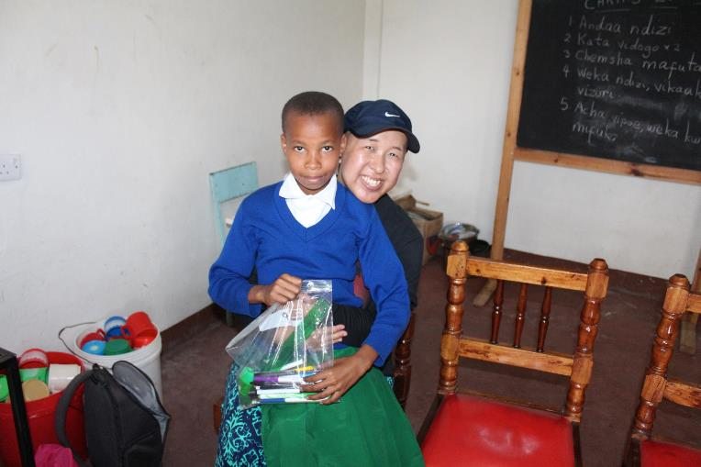
Was I happy, sad, tired, excited?

Slide 34
Volunteer – To help

Slide 35
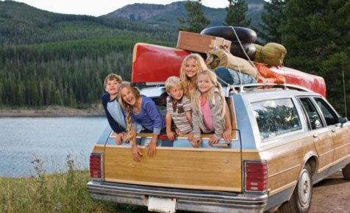
My Trip Activity
Write and draw about a trip you have taken with family or friends
Example: Zoo, department store, relative’s house, vacation
How did you travel? By bus, by walking, by airplane, by train
What did you see?
What did you like?
Were you happy, sad, tired, excited?

