Slide 1
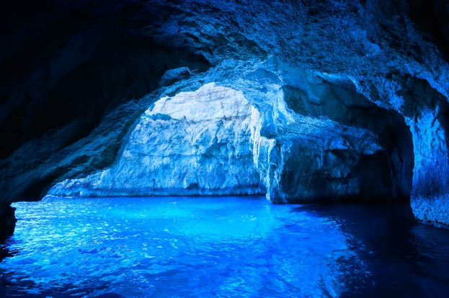
Blue Grotto

Slide 2
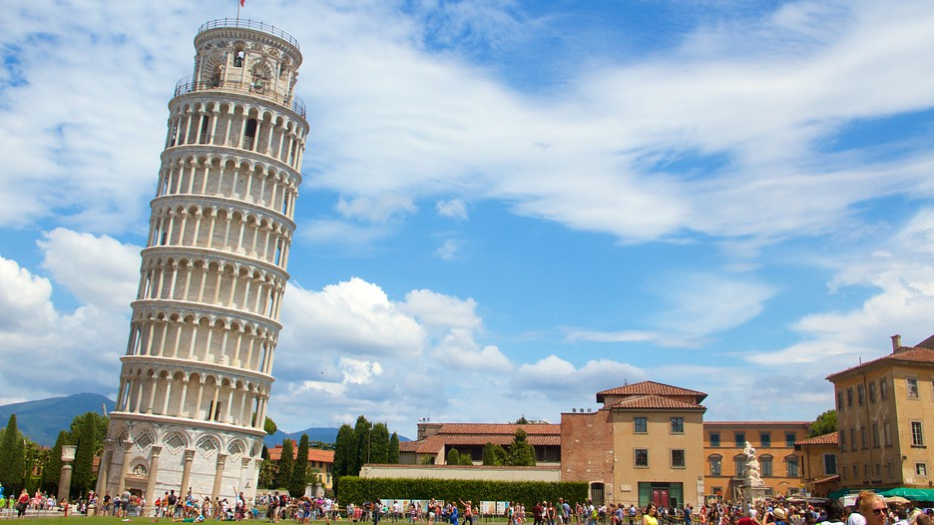
Leaning Tower of Pisa

Slide 3
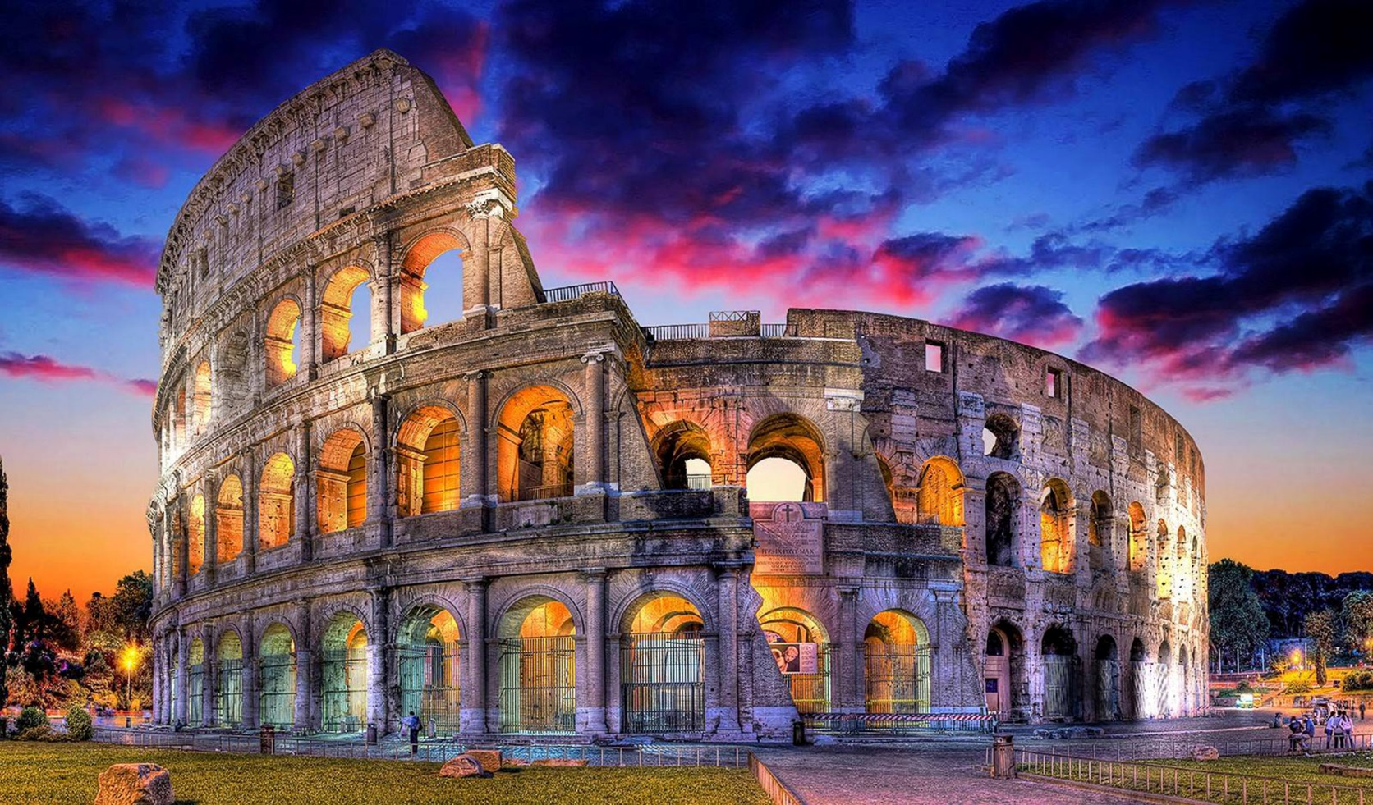
The Colosseum

Slide 4
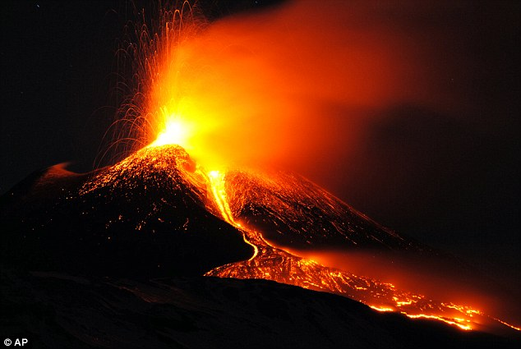
Mount Etna

Slide 5
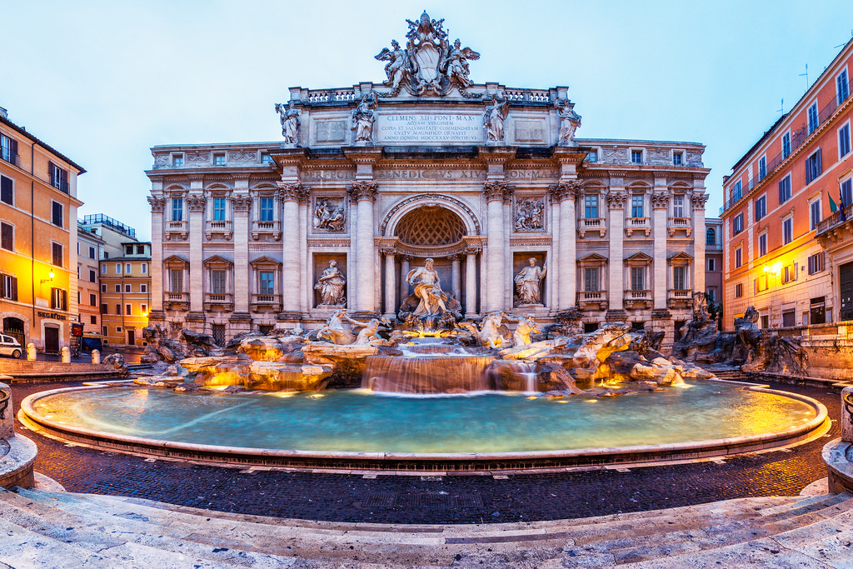
Trevi Fountain

Slide 6
The Last Supper
Painting

Slide 7
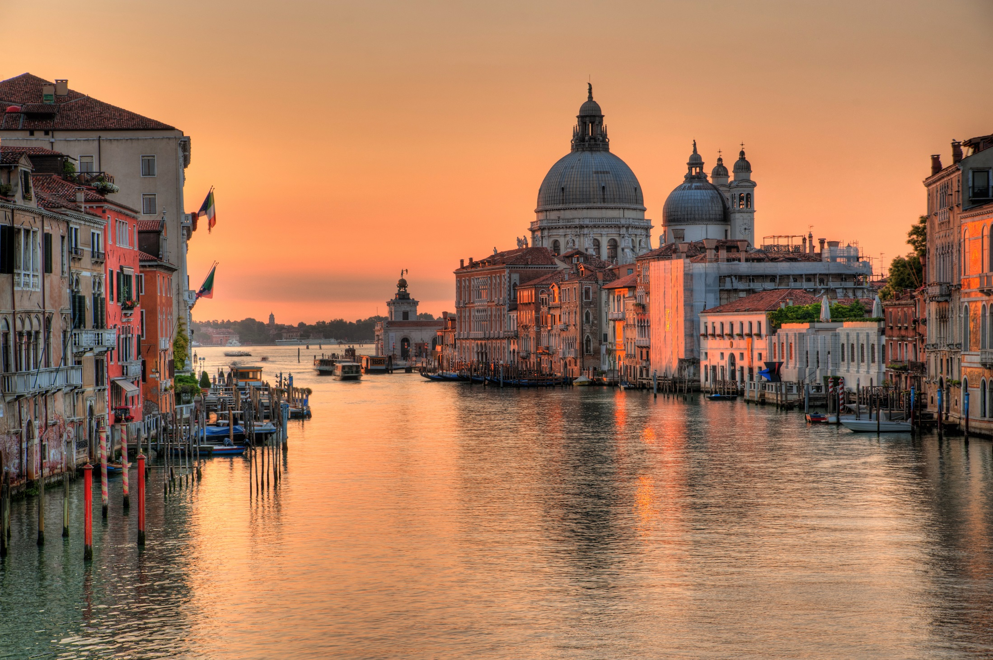
Venice Grand Canal

