Slide 1
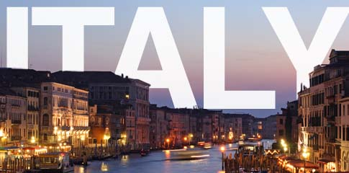
(이탈리아)
Day #3 of Winter Camp
January 6, 2016

Slide 2
Flight time: 11 - 18 hours
Cost: 590,000 – 831,000 won

Slide 3
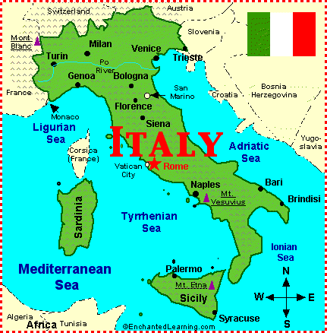
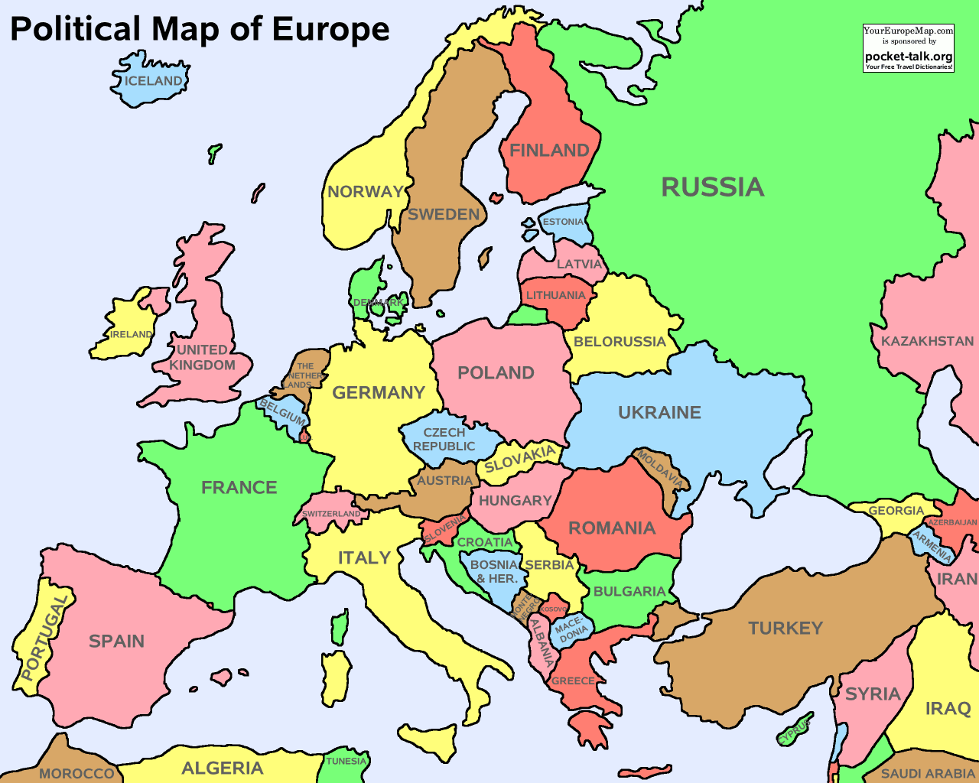
What continent is Italy located?
Europe!

Slide 4
https://www.youtube.com/watch?v=5LxuvEchge4
Notes:
Stop the video at 1 minute

Slide 5
Key Question: How do you say “Hello” in Italian?

Slide 6
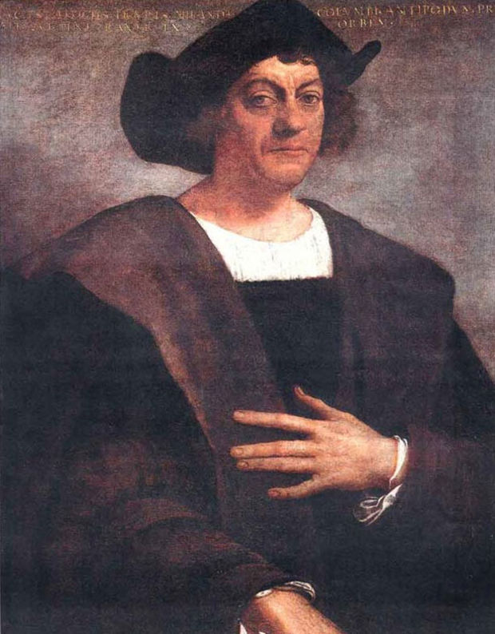
Facts about Italy
Population: 61 million people
Most people are Christians (Roman Catholics = 90%)
It has 3 active volcanoes
Christopher Columbus is Italian. He discovered America!

Slide 7
Let’s see famous things!

Slide 8
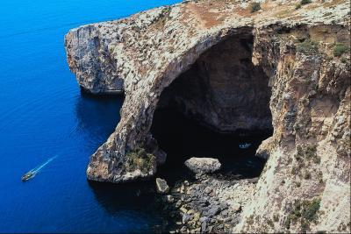
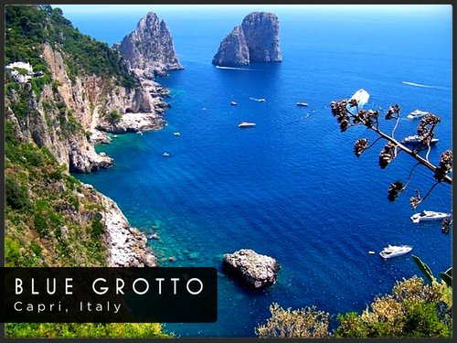
#1) Blue Grotto Sea Cave (푸른 작은 바다 동굴)
Located in Capri, Italy
Water is very blue because of the lighting in the cave

Slide 9
#2) Leaning Tower of Pisa (피사의 사탑은)
Located in Pisa, Italy
Height: 55 meters
Weight: 14,500 tons
It took 199 years to complete it!

Slide 10
#3) Last Supper Painting (마지막 만찬을 그림)
Located in Milan, Italy
Jesus’ last meal with his apostles before he was crucified and captured
Who painted the Last Supper?
Picasso
Leonardo DaVinci
Michelangelo

Slide 11
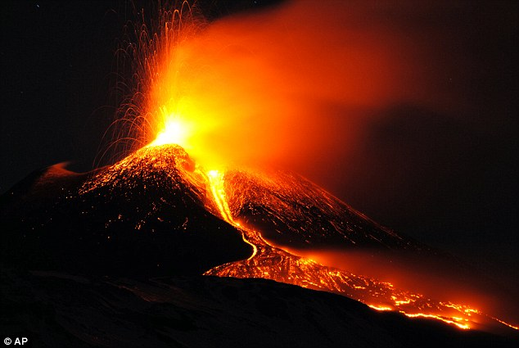
#4) Mount Etna (에트나 산)
Located in Sicily, Italy
Europe’s tallest and most active volcano

Slide 12
Mount Etna (에트나 산) erupted on December 3, 2015
https://www.youtube.com/watch?v=oqe-TLyXsqU
Notes:
-End video at 45 seconds

Slide 13
#5) Colosseum (콜로세움)
Located in Rome, Italy
Largest amphitheater ever built
50,000-80,000 people

Slide 14
#6) Trevi Fountain (트레비분수)
Located in Rome, Italy
People throw coins using right hand over left shoulder
About 3,000 Euros are thrown into the fountain daily (3,851,361 won)

Slide 15
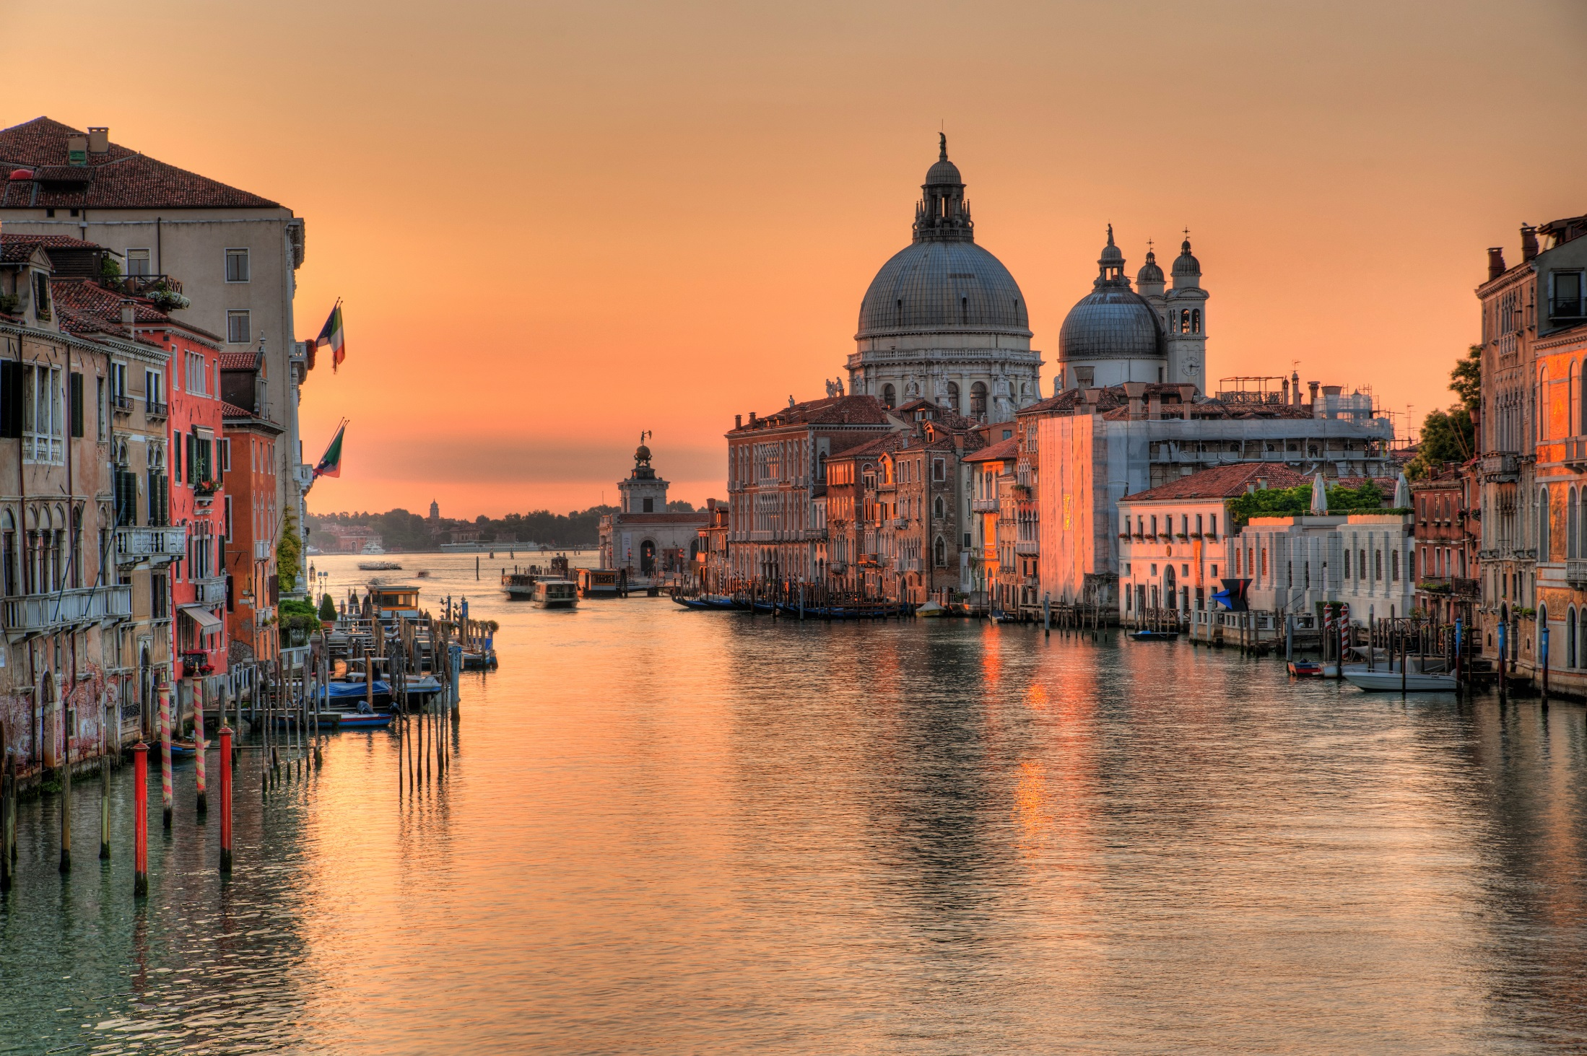
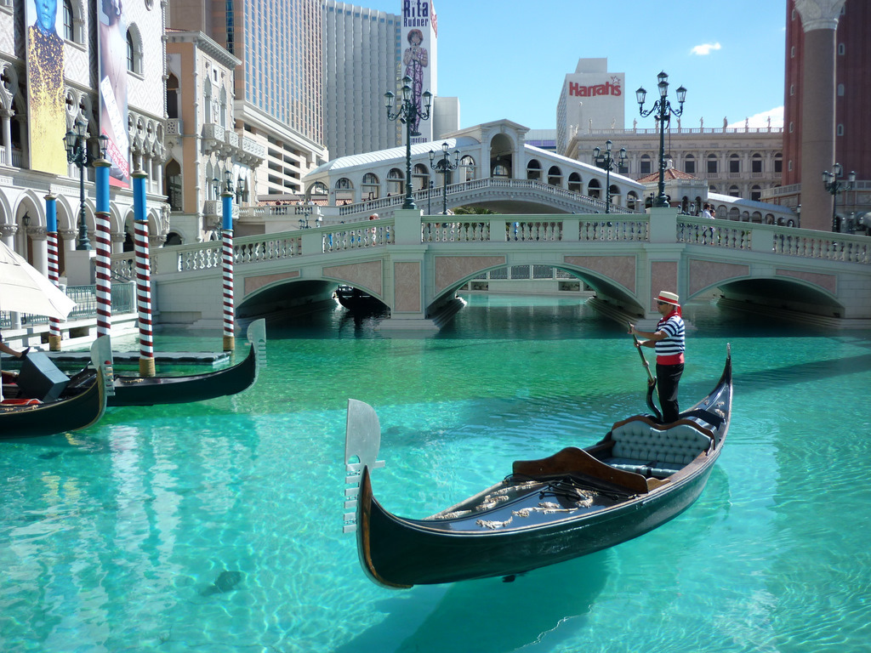
#7) Venice Grand Canal (베니스 대운하)
Located in Venice, Italy
3.8 km long
30 – 90 m wide
People ride water buses, water taxis, and gondola (Venetian rowing boat)

Slide 16
Key Question: How do you say “Hello” in Italian?

Slide 17
Photo Scavenger Hunt
Item No | A picture of: | Points: | Have:
1 | Something blue | 3
2 | Your teachers (3 points/each) | 3/6
3 | 3 members jumping in the air | 10
4 | Writing “I love you” | 10
5 | Being silly at Leaning Tower of Pisa (피사의 사탑은) | 8
6 | Two people fighting | 5
7 | Team dancing | 10
8 | The Colosseum (콜로세움) | 8
9 | A mountain (산) / volcano (화산) | 8
10 | 3 members with books on heads | 5
11 | Trevi Fountain (트레비분수) | 8
12 | A painting (그림) in Italy | 8
13 | Venice Grand Canal (베니스 대운하) | 8
14 | Team Picture | 10

Slide 18
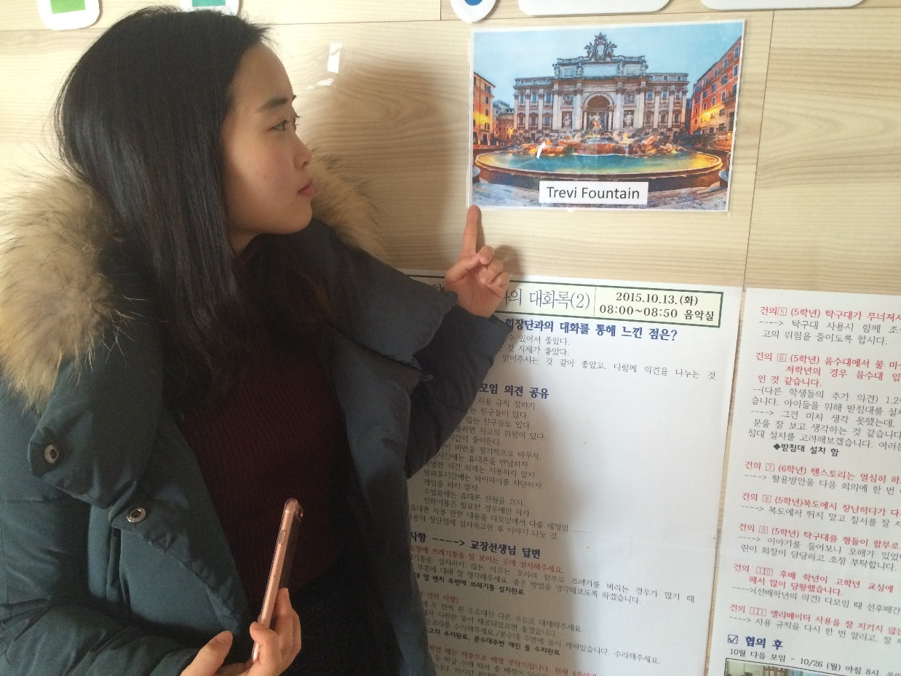
Item No | A picture of: | Points: | Have:
1 | Something blue | 3
2 | Your teachers (3 points/each) | 3/6
3 | 3 members jumping in the air | 10
4 | Writing “I love you” | 10
5 | Being silly at Leaning Tower of Pisa (피사의 사탑은) | 8
6 | Two people fighting | 5
7 | Team dancing | 10
8 | The Colosseum (콜로세움) | 8
9 | A mountain (산) / volcano (화산) | 8
10 | 3 members with books on heads | 5
11 | Trevi Fountain (트레비분수) | 8
12 | A painting (그림) in Italy | 8
13 | Venice Grand Canal (베니스 대운하) | 8
14 | Team Picture | 10

Slide 19
Item No | A picture of: | Points: | Have:
1 | Something blue | 3
2 | Your teachers (3 points/each) | 3/6
3 | 3 members jumping in the air | 10
4 | Writing “I love you” | 10
5 | Being silly at Leaning Tower of Pisa (피사의 사탑은) | 8
6 | Two people fighting | 5
7 | Team dancing | 10
8 | The Colosseum (콜로세움) | 8
9 | A mountain (산) / volcano (화산) | 8
10 | 3 members with books on heads | 5
11 | Trevi Fountain (트레비분수) | 8
12 | A painting (그림) in Italy | 8
13 | Venice Grand Canal (베니스 대운하) | 8
14 | Team Picture | 10

Slide 20
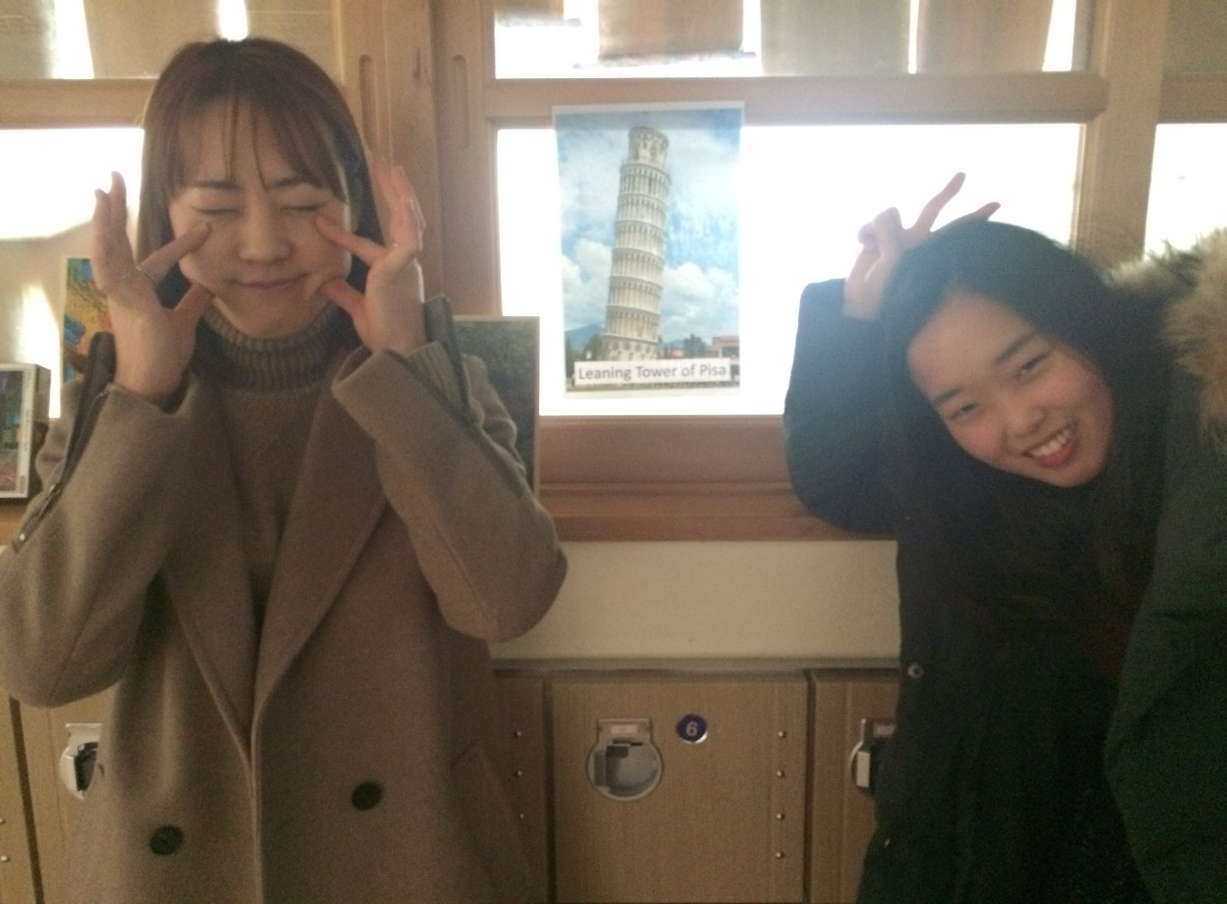
Item No | A picture of: | Points: | Have:
1 | Something blue | 3
2 | Your teachers (3 points/each) | 3/6
3 | 3 members jumping in the air | 10
4 | Writing “I love you” | 10
5 | Being silly at Leaning Tower of Pisa (피사의 사탑은) | 8
6 | Two people fighting | 5
7 | Team dancing | 10
8 | The Colosseum (콜로세움) | 8
9 | A mountain (산) / volcano (화산) | 8
10 | 3 members with books on heads | 5
11 | Trevi Fountain (트레비분수) | 8
12 | A painting (그림) in Italy | 8
13 | Venice Grand Canal (베니스 대운하) | 8
14 | Team Picture | 10

Slide 21
Photo Scavenger Hunt
Get as many X’s as you can!
Item No | A picture of: | Points: | Have:
1 | Something blue | 3
2 | Your teachers (3 points/each) | 3/6
3 | 3 members jumping in the air | 10
4 | Writing “I love you” | 10
5 | Being silly at Leaning Tower of Pisa (피사의 사탑은) | 8
6 | Two people fighting | 5
7 | Team dancing | 10
8 | The Colosseum (콜로세움) | 8
9 | A mountain (산) / volcano (화산) | 8
10 | 3 members with books on heads | 5
11 | Trevi Fountain (트레비분수) | 8
12 | A painting (그림) in Italy | 8
13 | Venice Grand Canal (베니스 대운하) | 8
14 | Team Picture | 10
Turn in one sheet per team
You have 20 minutes!
Winning team = most points
Any questions?

Slide 22
Let’s go to 3rd floor hallway!

Slide 23
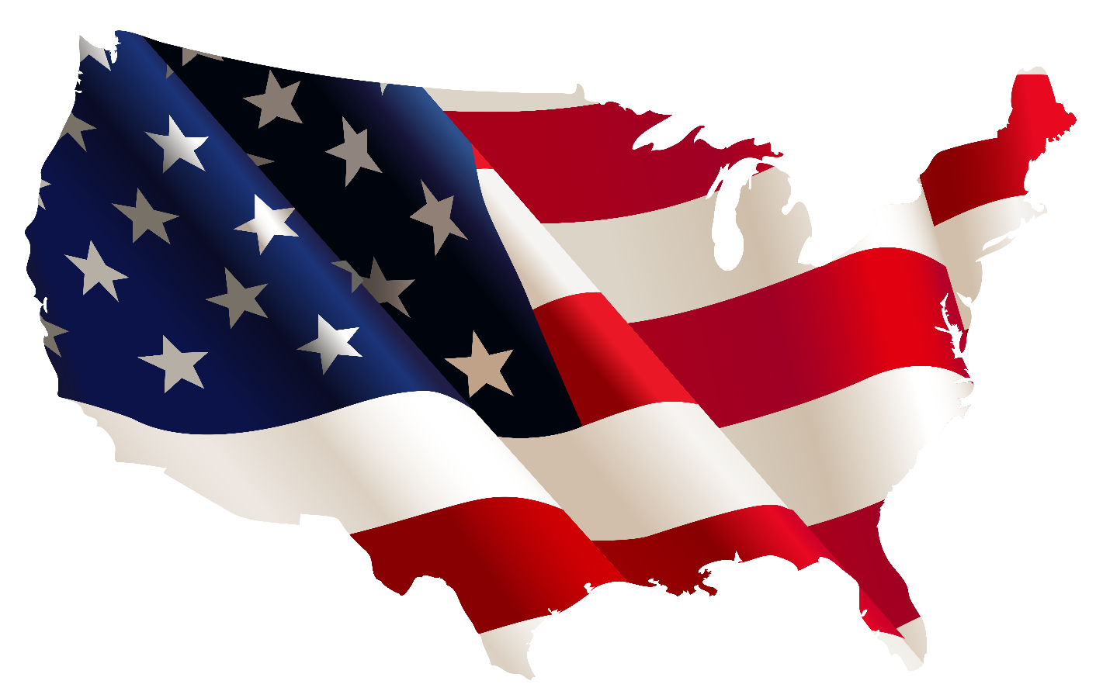
See you tomorrow. We are going to USA! ☺

