Slide 1

Travel Around
Winter camp 2016
The world

Slide 2





Rules for Winter Camp 2016
Be on time for class!
Respect each other.
Have good attitude.
Let’s have fun!
At the end of each class, give your nametag to Teacher

Slide 3
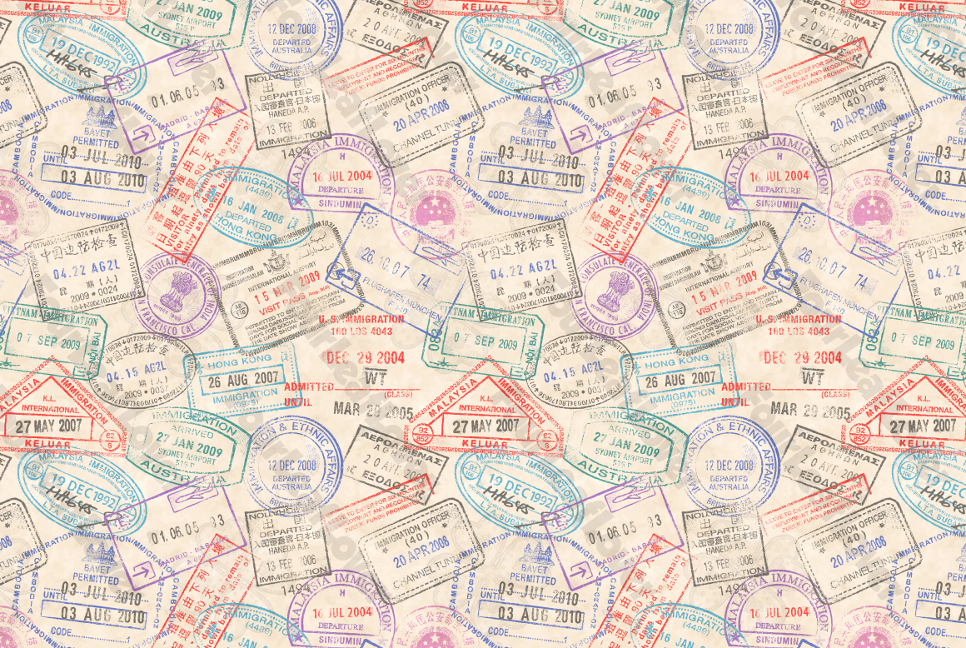


Rewards System
Grace Teacher will give out stickers
3 stickers = Candy!
Get 6 stickers = Choco Pie!

Slide 4
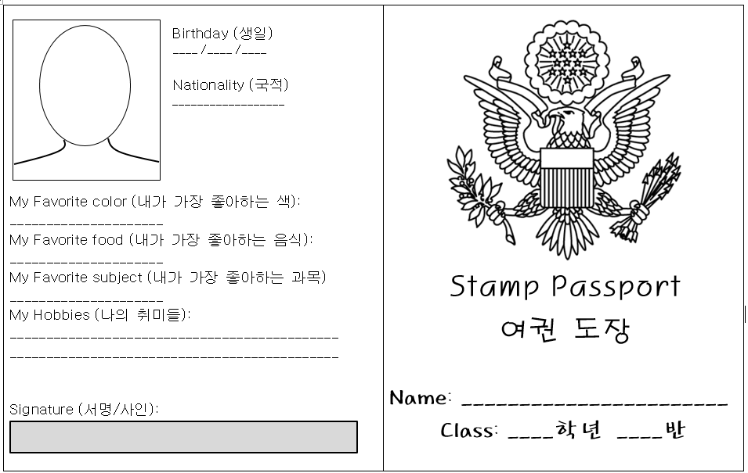
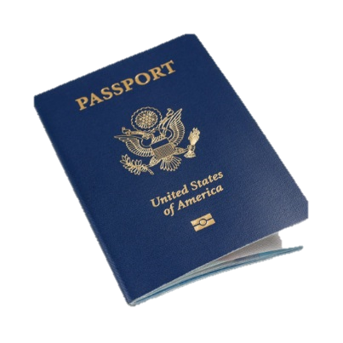
Let’s make our passports!

Slide 5
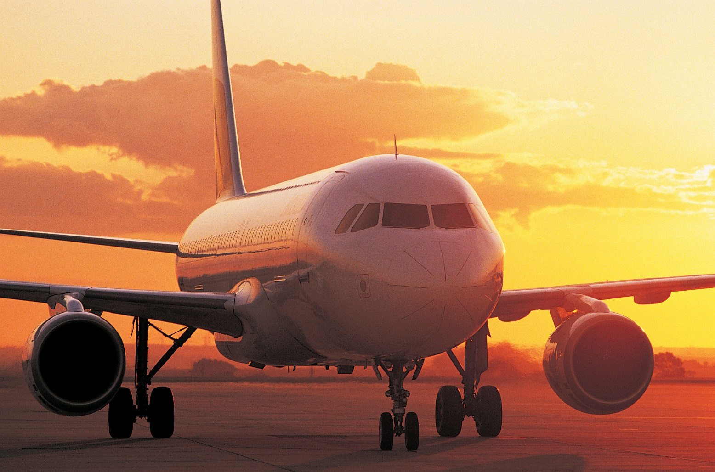
Where will we travel to?
We will travel to……
  Brazil (브라질)
  Italy (이탈리아)
  USA (미국)

Slide 6





Four teams during Winter Camp
Team Brazil
Team Korea

Slide 7



Four teams during Winter Camp
Team USA
Team Italy

Slide 8

Key Question
Each day, there will be a key question!
At the end of each day, we will give you a visa sticker showing you visited that country if you answer the key question!
Key Question Example: “What is my name?”
Key Question Answer: “Grace Teacher”

Slide 9

Brazil Immigration
05 JAN 2016
Brazil Immigration
05 JAN 2016
Brazil Immigration
05 JAN 2016
Brazil Immigration
05 JAN 2016
Brazil Immigration
05 JAN 2016
Brazil Immigration
05 JAN 2016
Brazil Immigration
05 JAN 2016
Brazil Immigration
05 JAN 2016
Brazil Immigration
05 JAN 2016
Brazil Immigration
05 JAN 2016
Brazil Immigration
05 JAN 2016
Brazil Immigration
05 JAN 2016
Brazil Immigration
05 JAN 2016
Brazil Immigration
05 JAN 2016
Brazil Immigration
05 JAN 2016
Brazil Immigration
05 JAN 2016
Brazil Immigration
05 JAN 2016
Brazil Immigration
05 JAN 2016
Brazil Immigration
05 JAN 2016
Brazil Immigration
05 JAN 2016
Brazil Immigration
05 JAN 2016
Brazil Immigration
05 JAN 2016
Brazil Immigration
05 JAN 2016
Brazil Immigration
05 JAN 2016

Slide 10



Italy Immigration
06 JAN 2016
Italy Immigration
06 JAN 2016
Italy Immigration
06 JAN 2016
Italy Immigration
06 JAN 2016
Italy Immigration
06 JAN 2016
Italy Immigration
06 JAN 2016
Italy Immigration
06 JAN 2016
Italy Immigration
06 JAN 2016
Italy Immigration
06 JAN 2016
Italy Immigration
06 JAN 2016
Italy Immigration
06 JAN 2016
Italy Immigration
06 JAN 2016
Italy Immigration
06 JAN 2016
Italy Immigration
06 JAN 2016
Italy Immigration
06 JAN 2016
Italy Immigration
06 JAN 2016
Italy Immigration
06 JAN 2016
Italy Immigration
06 JAN 2016
Italy Immigration
06 JAN 2016
Italy Immigration
06 JAN 2016
Italy Immigration
06 JAN 2016
Italy Immigration
06 JAN 2016
Italy Immigration
06 JAN 2016
Italy Immigration
06 JAN 2016

Slide 11

U.S.A. Immigration
07 JAN 2016
U.S.A. Immigration
07 JAN 2016
U.S.A. Immigration
07 JAN 2016
U.S.A. Immigration
07 JAN 2016
U.S.A. Immigration
07 JAN 2016
U.S.A. Immigration
07 JAN 2016
U.S.A. Immigration
07 JAN 2016
U.S.A. Immigration
07 JAN 2016
U.S.A. Immigration
07 JAN 2016
U.S.A. Immigration
07 JAN 2016
U.S.A. Immigration
07 JAN 2016
U.S.A. Immigration
07 JAN 2016
U.S.A. Immigration
07 JAN 2016
U.S.A. Immigration
07 JAN 2016
U.S.A. Immigration
07 JAN 2016
U.S.A. Immigration
07 JAN 2016
U.S.A. Immigration
07 JAN 2016
U.S.A. Immigration
07 JAN 2016
U.S.A. Immigration
07 JAN 2016
U.S.A. Immigration
07 JAN 2016
U.S.A. Immigration
07 JAN 2016
U.S.A. Immigration
07 JAN 2016
U.S.A. Immigration
07 JAN 2016
U.S.A. Immigration
07 JAN 2016

Slide 12
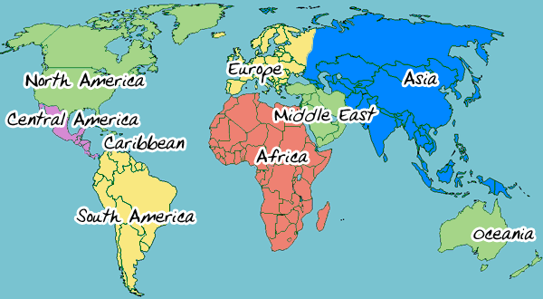
Let’s learn about the world map – continents!

Slide 13
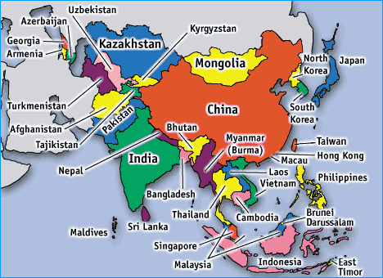
Asia
Asia is largest continent in the world.

Slide 14
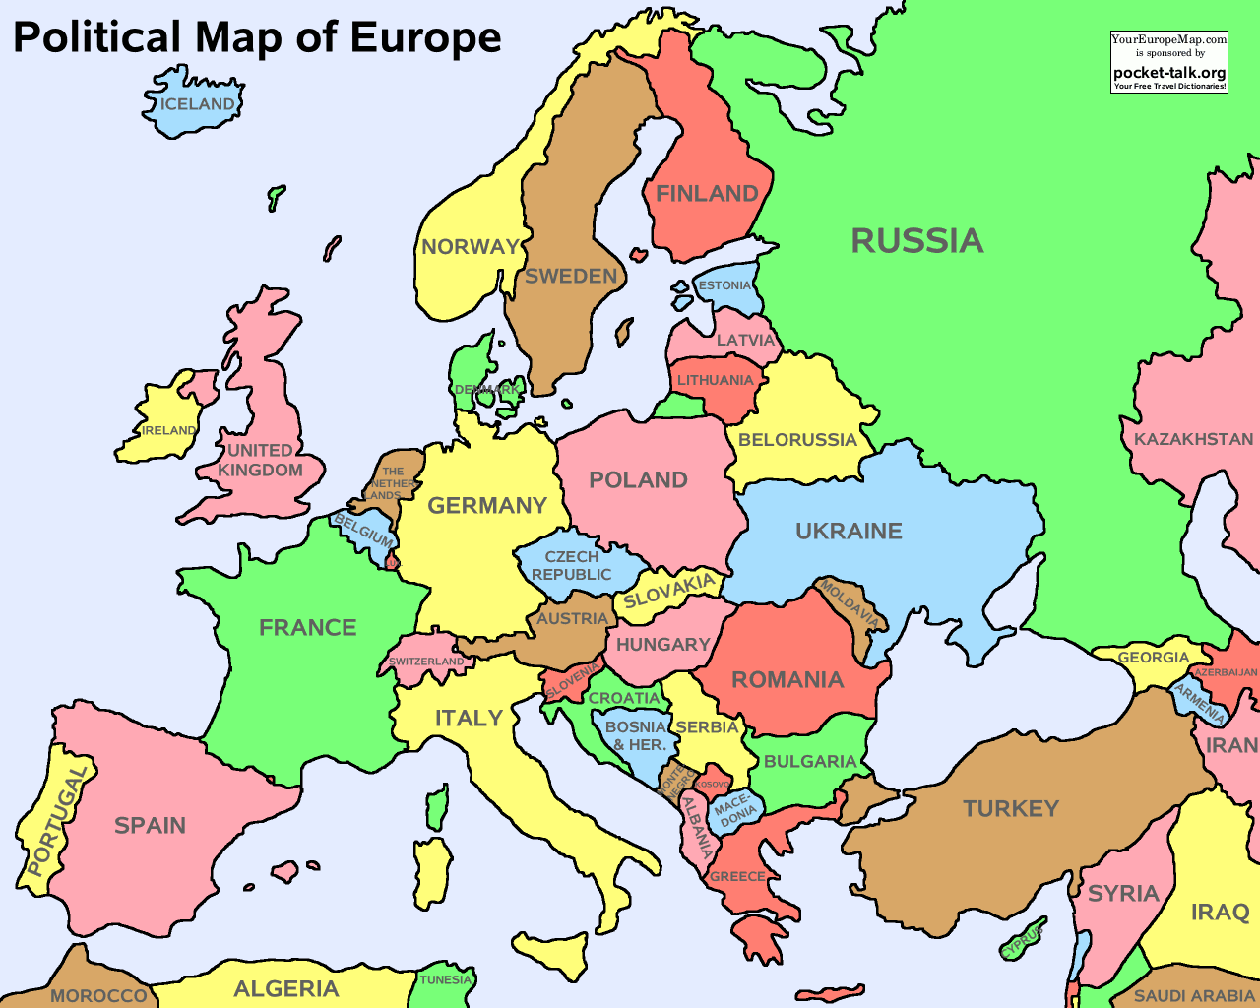
Europe
2nd smallest continent in the world
It has about 50 countries

Slide 15
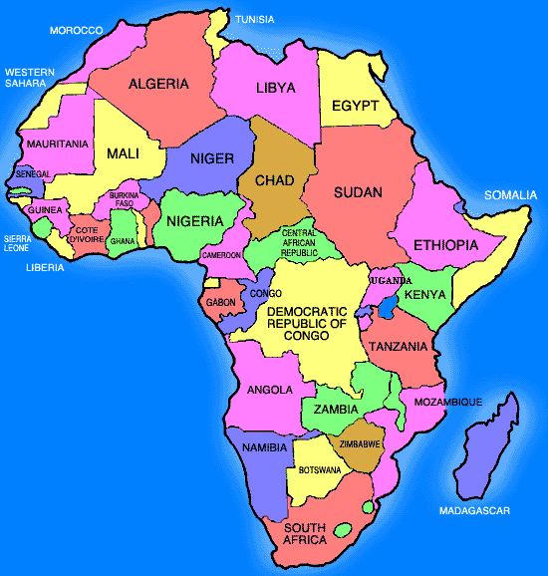
Africa
It is very hot!
2nd largest continent

Slide 16
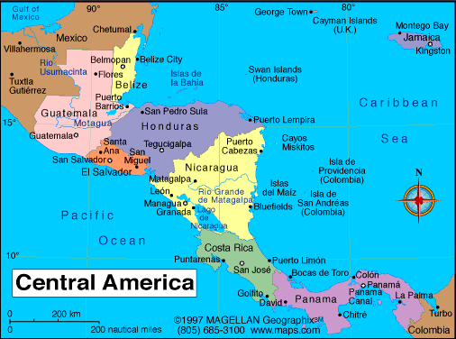
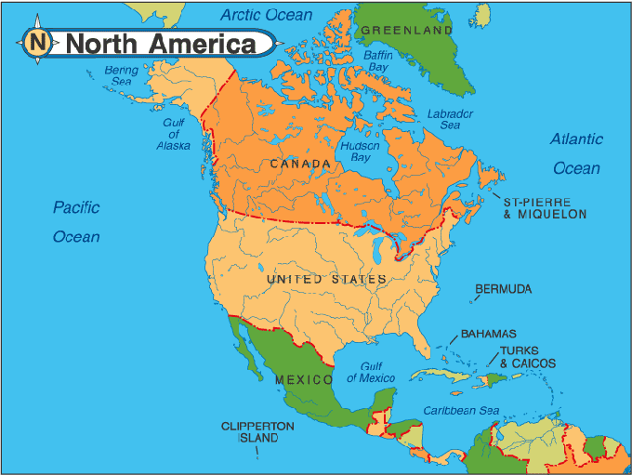
North America
It has 3 major countries.
It has smaller countries called Central America

Slide 17
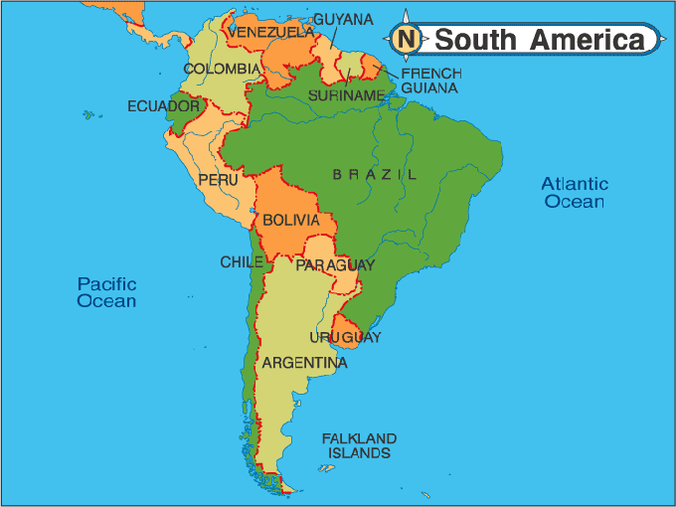
South
America
It has 12 countries.
The Amazon River is the largest river system in the world.

Slide 18
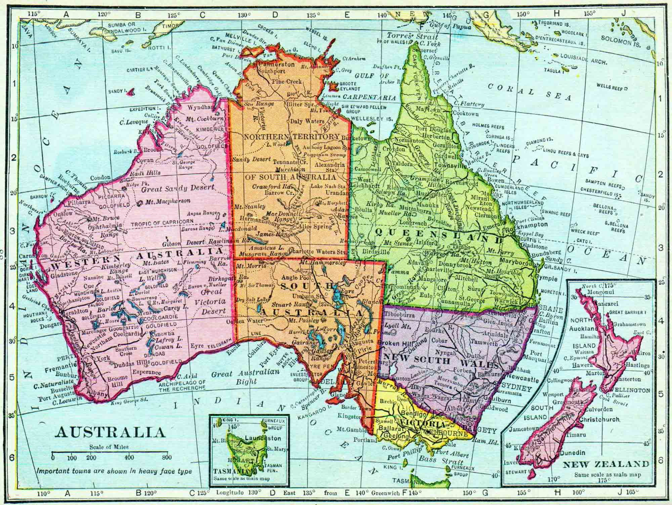
Australia
It is an island continent.
It is also called Oceania.

Slide 19
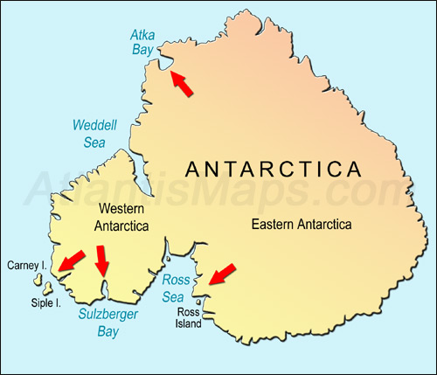
Antarctica
It is also an island continent.
It is made up of ice and rocks.

Slide 20

Give your nametag to Teacher!
See you tomorrow as we head to Brazil! ☺

