Slide 1
Cooking Class with
English
- Pizza -

Slide 2
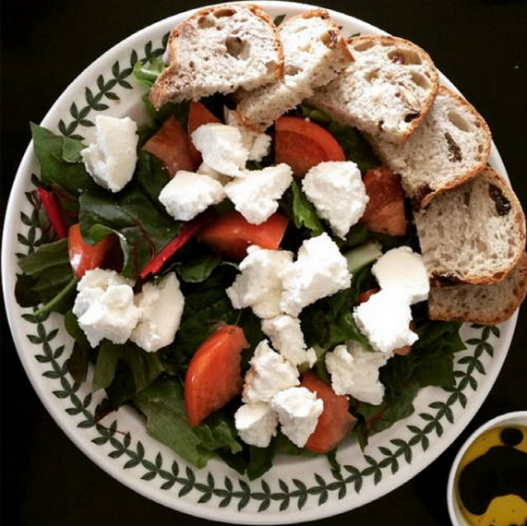
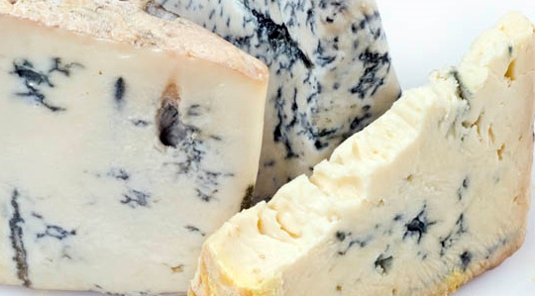
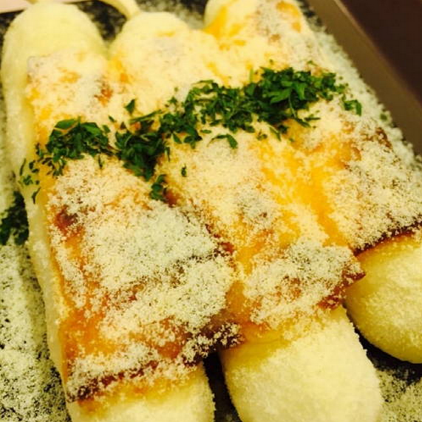
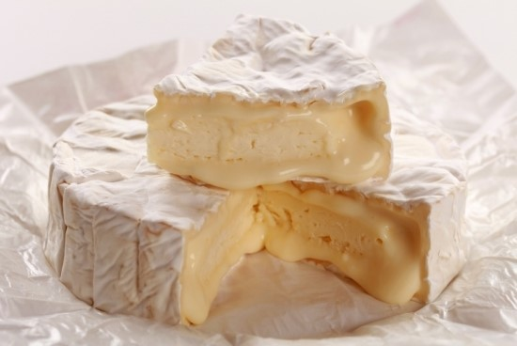
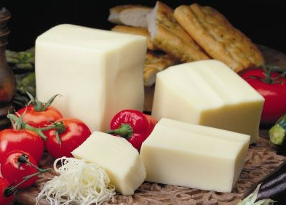
cheese
Gorgonzola
cheese
Ricotta cheese
Parmesan cheese
Camembert cheese
Mozzarella cheese

Slide 3
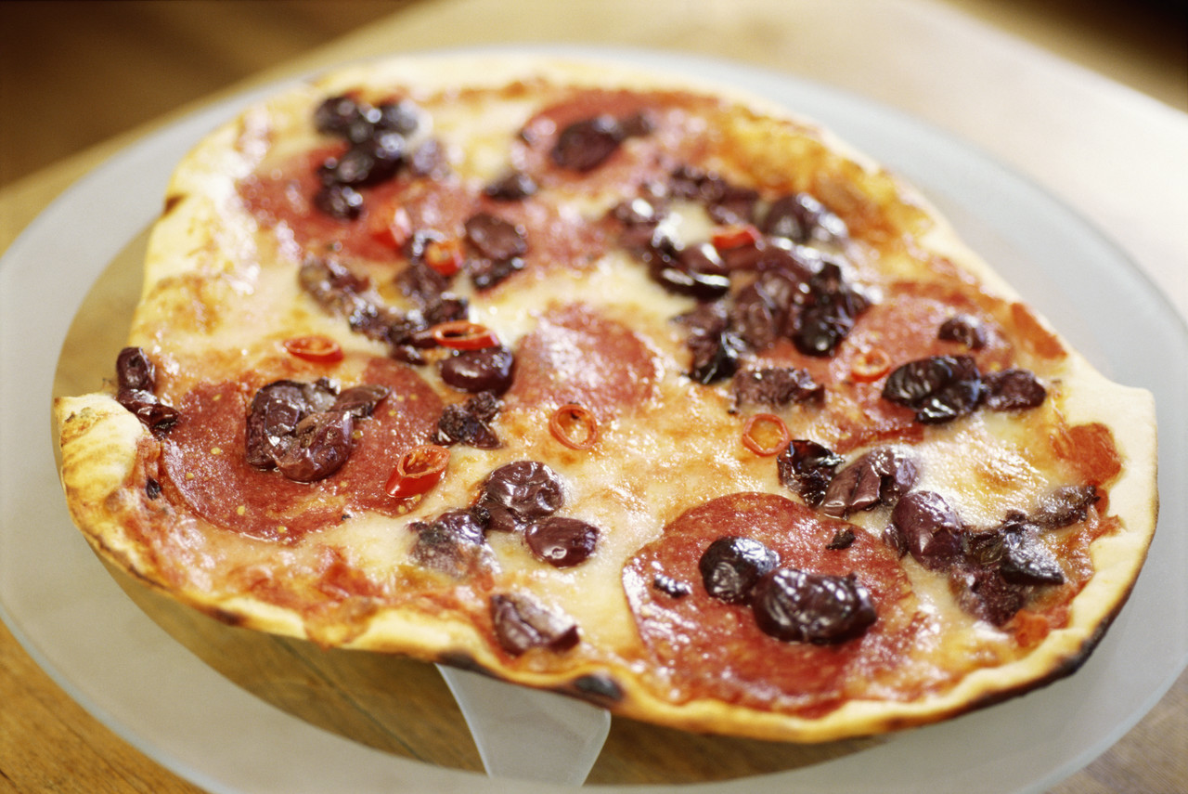
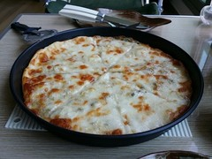
Pizza
Pizza
Pizza
:A pizza is a flat, round piece of dough covered with tomatoes, cheese, and other savory food, and then baked in an oven.

Slide 4
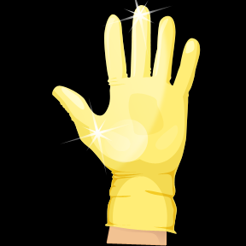
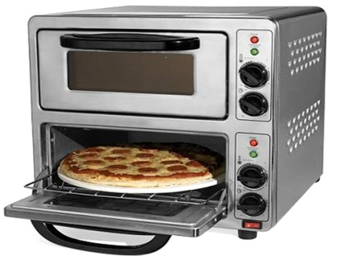
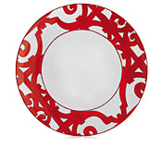
Pizza
■ Cooking Tools
spoons
oven
glove
dish

Slide 5
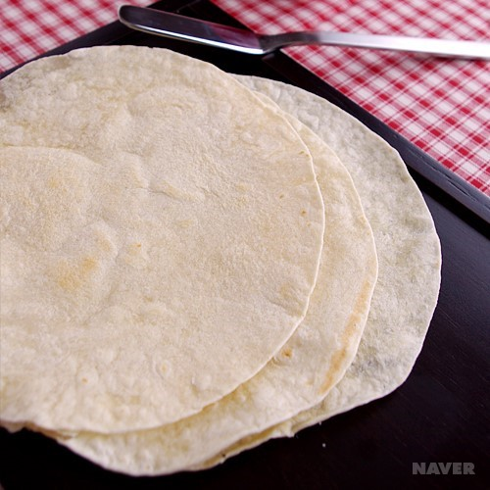
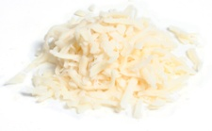
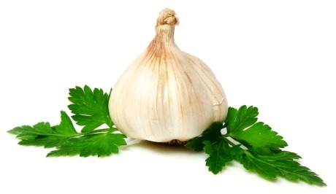

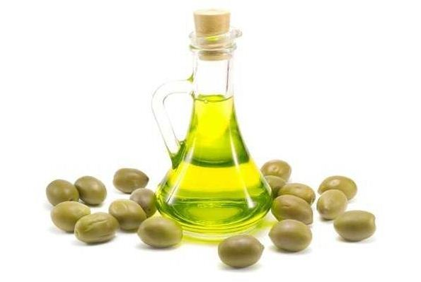
Pizza
■ Ingredients in Detail
tortilla
Gorgonzola
cheese
Mozzarella cheese
corns
honey
garlic
olive oil

Slide 6
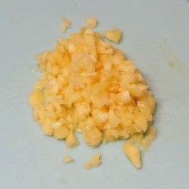
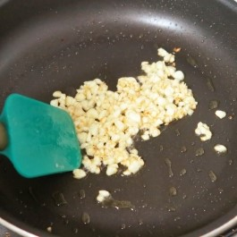
Pizza
■ How to Cook
1. Chop the garlic.
2. Fry the garlic in olive oil.
Chop garlic.

Slide 7
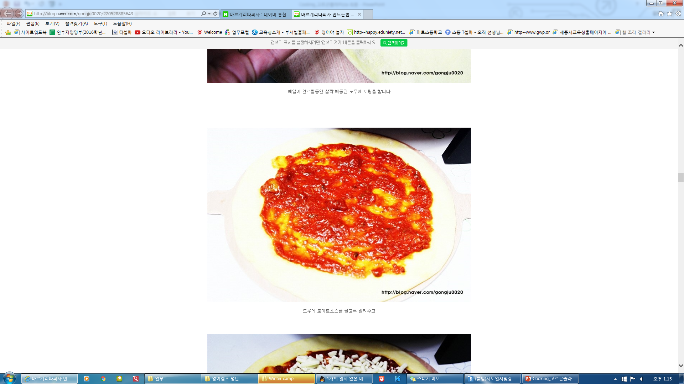
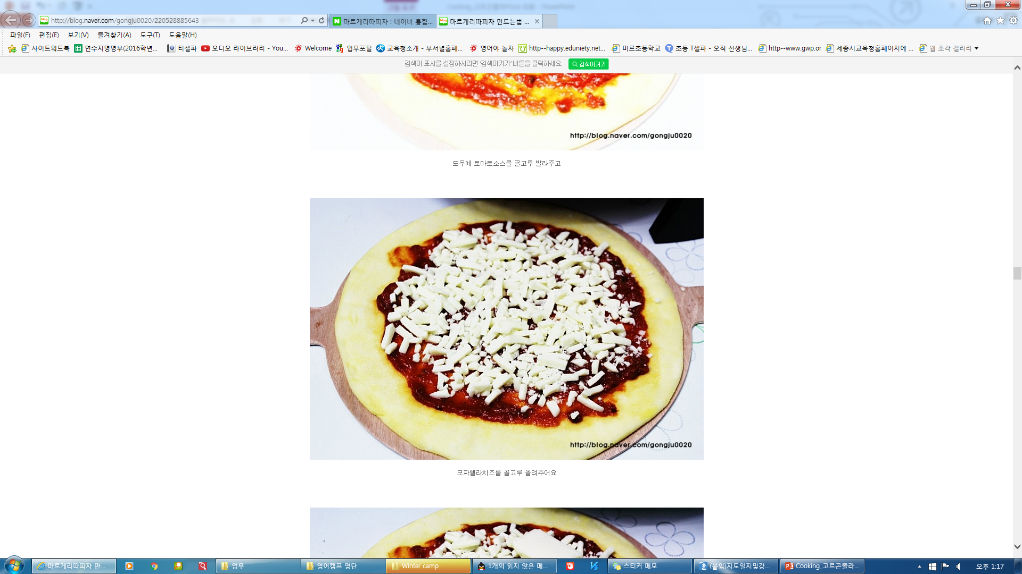
Pizza
■ How to Cook
3. Spread the tomato sauce on the tortilla
4. Put on some roasted garlic and Mozzarella cheese.

Slide 8
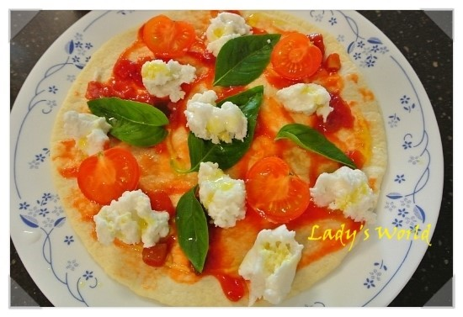
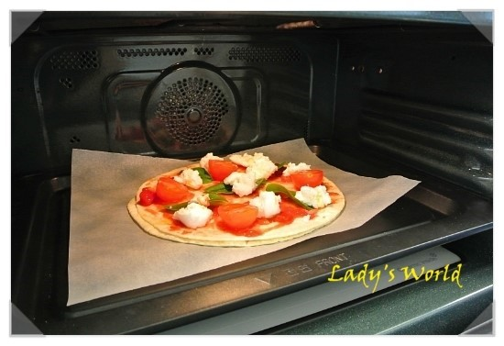
Pizza
■ How to Cook
5. Put the tomatoes on the pizza.
6. Sprinkle with parsley powder.
7. Bake it in the oven.

Slide 9


Pizza

