Slide 1
(브라질)
Day #2 of Winter Camp
January 5, 2016

Slide 2
Flight time: 20-40 hours
Cost: 1,658,590 won

Slide 3
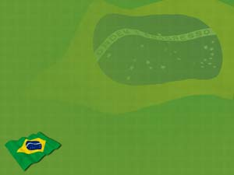
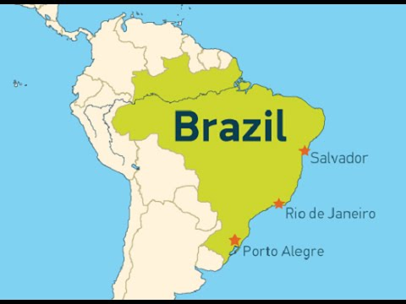
Key Question: What continent is Brazil located?
South America!

Slide 4
Beautiful Brazil
https://www.youtube.com/watch?v=z3wDsSh86Zs
Notes:
End video at 1 min, 10 sec. (1.10)

Slide 5
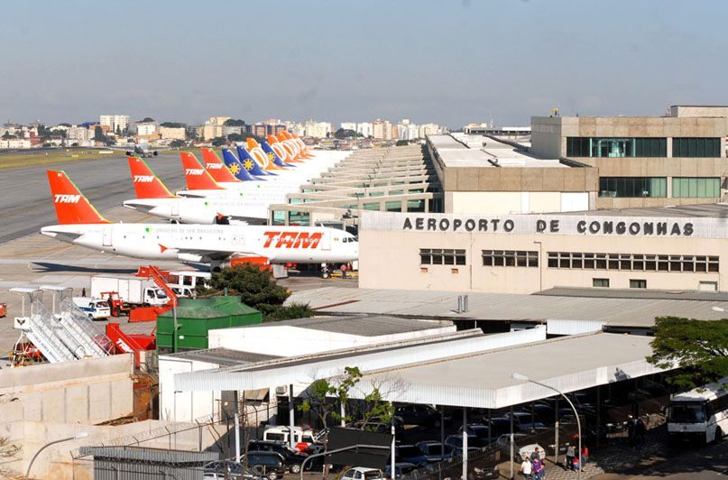
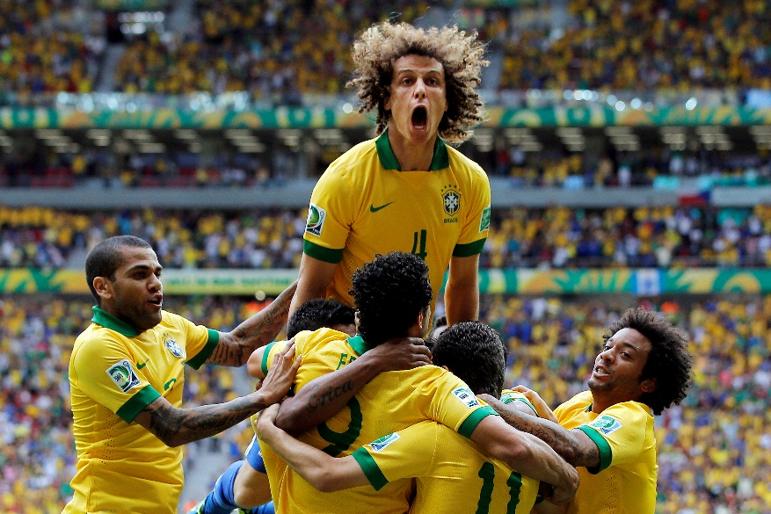
Facts about Brazil
Population: 200 million people
Largest country in South America
2,500 airports in Brazil
Soccer is most popular sport in Brazil (Brazilian team won World Cup five times)

Slide 6
Movie Clip from Rio
https://www.youtube.com/watch?v=ZZ81_Q0lYAM
Notes:
Start at 35 seconds and end around 2 min, 10 sec.

Slide 7
Let’s go to the Amazon Rainforest!

Slide 8
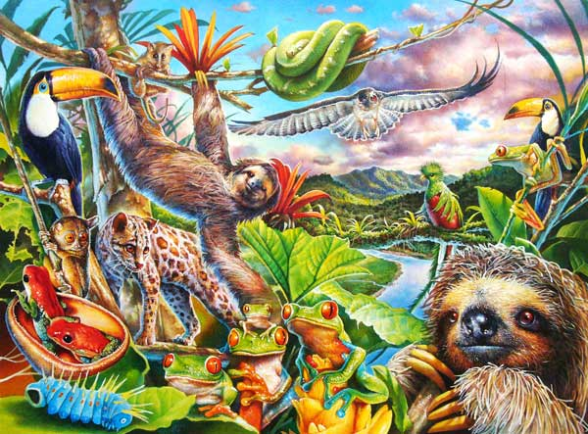
What kind of animals live in the rainforest?

Slide 9
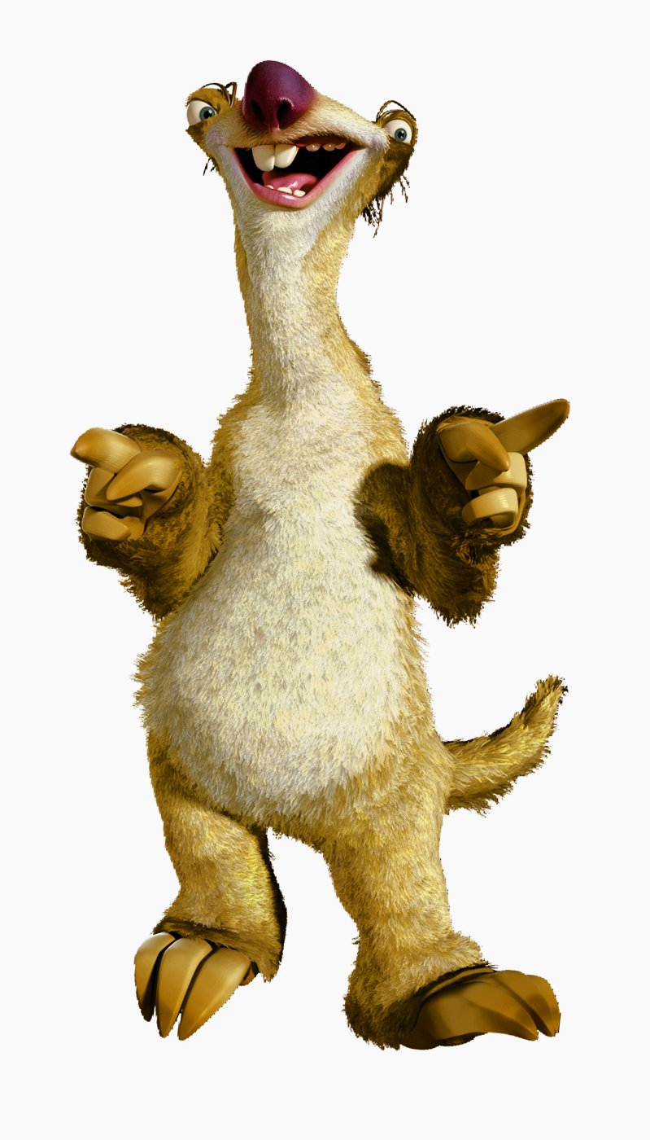
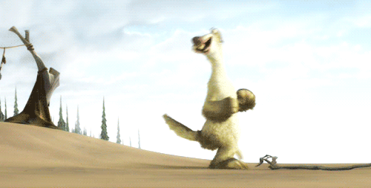
What kind of animal is Sid from Ice Age?

Slide 10
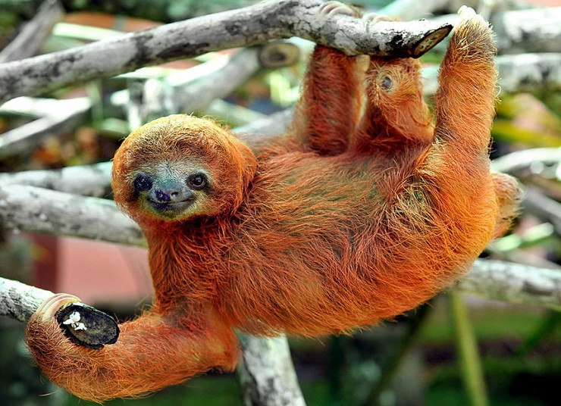
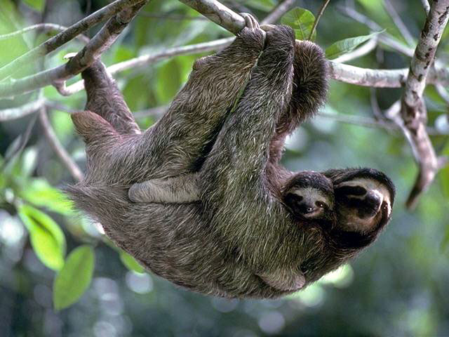
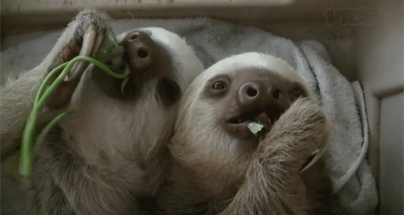
Sloth
It can live to be 30 years old
It mostly hangs upside down
It usually stays in the trees

Slide 11
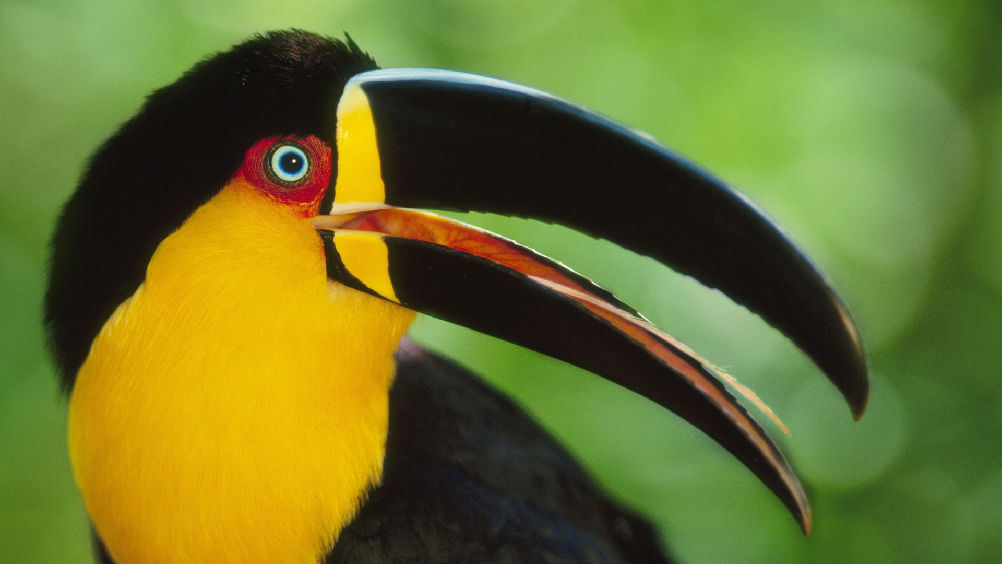
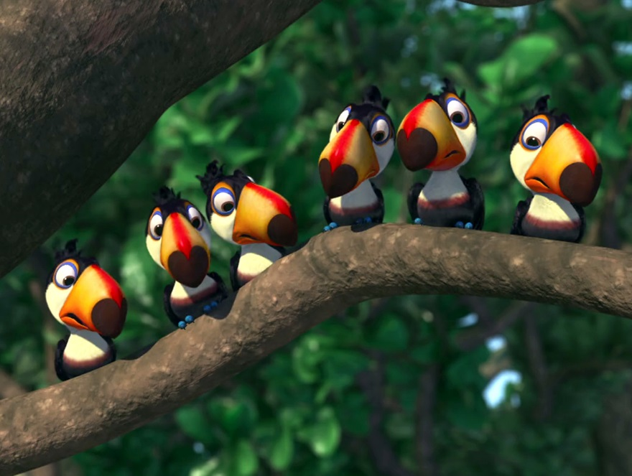
Toucan
It has a large and colorful beak (black, brown, green red, white)
There are about 40 different types of toucans

Slide 12
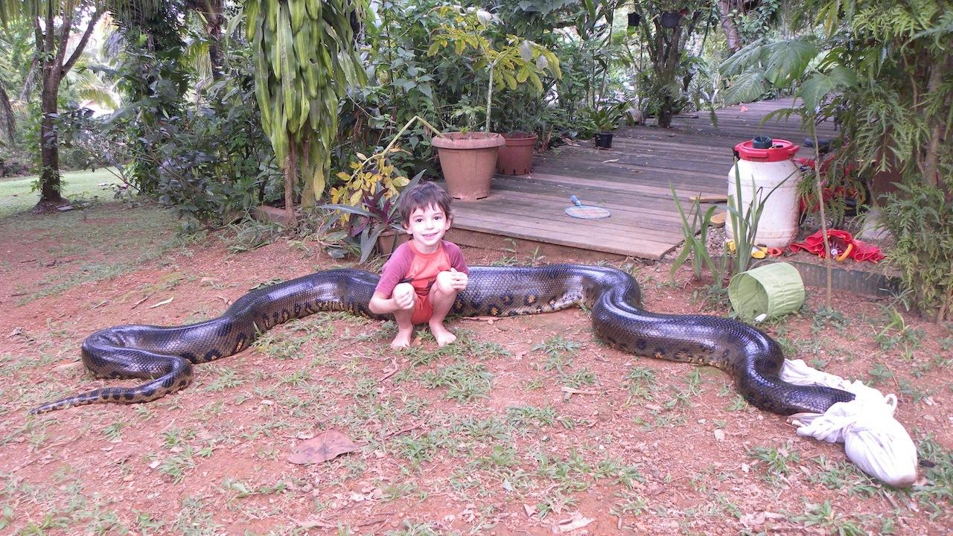
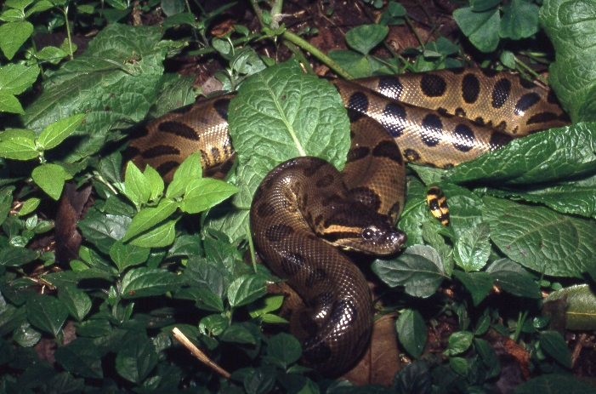
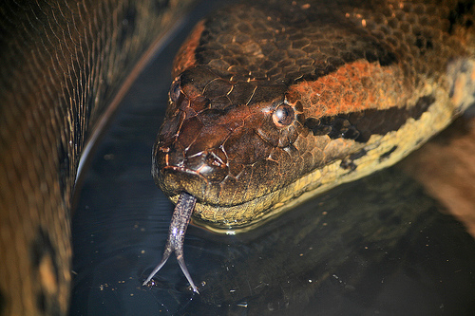
Anaconda
Biggest snake in the world
It can be 9 meters long and weigh 249 kg

Slide 13
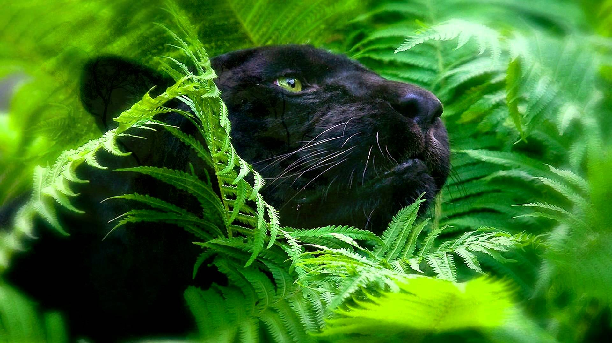
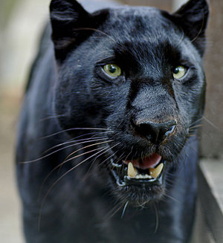
Black Jaguar
Biggest cat in South America
They are lonely animals – like to be by themselves

Slide 14
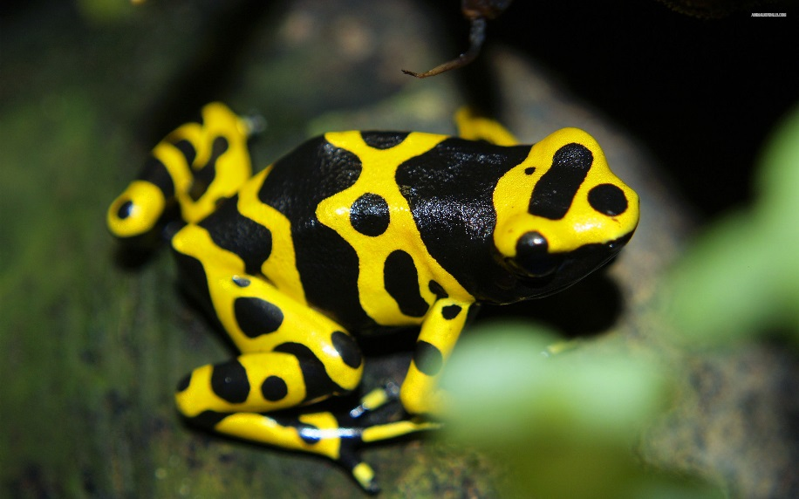
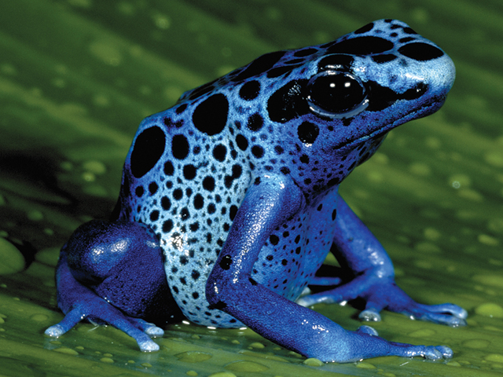
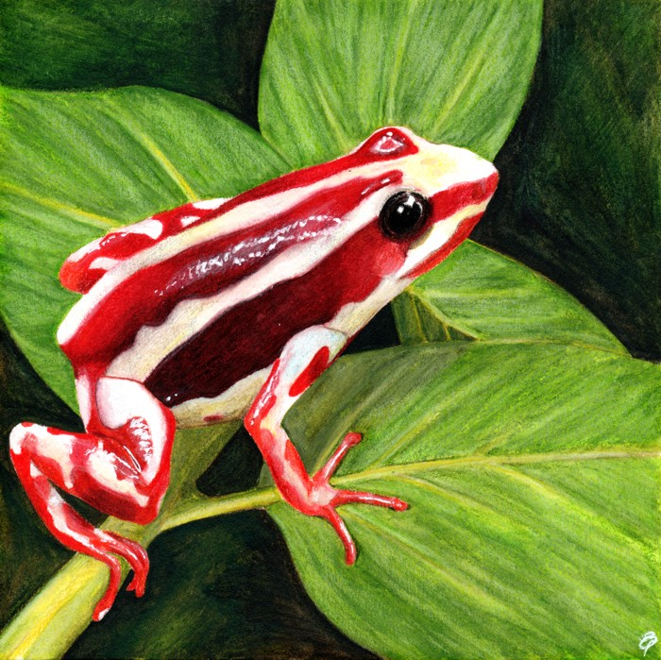
Poison Arrow Frog
Bright colored frog that has powerful poison
Size is man’s thumbnail
Its poison can kill 100 people

Slide 15
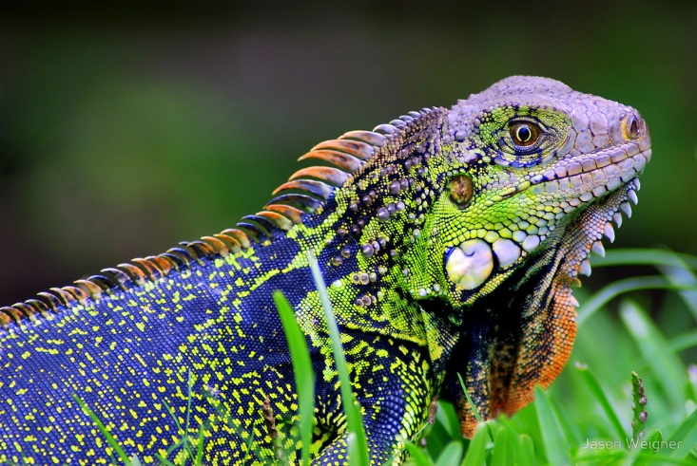
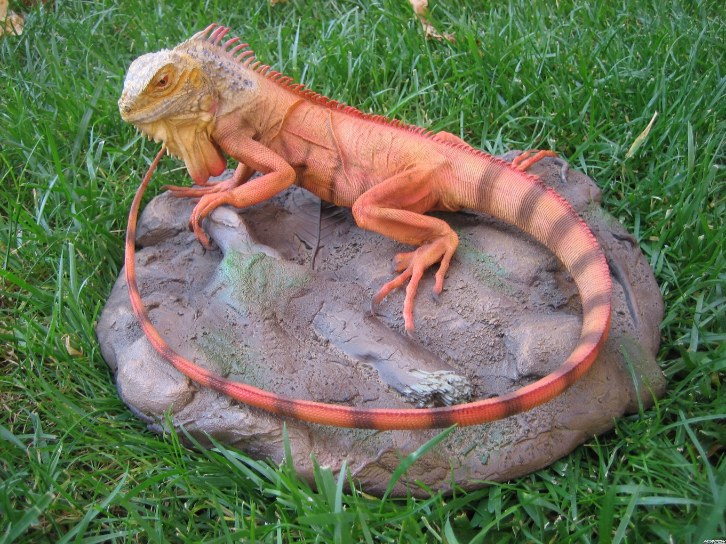
Iguana
They eat plants

Slide 16
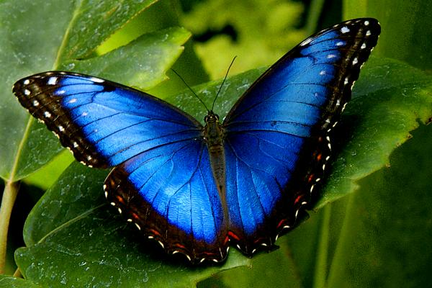
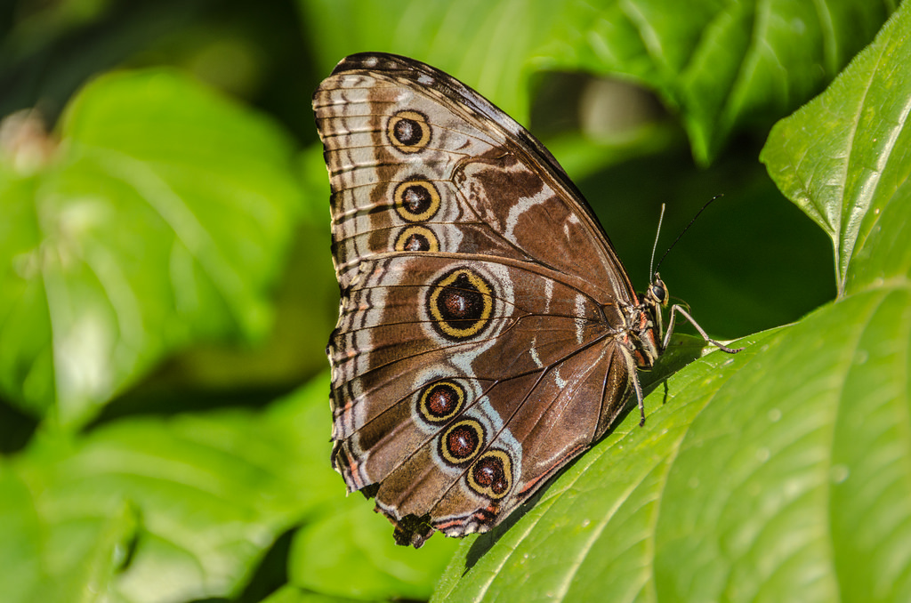
Blue Morpho Butterfly
One of largest butterflies in the world
Notes:
Underwing is brown – makes them look like they are disappearing

Slide 17
UNO CARD GAME
https://www.youtube.com/watch?v=dicgjskLVJc
Notes:
-start at 16 seconds and end at 1.12 seconds

Slide 18
Questions about UNO Game?
Play in groups of 4-6 people
Match cards based on color or animal on card
Special Cards:
Skip
Reverse
+2
Wild
When you have one card left, say UNO! If you don’t say UNO, and someone else says “UNO!” you have to draw 2 more cards
Let’s play!
https://www.youtube.com/watch?v=dicgjskLVJc

Slide 19
Key Question: What continent is Brazil located?
South America!
Notes:
If students answer it right, give them a mark on their passport!

Slide 20
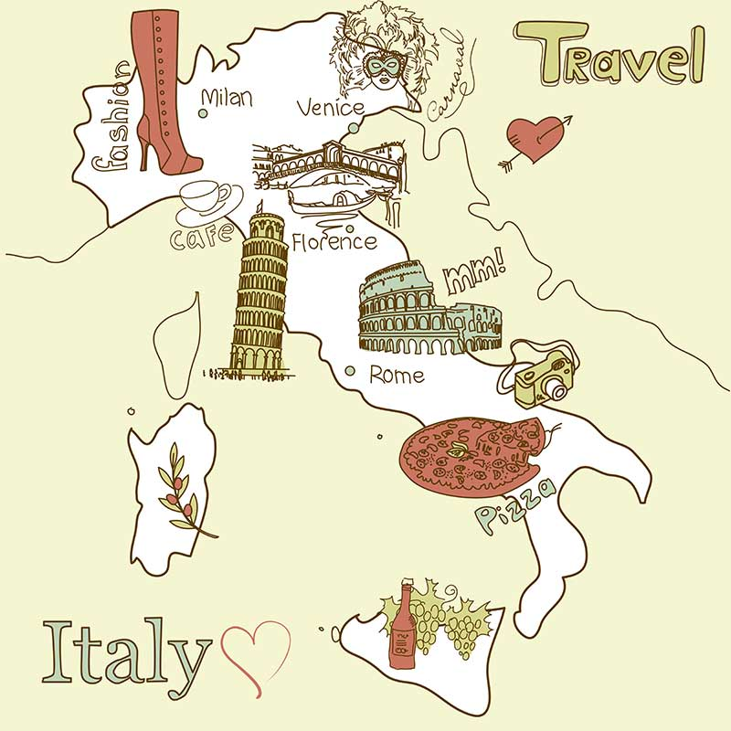
See you tomorrow.
We are going to Italy! ☺

