Slide 1
Hanukkah!

Slide 2
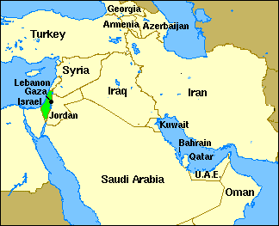
Judaism
Judaism = 유태교
It is a religion (종교)
Many Jewish people (유태인) live in Israel (이스라엘).

Slide 3
Hanukkah!
חֲנֻכָּה
Hanukkah is one of the most important celebrations in the Jewish calendar.
It means the Festival of Lights.
It is an 8-day holiday that takes place each year in November or December.
It is celebrated on the 25th of Kislev (Jewish calendar month)

Slide 4
The Story of Hanukkah
http://www.youtube.com/watch?v=7tws_uMAEOs&index=8&list=PLyHmk9V_f3w5nF6aJYT47GZXEJu7TZOjH
What happens in the story?
Why do we celebrate?
Also: Hanukkah Sesame Street: http://www.youtube.com/watch?v=3VfChLAADS8

Slide 5
Hanukkah is about Miracles
Hanukkah celebrates TWO miracles (기적)
Miracle 1:
The Jews defeated the Greeks, even though there were a LOT of Greeks and very few Jews.
Miracle 2:
The Greeks destroyed the Temple of the Jews. There was a light that was supposed to be eternal (forever). But there was only enough oil for one day. However, the oil lasted for 8 days!

Slide 6
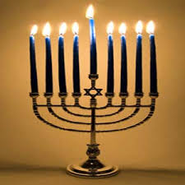
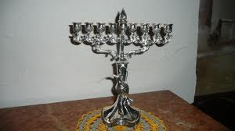
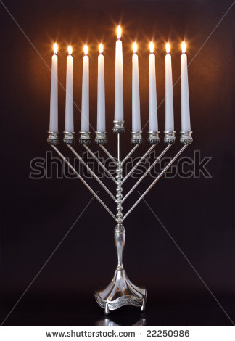
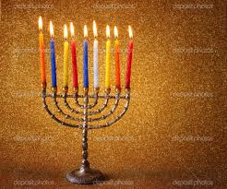
Menorah
http://www.reformjudaism.org/light-virtual-hanukkiyah-menorah
Notes:
Light the virtual menorah! http://www.reformjudaism.org/light-virtual-hanukkiyah-menorah

Slide 7
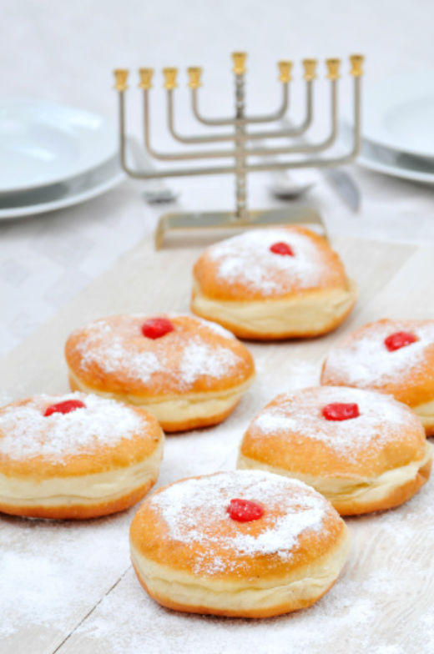
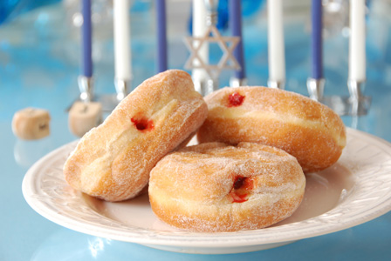
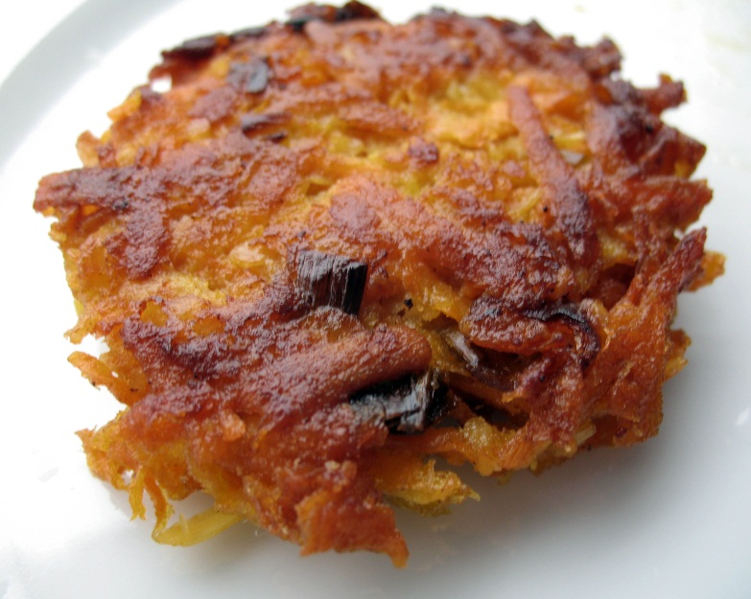
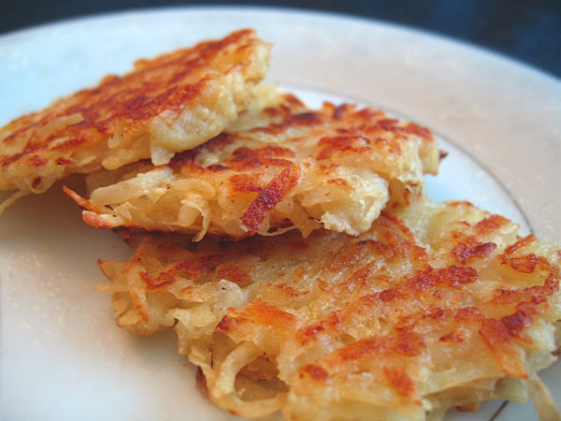
Food
Jelly Donuts
Latkes
= Potato Jeon
Notes:
Explain that we eat these foods because they are made with oil, and this holiday celebrates oil!

Slide 8
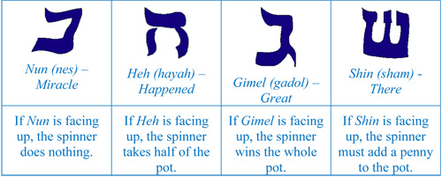
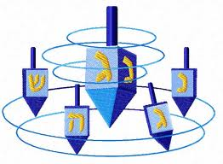
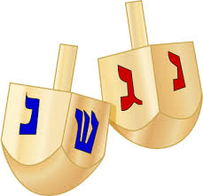
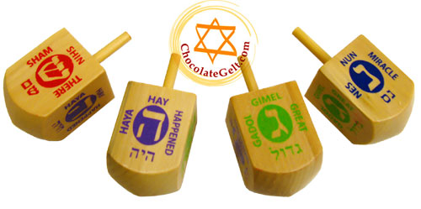
Dreidle
Chanukah game

Slide 9
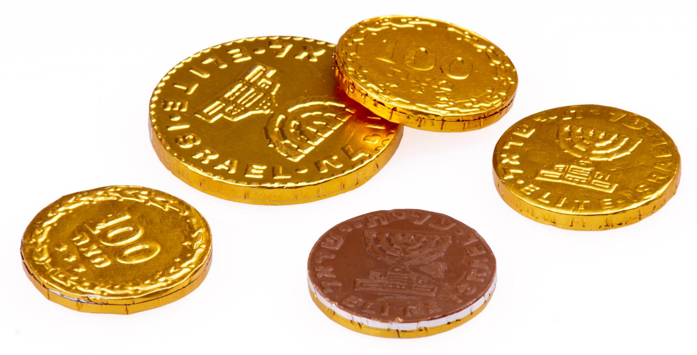
Hanukkah Gelt
http://www.eslholidaylessons.com/12/hanukkah.html

Slide 10
Hanukkah Songs
Svivon Sov Sov Sov (kids chorus): http://www.youtube.com/watch?v=ibMSJZUt1n8
Hanukkah, Oh Hanukkah (Glee): http://www.youtube.com/watch?v=XTokUy48Da8
Maoz Tzur (acapella group): http://www.youtube.com/watch?v=Lb_CbuhLi2Q
Maoz Tzur (kids Chorus): http://www.youtube.com/watch?v=1gMTvGmpVbI
I had a little dreidel: http://www.youtube.com/watch?v=gmvs0ShU6Hg
Mi Y'malel (Kids Chorus): http://www.youtube.com/watch?v=lsY0qJduFN8
Mi Y’malel (high school choir): http://www.youtube.com/watch?v=fmiGBOqlK18
Latke song with kids (very cute): http://www.youtube.com/watch?v=OAz9Vt-_huQ
Notes:
Explain that Hanukkah is a part of American culture. Many school choirs sing Hanukkah songs even though most or all of their members may not be Jewish. PS22 probably has no Jewish members, yet they sing Hanukkah songs in Hebrew anyway. While school is not cancelled in America for Hanukkah (as it is in Israel, for 8 days), many schools still celebrate by putting up a menorah or singing Hanukkah songs at their winter concerts.

Slide 11
Modern Videos
Hanukkah Flash Mob: http://www.youtube.com/watch?v=fqEQy6l1kzc
Hanukkah Dreidl Acapella: http://www.youtube.com/watch?v=DtlLHwk9_Rw
Eight Nights Hanukkah Mash-up: http://www.youtube.com/watch?v=WAbTDHblxFM
Maccabeats Burn: http://www.youtube.com/watch?v=vbec3WSPanw
Maccabeats Candlelight: http://www.youtube.com/watch?v=qSJCSR4MuhU
Notes:
This is a collection of cool songs about Hanukkah. Some are popular songs with lyrics changed to be about Hanukkah.

