Slide 1
Merry christmas everyone!
Today is monday, december 12th

Slide 2
Today’s class
Sticker games (next lesson = sticker market!)
Christmas Ornaments
Music

Slide 3

Sticker Games

Slide 4
REAL OR FAKE?
American Christmas Food
Stand up
Vote: real or fake
Wrong: sit down

Slide 5
잔실
거짓된
REAL OR FAKE?
American Christmas Food
Stand up
Vote: real or fake
Wrong: sit down

Slide 6
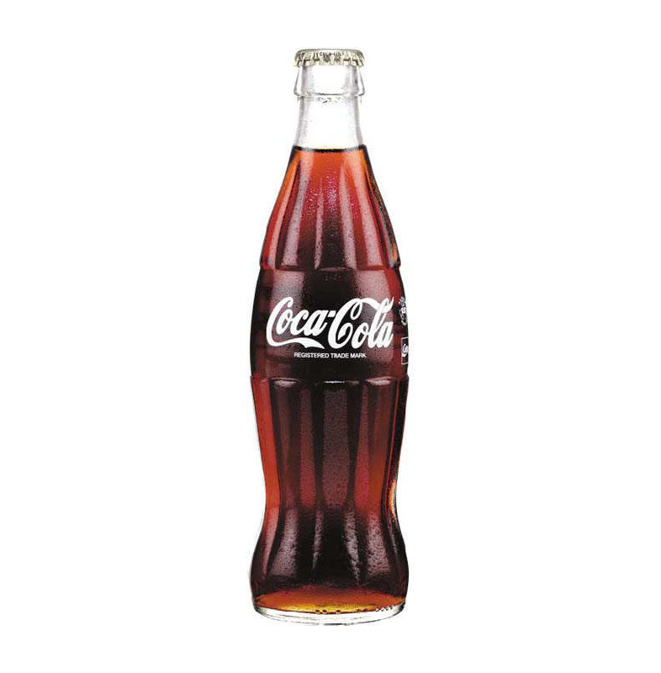
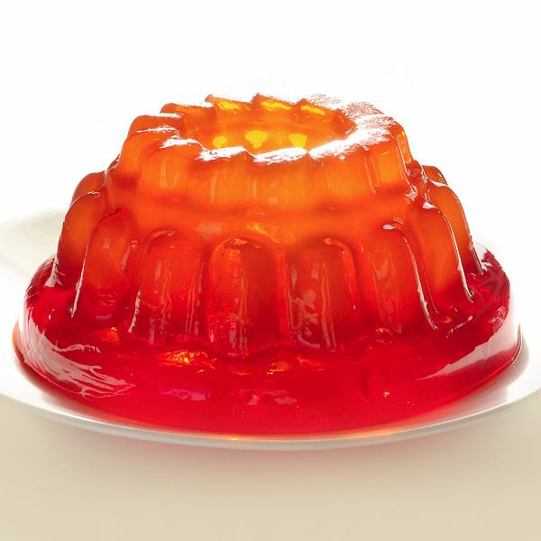
REAL OR FAKE?
Coke Salad: coke + jelly

Slide 7
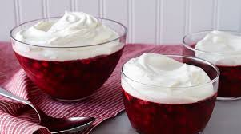
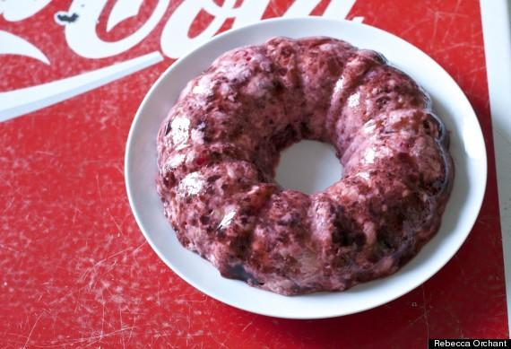
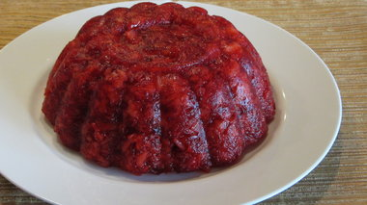
REAL OR FAKE?
Coke Salad = REAL

Slide 8
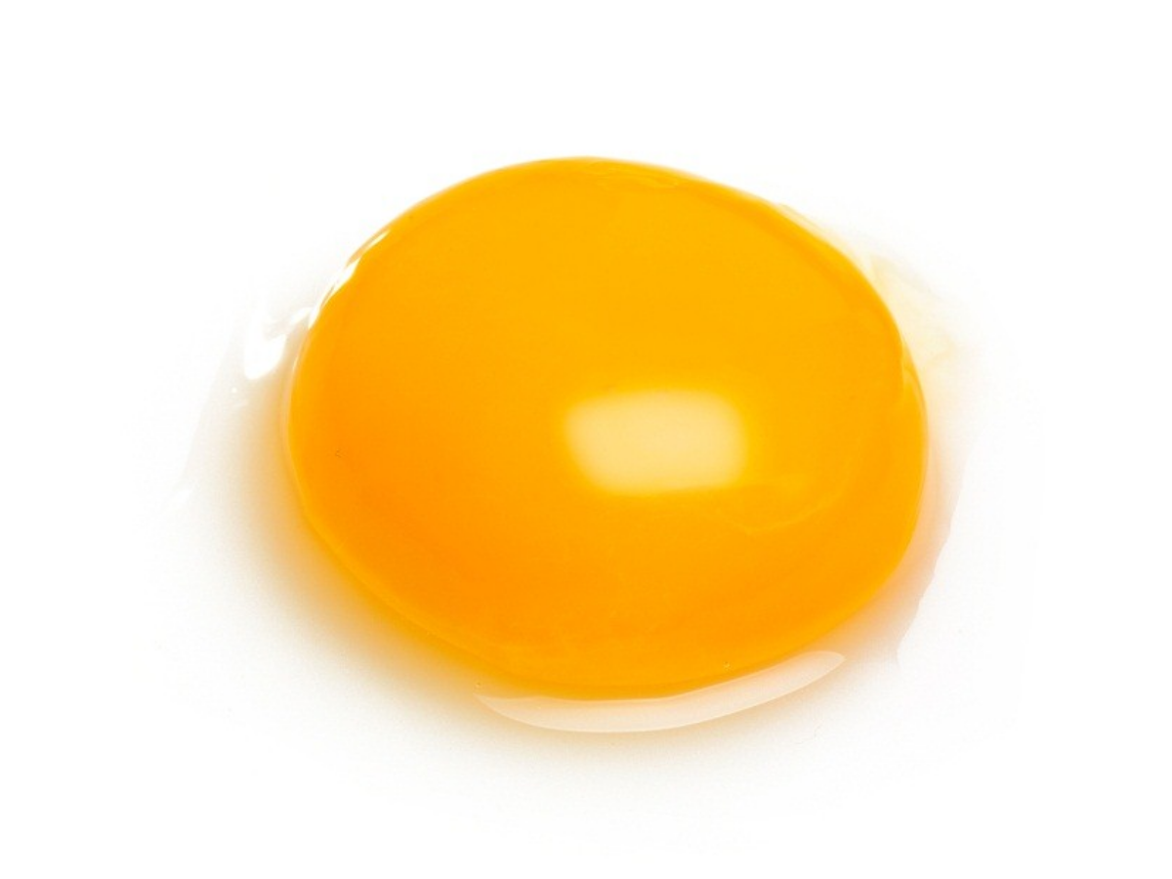
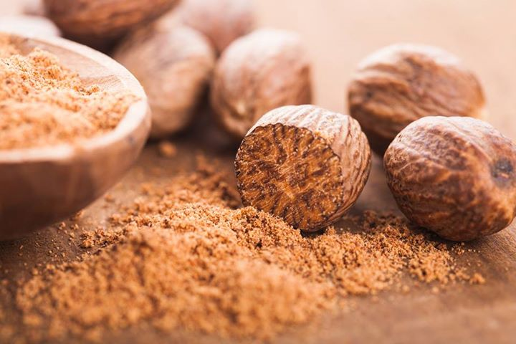
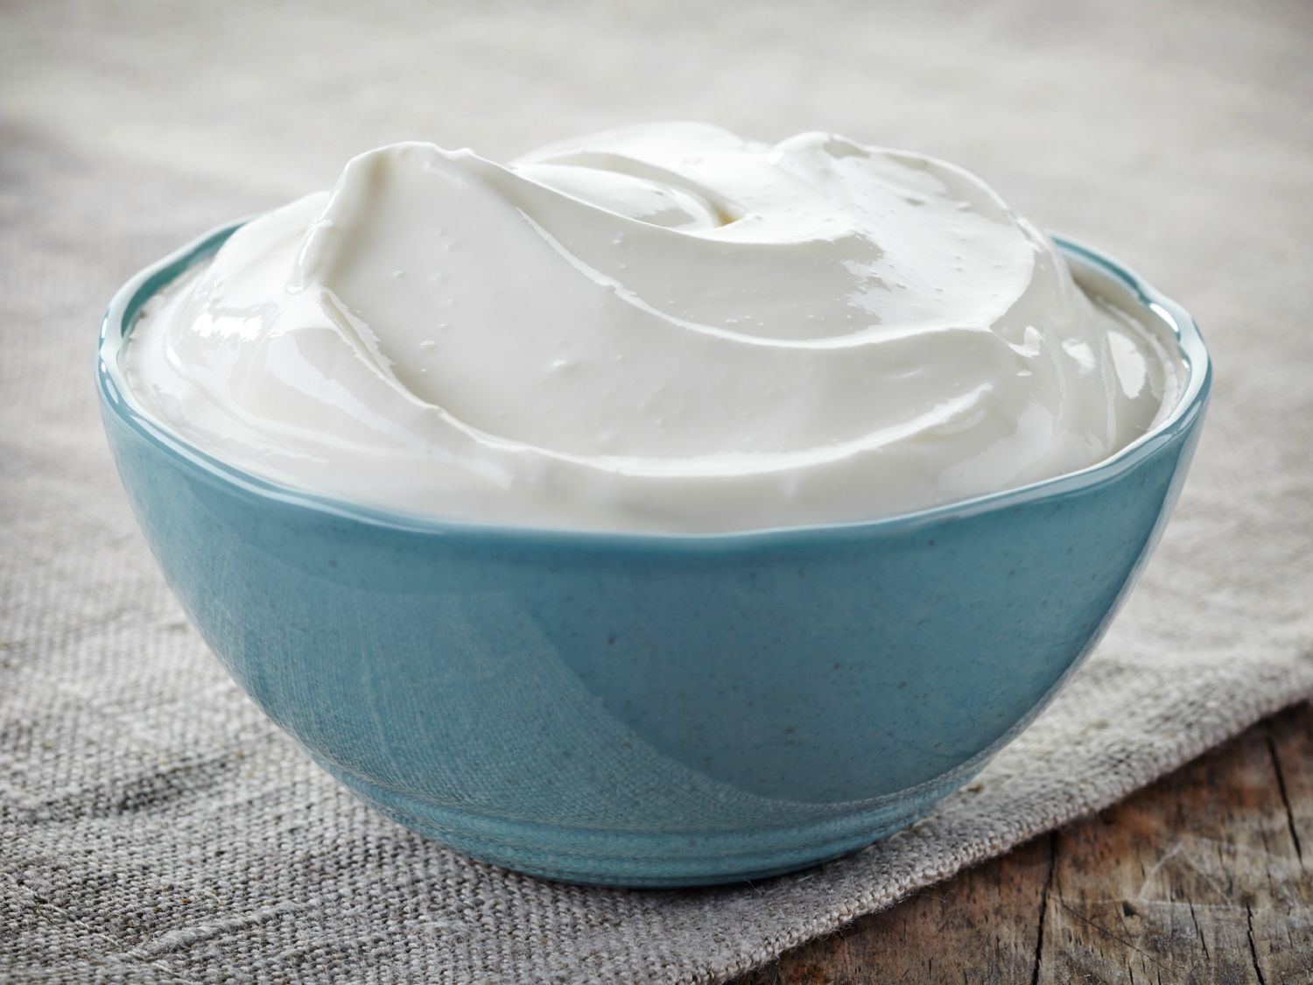
REAL OR FAKE?
Egg nog: egg yolk + nutmeg + cream

Slide 9
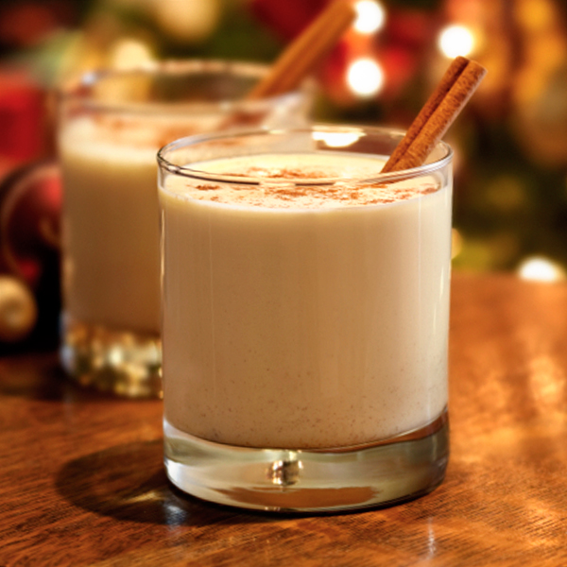
REAL OR FAKE?
Egg nog = REAL

Slide 10
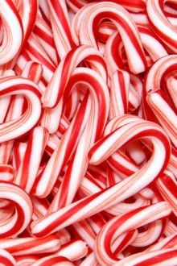
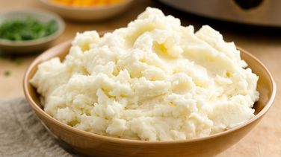
REAL OR FAKE?
Candy Mash = candy canes + mashed potatoes

Slide 11
REAL OR FAKE?
Candy Mash = FAKE

Slide 12
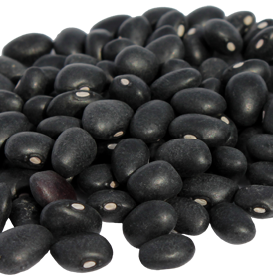
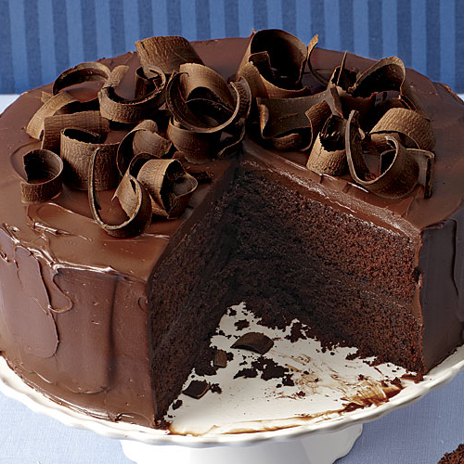
REAL OR FAKE?
Black Cake: black beans + cake

Slide 13
REAL OR FAKE?
Black Cake = FAKE

Slide 14
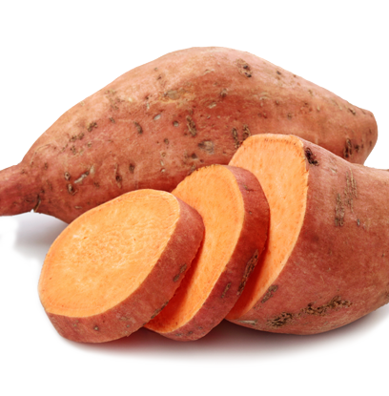
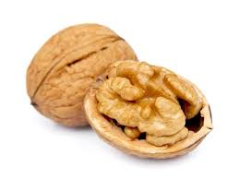
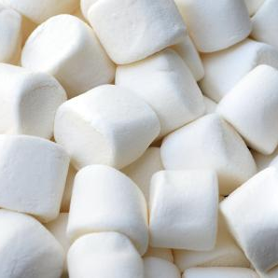
REAL OR FAKE?
Sweet Potato Casserole: sweet potato + walnut + marshmallow

Slide 15
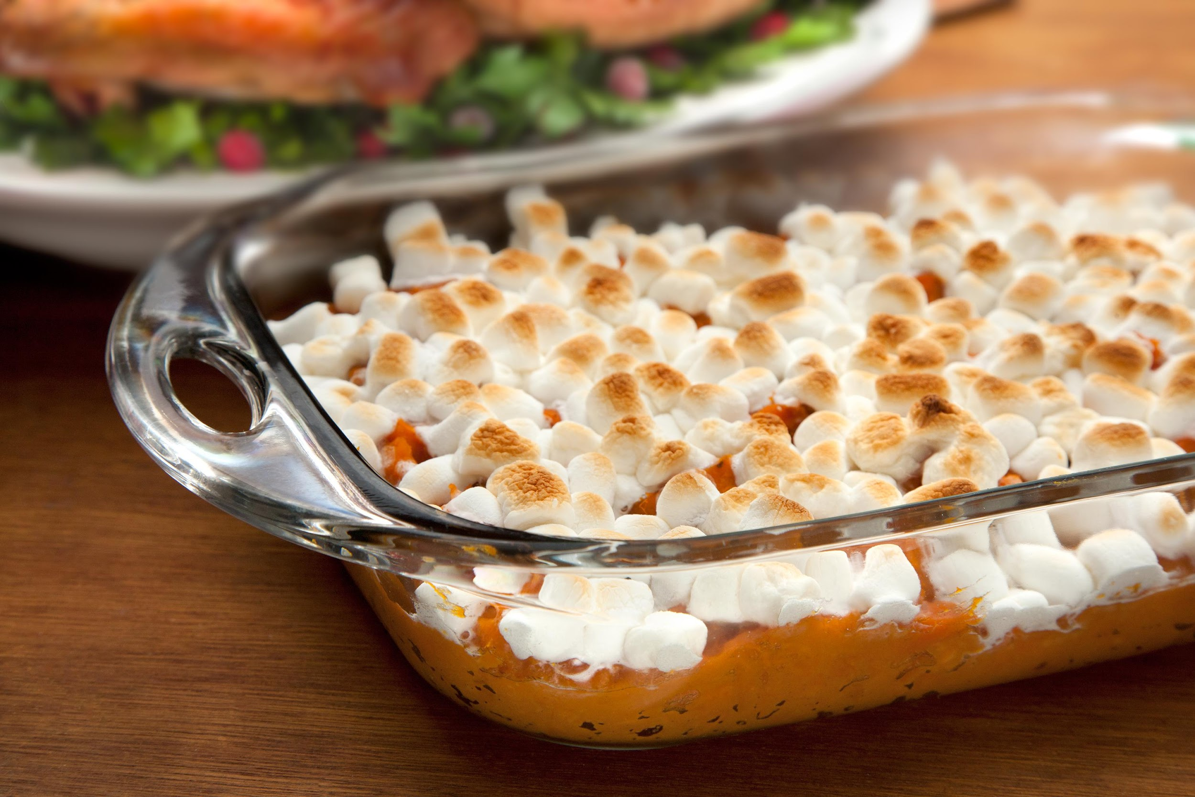
REAL OR FAKE?
Sweet Potato Casserole: REAL

Slide 16
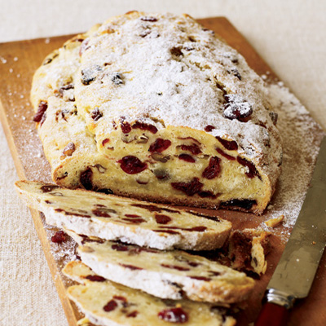
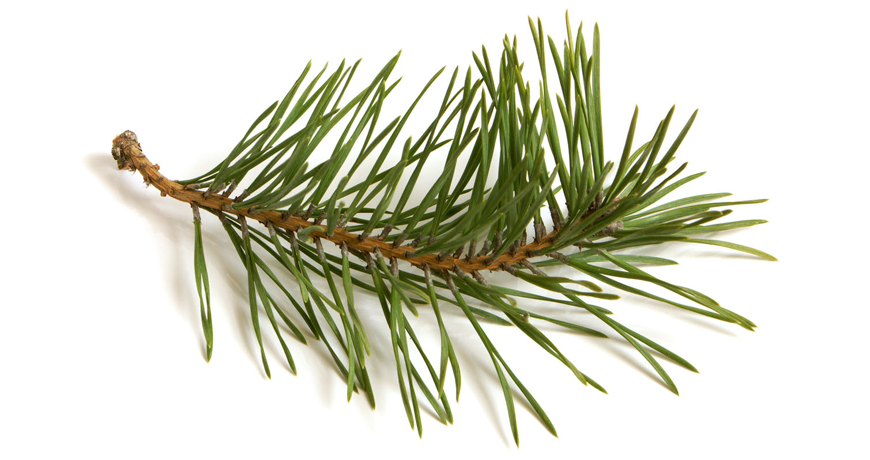
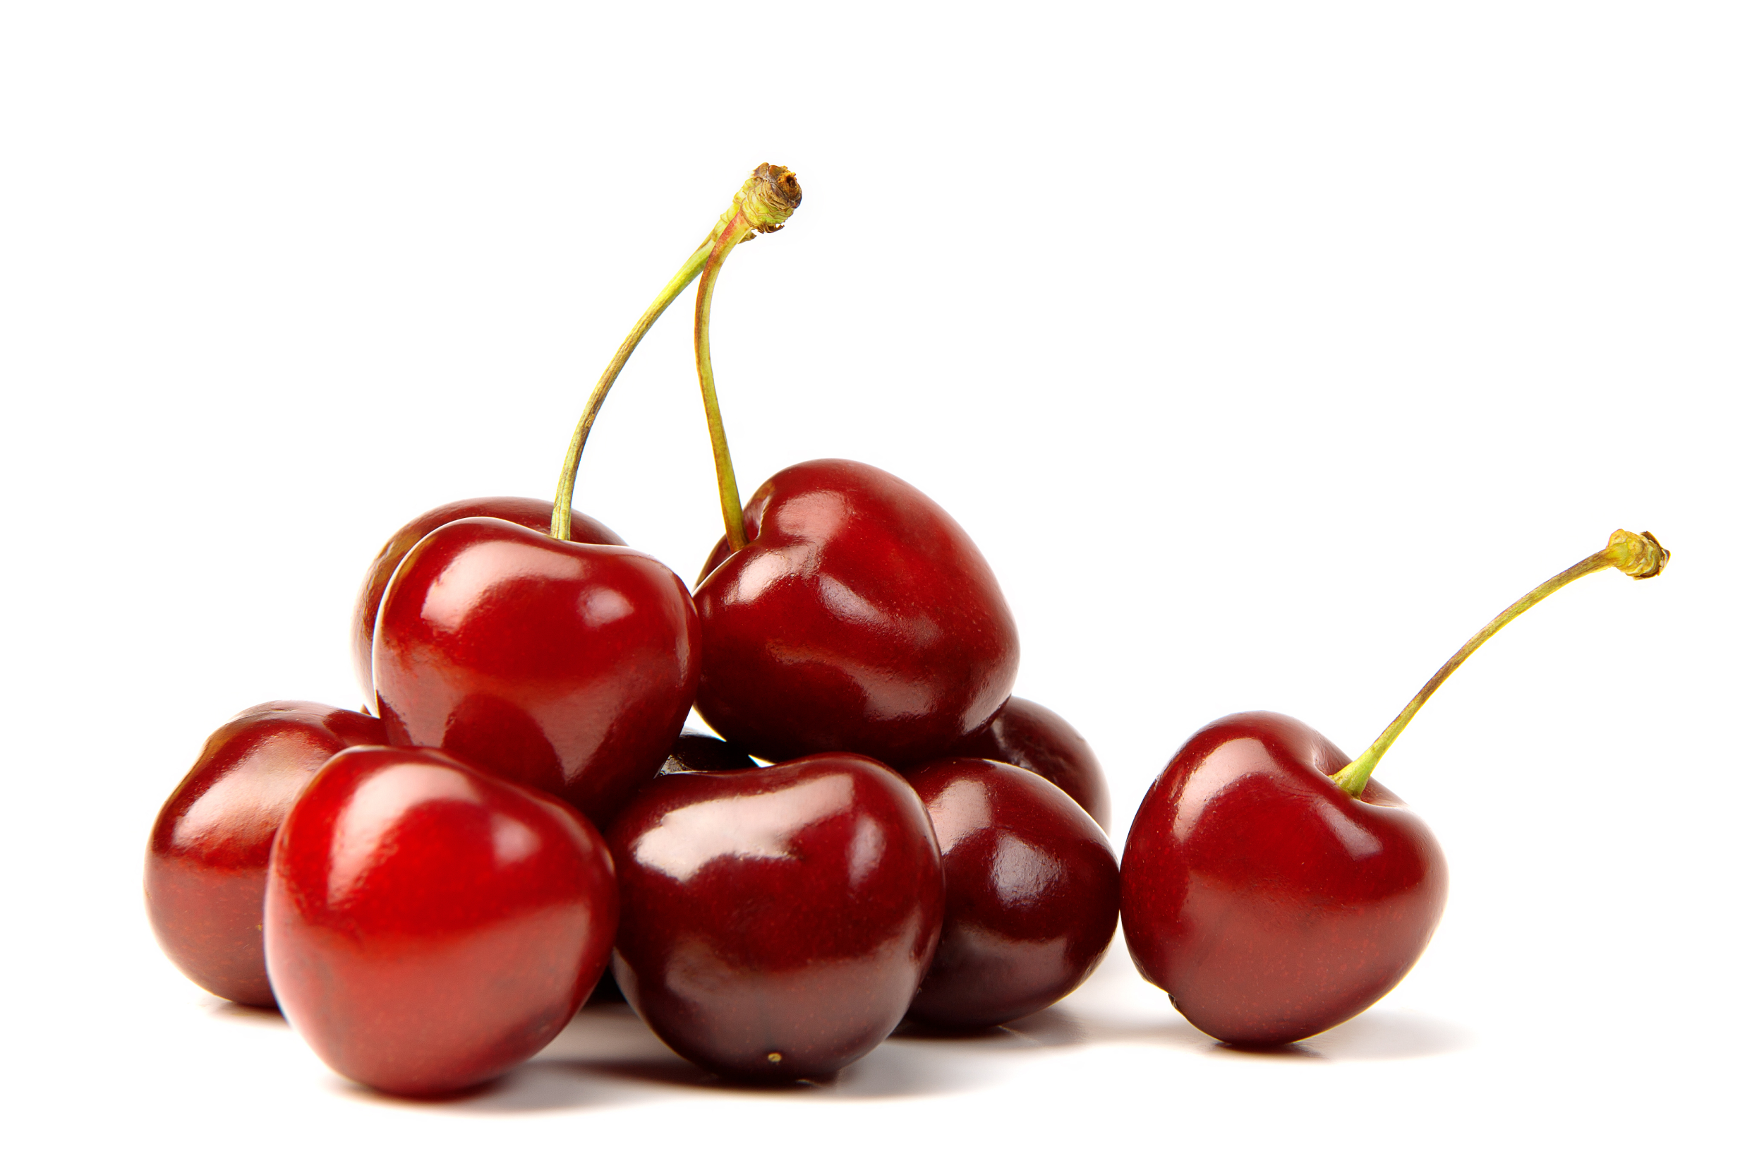
REAL OR FAKE?
Sprucestein: pine needles + cherries + bread

Slide 17
REAL OR FAKE?
Sprucestein: pine needles + cherries + bread

Slide 18
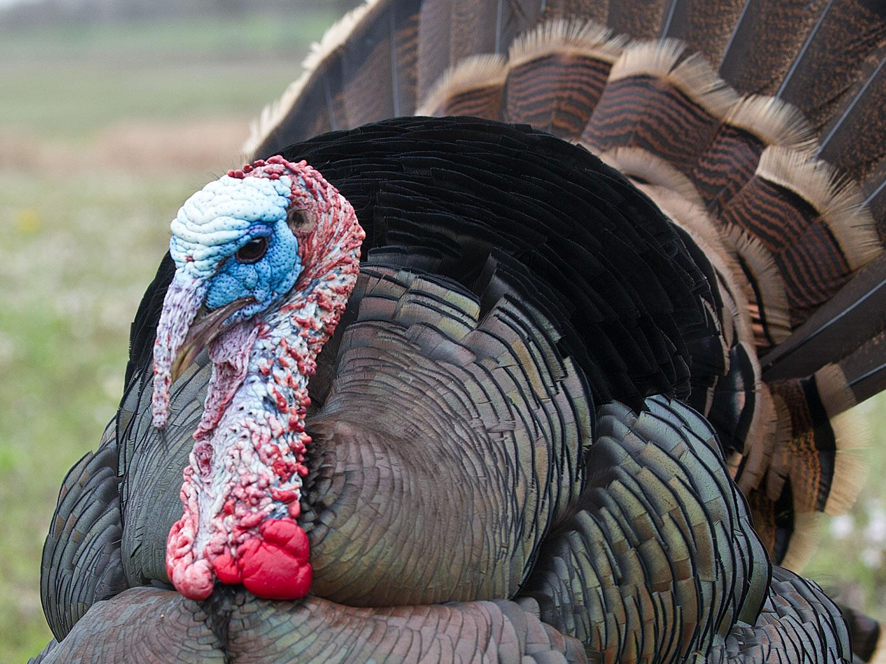
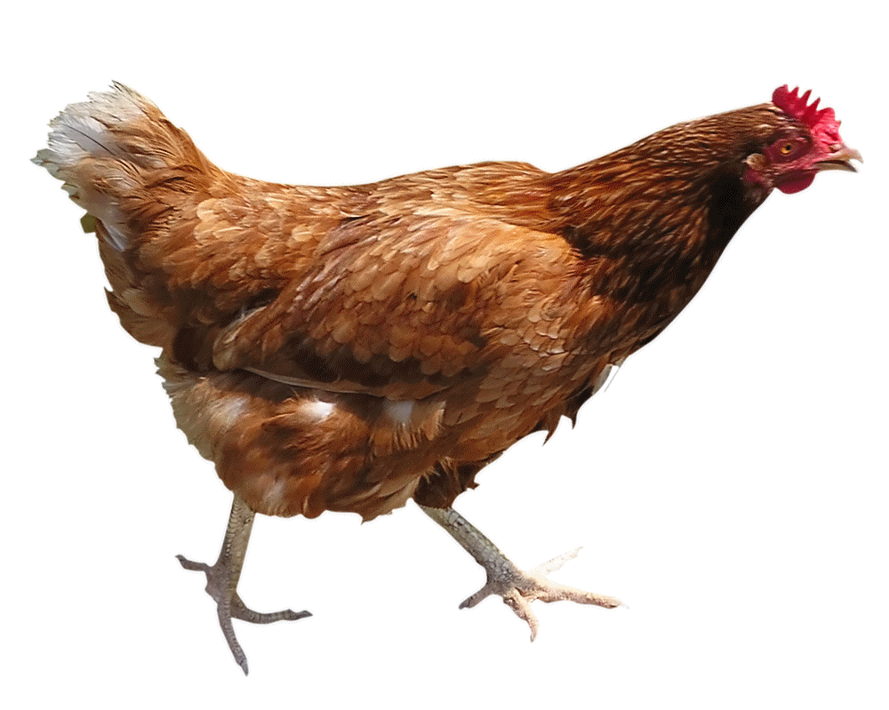
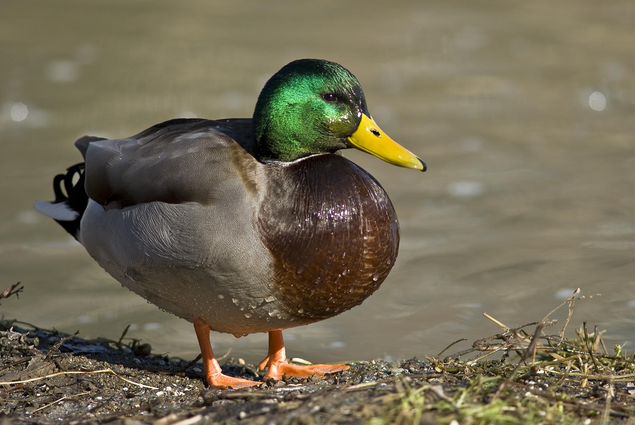
REAL OR FAKE?
Turduken: chicken, inside a duck, inside a turkey

Slide 19
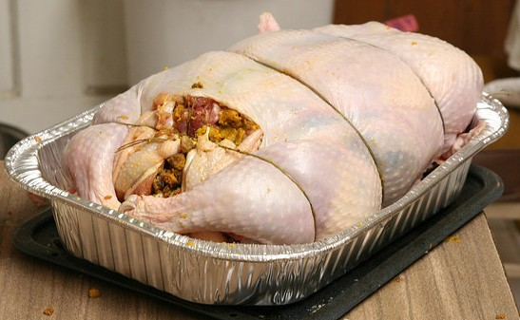
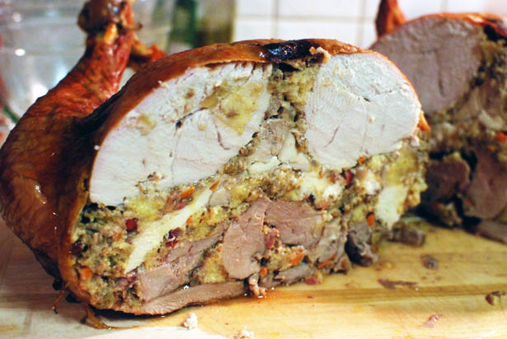
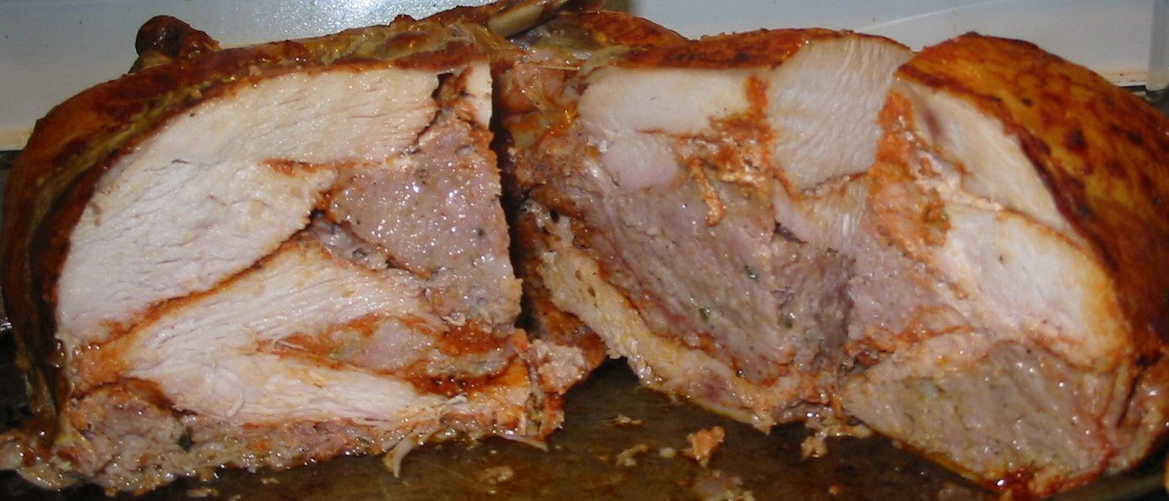
REAL OR FAKE?
Turduken: REAL

Slide 20
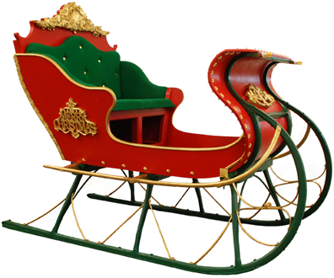
1.
What is this?

Slide 21
1.
sleigh

Slide 22

2.
What is this?

Slide 23
2.
snowflake

Slide 24

3.
What is this?

Slide 25
3.
wreath

Slide 26

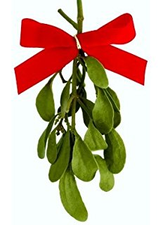
4.
What do people do under mistletoe?

Slide 27
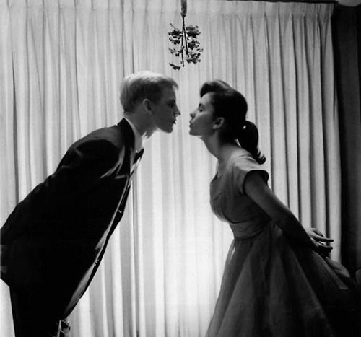
4.
KISS

Slide 28
5.
Picture
10 seconds
Notice (알아채다) as many things as you can

Slide 29

4.
Picture
10 seconds
Notice as many things as you can

Slide 30
4.
Question:
How many stars were on the wall?

Slide 31
5.
True or false:
Was there a cat?

Slide 32
6.
Write as many Christmas things as you saw.

Slide 33
Ornaments

Slide 34
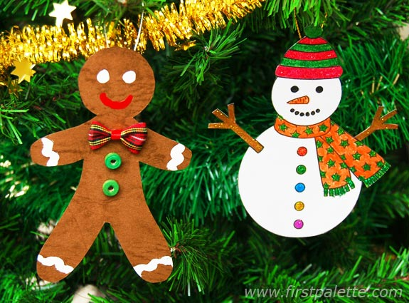
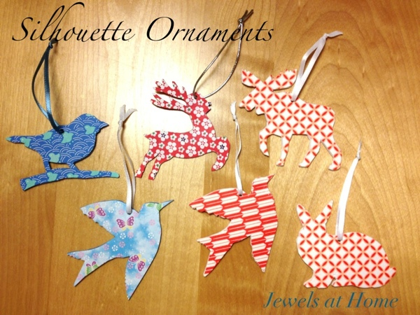
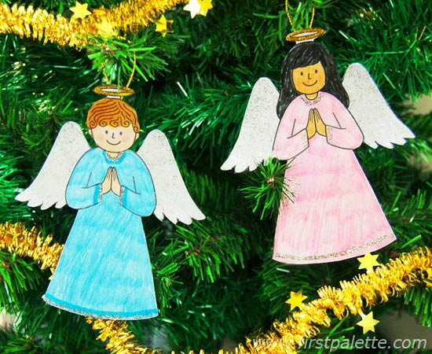
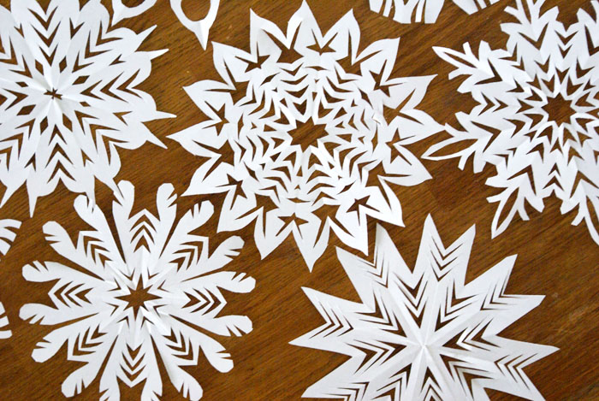


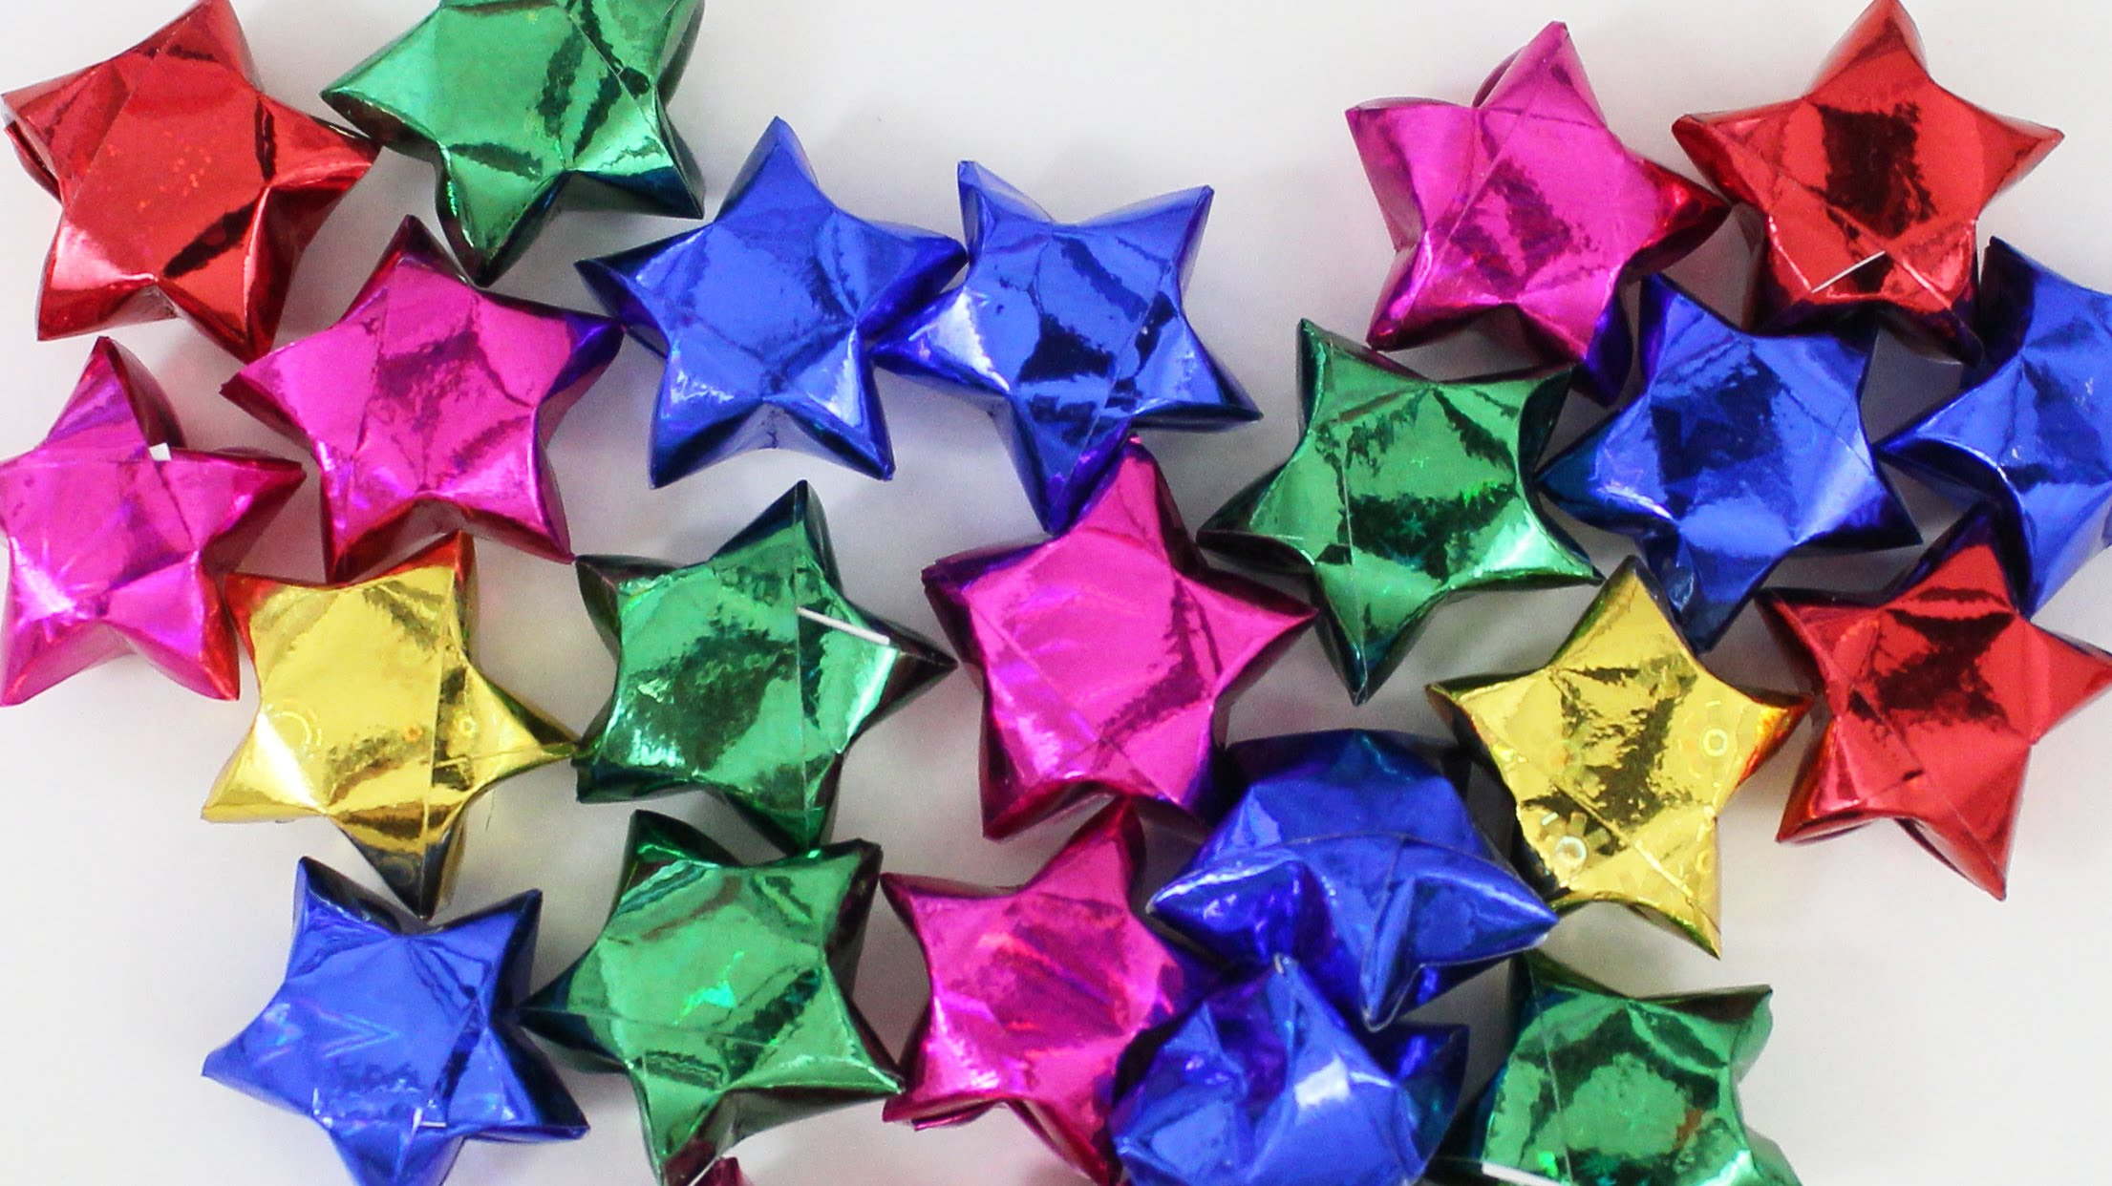
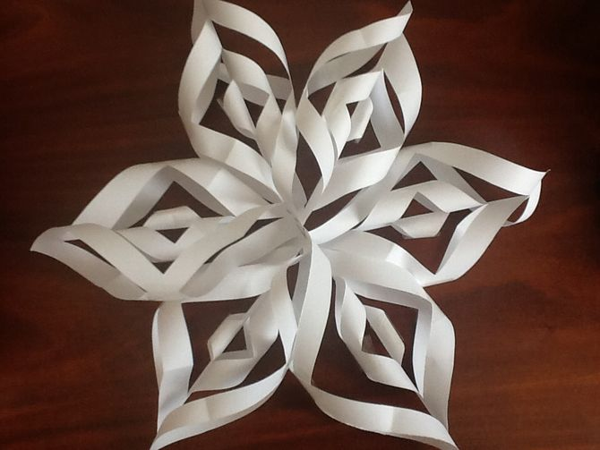
Ornaments

Slide 35
easy
Ornaments
medium
hard

Slide 36
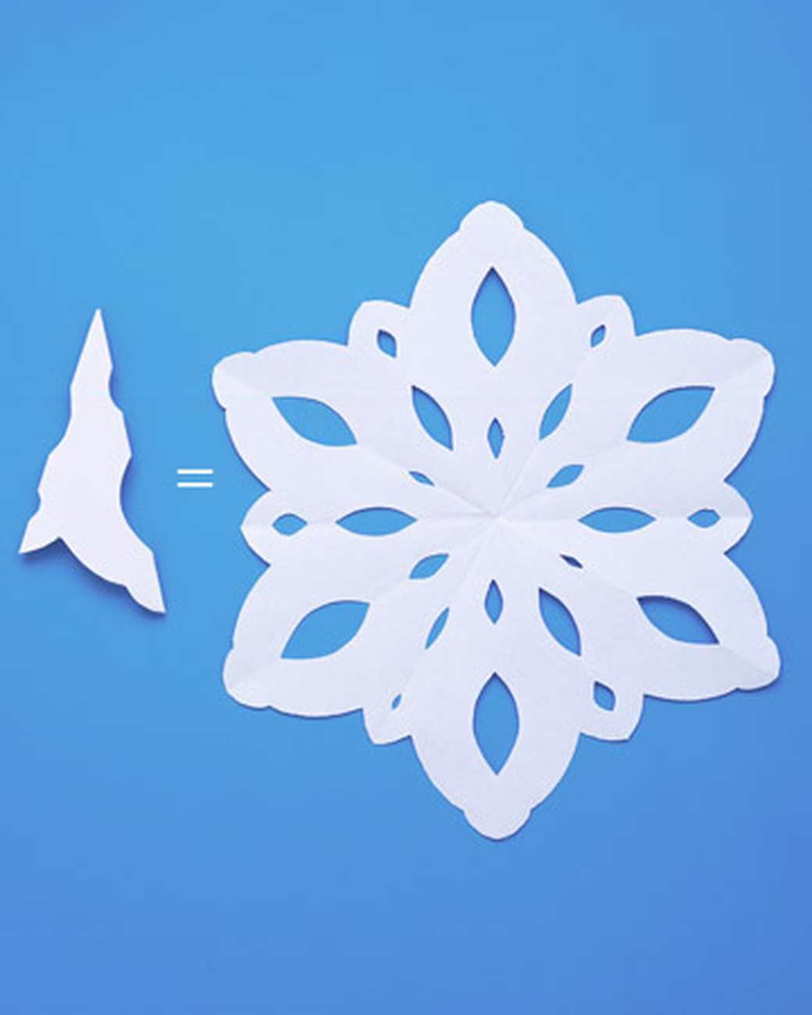
EASY
back
Cut a shape
Color
Hang up!

Slide 37

medium
back
Cut strips
Tape
Hang up!

Slide 38

hard
back
uhttps://www.youtube.com/watch?v=FDDvYwb-D44
http://www.wikihow.com/Make-a-3D-Paper-Snowflake

Slide 39
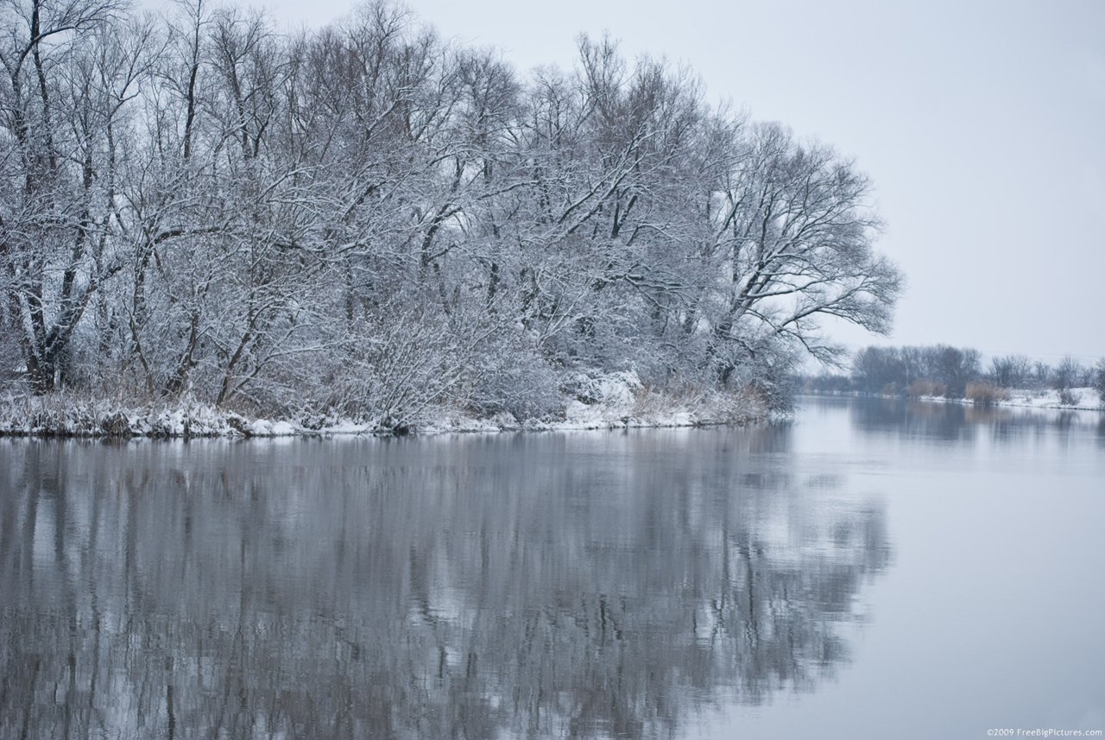
Music
https://www.youtube.com/watch?v=-eqJwRkDsSw (Beyonce)
https://www.youtube.com/watch?v=nAI_xI9wQnE (Justin Bieber)
https://www.youtube.com/watch?v=pFjdfjrtf1Q (Pentatonix Christmas to Me)
https://www.youtube.com/watch?v=C-c7S56HvBg (Maroon 5)
https://www.youtube.com/watch?v=rnEqv8WcVq8 (Sam Smith)
https://www.youtube.com/watch?v=PrLoWt2tfqg (Angels We Have Heard on)
https://www.youtube.com/watch?v=shZafPmUVPg (fails)
Let’s start with the first set of slides

Slide 40
To the extent possible under law, http://www.slidescarnival.com has waived all copyright and related or neighboring rights to these Christmas Icons.

