Slide 1

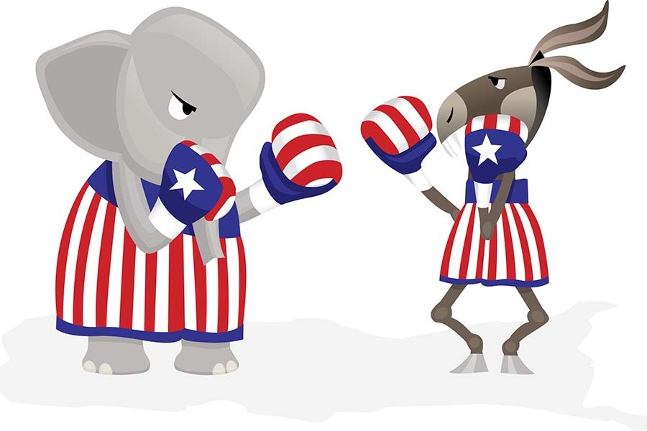
Election Day

Slide 2
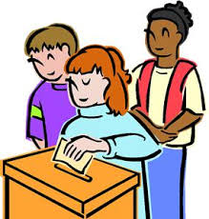
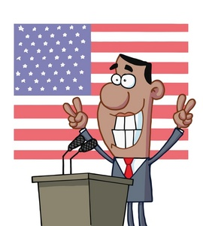
November 8th is Election Day in America.
Americans will vote for the next President.

Slide 3

The Presidential Election is every _______ years.
Two
B. Four
C. Eight
D. 100

Slide 4

What about Korea?

Slide 5
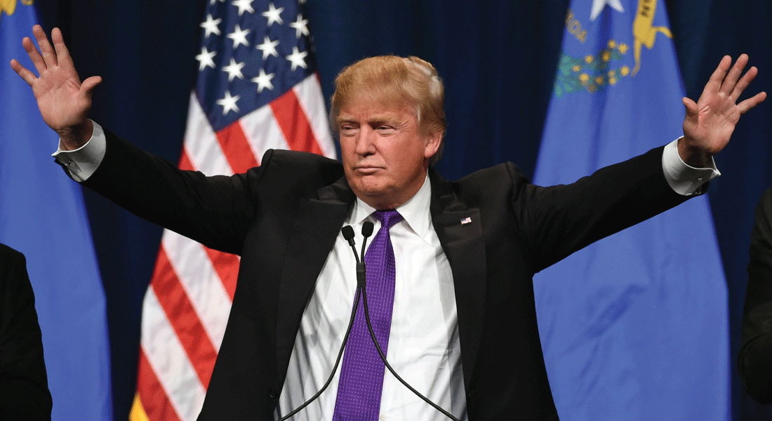
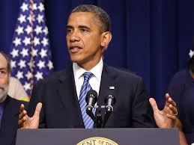
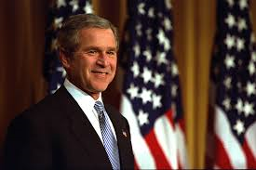
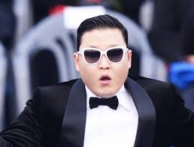
Who is the current U.S. President?
Donald Trump
B. Barack Obama
C. George W. Bush
D. PSY

Slide 6
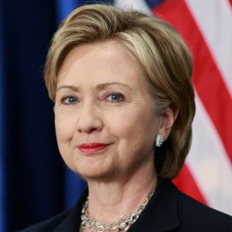
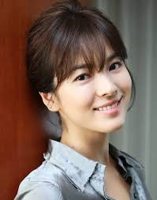
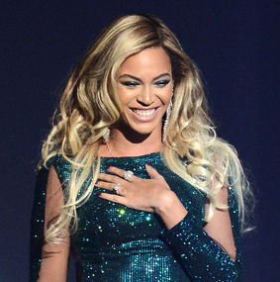
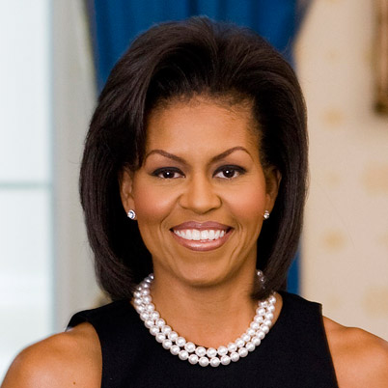
Who is President Obama’s wife?
Hillary
B. Song Hye Gyo
C. Beyonce
D. Michelle

Slide 7
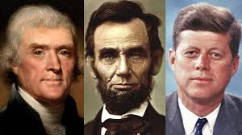
Do you know any other American presidents?

Slide 8

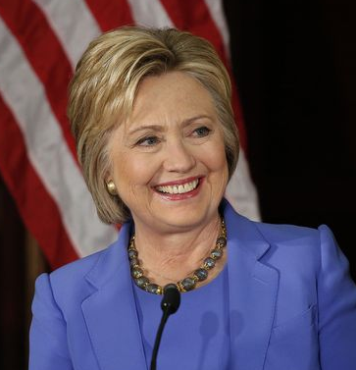
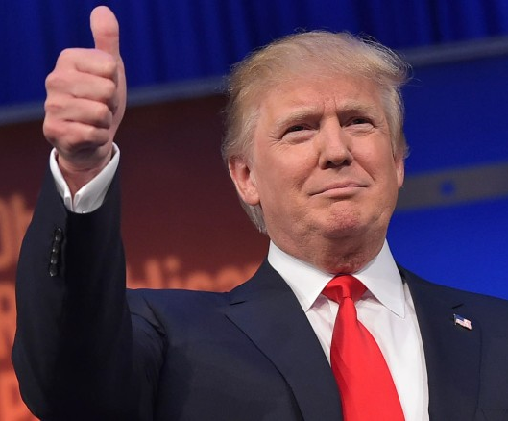
This year, the main candidates for president are:
Hillary Clinton
Donald Trump

Slide 9
Hillary Clinton
Political Party: Democratic
Hometown: Chicago
Job: Politician
One thing she wants to do as President:
Improve healthcare
People like her because:
She has 30 years of experience in politics.
People don’t like her because:
She used her personal email for government information.

Slide 10
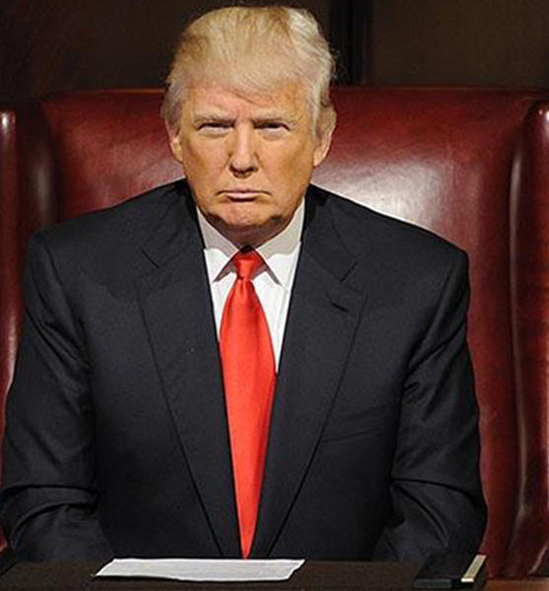
Donald Trump
Political Party: Republican
Hometown: New York City
Job: Businessman
One thing he wants to do as President:
Build a wall between Mexico and the United States.
People like him because:
He wants to defeat ISIS.
People don’t like him because:
He speaks rudely.

Slide 11
What would you do as President?
(In the United States or Korea)
I would fight for…
I would help…
I would make a law for…
I would ____________ everyday.

Slide 12
Let’s vote for President!
Hillary Clinton
Donald Trump

Slide 13
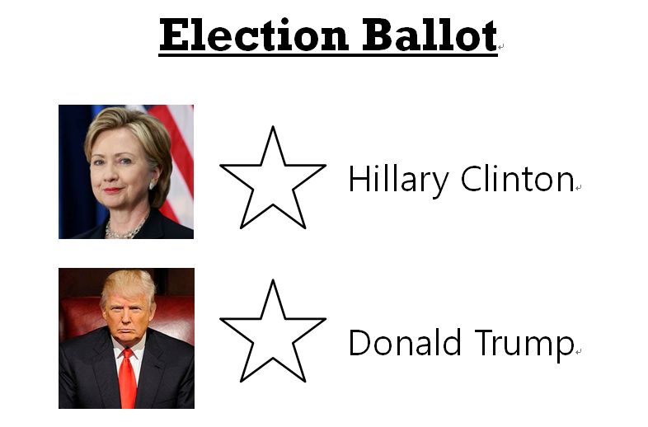
Color one star to vote!

