Slide 1
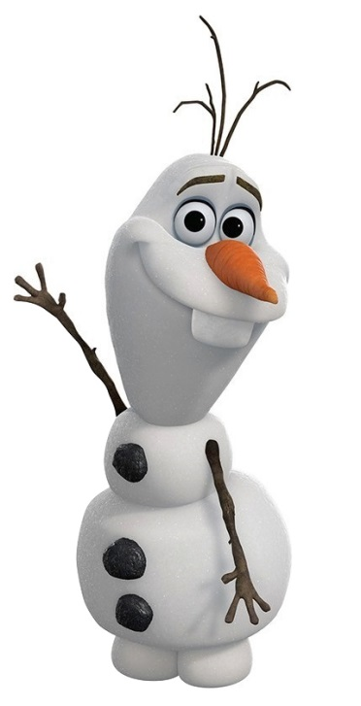
Do You Want to Build a
Snowman?
Making Excuses

Slide 2
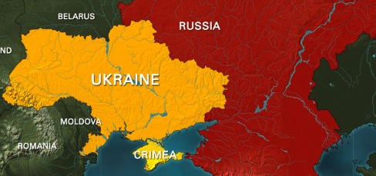
News Stories: Crimea

Slide 3
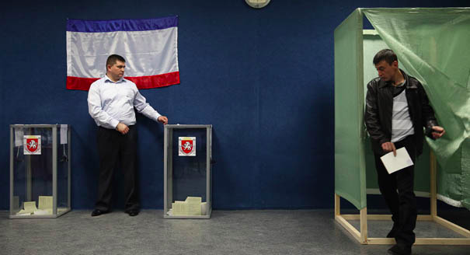
97% of people in Crimea voted to leave Ukraine.
US and EU said vote was illegal (불법).
Crimea will become part of Russia.

Slide 4
Idiom of the Day
“Let it go.”

Slide 5
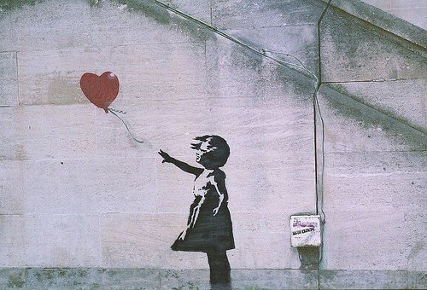
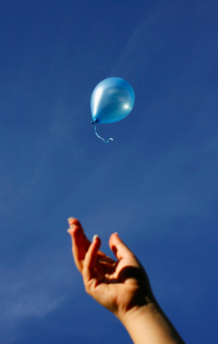
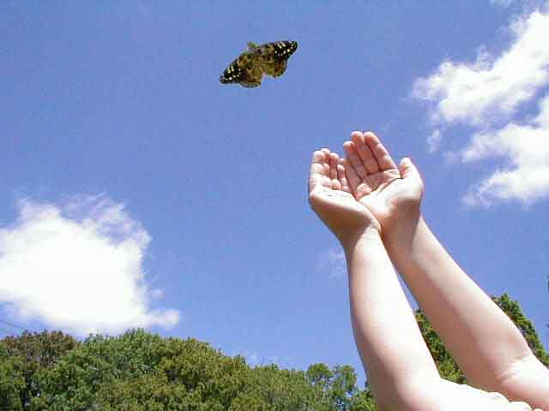
Forget about it, stop worrying about it

Slide 6
“I’m having a bad day. I got a bad grade on my math test.”
“Don’t worry, just let it go”

Slide 7
Invitations
What is an invitation?
An invitation (초대) is a suggestion made by someone to go somewhere or do something.
  Ex: Would you like to go to the movies?

Slide 8
Excuses
What is an excuse?
An excuse (핑계) is a reason for rejecting an invitation.
  Ex: I cannot go to the movies because I have a lot of homework to do.

Slide 9
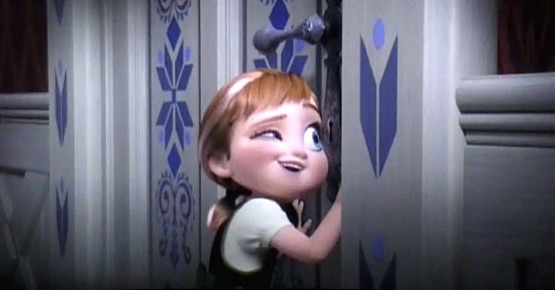
Invitations
What does Anna invite Elsa to do?
To Build a Snowman!
Do you want to build a snowman?

Slide 10
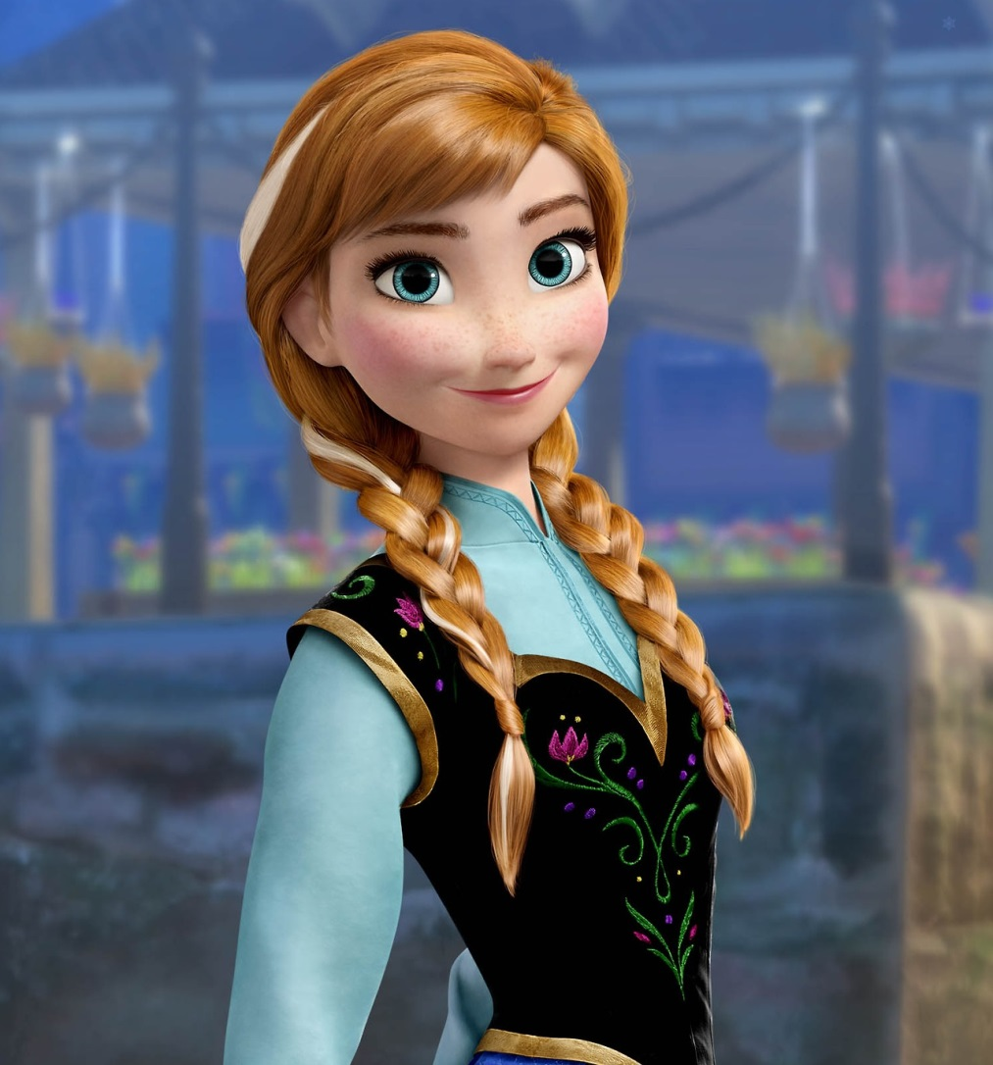
Do you want to build a snowman?

Slide 11
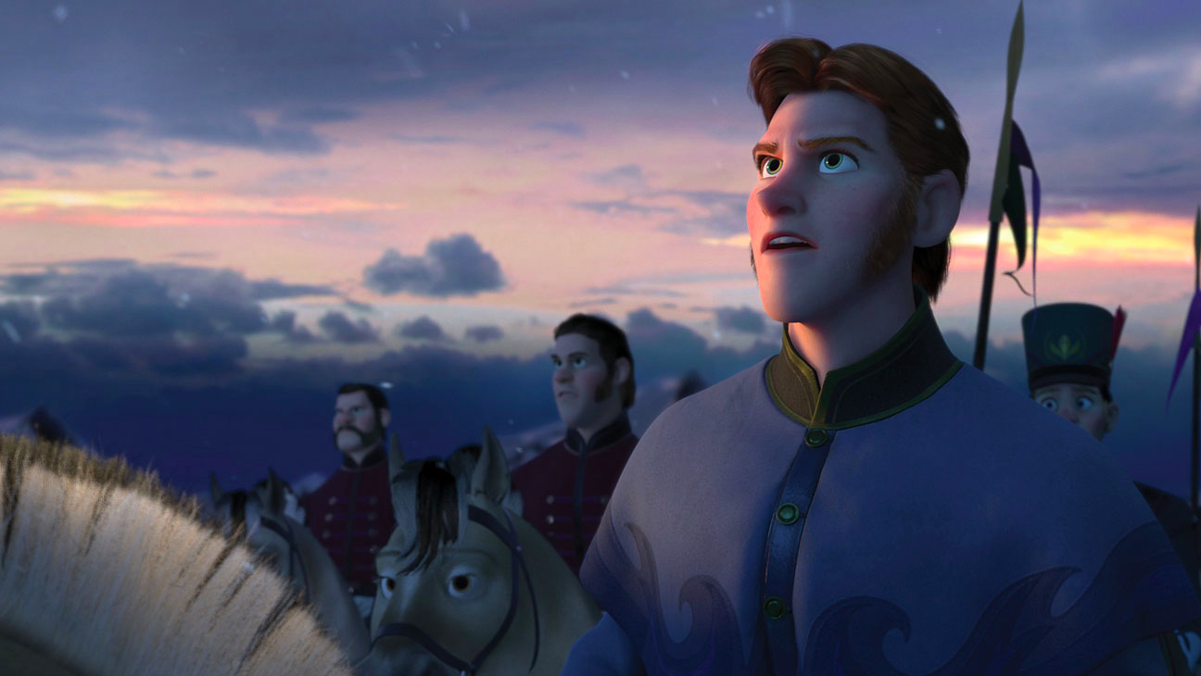
Let’s help Elsa make an excuse without using awkward English!

Slide 12
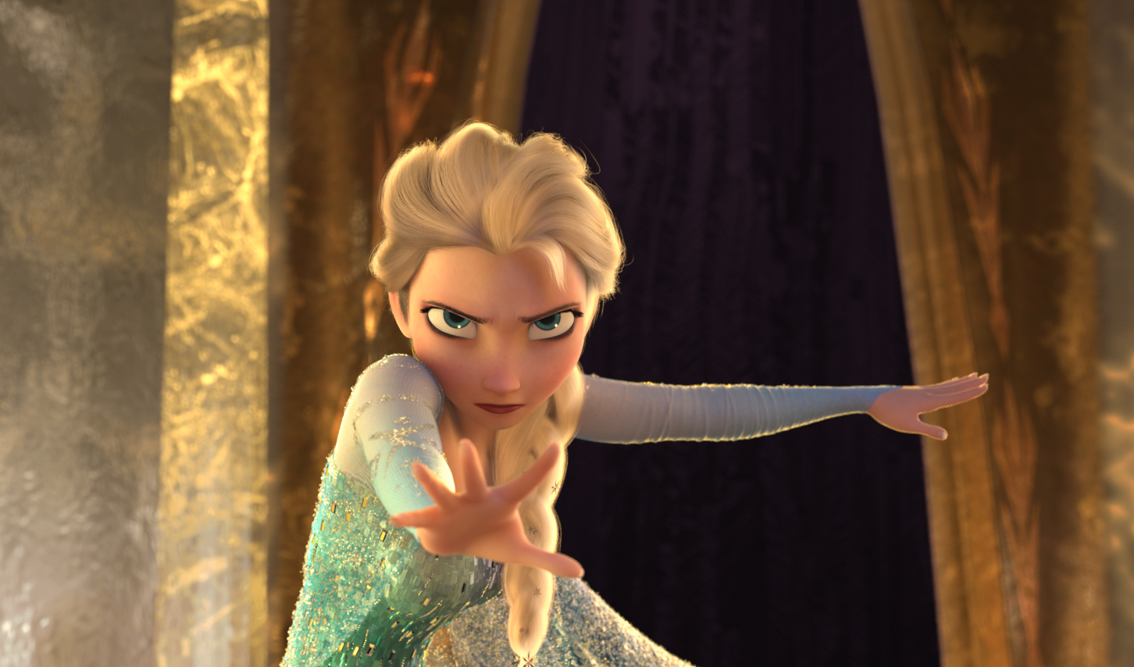
Choose the answer that sounds better in English!
Α
B
I’m sorry Anna. I promised my dad I’d be home early.
I’m sorry Anna. I have a promise.

Slide 13
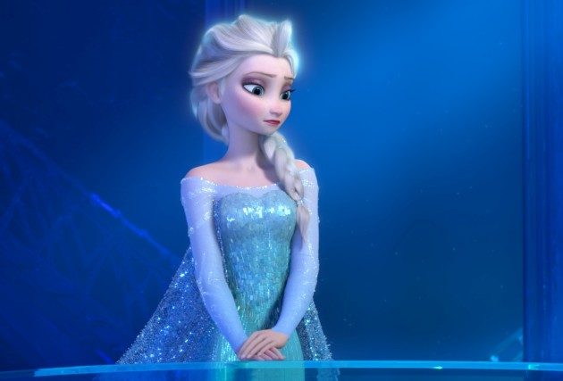
I have an appointment with my boyfriend at that time.
I have an appointment at the doctor’s office.
Α
B
Which one is correct?

Slide 14
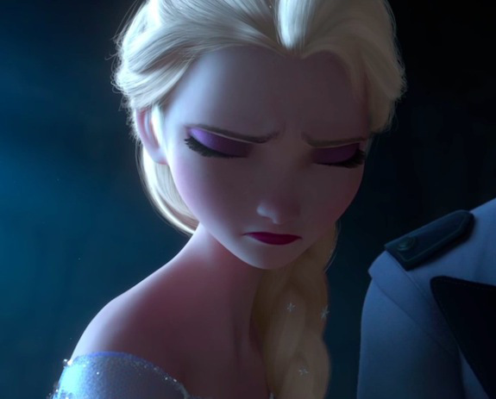
Thank you. But, I am feeling a little sick today.
Thank you. But my feeling is not good today.
B
Α
Which one is correct?

Slide 15
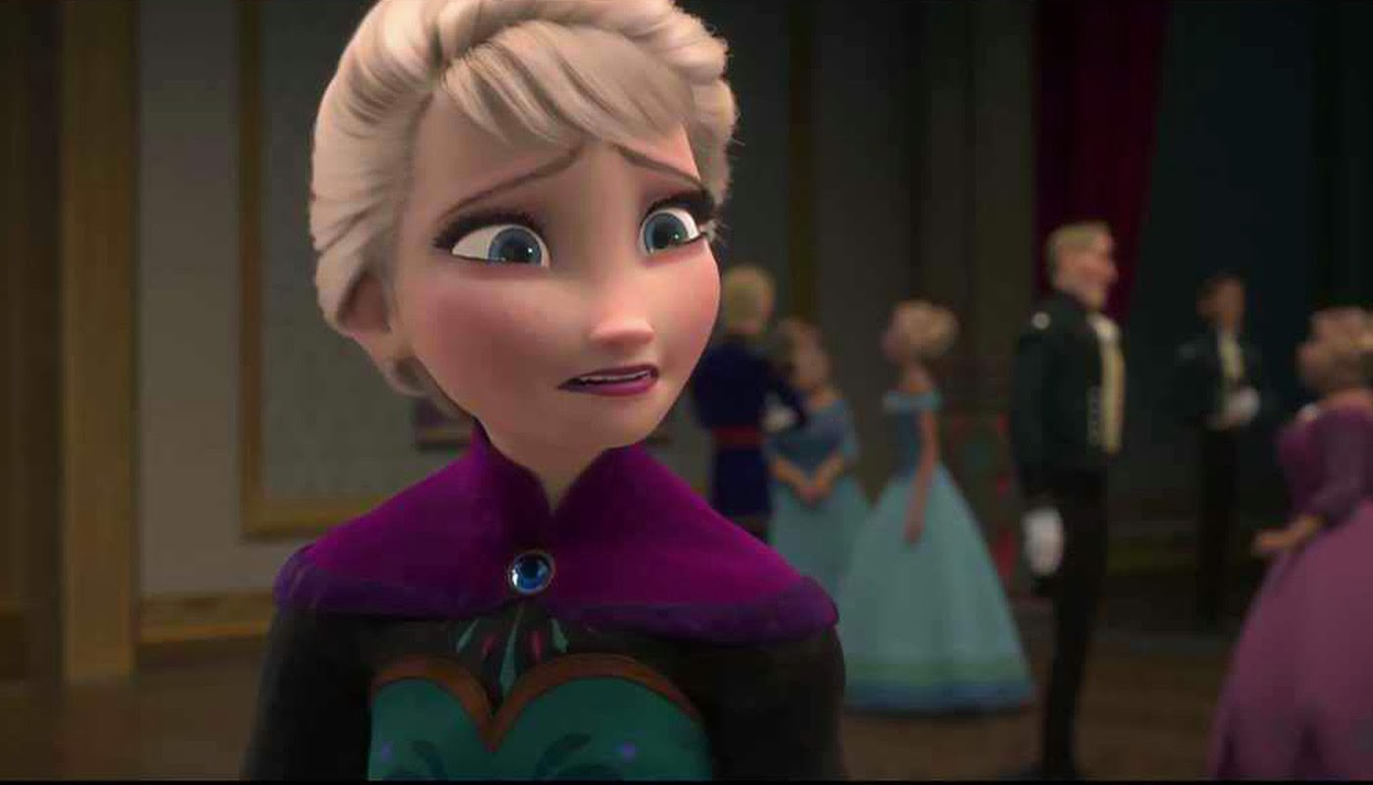
Α
Today? I am so busy. I have much homework to do.
Today? I’m a little busy. I have a lot of homework to do.
B
Which one is correct?

Slide 16
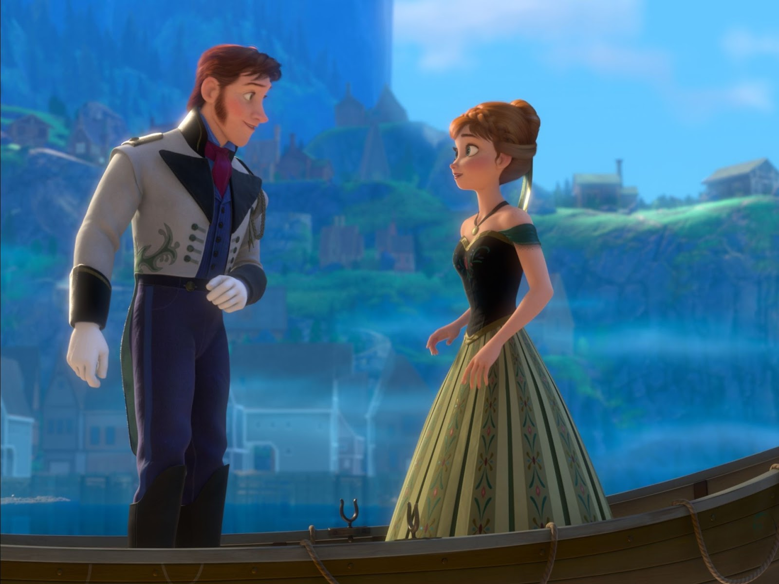
If you do not want to reject an invitation, and need time to think, what are some phrases you can say?

Slide 17
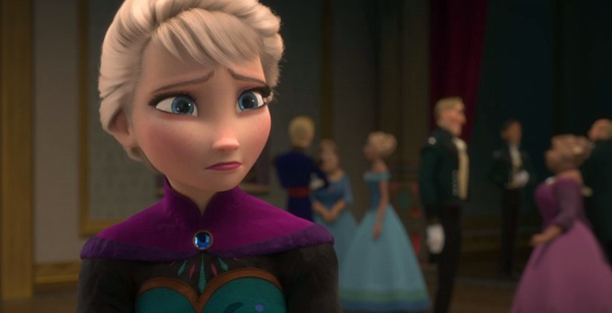
I’ll let you know.
I’ll get back to you.
I’ll see.
I’ll think about it.
I don’t know if I can make it.

Slide 18
Assignment
Write a letter to Anna, making an excuse why you don’t want to build a snowman. Use at least one of the phrases we learned in class today!

Slide 19

Be Creative!!!!!
At least 4 sentences.
Dear Anna,
Thank you for the invitation to build a snowman together. Unfortunately, my dog is very sick and I have to take him to the hospital. Maybe we can build a snowman another time. Thank you!
Sincerely,
Jessica

Slide 20
Assignment
Write a letter to Anna, making an excuse why you don’t want to build a snowman.
Phrases you can use:
  Thank you for your invitation but…
  Unfortunately…
  I’ll see.
  I’ll let you know.
  I’ll think about it.
  I don’t know if I can make it.

Slide 21

“Let It Go”
Listen to song and fill in lyrics
http://www.youtube.com/watch?v=moSFlvxnbgk

Slide 22
“Let It Go”
mountain
The snow glows white on the _________ tonight, not a _________ to be seen.
A _________ of isolation and it looks like I'm the __________.
The wind is howling like this swirling ______ inside.
Couldn't keep it in, Heaven knows I tried.
Don't let them ____, don't let them ______.
Be the good girl you always have to be.
Conceal, don't _______, don't let them know.
Well, now they know!
footprint
Kingdom
queen
storm
in
see
feel

Slide 23

Let it go, let it go!
Can't hold it back _________.
Let it go, let it go!
Turn away and ________ _______ _______.
I don't ______ what they're going to say.
Let the storm rage on.
The cold never ___________ me anyway.
It's funny how some __________,
makes ____________ seem small.
And the fears that once controlled me, can't get to me at all
It's time to see what I can do,
to ______ the limits and break through.
No right, no wrong, no rules for me.
I'm ________!
anymore
shut
the
door
care
bothered
distance
everything
test
free

Slide 24

Let it go, let it go.
I am one with the ______ and ______.
Let it go, let it go.
You'll never see me ______.
Here I _______, and here I'll stay.
Let the storm rage on.
My power flurries through the air into the ____________.
My soul is ___________ in frozen fractals all around
And one _________ crystallizes like an icy blast
I'm never going back; the past is in the __________!
Let it go, let it go.
And I'll _________ like the break of dawn.
Let it go, let it go
That _________ girl is gone
Here I stand, in the light of day.
Let the ________ rage on!
The cold never ___________ me anyway...
wind
sky
cry
stand
ground
spiraling
thought
past
rise
perfect
storm
bothered

Slide 25

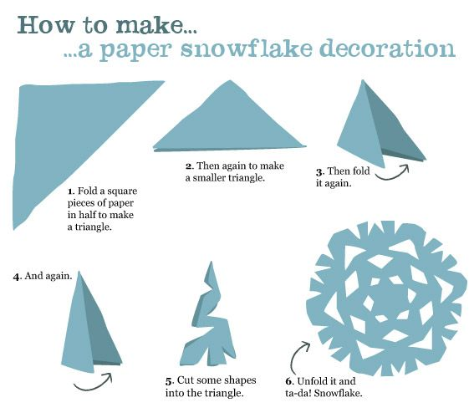
Do You Want to Build a Snowflake?

Slide 26
Sing Along
https://www.youtube.com/watch?v=-RhuwLTmtAg

