Slide 1
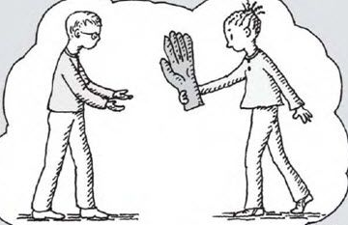
Can I give you a hand?
= Can I help you?

Slide 2
Example (p. 130)
A: Can I give you a hand?
B: Yes, please. Where can I find this book?
A: It’s over there.
B: Thank you very much.
A: You’re welcome.

Slide 3
You Try!
A: Can I give you a hand?
B: Yes, please. Where can I find ______?
A: It’s over there.
B: Thank you very much.
A: You’re welcome.
this book
salt
this music CD
the restroom

Slide 4
Can you give me a hand?
= Can you help me?

Slide 5
Example
A: Can you give me a hand?
B: What do you need?
A: I can’t open this window.
B: Let me try.

Slide 6
Can you give me a hand?
I like these songs, but I don’t know all the lyrics.
(lyrics = words)
Can you help me figure them out?

Slide 7
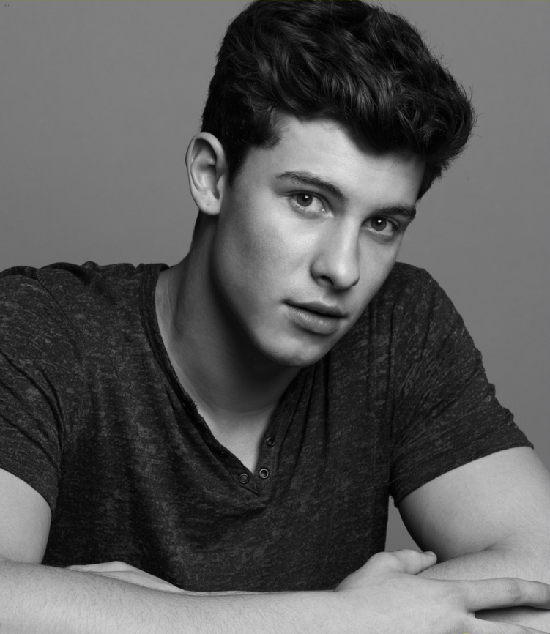
“Treat You Better” by Shawn Mendes
https://www.youtube.com/watch?v=lY2yjAdbvdQ (:33-1:20)

Slide 8
“Treat You Better” by Shawn Mendes
https://www.youtube.com/watch?v=lY2yjAdbvdQ (:33-1:20)
I won't lie to you I know he's just not right for you And you can tell me if I'm off But I see it on your face When you say that he's the one that you want And you're spending all your time In this wrong situation And anytime you want it to stop

Slide 9
“Treat You Better” by Shawn Mendes
https://www.youtube.com/watch?v=lY2yjAdbvdQ (:33-1:20)
Chorus:
I know I can treat you better than he can And any girl like you deserves a gentleman Tell me why are we wasting time On all your wasted crying When you should be with me instead I know I can treat you better Better than he can

Slide 10
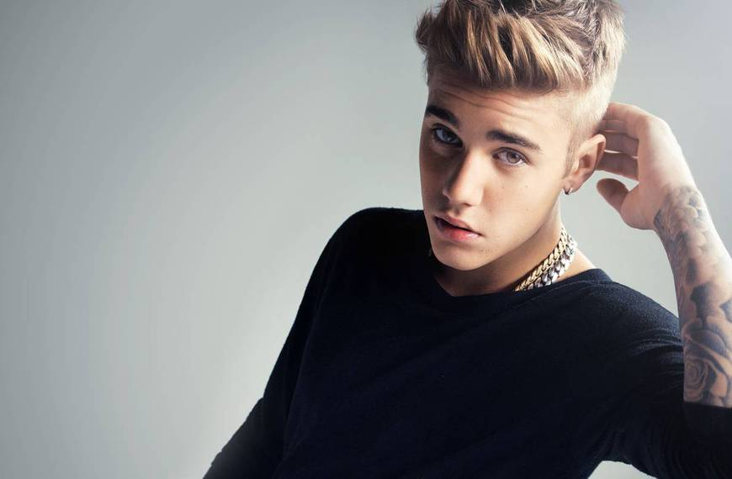
“Love Yourself” by Justin Bieber
https://www.youtube.com/watch?v=oyEuk8j8imI (start-1:25)

Slide 11
“Love Yourself” by Justin Bieber
https://www.youtube.com/watch?v=oyEuk8j8imI (start-1:25)
For all the times that you rain on my parade And all the clubs you get in using my name You think you broke my heart, oh, girl for goodness' sake You think I'm crying on my own. Well, I ain't

Slide 12
“Love Yourself” by Justin Bieber
https://www.youtube.com/watch?v=oyEuk8j8imI (start-1:25)
And I didn't wanna write a song 'Cause I didn't want anyone thinking I still care. I don't, But you still hit my phone up And, baby, I be movin' on And I think you should be somethin' I don't wanna hold back, Maybe you should know that

Slide 13
“Love Yourself” by Justin Bieber
https://www.youtube.com/watch?v=oyEuk8j8imI (start-1:25)
My mama don't like you and she likes everyone And I never like to admit that I was wrong And I've been so caught up in my job, Didn't see what's going on But now I know, I'm better sleeping on my own

Slide 14
“Love Yourself” by Justin Bieber
https://www.youtube.com/watch?v=oyEuk8j8imI (start-1:25)
'Cause if you like the way you look that much Oh, baby, you should go and love yourself And if you think that I'm still holdin' on to somethin' You should go and love yourself

Slide 15
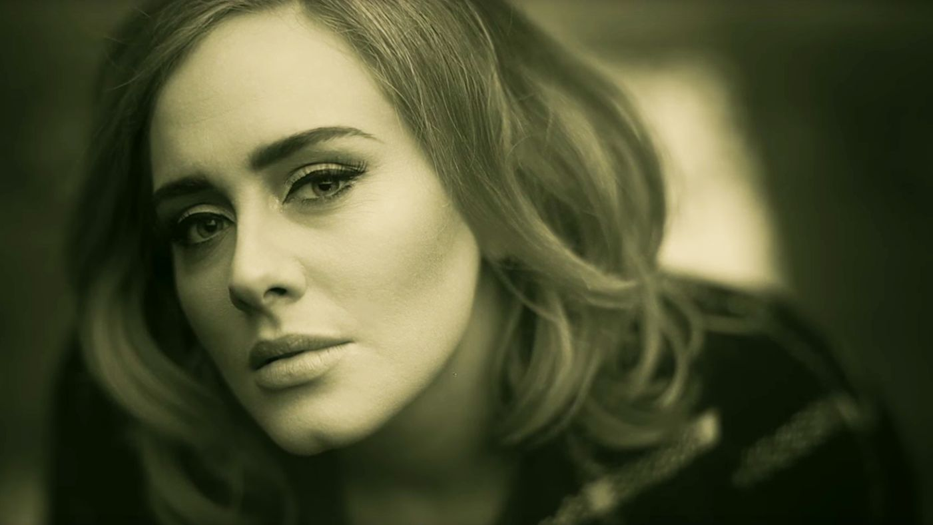
“Hello” by Adele
https://www.youtube.com/watch?v=YQHsXMglC9A (2:08-3:11)

Slide 16
“Hello” by Adele
https://www.youtube.com/watch?v=YQHsXMglC9A (2:08-3:11)
There's such a difference between us And a million miles Hello from the other side I must have called a thousand times To tell you I'm sorry for everything that I've done But when I call you never seem to be home

Slide 17
“Hello” by Adele
https://www.youtube.com/watch?v=YQHsXMglC9A (2:08-3:11)
Hello from the outside At least I can say that I've tried To tell you I'm sorry for breaking your heart But it don't matter. It clearly doesn't tear you apart anymore

Slide 18
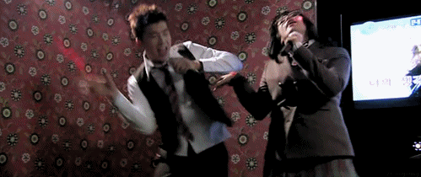
Your Choice!
Sing
Play a different listening game

Slide 19
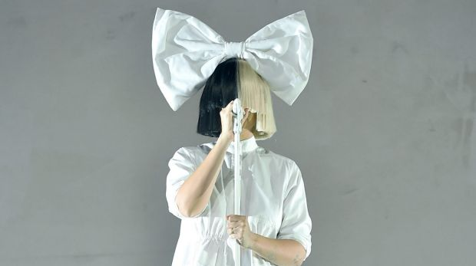
“Cheap Thrills” by Sia
https://www.youtube.com/watch?v=nYh-n7EOtMA (:40-1:25)
“As long as I can feel the beat”

Slide 20
“Stressed Out” by Twenty One Pilots
https://www.youtube.com/watch?v=pXRviuL6vMY (:27-1:19)
“to the good old days”

Slide 21
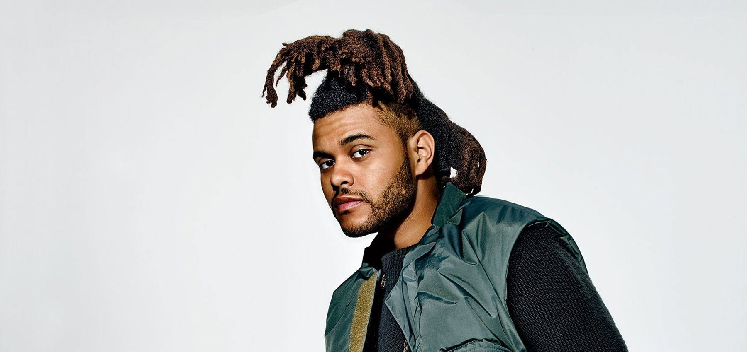
“Can’t Feel My Face” by The Weeknd
https://www.youtube.com/watch?v=KEI4qSrkPAs (:25-1:00) “but I love it”

Slide 22
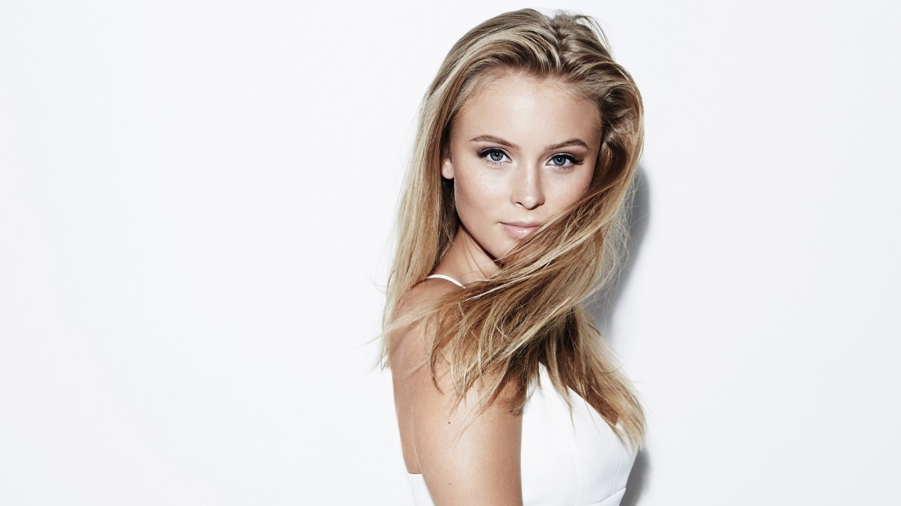
“Never Forget You” by Zara Larsson
https://www.youtube.com/watch?v=GTyN-DB_v5M (:39-1:07)
“’til the day I die”

Slide 23
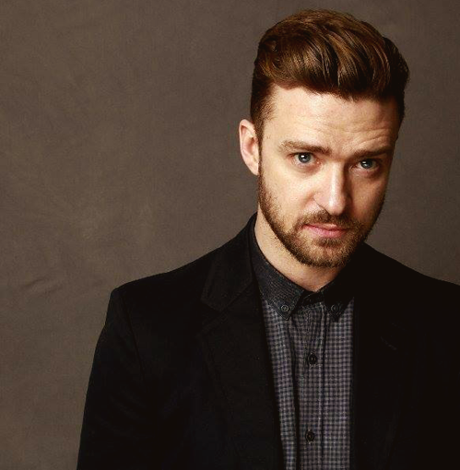
“Can’t Stop the Feeling” by Justin Timberlake
https://www.youtube.com/watch?v=ru0K8uYEZWw (:24) “so don’t stop”

