Slide 1
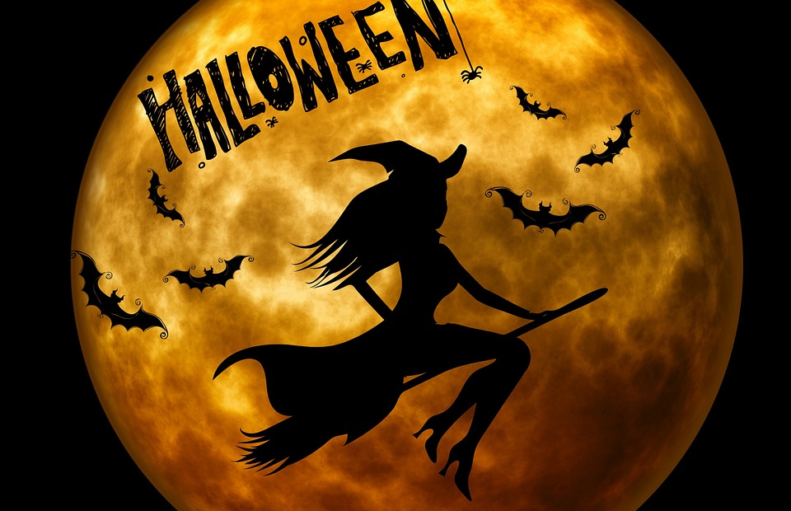

Slide 2
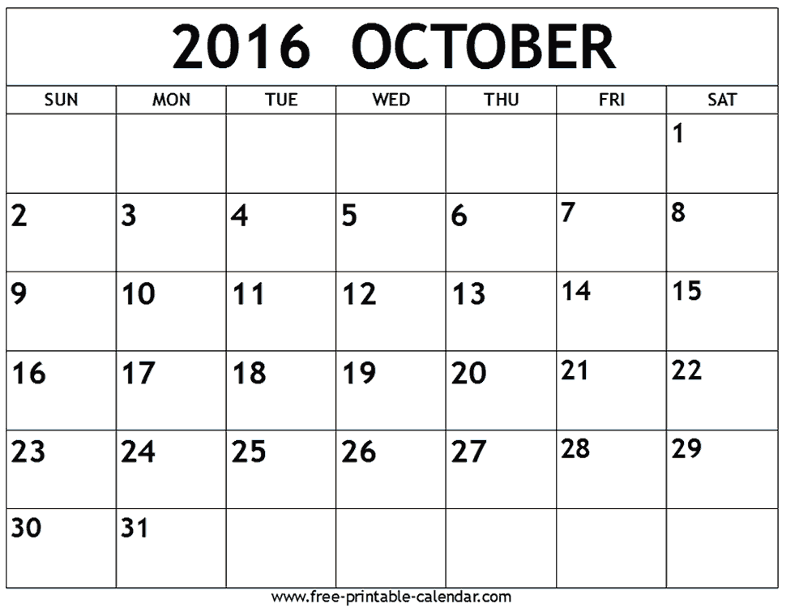
Halloween is October 31st

Slide 3
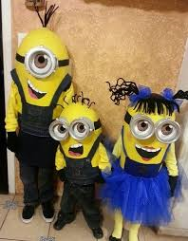
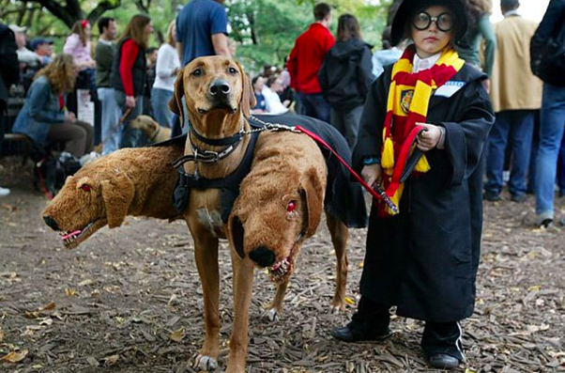
Costumes
People in America wear costumes for Halloween.

Slide 4
*Insert a picture of yourself as a kid dressed up for Halloween.

Slide 5
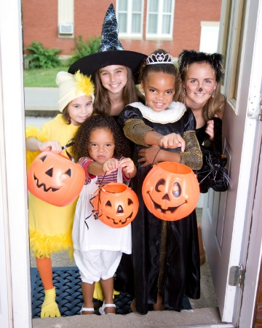
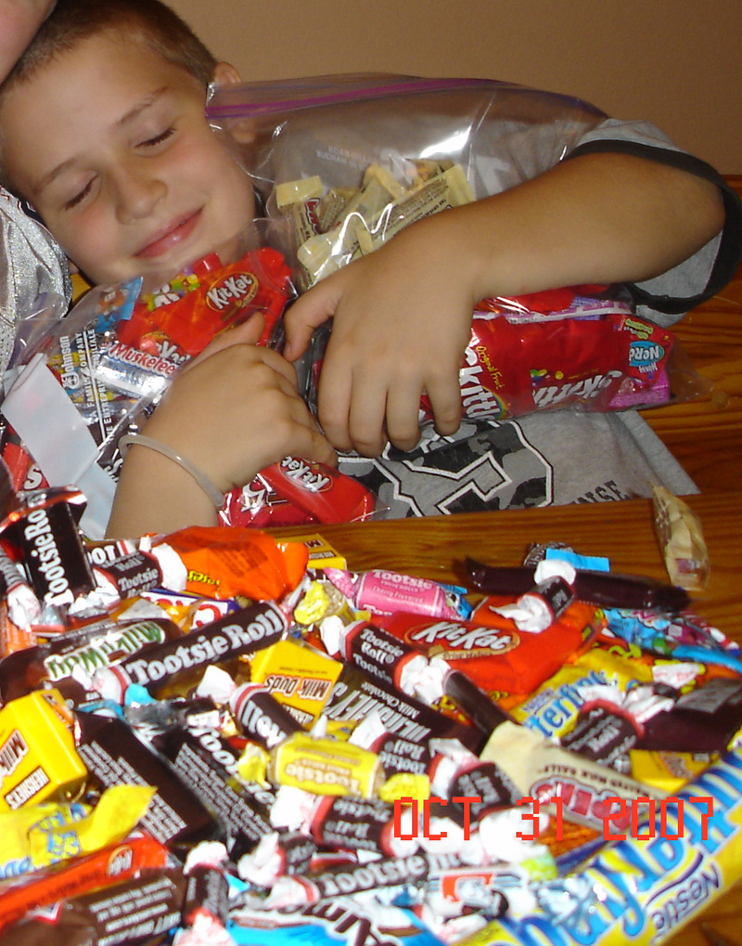
CANDY!!
If kids visit someone’s house and say “trick or treat” they get candy.

Slide 6
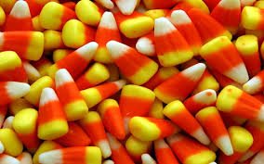
Candy corn is a popular fall candy.

Slide 7
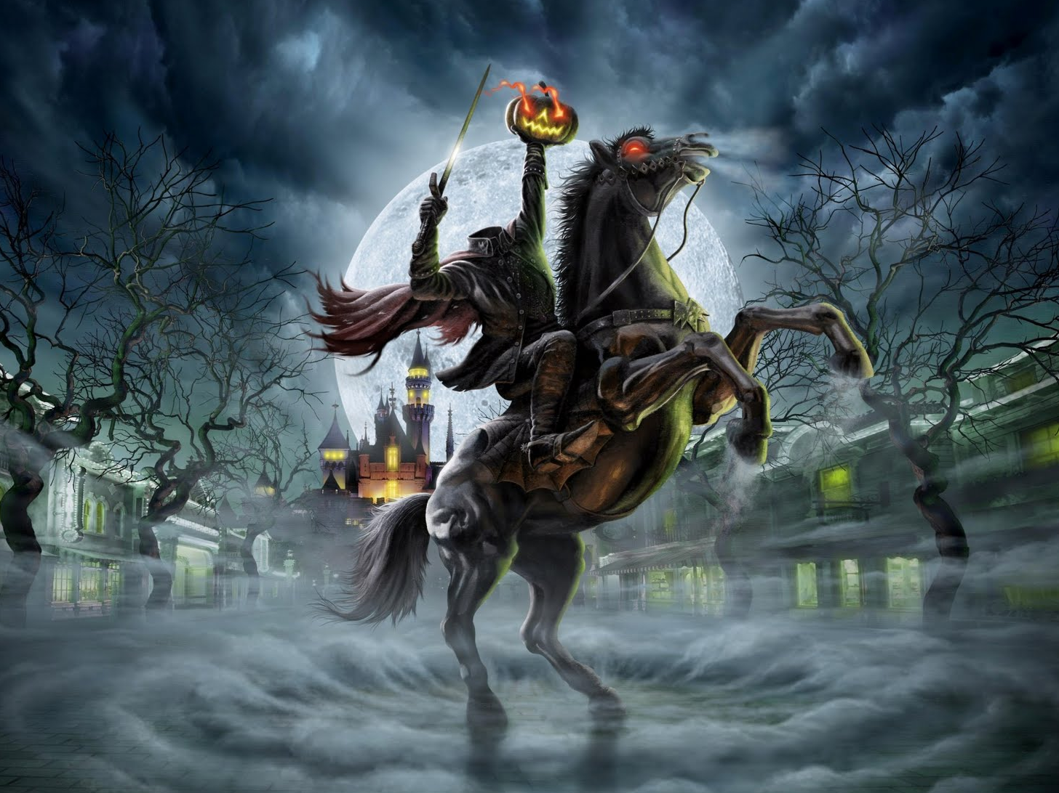
Halloween stories
1. The Headless Horseman

Slide 8
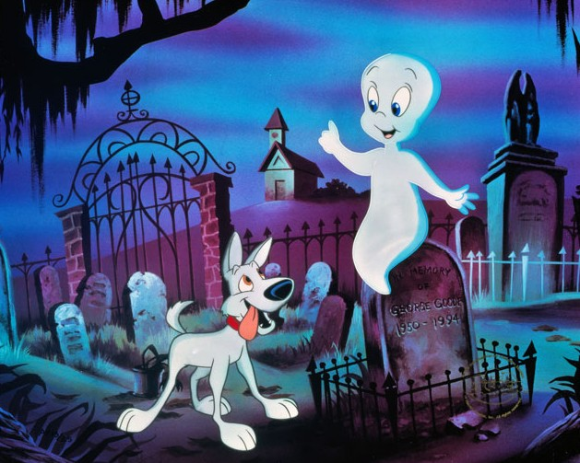
2. Casper the Friendly Ghost

Slide 9
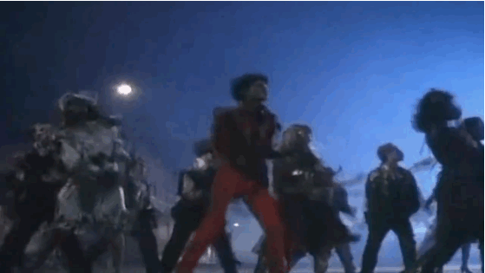
Halloween songs
Thriller is a popular Halloween song. Michael Jackson sings it.

Slide 10
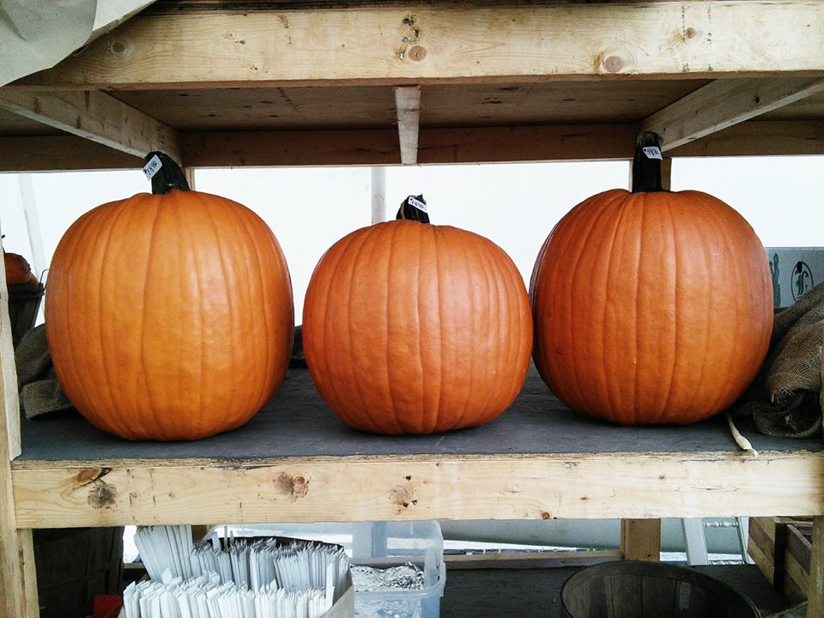
Pumpkins
Many people go to farms and buy pumpkins.

Slide 11
Pumpkins are used to make jack-o-lanterns.

Slide 12
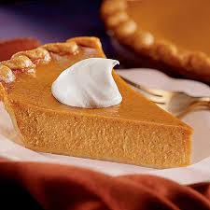
Americans love pumpkin pie and pumpkin spice coffee.

Slide 13
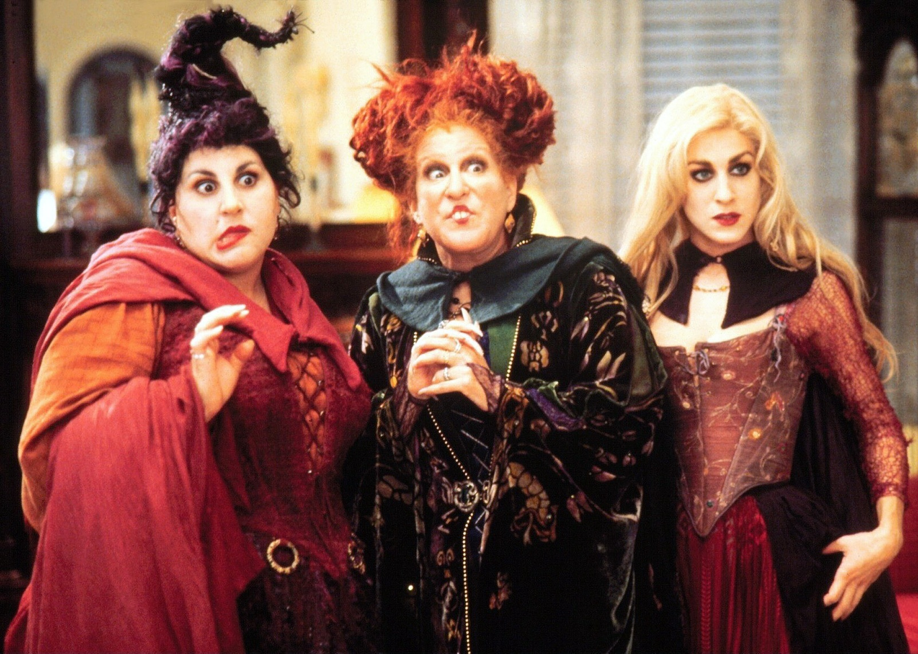
Halloween movies
1. Hocus Pocus

Slide 14
2. Casper the Friendly Ghost

Slide 15
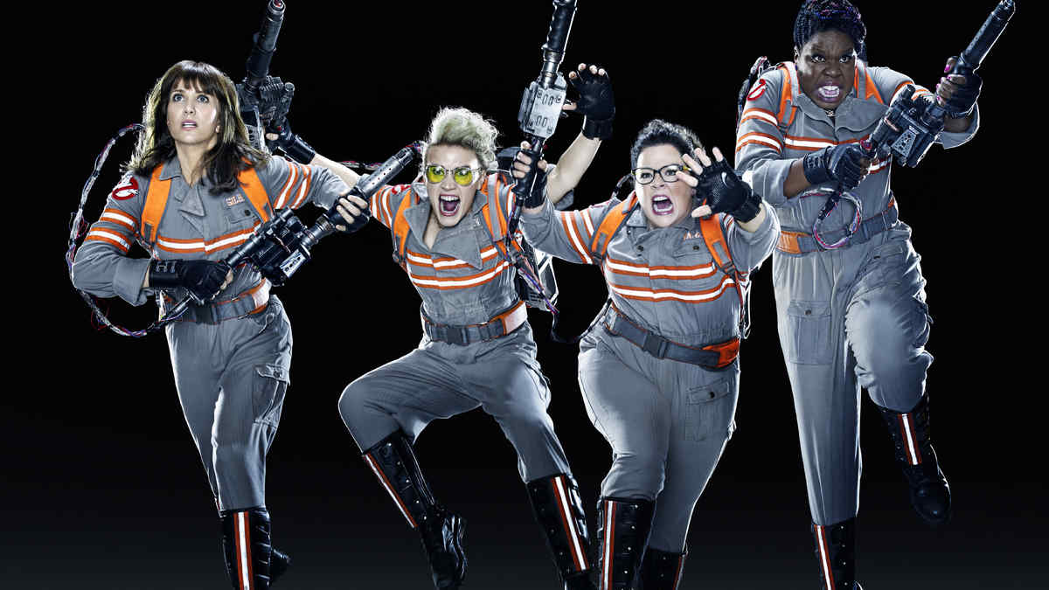
3. Ghostbusters
Ghostbusters is about catching ghosts.

Slide 16
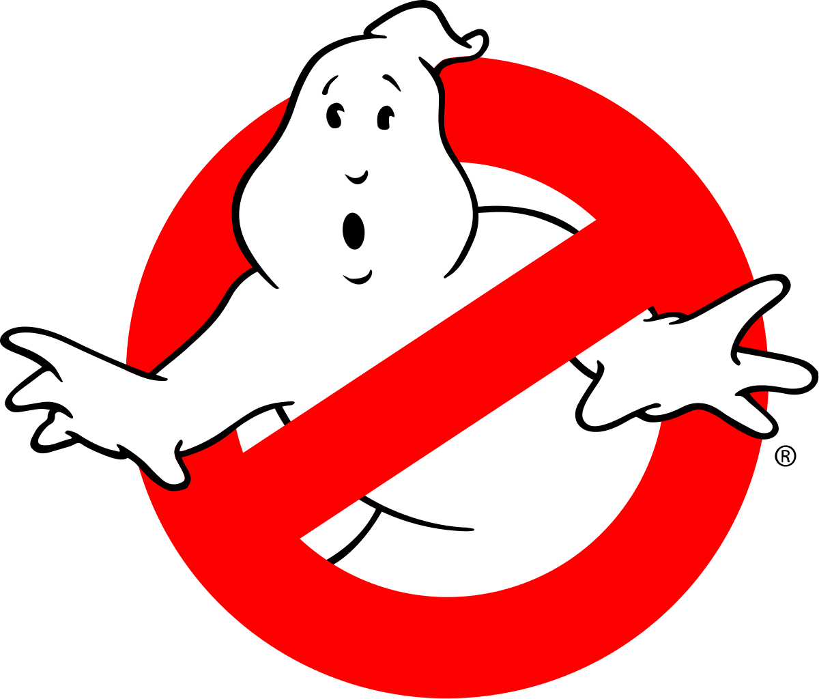
Game Time!

