Slide 1
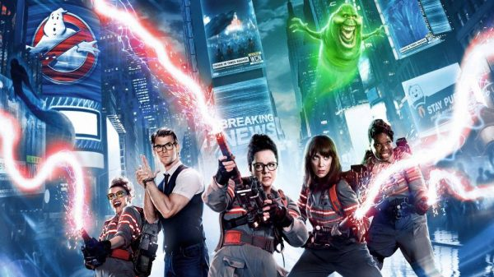
GHOSTBUSTERS
Card Game

Slide 2
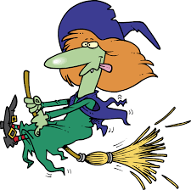
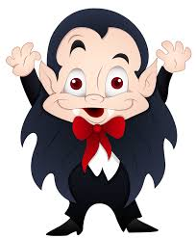
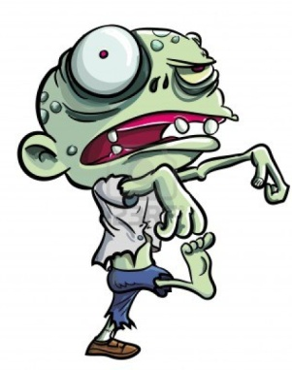
If you answer the question correctly, you can choose a card for your team.
= 0 points
= 2 points
= 4 points
= 10 points
= 20 points

Slide 3
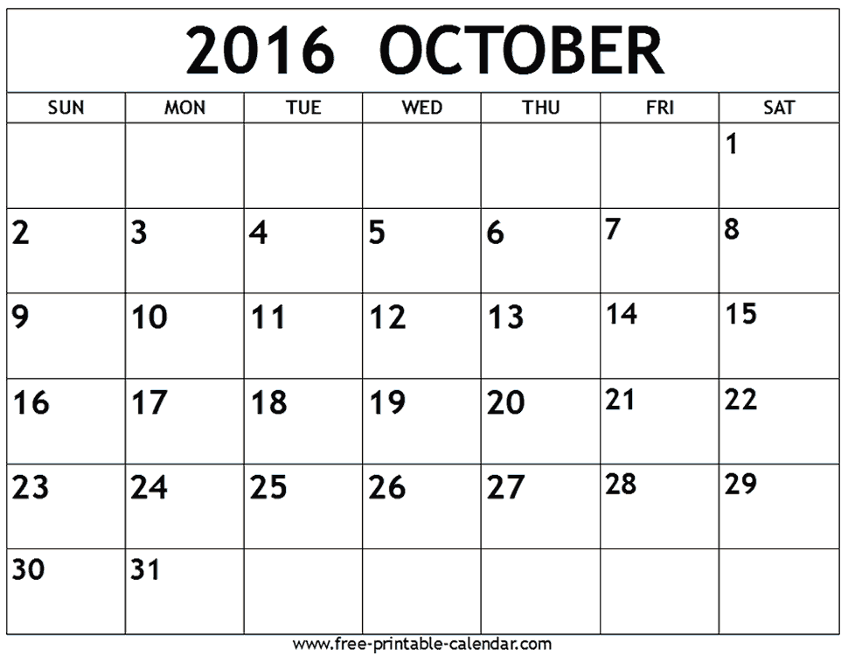
When is Halloween?

Slide 4
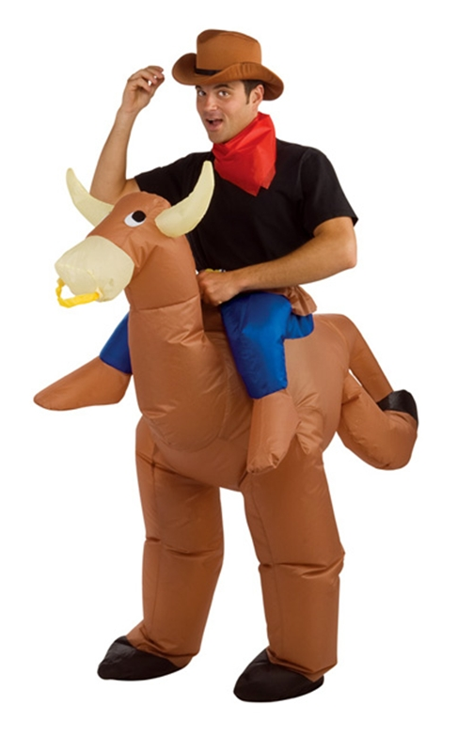
What do people wear for Halloween?
A. transformers
B. ghostbusters
C. costumes
D. swag

Slide 5
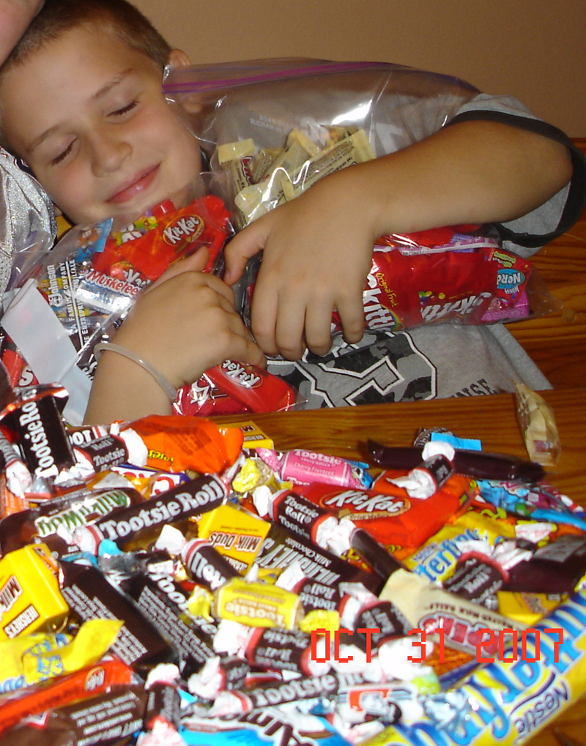
What is a popular Halloween food?
A. candy corn
B. bulgogi
C. sweet corn
D. ice cream

Slide 6
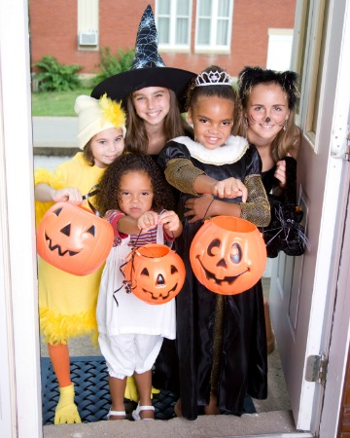
What do kids say to get candy?
A. Give me the candy.
B. Nice to meet you.
C. Trick or treat.
D. Hi, my name is ---.

Slide 7
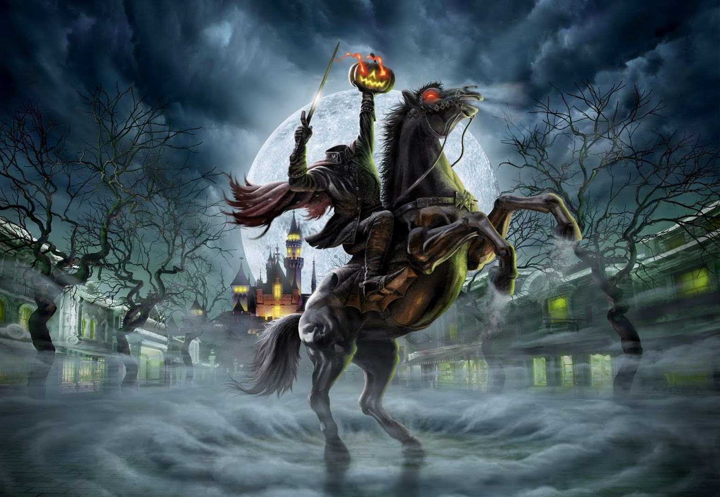
What is this?
The headless ____________
A. mailman
C. farmer
B. horseman
D. horse

Slide 8
What are the missing letters?
H __ ll __ we __ n
A. a, e, i, o, u
B. a, o, e
C. a, o, a
D. e, y, e

Slide 9
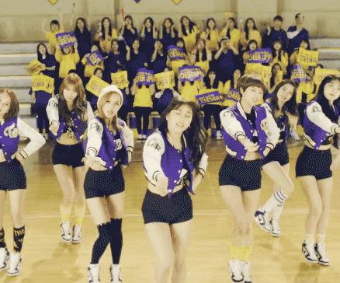
What is a popular Halloween song?
A. Thriller
B. Trick or Treat
C. Three Bears
D. Cheer Up

Slide 10
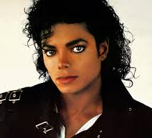
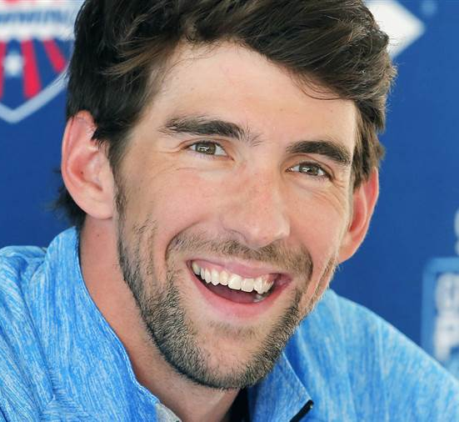
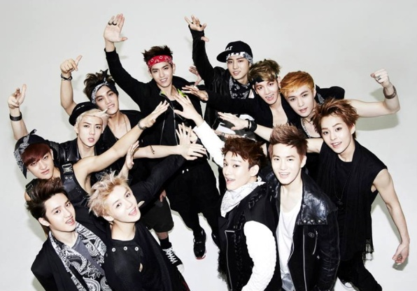
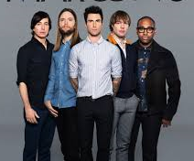
Who sings “Thriller?”
A. Michael Jackson
B. Michael Phelps
C. EXO
D. Maroon 5

Slide 11
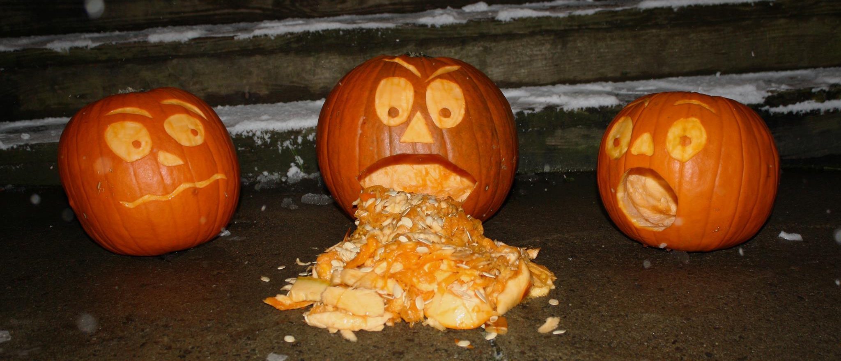
What are these?
__________ -o- lanterns
A. Jill
C. Jack
B. John
D. Jesus

Slide 12
What is a popular fall coffee flavor?
A. sugar and spice
B. caramel
C. apple pie
D. pumpkin spice

Slide 13
What are the missing letters?
__ u __ p __ in
A. p, m, k
B. p, s, y
C. p, r, l
D. p, n, k

Slide 14
Which one is NOT a popular Halloween movie?
A. Casper the Friendly Ghost
B. Ghostbusters
C. Zombies of New York
D. Hocus Pocus

Slide 15
What is the movie Ghostbusters about?
A. catching zombies
B. catching a cold
C. catching bad teachers
D. catching ghosts

Slide 16
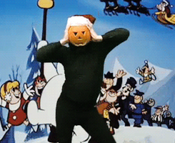
Happy Halloween!

