Slide 1
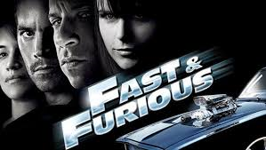

Slide 2
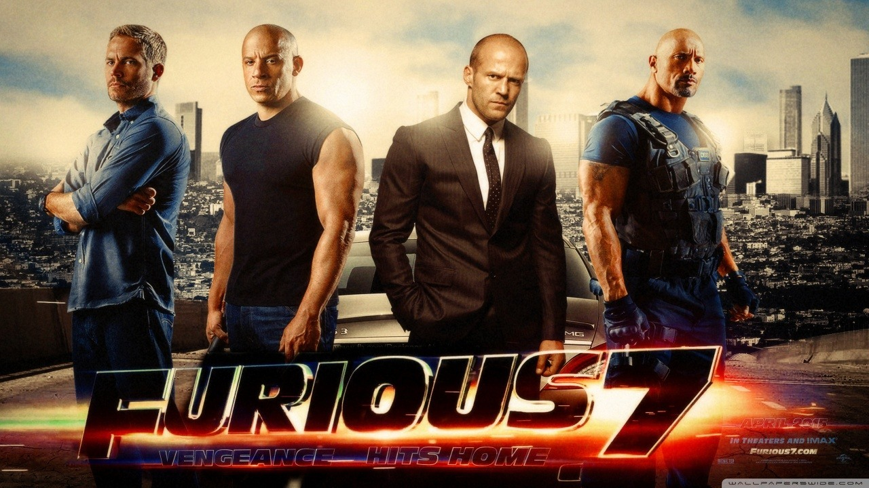
The “Fast and Furious” are famous movies in America. There are 7 movies.

Slide 3
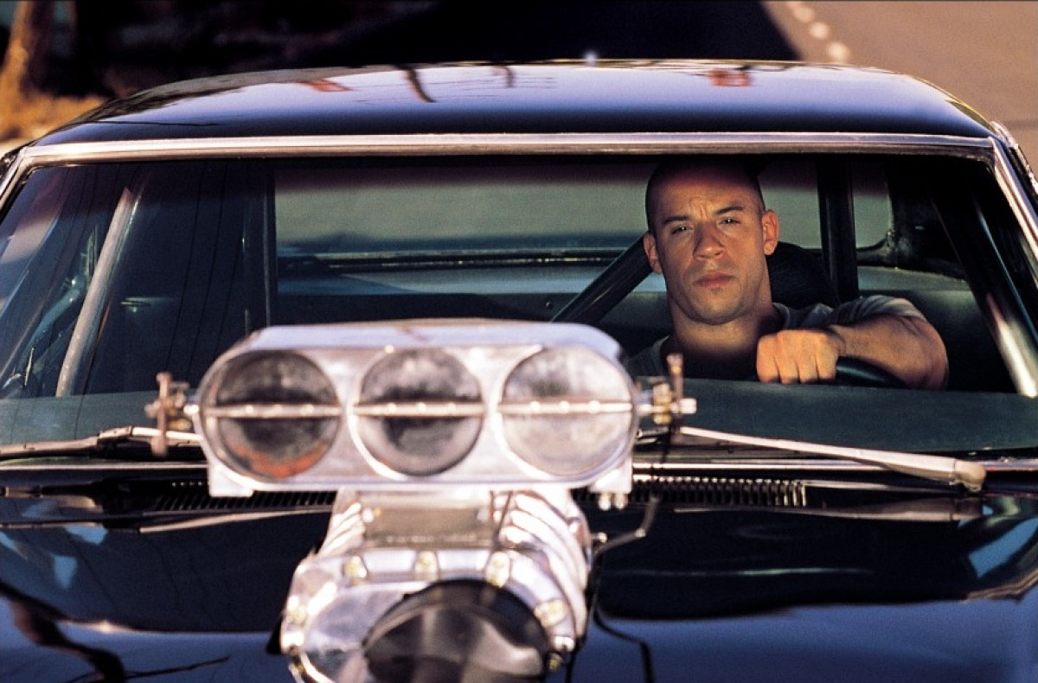
What do you think the movies are about?

Slide 4
The movies are about fast cars.

Slide 5
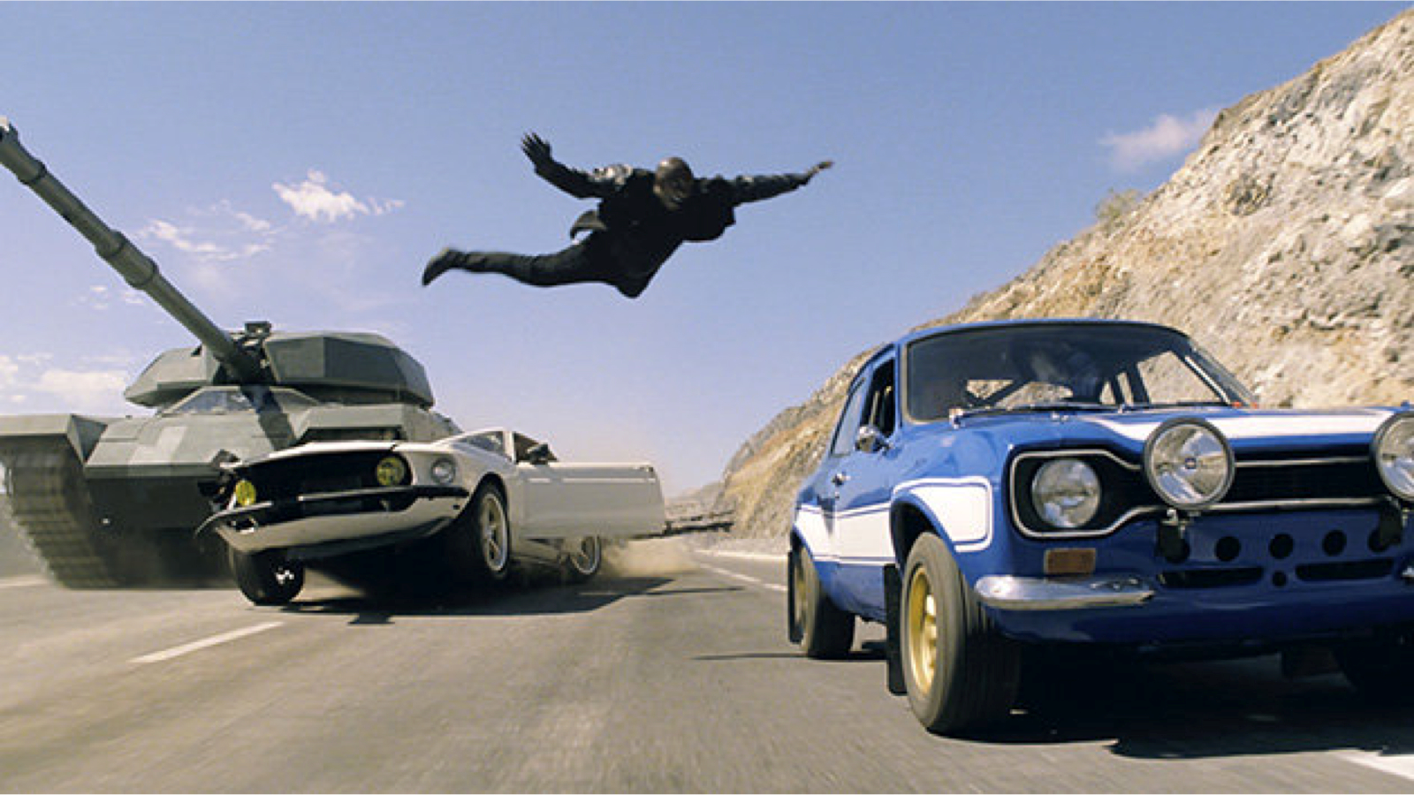
The characters in the movies fight bad guys to complete a mission.

Slide 6
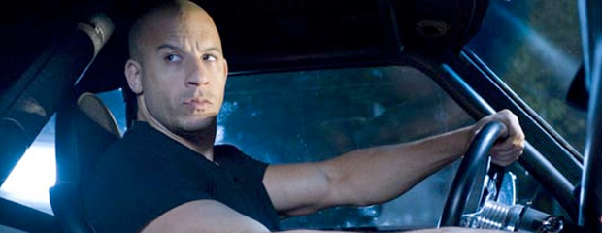
Let’s watch a Fast and Furious video.
https://www.youtube.com/watch?v=Skpu5HaVkOc

Slide 7
Mad Lib Activity
A mad lib is a story with blank spaces. I will ask you for words to fill in the spaces. Then, I will read the completed story.

Slide 8
Word List
1. Student 1
2. Date
3. City in Korea 1
4. Emotion
5. Student 2
6. Something expensive
7. Fictional creature (plural)
8. City in Korea 1
9. Teacher’s name 1
10. Teacher’s name 2
11. Famous person
12. Emotion
13. Country in Europe
14. Color 1
15. Color 2
16. Famous foreign landmark
17. Foreign country
18. Small animal
19. City in Korea 2
20. Large number
21. Location word
22. Historical figure name
23. Landmark in Korea 1
24. Landmark in Korea 2
25. City in Korea 1
26. Time
27. Electronic device
28. School supply item
29. Article of clothing
30. Famous American

Slide 9
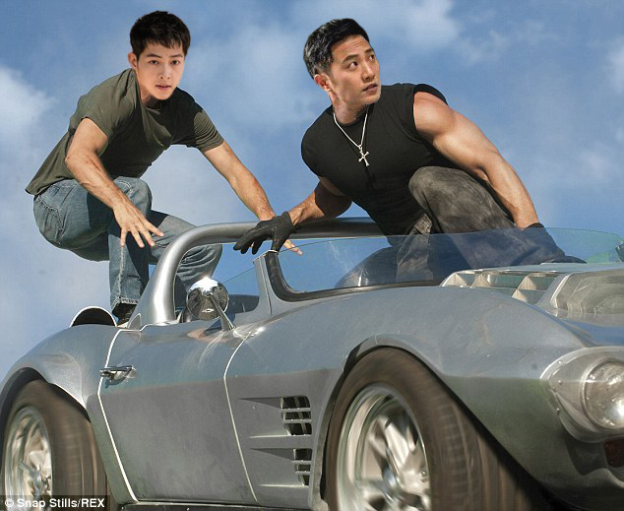
Fast & Furious
The Streets of Korea

Slide 10
Dear (1),
On (2) I have to go to (3) to complete a mission. The President is (4) because (5) took her (6).
The mission will be difficult because there are (7) in (8). (9), (10) and (11) will also help with the mission.

Slide 11
I’m (12) because I got a new car. I will use it for the mission. It was made in (13).
It’s (14) with (15) stripes. It’s bigger than (16) and faster than a/an (17) (18) .

Slide 12
We will meet in (19) and drive for (20) kilometers. We will drive (21) the (22) River.
We will also drive by (23) and (24). We will arrive in (25) at (26).

Slide 13
For the mission we will also need (25), (28) and (29).
Can you help with the mission?
From,
(30)

Slide 14
Mission complete

