Slide 1
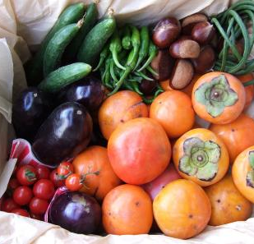
Fall foods
Part II

Slide 2
Today’s Goals
Students will review vocabulary about cooking.
Students will play a cooking game to practice using the new vocabulary.
Students will finish writing their recipes for points and a chance to win pumpkin pie! Mmmmmm

Slide 3
Goal #1
Students will review vocabulary about cooking.

Slide 4
Review
Fry Deep Fry Boil Bake Grill Steam | Oven Stove, Pot Grill Stove, Pan, Oil Oil, Stove, Pot Cooker, Pot

Slide 5
Goal #2
Students will play a cooking game to practice using the new vocabulary.

Slide 6
Rules
- I will show you a recipe.
- Put all the ingredients your team needs into your bowl.
- Run to the “machine” where you would cook that recipe.
- First 3 teams get points.

Slide 7
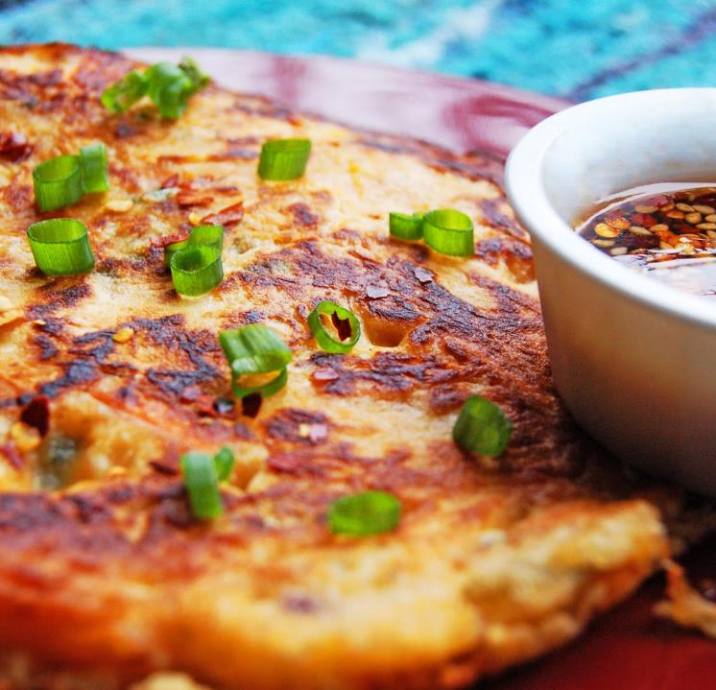
Kimchi Pancake
Chop kimchi, squid, onion, and green onion.
Mix the chopped vegetables and squid with flour and water in a bowl to make the batter.
Put the batter into a frying pan.
Fry it for a few minutes, flipping it over with a spatula several times until it becomes brown.
Serve it with soy sauce.

Slide 8
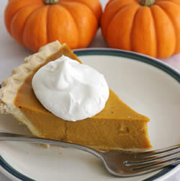
Pumpkin Pie
Mix flour, butter, and water in a bowl to make the crust.
Knead the dough, roll it out to make it thin, and put it in the pie plate.
Mix a pumpkin, brown sugar, cinnamon, ginger, milk, and eggs together to make the filling.
Pour the filling into the crust.
Bake it for one hour.

Slide 9
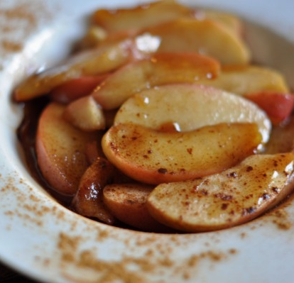
Fried Apples
Chop 8 apples.
Melt ¼ cup of butter in a frying pan.
Add apples, brown sugar, and cinnamon.
Fry them for 15 minutes.

Slide 10
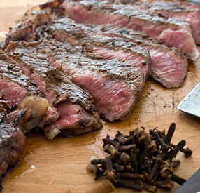
Persimmon-Marinated Steak
Peel and mince the persimmon.
Mix it with soy sauce, ginger, and brown sugar to make a marinade sauce.
Marinate a steak in the sauce for 30 minutes.
Grill the steak.

Slide 11
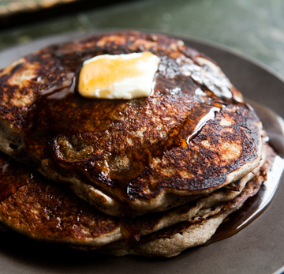
Buckwheat Chestnut Pancakes
Melt butter in a frying pan.
Mix buckwheat flour, regular flour, sugar, and chestnuts together in a bowl.
Mix eggs and milk in a different bowl.
Combine everything in one bowl to make the batter.
Cook it in a frying pan until the pancakes turn brown. Flip it with a spatula.

Slide 12
Goal #3
Students will finish writing their recipes for points and a chance to win pumpkin pie!

