Slide 1
Fall foods
Bon Appetit!

Slide 2
Today’s Goals
1. Students will learn new vocabulary about cooking.
2. Students will use the new vocabulary to explain how to make food like pumpkin pie and kimchi pancakes.
3. Students will create their own recipe using fall foods.

Slide 3
Goal #1
Students will learn new vocabulary about cooking.

Slide 4
Bake

Slide 5
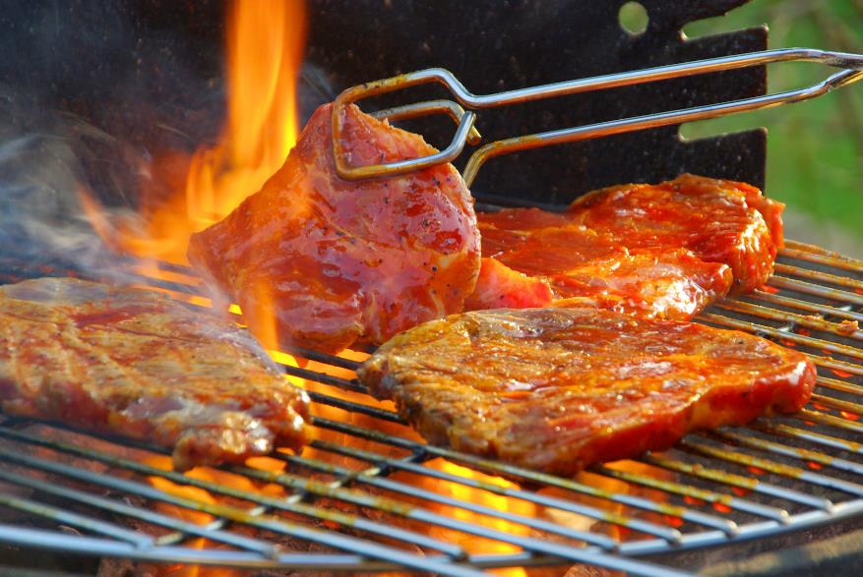
grill

Slide 6
steam

Slide 7
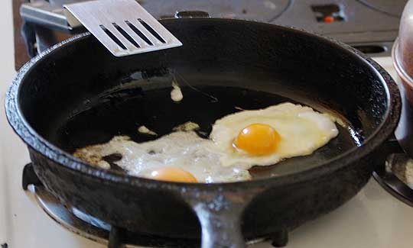
fry

Slide 8
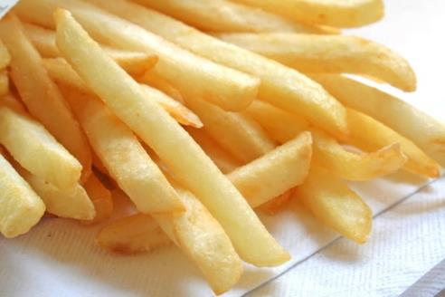
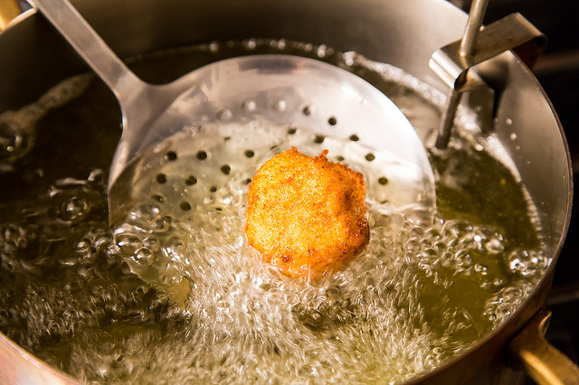
Deep fry

Slide 9
Boil

Slide 10
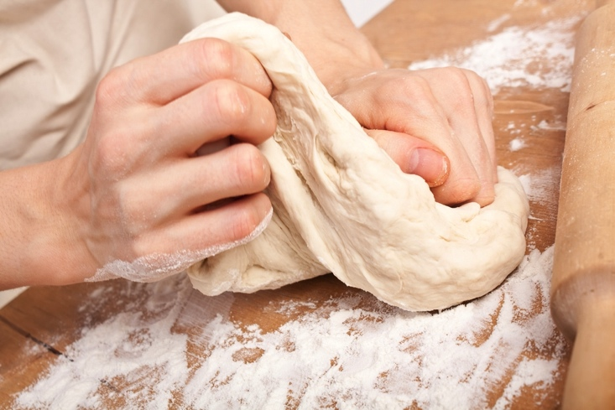
knead

Slide 11
Goal #2
Students will use the new vocabulary to explain how to make food like pumpkin pie and kimchi pancakes.

Slide 12
Let’s make pumpkin pie!!!

Slide 13
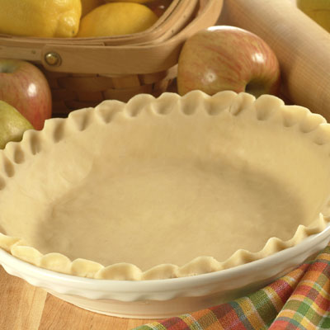
First: Pie Crust
Ingredients:
Flour
Butter
Salt
Water

Slide 14
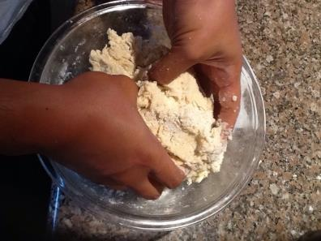
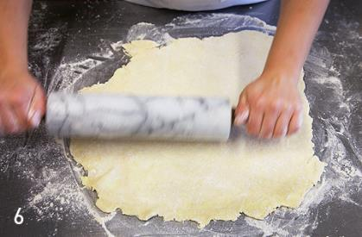
Pie crust recipe
To make the pie crust:
_______, ________ the dough and roll it out to make it thin.
1
_______, _____ all the ingredients in a bowl to make the dough.
2

Slide 15
___________, put the dough in the pie plate. Now we’re ready to make the filling.
3

Slide 16
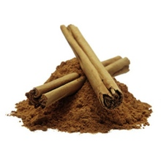
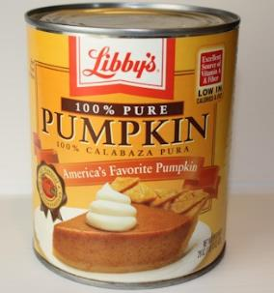
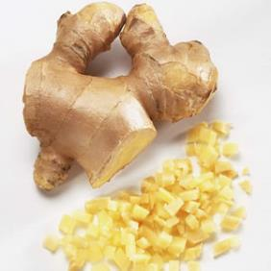
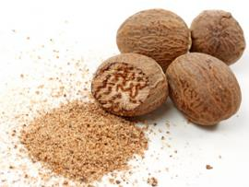
Next: Pie Filling
Ingredients:
Canned Pumpkin
Sugar
Cinnamon
Ginger
Nutmeg
Sweet Milk
Eggs
Salt

Slide 17
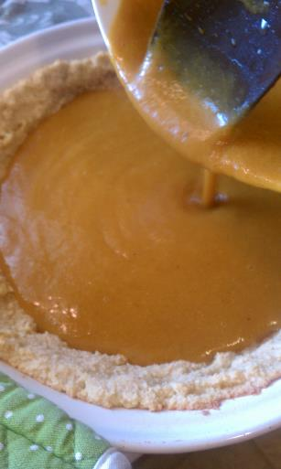
Pumpkin pie recipe
_____ all the ingredients in a bowl to make the filling.
_____, _____ the filling into the pie crust.

Slide 18
Pumpkin pie recipe
_________, put the pie in the oven and ______ it for one hour. After it cools, let’s eat!

Slide 19
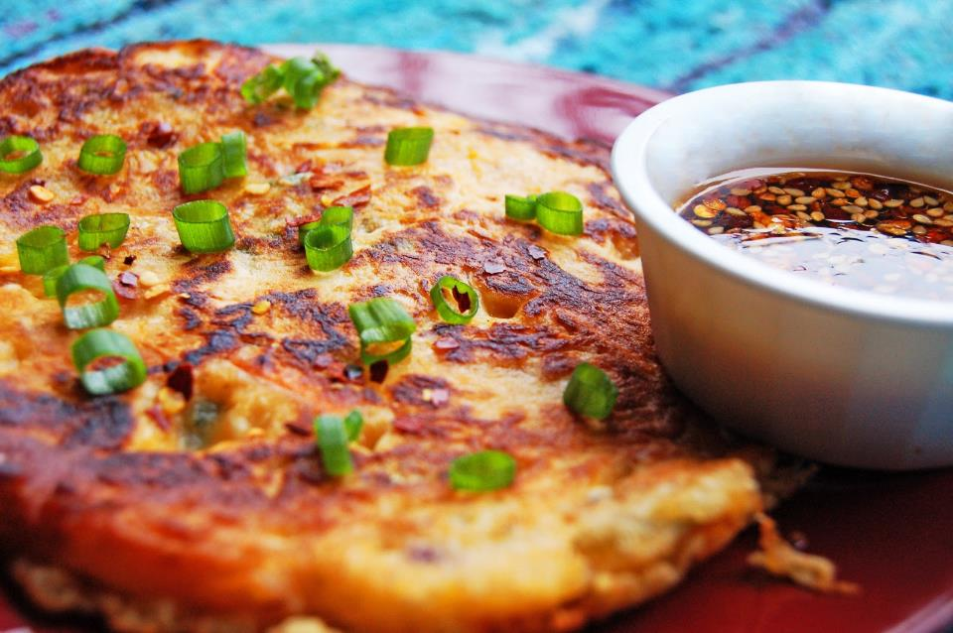
Now let’s make a kimchi pancake! (Jeon)

Slide 20
What do we need?
Ingredients:
Cooking Equipment:

Slide 21
Goal #3
Students will create their own recipe using fall foods.

