Slide 1
카드 빨리 집기 놀이
Slap Game/
Grab the Card Game

Slide 2
Instructions for teacher:
Number of students: 2 students per card set
Materials
-1 set of Picture cards/word cards/sentence cards (per 2 students)

Slide 3
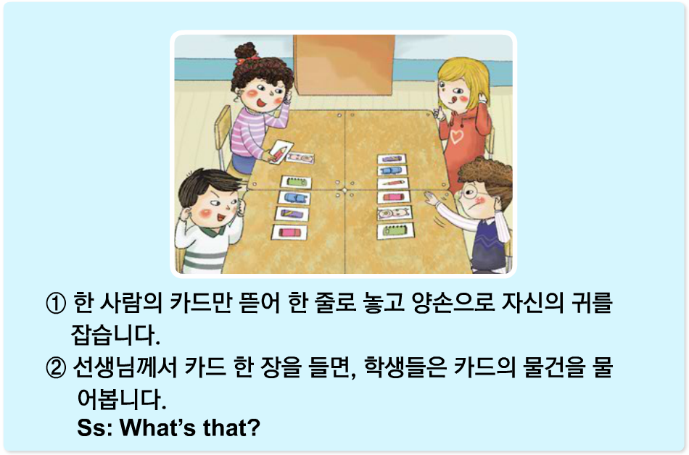

Slide 4
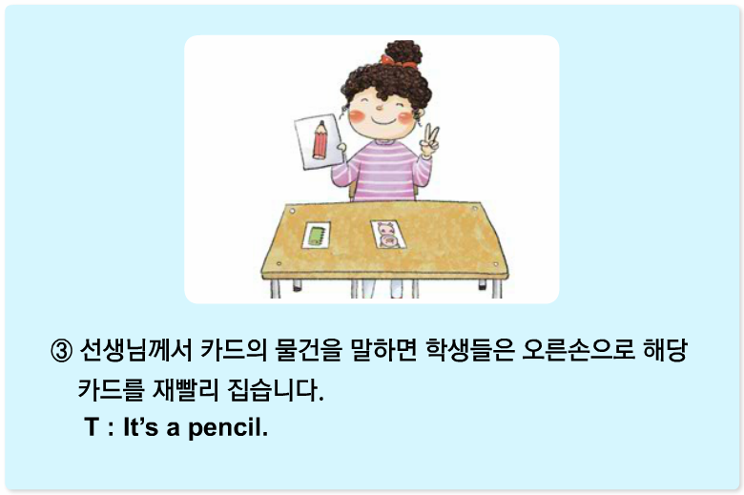

Slide 5
