Slide 1
Do you know about….?
QUIZ

Slide 2
Rules (규칙)
There may be more than one right answer.
답이 하나 보다 가능해요.
Choose only 1 answer.
하나만 정답을 고르세요

Slide 3
1
2
3
4
5
6
7
8
9
10
11
12
13
14
15
16
17
18
19
20
21
22
23
24

Slide 4
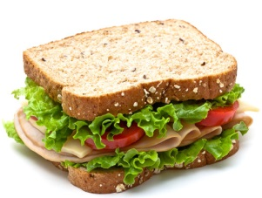
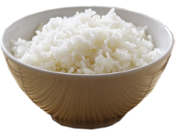
What do foreigners eat for breakfast?
Oatmeal
Ice cream
+3
-1
Rice
Sandwiches
-1
-1

Slide 5
What do foreigners drink for breakfast?
Juice
Coke
+2
-1
Beer
Coffee
-1
+3

Slide 6
What do foreigners eat for lunch?
Sandwiches
Tacos
+2
-1
Cereal
Spaghetti
-1
-1

Slide 7
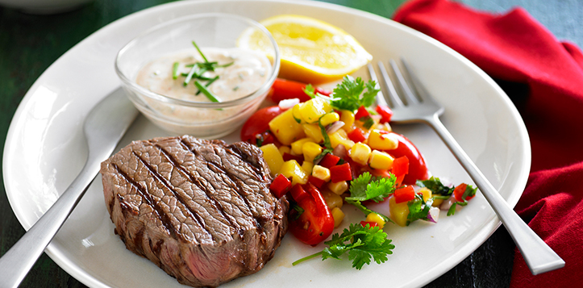
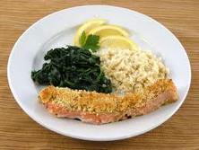
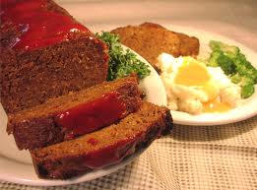
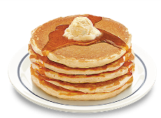
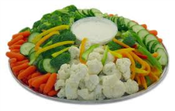
What do foreigners eat for dinner?
Chicken and Rice
Meatloaf
+2
+4
Pancakes
Vegetables
-1
-1

Slide 8
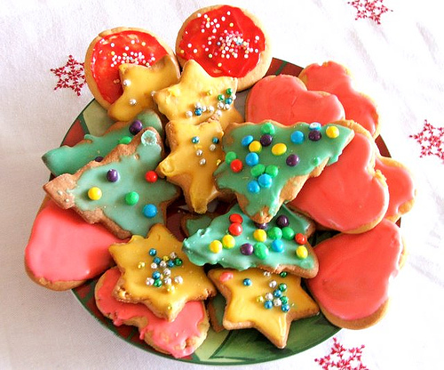
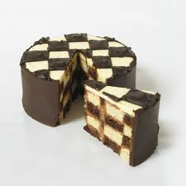
What do foreigners eat for dessert?
Cake
+5
Ice Cream
+1
Pie
+2
Tacos
-2

Slide 9
What do foreigners drink?
Juice
Kool-Aid
+1
+1
Aloe Vera Juice
Mango Juice
-1
-1

Slide 10
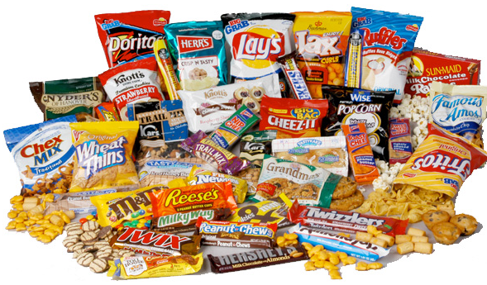
What do foreigners eat for a snack?
Chips
Pizza
+2
-2
Ice Cream
Pie
-1
-1

Slide 11
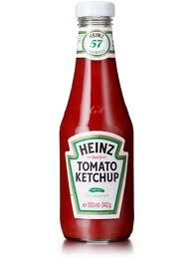
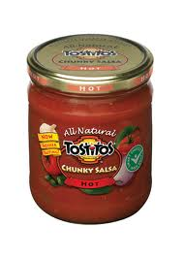
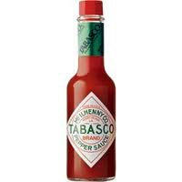
What sauces do foreigners eat?
+1
+3
+2

Slide 12
D_______
Diner
+2

Slide 13
F________ restaurant
Family Restaurant.
+3

Slide 14
What’s this?
Cola
Coca Cola
-1
-1
Diet Cola
Coke
-1
+2

Slide 15
What’s this?
Cider
Lemon Drink
-1
-1
Sprite
Soft drink
+1
-1

Slide 16
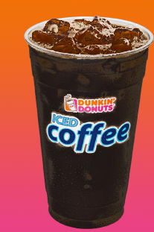
Do you know about Show Me the Money 4?
Do you know who Jennifer’s favorite rapper is?
Black Coffee
+3

Slide 17
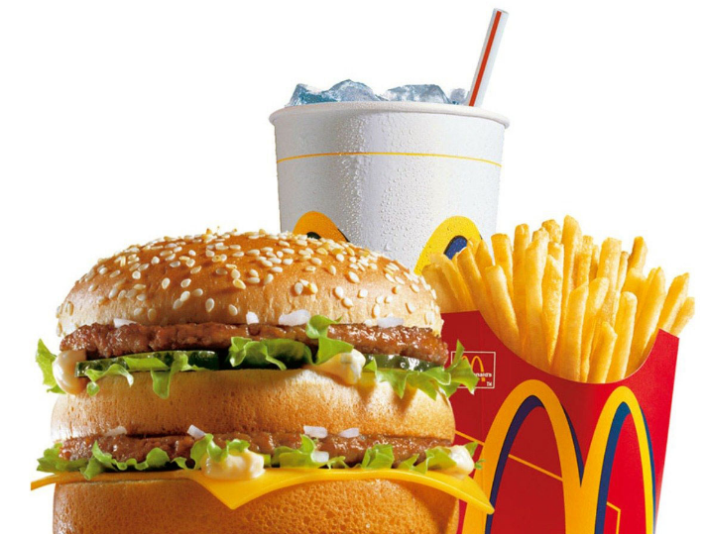
What’s this?
Combo / Combo meal
+2

Slide 18
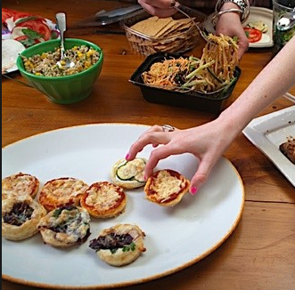
What’s this?
On the house
Free of charge
Complimentary
+8

Slide 19
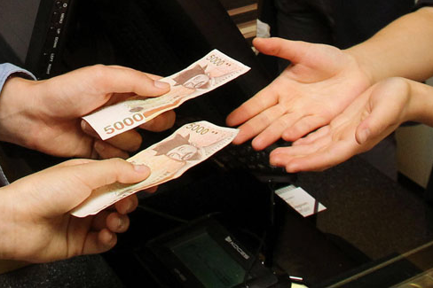
What’s this?
Let’s _____ _______.
Let’s _____ the bill.
pay dutch
split
+5
+3

Slide 20
Which is a fast food restaurant?
+3
-1
-1

Slide 21
Which is a family restaurant ?
+2
+4
-2

Slide 22
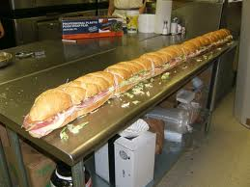
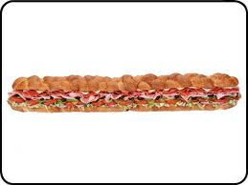
What’s the name of this food?
Sub
Sandwich
+2
-1
Subway
Meat
-1
-1

Slide 23
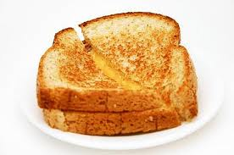
What’s the name of this food?
Cheese Sandwich
Grilled Cheese
-1
+3
Sandwich
Cheese
-1
-1

Slide 24
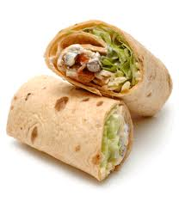
What’s the name of this food?
Sandwich
-1
Wrap
+4
Tortilla
Salad
-1
-1

Slide 25
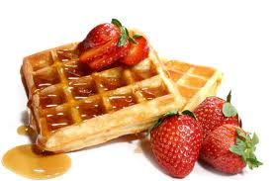
What’s the name of this food?
Wapples
Waffles
-1
+3
Toast
French Toast
-1
-1

Slide 26
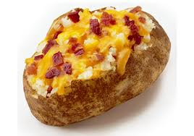
What’s the name of this food?
Cheese Bacon Potato
Cheese Potato
-1
-1
Cooked Potato
Baked Potato
-1
+6

Slide 27
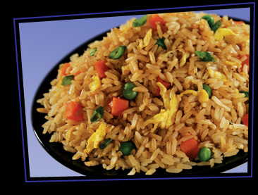
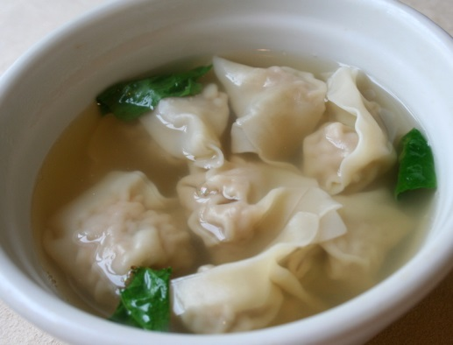
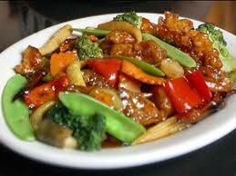
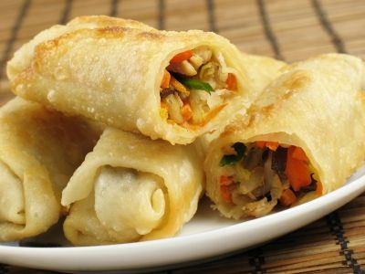
What’s this?
Vegetables
Chinese takeout
-1
+5
Rice
Delivery
-1
-1

