Slide 1
Make a Tail Game
“꼬리 만들기” 놀이

Slide 2
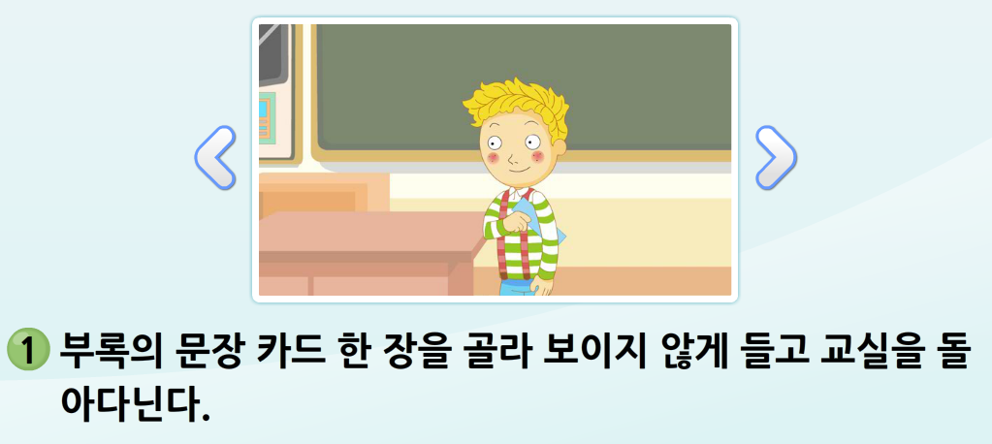
1) Choose 1 of the 3 sentence cards. Take it and walk around the classroom. Don’t show it to your friends.

Slide 3
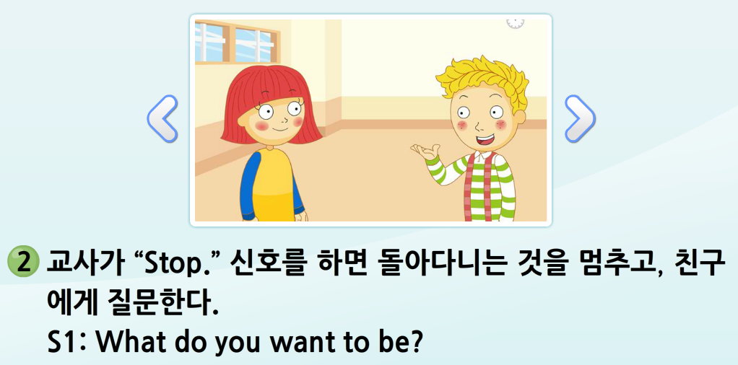
2) When I say “stop,” ask your friend (S2) “What do you want to be?”

Slide 4
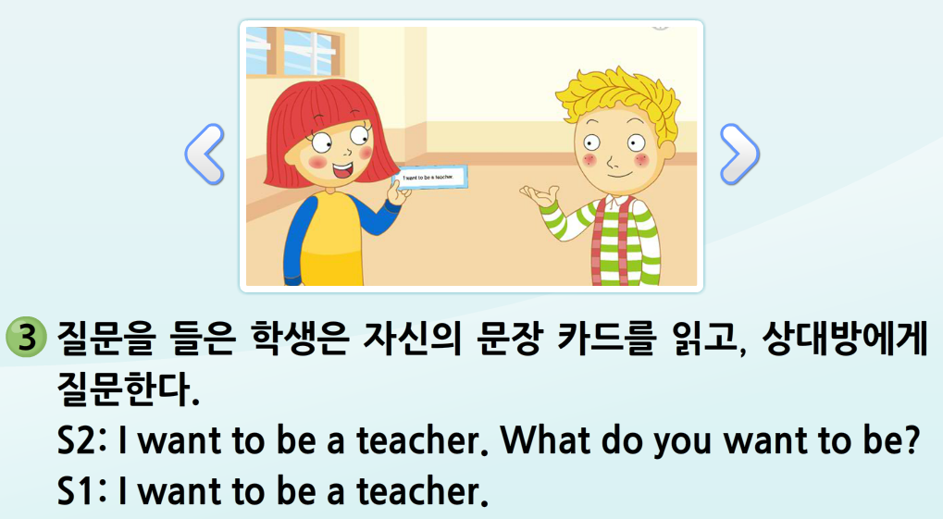
3) Your friend (S2) will answer “I want to be a/an ____________.”

Slide 5
4) If you have the same card, do rock-paper-scissors.
5) If you have different cards, read your sentences, then keep walking around the classroom.
6) When everyone is part of the tail, the game ends. The student with the longest tail wins!

