Slide 2
ICOMANIA GAME
You will see a picture or ‘icon’.
The picture is a hint for something famous.
If you can guess what it is, raise your hand.
Correct answer = 1 point for your team.
Categories:
CITIES
COUNTRIES
TV/MOVIES
VIDEO GAMES
FAMOUS PEOPLE
CHARACTERS
BRANDS

Slide 3
CITIES :
HOW TO ANSWER
The city is ____________.

Slide 4
CITIES
Paris

Slide 5
CITIES
New York

Slide 6
CITIES
Hollywood / LA /
Los Angeles

Slide 7
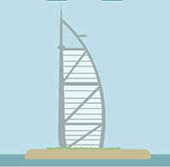
CITIES
Dubai

Slide 8
CITIES
Sydney

Slide 9
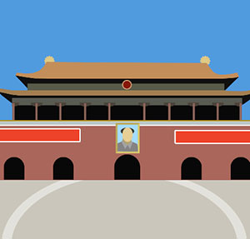
CITIES
Beijing

Slide 10
CITIES
Rome

Slide 11
CITIES
San Francisco

Slide 12
CITIES
Cairo

Slide 13
CITIES
London

Slide 14
CITIES
Las Vegas

Slide 15
TV & MOVIES :
HOW TO ANSWER
The movie is __________.

Slide 16
TV & MOVIES
shrek

Slide 17
TV & MOVIES
Jurassic park

Slide 18
TV & MOVIES
Ice age

Slide 19
TV & MOVIES
avatar

Slide 20
TV & MOVIES
superman

Slide 21
TV & MOVIES
Avengers

Slide 22
TV & MOVIES
titanic

Slide 23
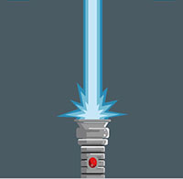
TV & MOVIES
star wars

Slide 24
TV & MOVIES
The lion king

Slide 25
TV & MOVIES
Kung fu panda

Slide 26
TV & MOVIES
X-men

Slide 27
TV & MOVIES
terminator

Slide 28
TV & MOVIES
et

Slide 29
TV & MOVIES
spiderman

Slide 30
TV & MOVIES
the Little mermaid

Slide 31
VIDEO GAMES :
how to answer
The game is ________.

Slide 32
VIDEO GAMES
Sudden Attack

Slide 33
VIDEO GAMES
Sonic

Slide 34
VIDEO GAMES
Super Mario

Slide 35
VIDEO GAMES
League of Legends

Slide 36
VIDEO GAMES
Starcraft

Slide 37
VIDEO GAMES
Pokemon

Slide 38
VIDEO GAMES
Minecraft

Slide 39
BRAND :
HOW TO ANSWER
The brand is ________

Slide 40
BRAND
Hyundai

Slide 41
BRAND
KFC

Slide 42
BRAND
The North Face

Slide 43
BRAND
LEGO

Slide 44
BRAND
YouTube

Slide 45
BRAND
Red Bull

Slide 46
BRAND
Oral B

Slide 47
BRAND
Twix

Slide 48
BRAND
Hello Kitty

Slide 49
BRAND
Home plus

Slide 50
BRAND
Twitter

Slide 51
BRAND
Pringles

Slide 52
BRAND
LG

Slide 53
BRAND
Kellogg’s

Slide 54
BRAND
IMAX

Slide 55
BRAND
Baskin Robbins

Slide 56
BRAND
Canon

Slide 57
BRAND
Pixar

Slide 58
BRAND
Playstation

Slide 59
BRAND
Ferrari

Slide 60
BRAND
Lacoste

Slide 61
BRAND
Intel

Slide 62
BRAND
Skype

Slide 63
BRAND
Windows

Slide 64
BRAND
Facebook

Slide 65
FAMOUS PEOPLE :
HOW TO ANSWER
The person is ________

Slide 66
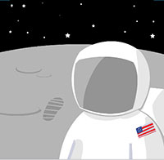
FAMOUS PEOPLE
Neil armstrong

Slide 67
FAMOUS PEOPLE
Johnny depp

Slide 68
FAMOUS PEOPLE
Galileo

Slide 69
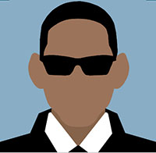
FAMOUS PEOPLE
Will smith

Slide 70
FAMOUS PEOPLE
elvis PRESLEY

Slide 71
FAMOUS PEOPLE
Marylin monroe

Slide 72
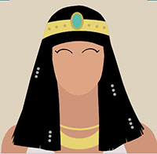
FAMOUS PEOPLE
cleopatra

Slide 73
FAMOUS PEOPLE
Lady gaga

Slide 74
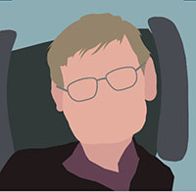
FAMOUS PEOPLE
Stephen hawking

Slide 75
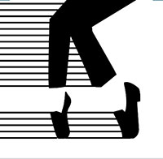
FAMOUS PEOPLE
Michael jackson

Slide 76
FAMOUS PEOPLE
Justin bieber

Slide 77
FAMOUS PEOPLE
Isaac Newton

Slide 78
FAMOUS PEOPLE
Barack obama

Slide 79
FAMOUS PEOPLE
psy

Slide 80
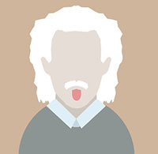
FAMOUS PEOPLE
Albert einstein

Slide 81
FAMOUS PEOPLE
Usain bolt

Slide 82
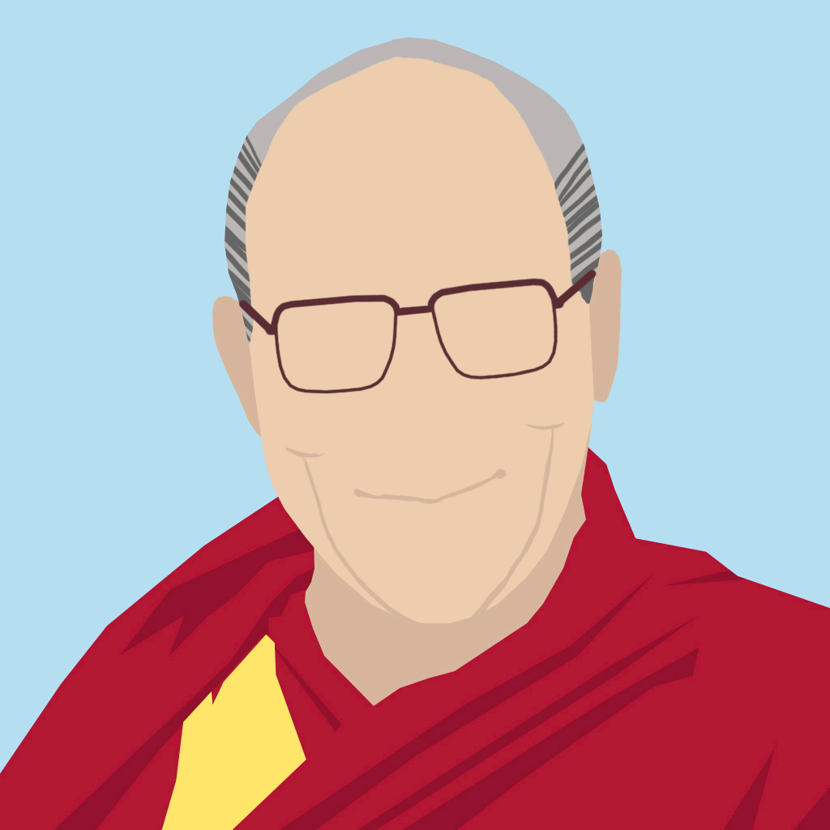
FAMOUS PEOPLE
Dalai lama

Slide 83
FAMOUS PEOPLE
Bill gates

Slide 84
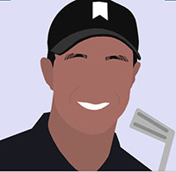
FAMOUS PEOPLE
Tiger woods

Slide 85
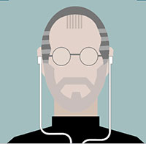
FAMOUS PEOPLE
Steve jobs

Slide 86
COUNTRIES :
How to answer
The country is ___________.

Slide 87
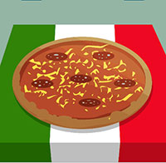
COUNTRIES
Italy

Slide 88
COUNTRIES
United Kingdom

Slide 89
COUNTRIES
India

Slide 90
COUNTRIES
South Africa

Slide 91
COUNTRIES
Egypt

Slide 92
COUNTRIES
Mexico

Slide 93
COUNTRIES
Switzerland

Slide 94
COUNTRIES
Greece

Slide 95
COUNTRIES
Cuba

Slide 96
COUNTRIES
Brazil

Slide 97
COUNTRIES
Canada

Slide 98
COUNTRIES
Russia

Slide 99
COUNTRIES
Japan

Slide 100
COUNTRIES
China

Slide 101
COUNTRIES
USA

Slide 102
Characters :
how to answer
The character is ________.

Slide 103
Characters
Nemo

Slide 104
Characters
Donald Duck

Slide 105
Characters
Mickey Mouse

Slide 106
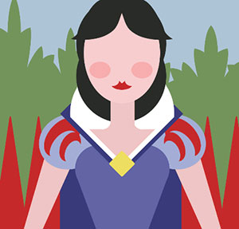
Characters
Snow White

Slide 107
Characters
Homer Simpson

Slide 108
Characters
Gandalf

Slide 109
Characters
Mr. Bean

Slide 110
Characters
Pinocchio

Slide 111
Characters
Batman

Slide 112
Characters
Pocahontas

Slide 113
Characters
The (Incredible) Hulk

Slide 114
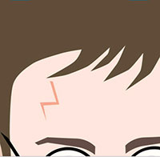
Characters
Harry Potter

Slide 115
Characters
Spongebob

Slide 116
Characters
Bart Simpson

Slide 117
Characters
Frodo

Slide 118
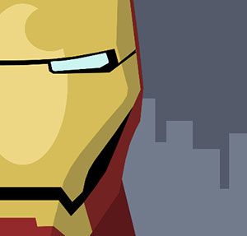
Characters
Iron Man

Slide 119
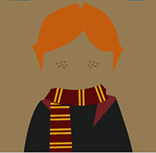
Characters
Ron Weasley

Slide 120
Characters
Sherlock Holmes

Slide 121
Characters
Buzz Lightyear

Slide 122
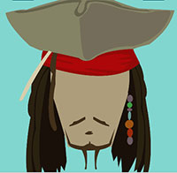
Characters
Captain Jack Sparrow

Slide 123
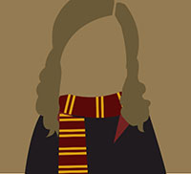
Characters
Hermione Grainger

