Slide 1
Ghibli Game
Lesson 1: I want to be a cook

Slide 2
Win points!

Slide 3
Lose points!

Slide 4
A
B
C
D
E
F
G
H
I
J
K
L
M
N
O
P
Q
R
S
T
U
V
W
X
Y
Z
1
2

Slide 5
You found a cave. Go in?
No
Yes

Slide 6
Treasure!
+5 points!

Slide 7
What do you want to be?
I want to be a teacher.

Slide 8
+2 points!

Slide 9
What do you want to be?
I want to be a doctor.

Slide 10
+4 points!

Slide 11
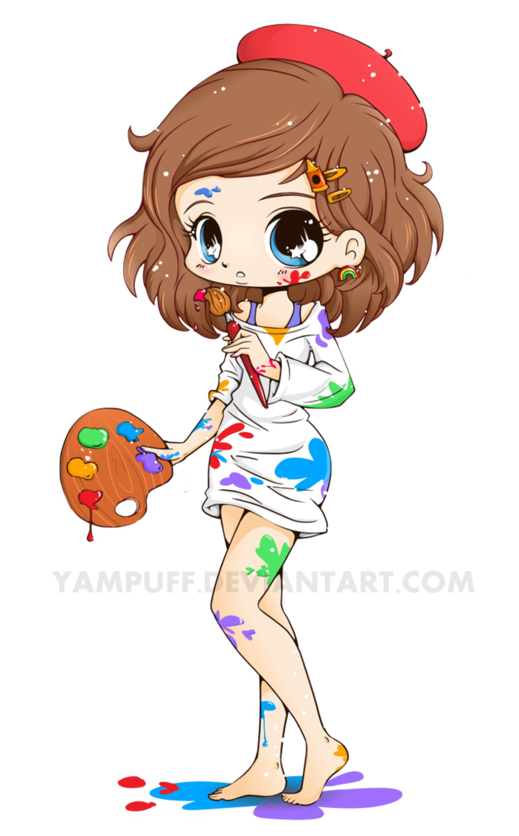
What do you want to be?
I want to be an artist

Slide 12
+1 point!

Slide 13
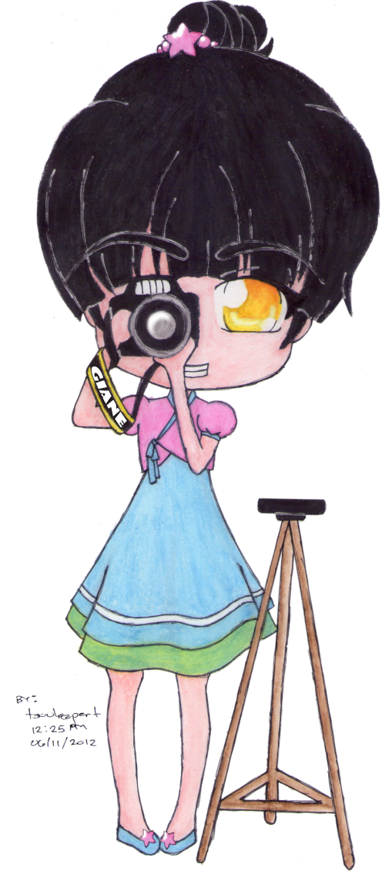
What is she good at?
She is good at taking pictures.

Slide 14
+4 points!

Slide 15
Choose!
1
2
3

Slide 16
Rock, paper, scissors!
Losing team -5 points!

Slide 17
Rock, paper, scissors! Win +5 points!

Slide 18
Steal 4 points!

Slide 19
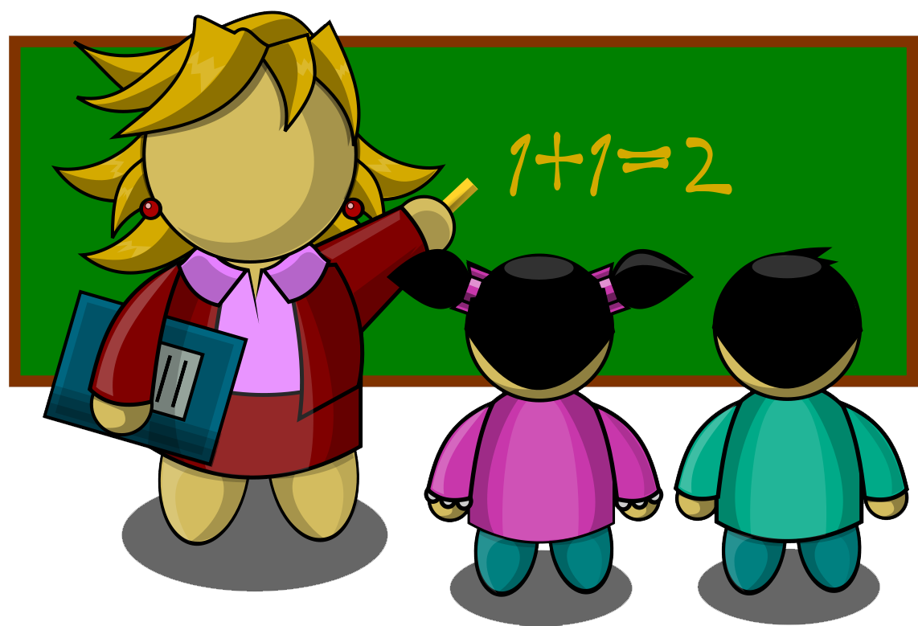
What are you good at?
I am good at teaching.

Slide 20
+3 points!

Slide 21
It’s a cat bus!
Get on?
Yes
No

Slide 22
Your friends are here!
+10 points!

Slide 23
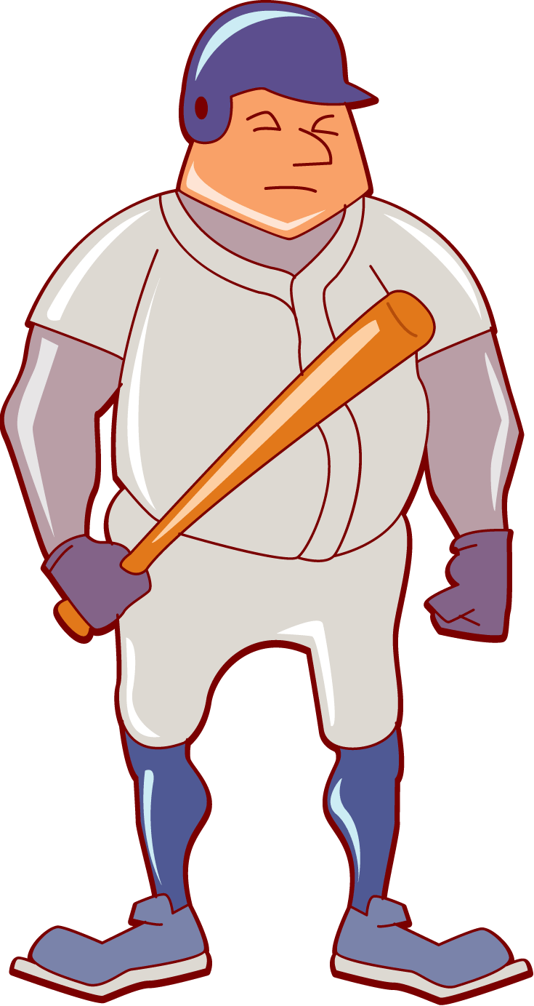
What do you want to be?
I want to be a baseball player.

Slide 24
+1 point!

Slide 25
You found a house. Go in?
Yes
No

Slide 26
It’s scary!
-4 points!

Slide 27
What do you want to be?
I want to be a pianist.

Slide 28
+1 point!

Slide 29
What do you want to be?
I want to be a writer.

Slide 30
+3 points!

Slide 31
Choose!
1
2
3

Slide 32
Rock, paper, scissors! Win +5 points!

Slide 33
Steal 3 points!

Slide 34
+10 points!

Slide 35
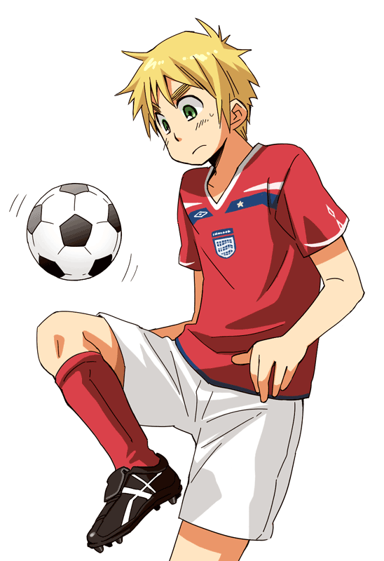
What do you want to be?
I want to be a soccer player.

Slide 36
+2 points!

Slide 37
What is he good at?
He is good at running.

Slide 38
+2 points!

Slide 39
What is she good at?
She is good at singing.

Slide 40
+5 points!

Slide 41
What do you want to be?
I want to be a police officer.

Slide 42
+1 point!

Slide 43
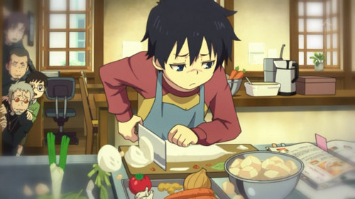
What is he good at?
He is good at cooking.

Slide 44
+3 points!

Slide 45
What are you good at?
I am good at painting.

Slide 46
+5 points!

Slide 47
What is she good at?
She is good at playing the piano.

Slide 48
+2 points!

Slide 49
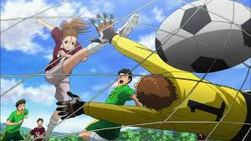
What are you good at?
I am good at playing soccer.

Slide 50
+2 points!

Slide 51
Choose!
1
2
3

Slide 52
Totoro is angry!
Lose all points!

Slide 53
+10 points!

Slide 54
Steal 5 points!

Slide 55
You found a castle. Go in?
Yes
No

Slide 56
It’s haunted!
Lose all points!

Slide 57
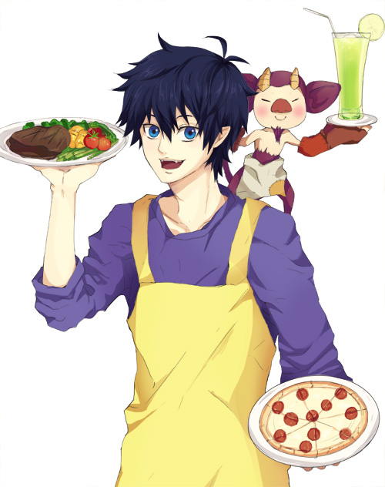
What do you want to be?
I want to be a cook.

Slide 58
+1 point!

Slide 59
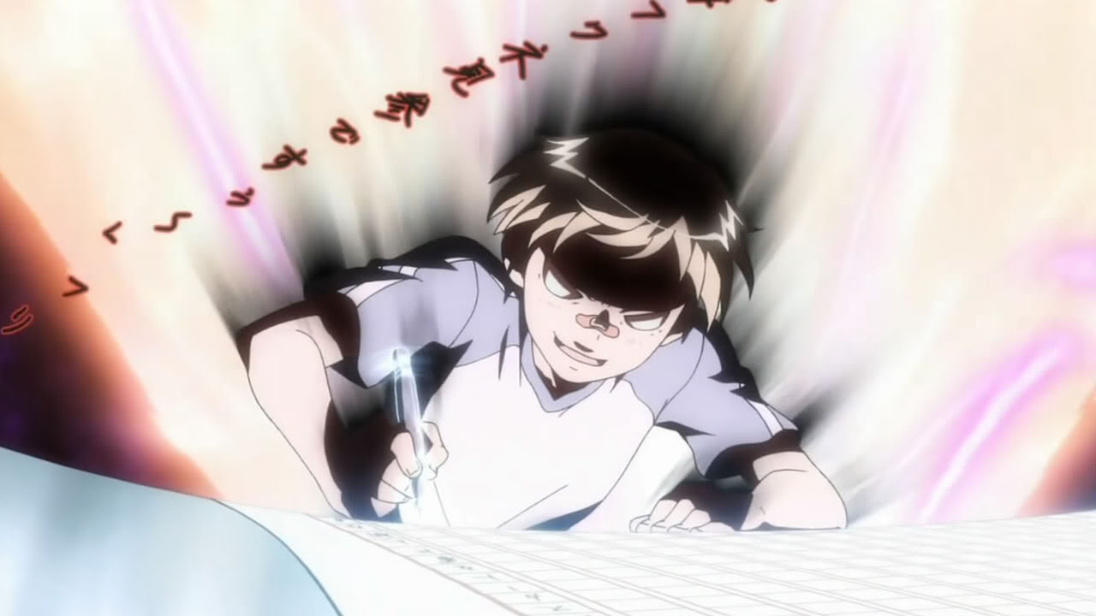
What are you good at?
I am good at writing.

Slide 60
+3 points!

Slide 61
What is she good at?
She is good at singing.

Slide 62
+1 point!

Slide 63
Choose!
1
2
3

Slide 64
Rock, paper, scissors! Win +5 points!

Slide 65
+10 points!

Slide 66
01100100 01101001 01100101
All teams lose all points!

Slide 67
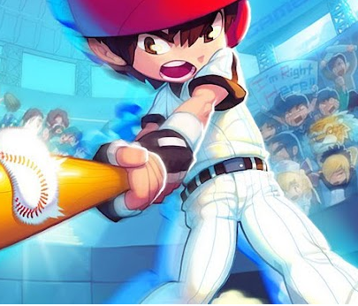
What is he good at?
He is good at playing baseball.

Slide 68
+4 points!

