Slide 1
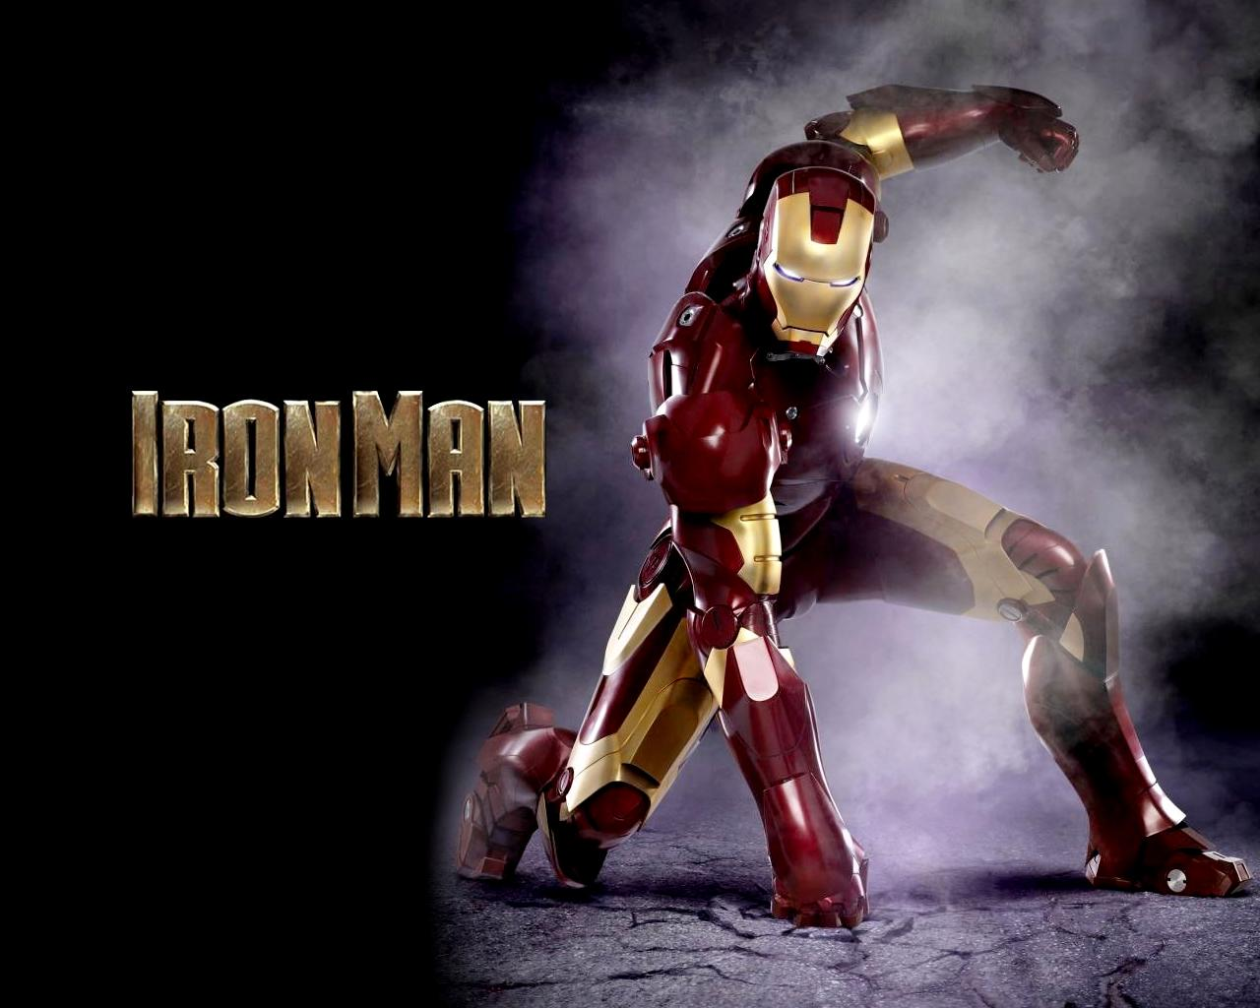
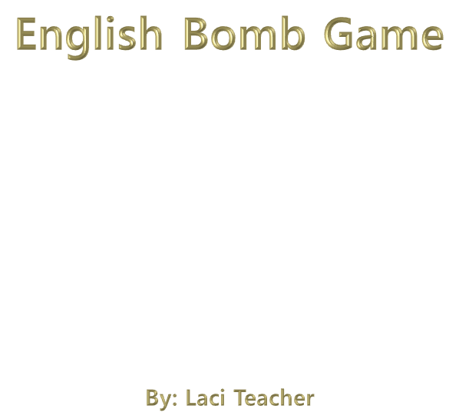


Slide 2
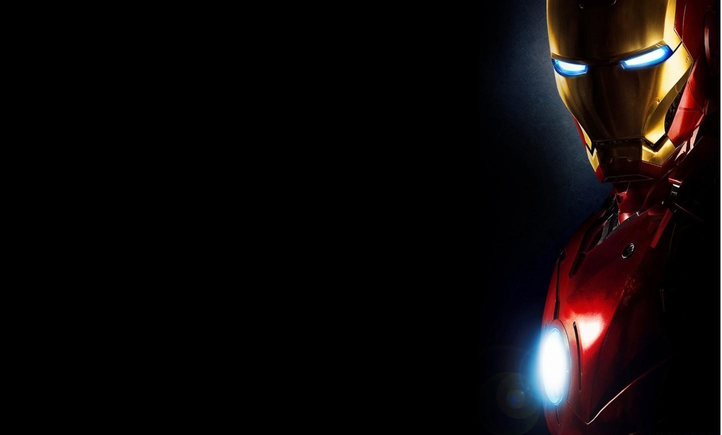

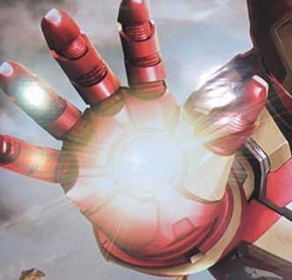

1-5 points
Change points
10 points

Slide 3
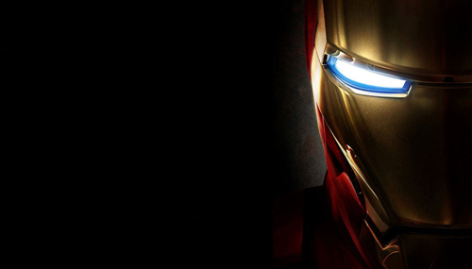
A
B
C
D
E
F
G
H
I
J
K
L
M
N
O
P
Q
R
S
T
U
V
W
X

Slide 4
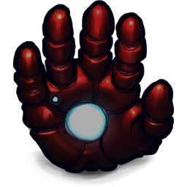
OOPS! Go Back!
Click here

Slide 5
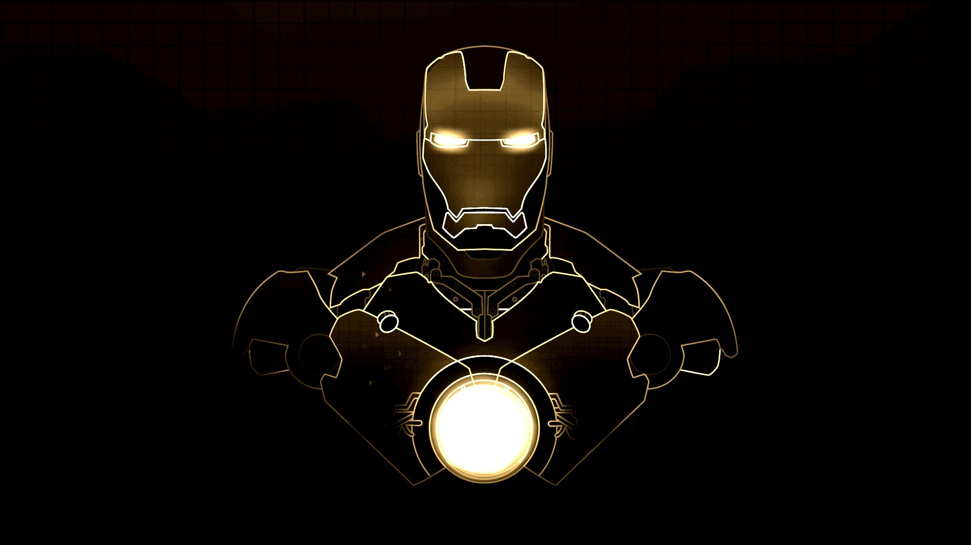

What’s this?
It’s a ball.

Slide 6
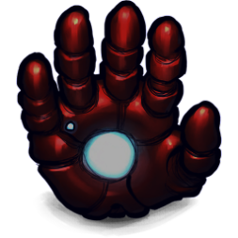

Slide 7
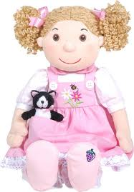
What’s this?
It’s a doll.

Slide 9
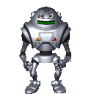
What’s this?
It’s a robot.

Slide 11

What’s this?
It’s a pencil.

Slide 12
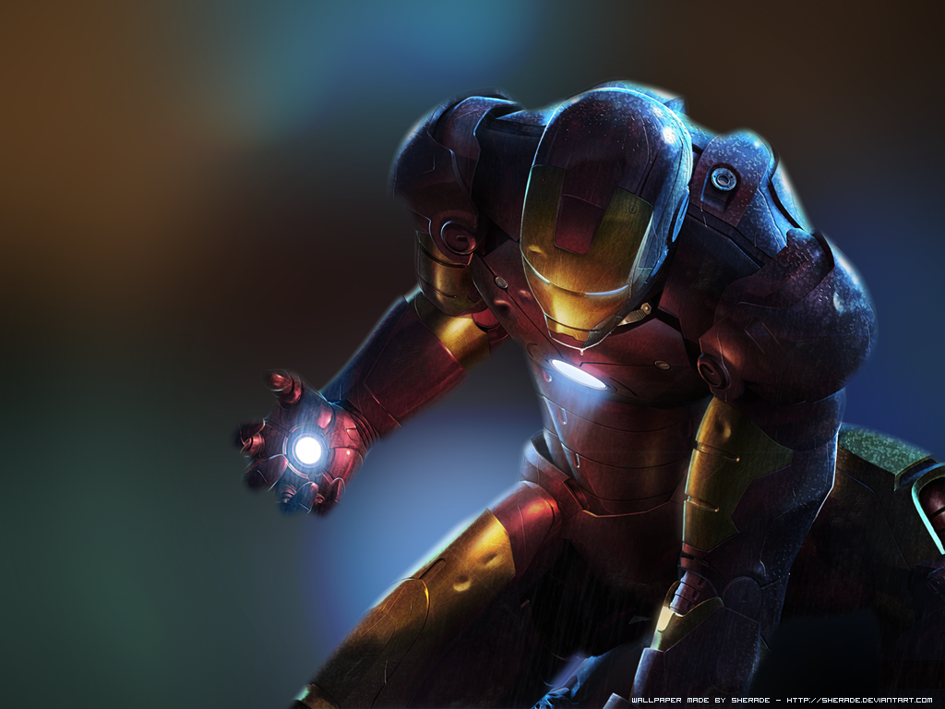
10 points

Slide 13

What’s this?
It’s a book.

Slide 15
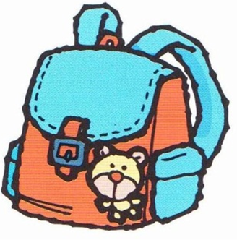
What’s this?
It’s a bag.

Slide 17
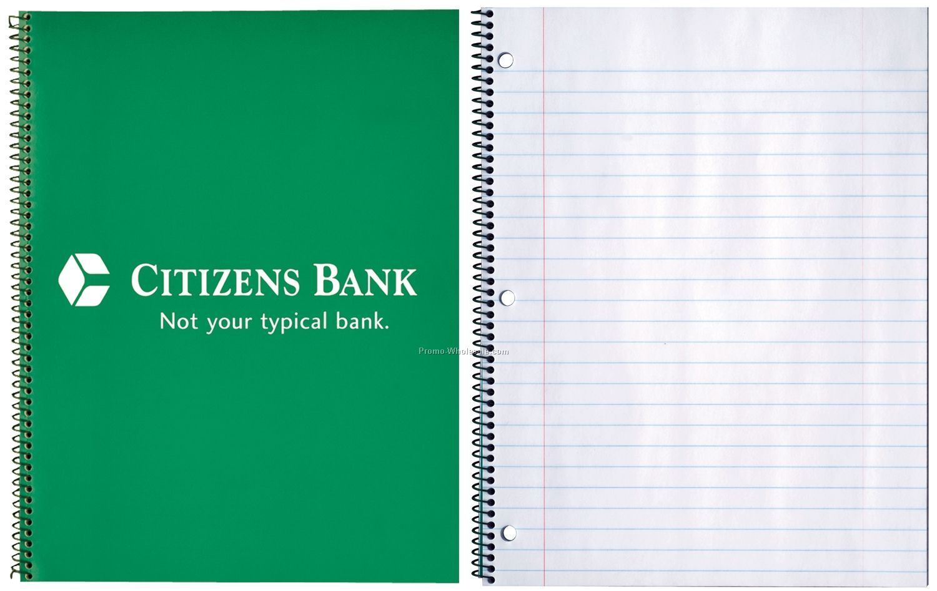
What’s this?
It’s a notebook.

Slide 18
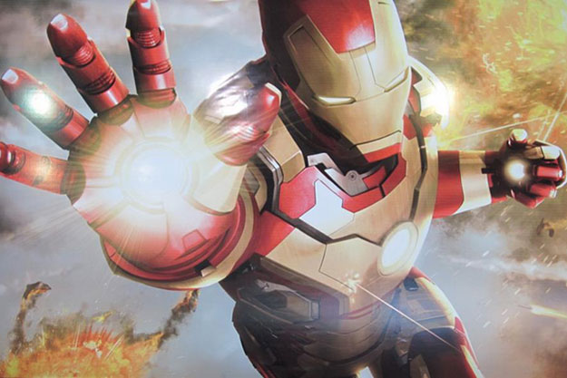
CHANGE
POINTS

Slide 19
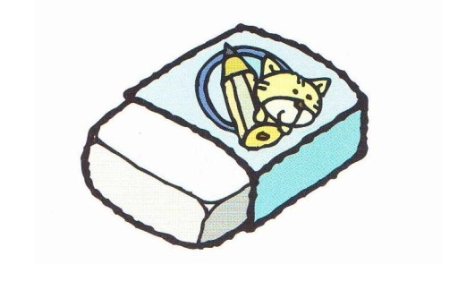
It’s __ eraser.
An.

Slide 21

T____ Y___!
Thank you.

Slide 22
10 points

Slide 23



Y____ W________!
You’re welcome.

Slide 24
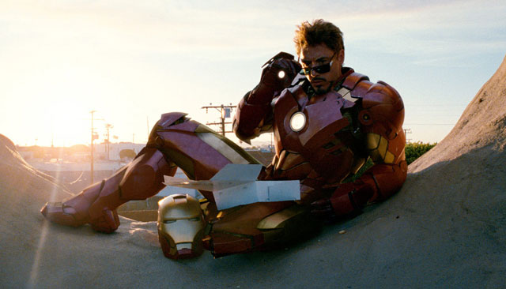
10 points
Tony Stark
IRON MAN
Lose all points

Slide 25

What’s this?
It’s a piano.

Slide 27

What’s this?
It’s a banana.

Slide 28
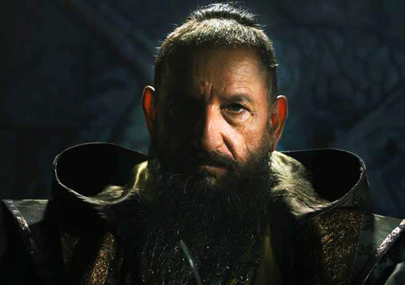
MANDARIN
Lose all points!

Slide 29


What’s _______
It’s a _______ ______
That/pencil case.

Slide 31

What’s this?
It’s a pen.

Slide 33
Unscramble the letters.
HKNAT OYU
Thank you.

Slide 34
Tony Stark
-5 points
IRON MAN
5 points

Slide 35
Unscramble the letters.
RYUO LEOWMCE
Your Welcome.

Slide 37
Unscramble the letters.
SI’T A NCIPLE
It’s a pencil.

Slide 38
CHANGE
POINTS

Slide 39
Unscramble the letters.
‘TSHWA ITSH
What’s this?

Slide 41
Unscramble the letters.
‘TSHWA ATHT
What’s that?

Slide 42
CHANGE
POINTS

Slide 43
Spell this word:
P-E-N-C-I-L

Slide 45
Spell this word:
D-O-L-L

Slide 46
MANDARIN
Lose all points!

Slide 47
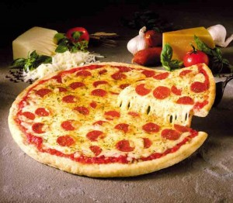
What’s this?
It’s a pizza.

Slide 49
Spell this word:
N-O-T-E-B-O-O-K

Slide 50
10 points

Slide 51

Fill in the blanks:
________ that?
_____ ____ pencil.
What’s/It’s/A

Slide 53
Question Y
Answer

Slide 54
10 points

Slide 55
Question Z
Answer

Slide 57
Question 1
Answer

Slide 59
Question 2
Answer

Slide 60
Tony Stark
IRON MAN
10 points
Lose all points

Slide 61
Question 3
Answer

Slide 63
Question 4
Answer

Slide 64
CHANGE
POINTS

