Slide 1
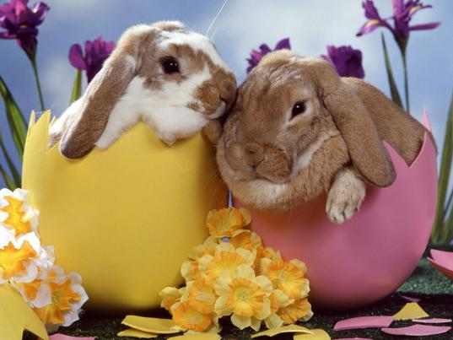
Hooray! It’s almost Easter!

Slide 2
So what?

Slide 3
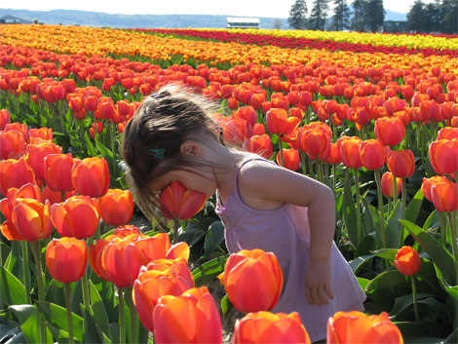
Well, that means it’s almost spring!

Slide 4
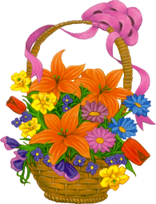
A long time ago, people celebrated the start of spring.

Slide 5
Bunnies and eggs were springtime symbols.
They meant fertility (다산) and new life.

Slide 6
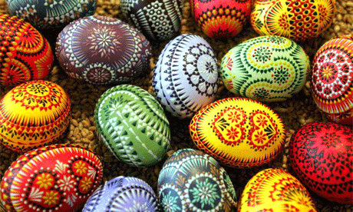
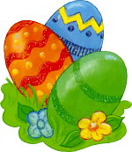
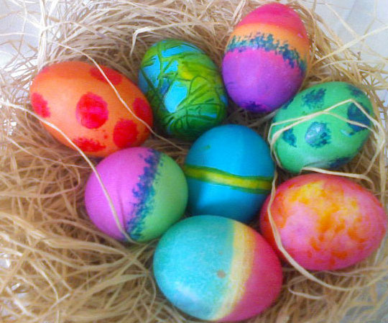
People painted eggs bright colors.

Slide 7
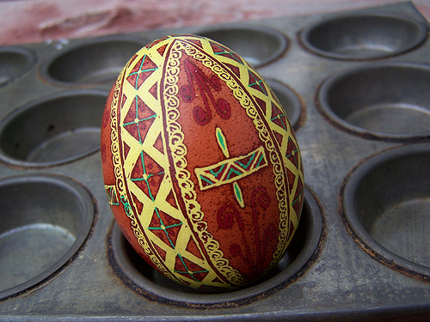
Sometimes these eggs were given as gifts.

Slide 8
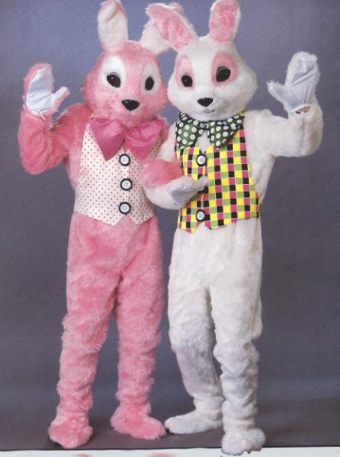
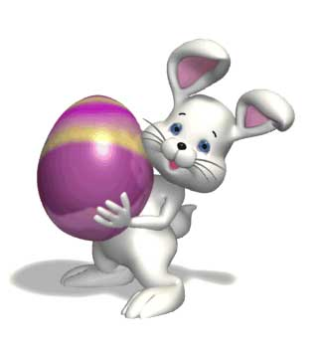
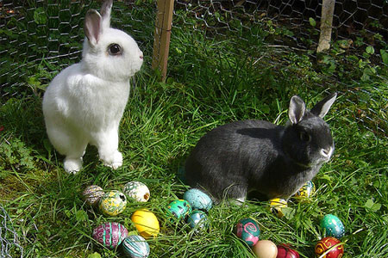
The is a symbol of Easter.
bunny

Slide 9
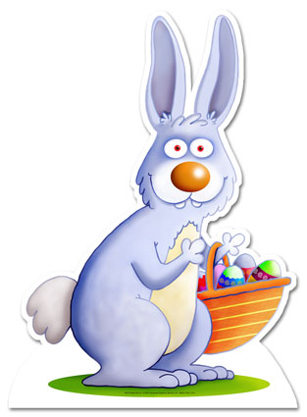
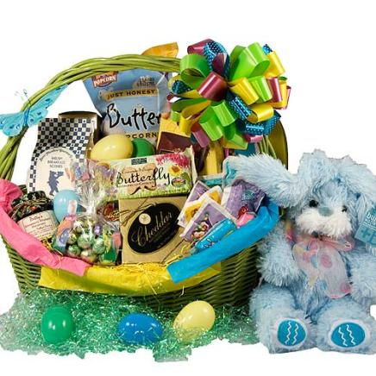
The Easter Bunny brings Easter baskets for children.
The baskets are filled with candy and gifts.

Slide 10
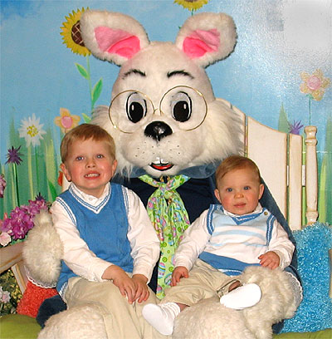
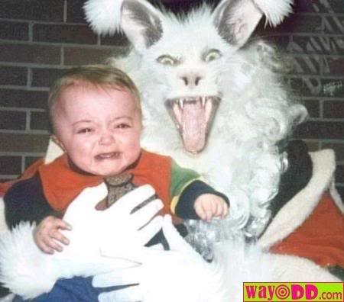
Many children get their picture taken with the Easter Bunny!

Slide 11
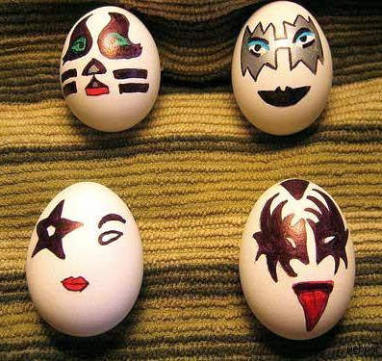
Also, people paint eggs for Easter.

Slide 12
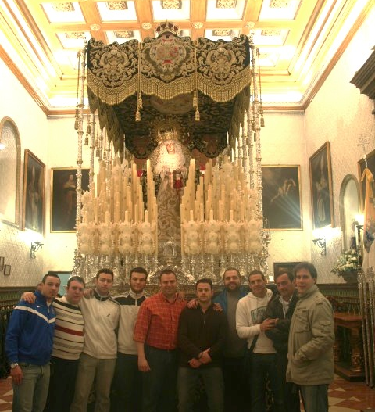
For some people, Easter is a religious holiday.

Slide 14
When we think of Easter, we think of . . .

Slide 15
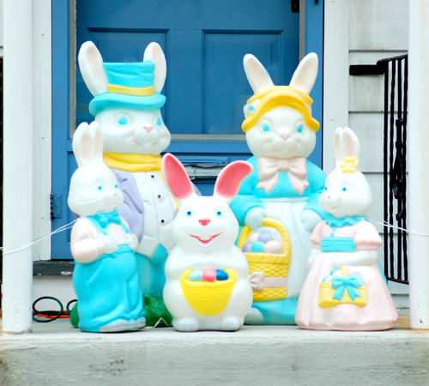
The Easter Bunny

Slide 16
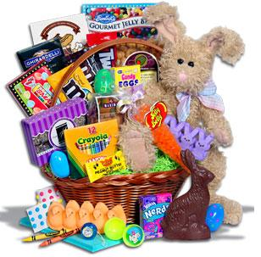
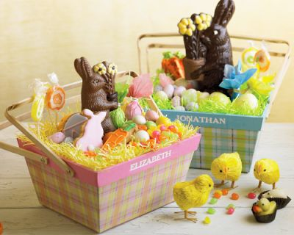
Easter baskets

Slide 18
Decorated eggs

Slide 20
Easter egg hunts

Slide 21
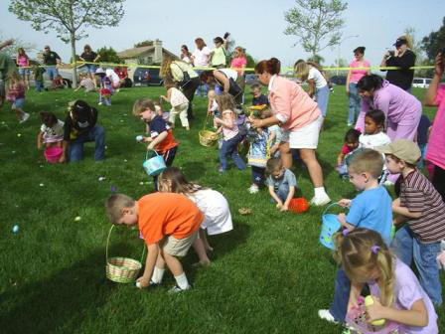
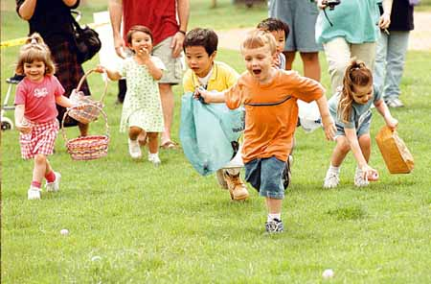
Find the egg!

Slide 22
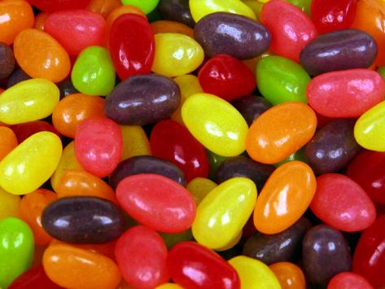
Candies and jelly beans

Slide 23
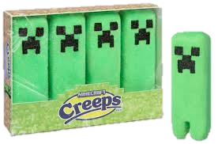
Peeps!

Slide 24
Chocolate bunnies

Slide 26
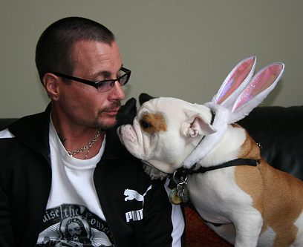
Everybody loves Easter!

Slide 27
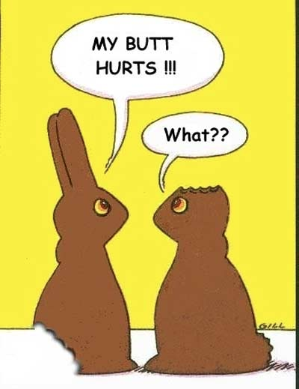

Slide 29
Easter Egg Hunt Time!

