Slide 1
The English
Alphabet

Slide 2
Aa

Slide 3
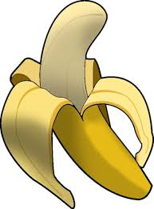
Bb

Slide 4
Cc

Slide 5
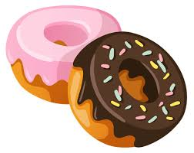
Dd

Slide 6
Ee

Slide 7
Ff

Slide 8
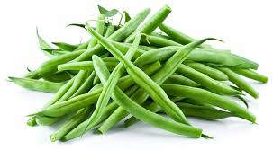
Gg

Slide 9
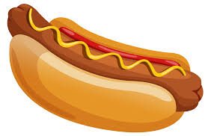
Hh

Slide 10
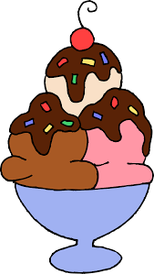
Ii

Slide 11
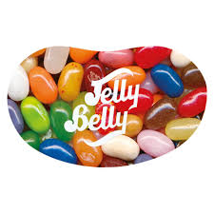
Jj

Slide 12
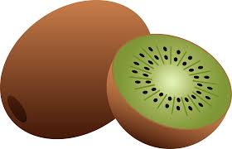
Kk

Slide 13
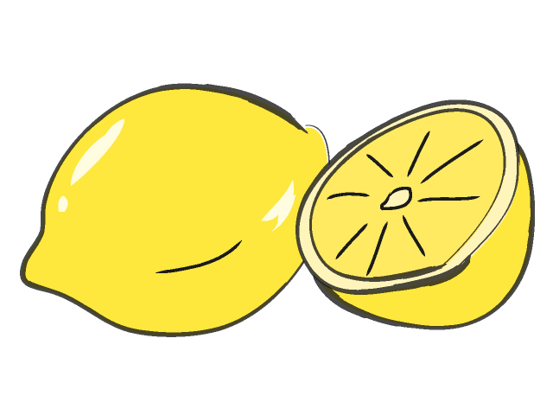
Ll

Slide 14
Mm

Slide 15
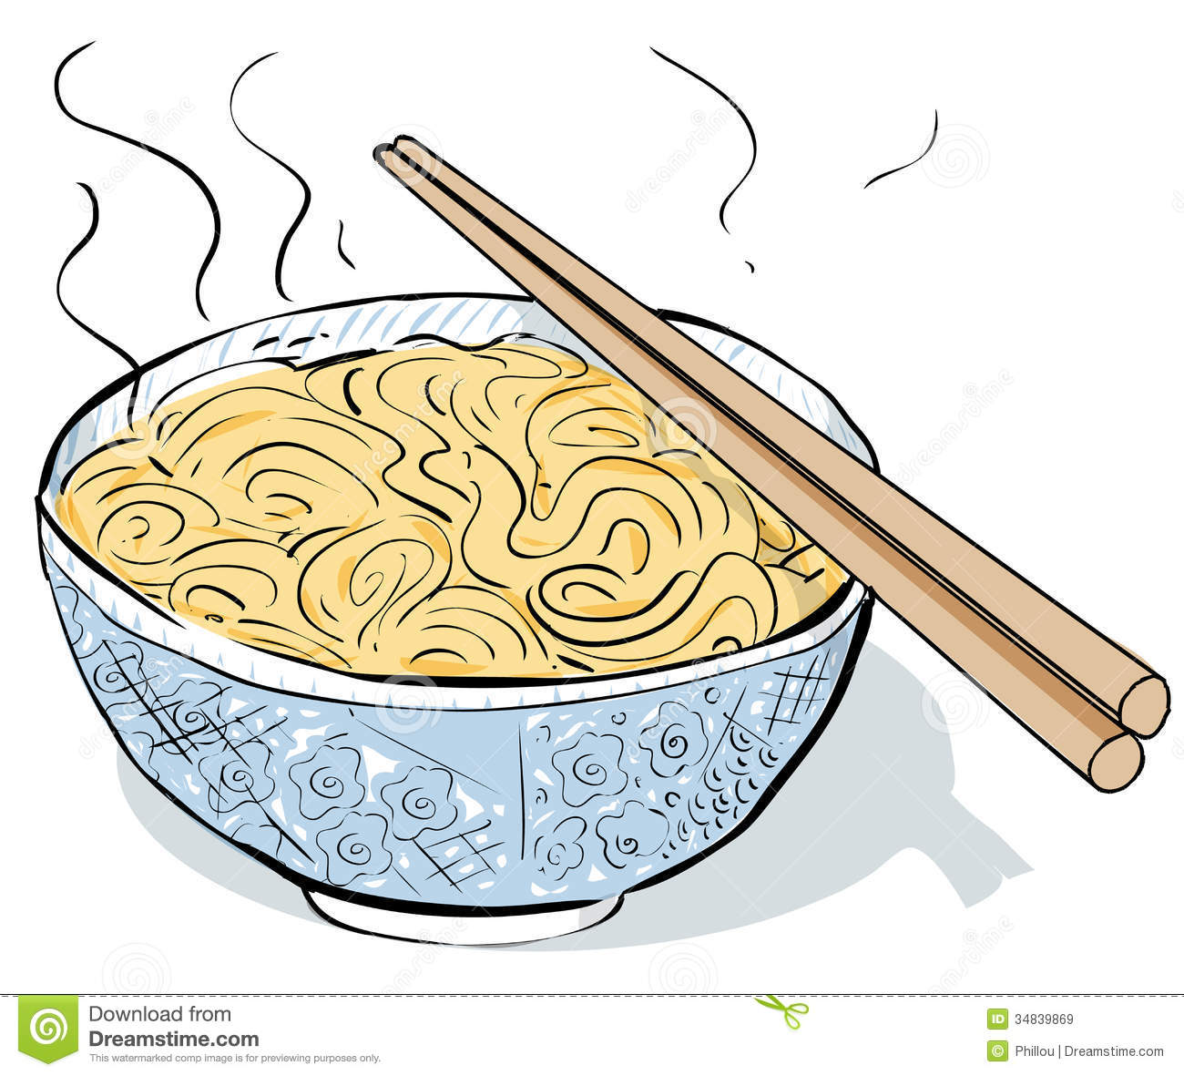
Nn

Slide 16
Oo

Slide 17
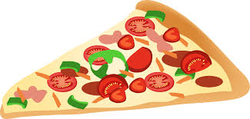
Pp

Slide 18
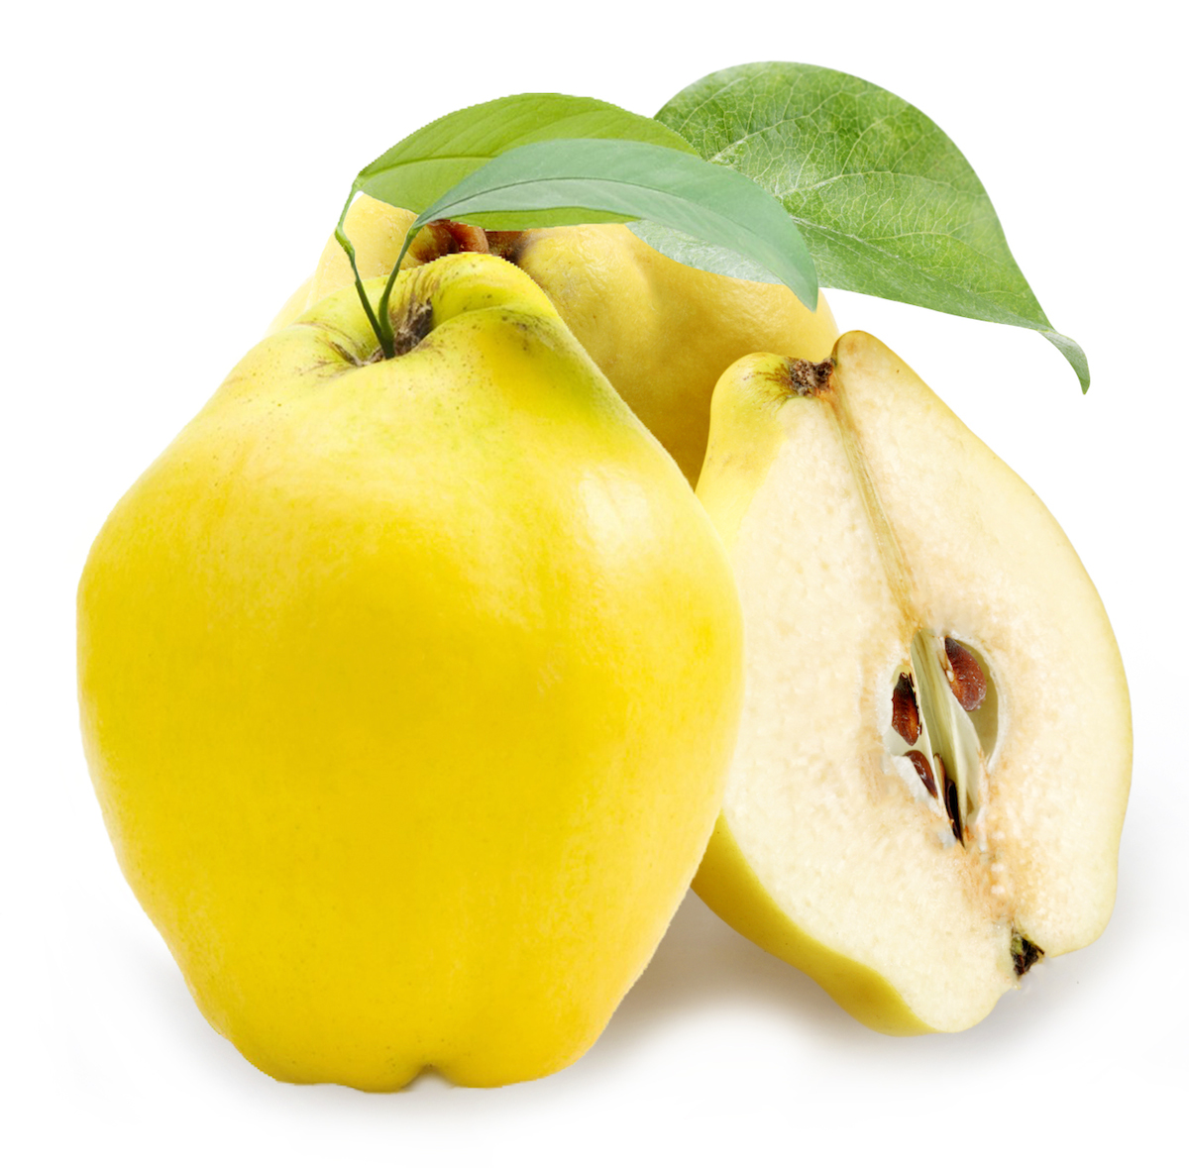
Qq

Slide 19
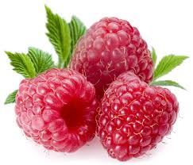
Rr

Slide 20
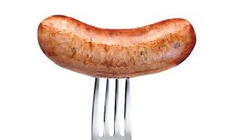
Ss

Slide 21
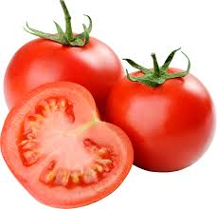
Tt

Slide 22
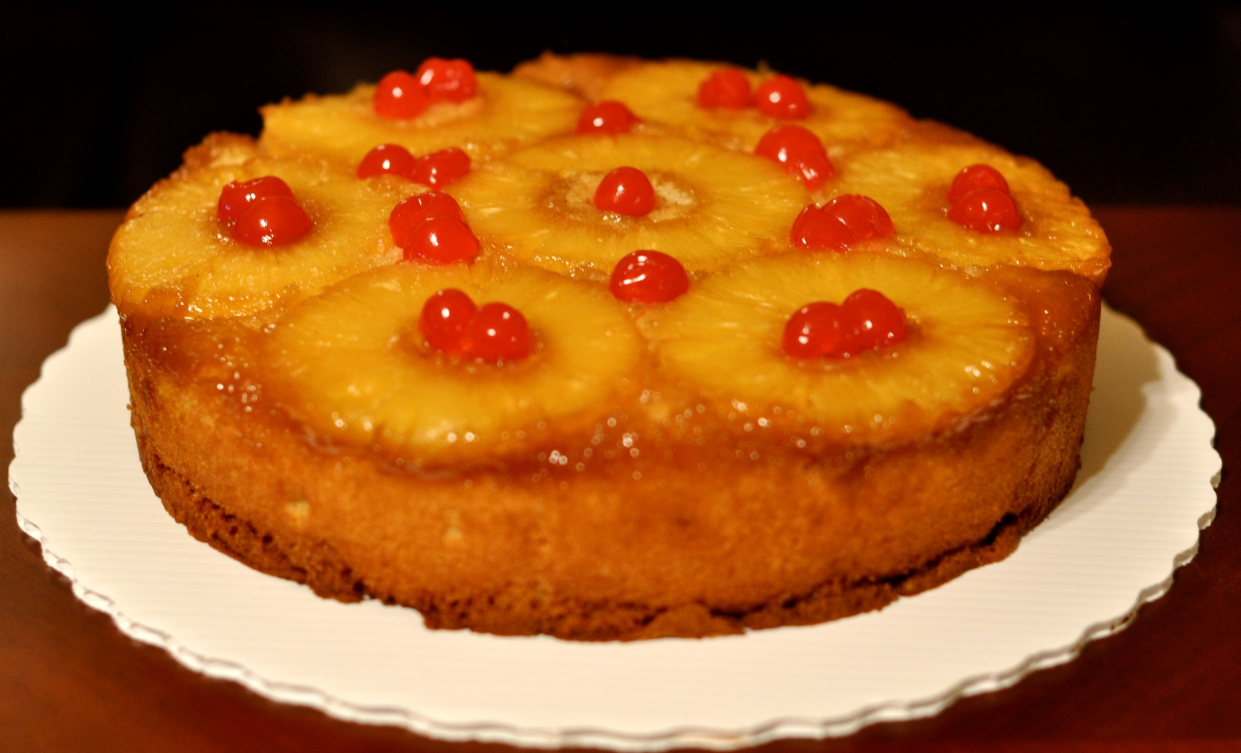
Uu

Slide 23
Vv

Slide 24
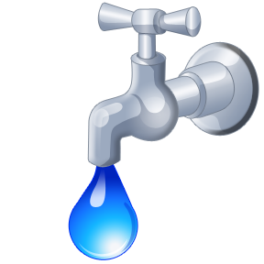
Ww

Slide 25
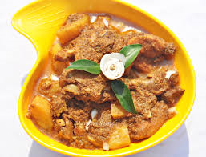
Xx

Slide 26
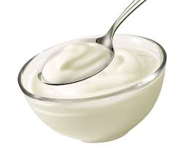
Yy

Slide 27
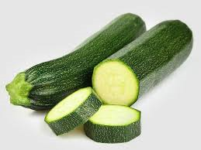
Zz

Slide 28
Now I know my ABC’s, next time won’t you sing with me?

