Slide 1
Answer this:
Where do Jewish people (유대인) live?
What countries are Israel near?
Who do Jewish people worship?

Slide 2
Hanukkah

Slide 3
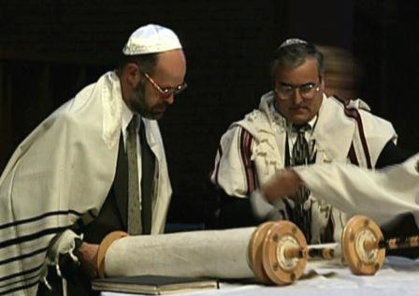
Who celebrates Hanukah?
The Jewish people! (유대인)

Slide 4
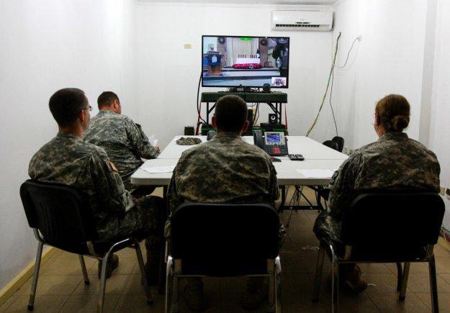
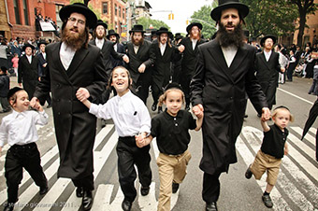
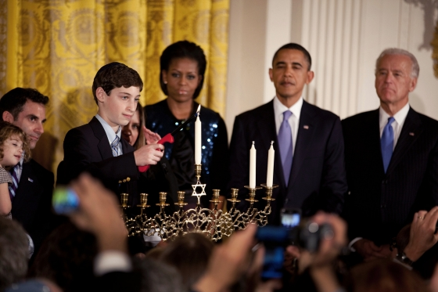
Hanukkah in America!
About 5.3 million Jewish people live in the United States.
So Hanukkah is celebrated across the US!

Slide 5
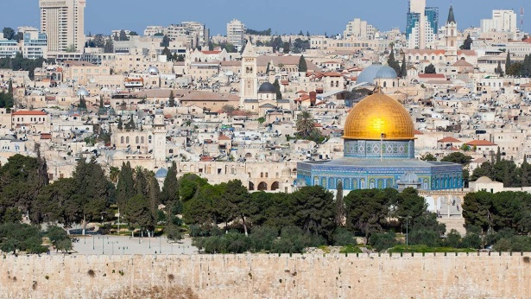
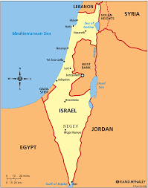
Where are the Jewish people (유대인) from?

Slide 6
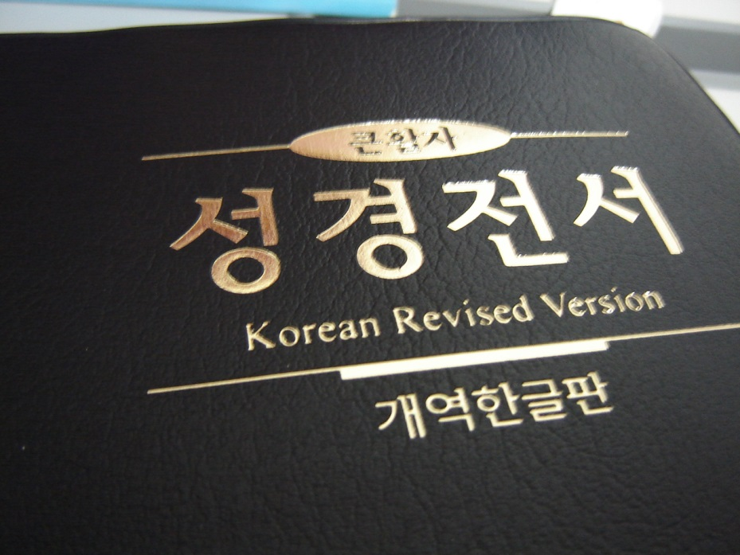
What famous book are the Jewish people in?
The Bible!

Slide 7
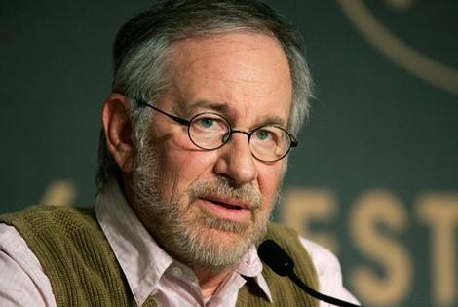
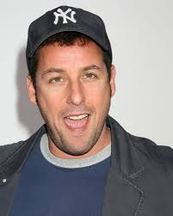
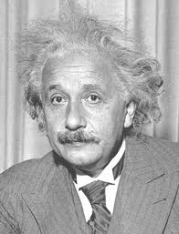
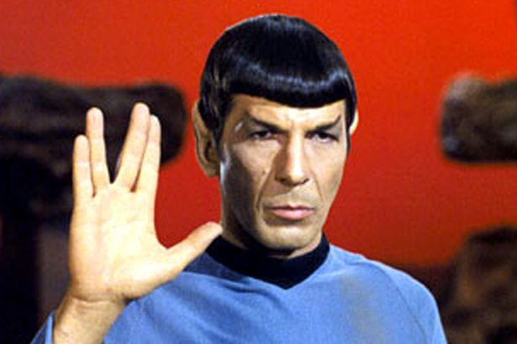
Who are some famous Jewish people?

Slide 8
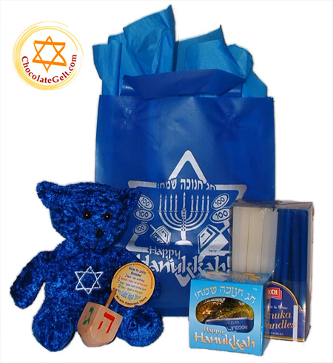
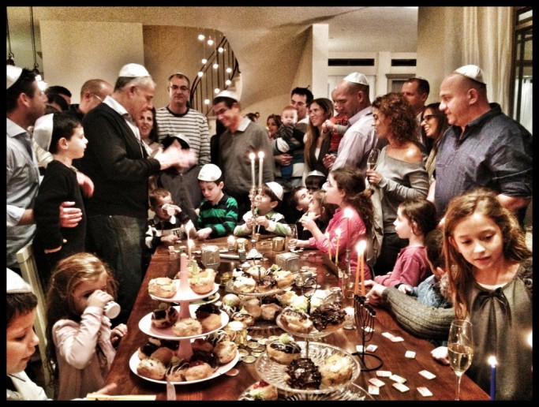
Hanukkah is…
The festival of lights
December 6-14, 2015

Slide 9
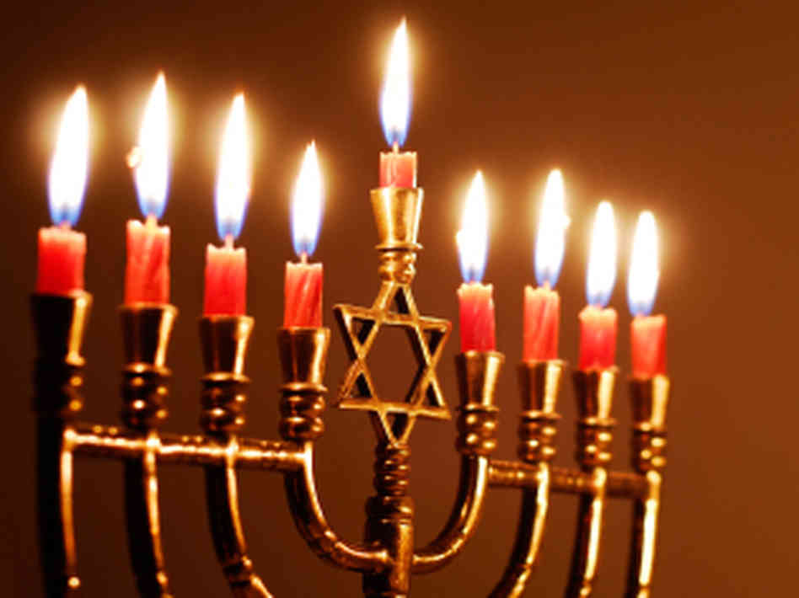
Hanukkah history…
Read the handout!

Slide 10
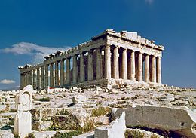
Who ruled Israel?
The Greeks!

Slide 11
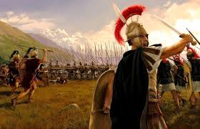
What did the Greeks do?
They forced the Jews to worship Greek Gods.

Slide 12
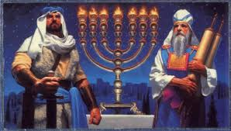
What did the Maccabees do?
They stopped the Greeks!

Slide 13
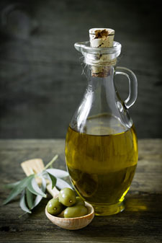
How much oil was in the temple?
Only enough for one night.

Slide 14
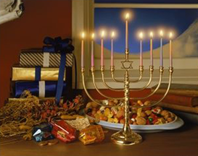
But what happened?
It burned for eight nights!

Slide 15
Celebrating Hannukah…
Demetria: “My family makes latkes, a type of potato pancake. Some people use apple sauce, but I like sour cream.”

Slide 16
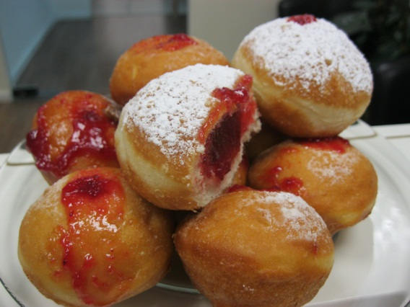
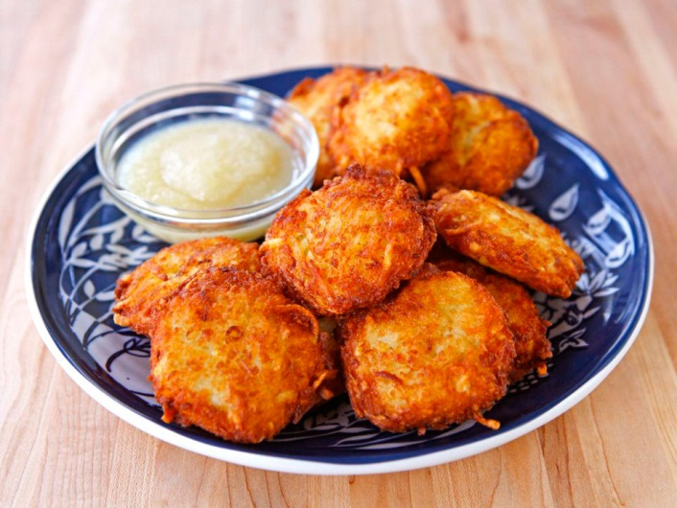
Hanukkah Food!
Usually fried in oil to remember the Hanukkah Miracle (기적).
Latkes (potato pancake)
Sufgainot (fried donut)

Slide 17
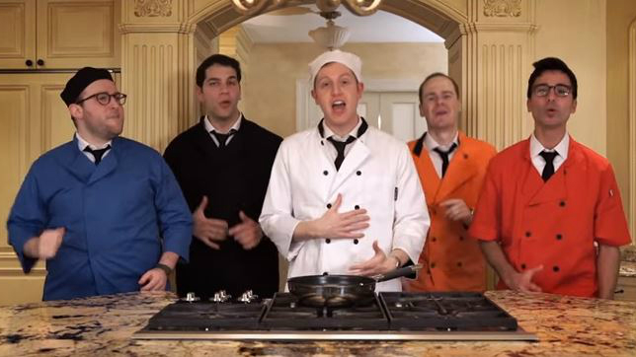
Latke Recipe Song!
https://www.youtube.com/watch?v=fg51la8Yayc

Slide 18
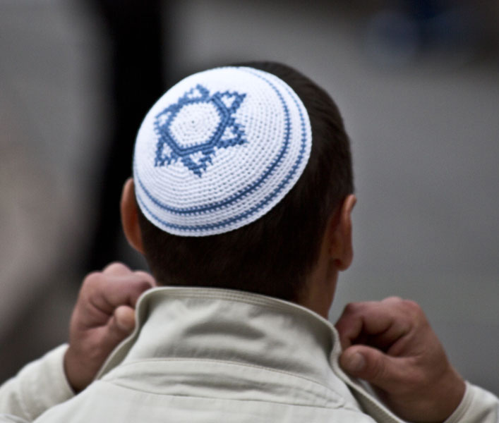
Yamaka (Kippah)
Worn by Jewish men/boys during times of worship.
Worn on Hanukkah.
Shows respect to God.

Slide 19
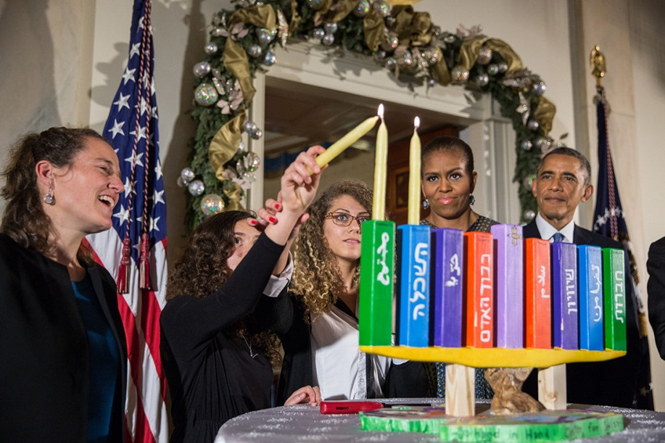
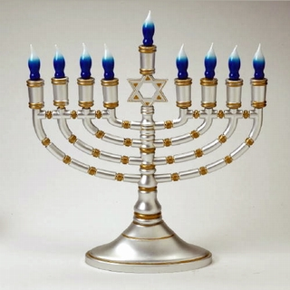
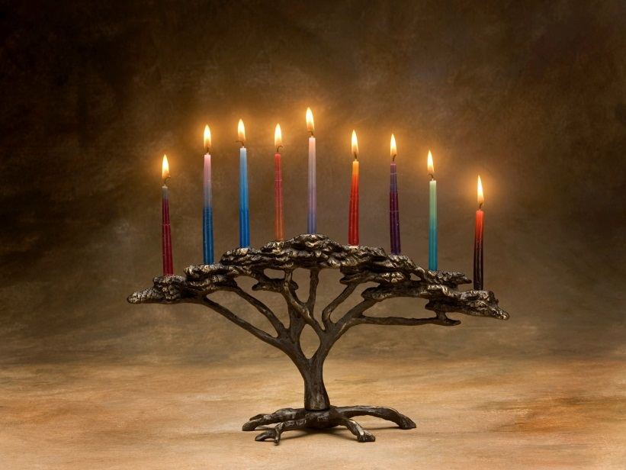
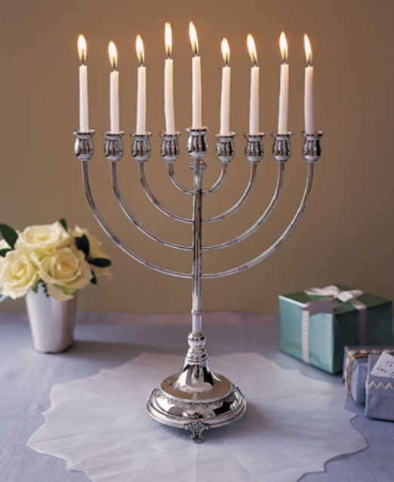
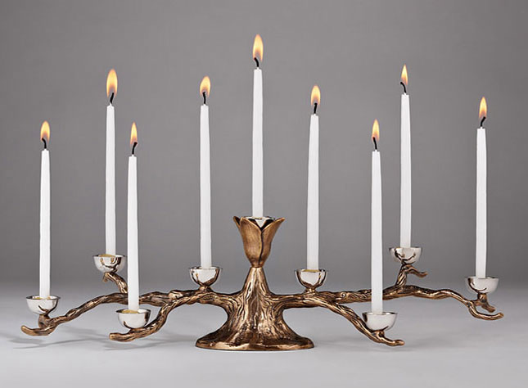
The Menorah
Candle holder used during Hanukkah.
Has eight candles, and one in the middle to light the others.
Placed in the window to celebrate Hanukkah.

Slide 20
Lighting the Menorah
One candle lit each night. At the end of Hanukkah, all candles are lit.
https://www.youtube.com/watch?v=Qq_D56_RE3U

Slide 21
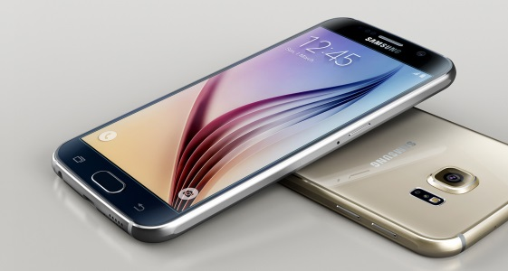
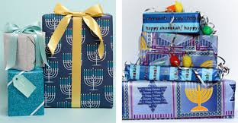
Presents!
Every night, people receive presents!
It is like Christmas, but for eight nights!

Slide 22
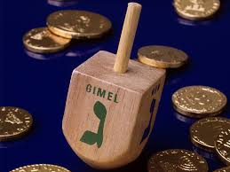
Dreidel
A type of spinning top played with on Hanukah.
All the sides have Hebrew letters, which mean different things.
Depending what letter you get, you win more sweets or lose them!

Slide 23
Dreidel song!
https://www.youtube.com/watch?v=DtlLHwk9_Rw

