Slide 1
Christmas
Quiz Game
Notes:
http://www.elfyourself.com/?mId=62886408.2
Elf Yourself & Snowflake Activity

Slide 2
YELLOW
ORANGE
RED
GOLD
GREEN
10
10
10
10
10
10
10
10
10
10
20
20
20
20
20
20
20
20
20
20
30
30
30
30
30
30
30
30
30
30
40
40
40
40
40
40
40
40
40
40
50
50
50
50
50
50
50
50
50
50

Slide 3
When is Christmas Eve?
10 Points
December 24th

Slide 4
True or False?:
Christmas is a holiday for couples in America
20 Points
False
It is a family holiday

Slide 5
What is the name of Santa’s “car”?
30 Points
Sleigh

Slide 6
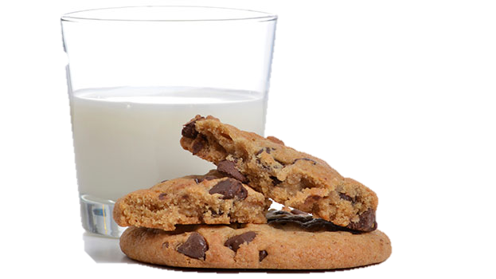
What treats do people leave out for Santa on Christmas Eve?
40 Points
Notes:
Milk & Cookies

Slide 7
Sing one part of any Christmas song in English
50 points
“Deck the Halls”
“Last Christmas”
“Silent Night”
Notes:
https://www.youtube.com/watch?v=PjxBNej7Nlc
Youtube link to Glee Christmas Carols

Slide 8
What are the two traditional colors of Christmas?
10 points
Red & Green

Slide 9
Where do people put Christmas presents in the house? (Act)
20 Points
Notes:
Under the Christmas tree

Slide 10
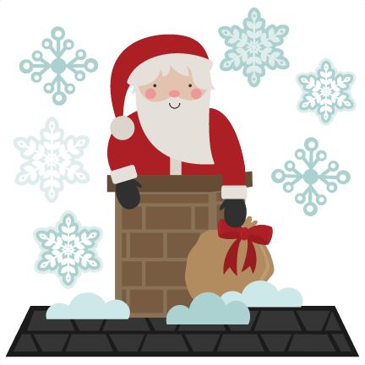
How does Santa enter a house to deliver gifts?
30 Points

Slide 11
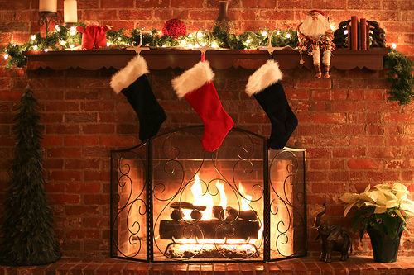
Where do people put Christmas stockings in the house?
40 Points

Slide 12
Who are Santa’s helpers and what do they do?
50 points
Elves make toys

Slide 13
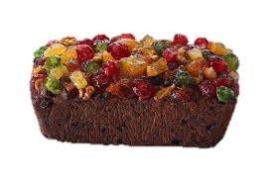
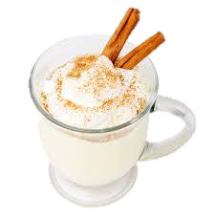
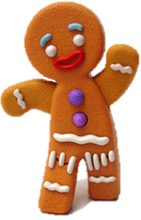
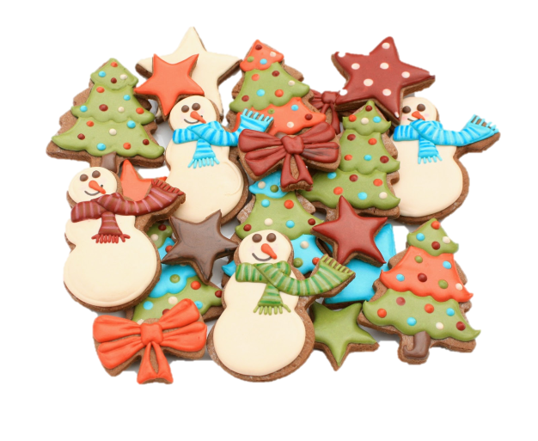
Name two Christmas foods
10 points
Notes:
Eggnog, Fruitcake, Christmas cookies, candy canes, gingerbread

Slide 14
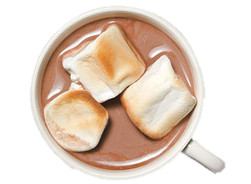
What do people put into hot cocoa?
20 points
Notes:
Marshmallows

Slide 15
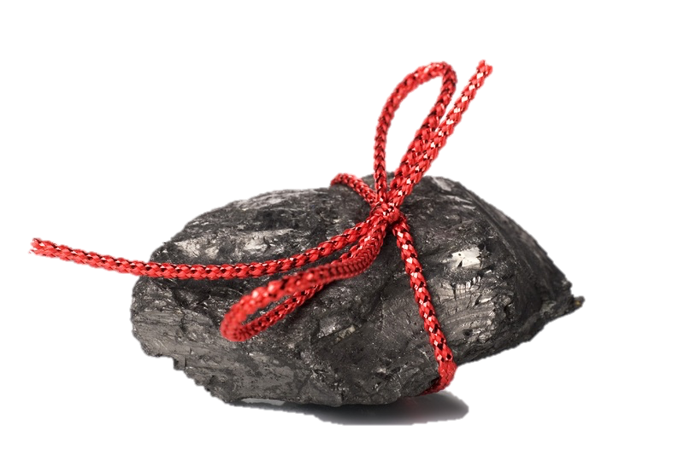
What do bad children receive on Christmas?
30 points
Coal

Slide 16
“Dashing through the snow” is a line from what Christmas song? (Sing)
40 points
“Jingle Bells”

Slide 17
What ingredients are found in eggnog? Name at least 3.
50 points
Eggs, Milk, Cream, Whiskey, Sugar, Nutmeg

Slide 18
What is Santa Claus’ famous greeting?
10 points

Slide 19
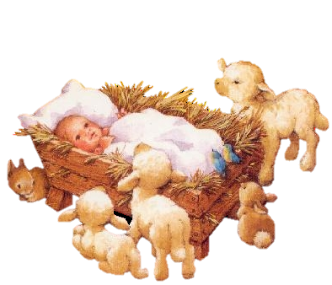
Why was Christmas first celebrated?
20 points

Slide 20
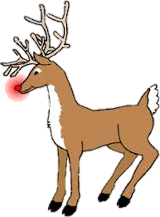
Draw and name the animal that pulls Santa’s sleigh
30 points
Reindeer

Slide 21
What is another name for a Christmas “song”?
40 points
Christmas CAROL
Notes:
https://www.youtube.com/watch?v=PjxBNej7Nlc
Youtube link to Glee Christmas Carols

Slide 22
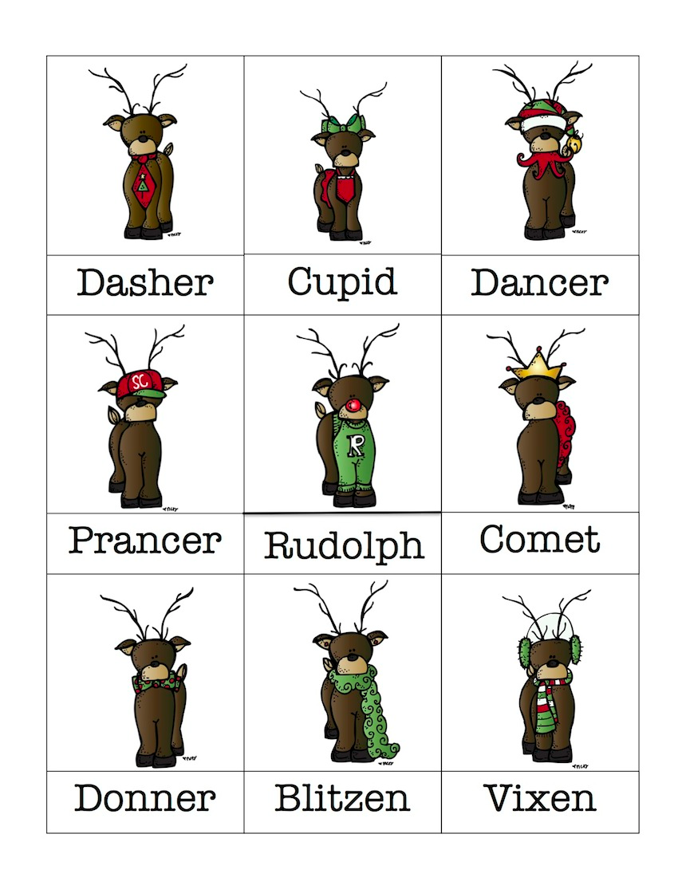
How many reindeer does Santa have?
Name at least two.
50 points

Slide 23
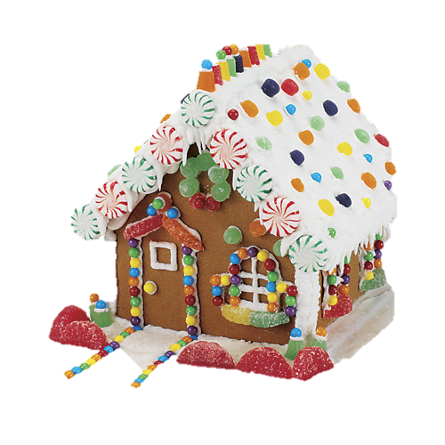
Name one activity people do for Christmas
10 points
Notes:
Make Christmas cookies, Build gingerbread houses, Give and receive presents, Decorate their houses (inside and outside!), Eat holiday foods, Go Christmas shopping, Sing Christmas carols, Attend a Christmas church service, Watch Christmas movies, Spend time with family and friends

Slide 24
What do people do with a mistletoe? (Act)
20 points

Slide 25
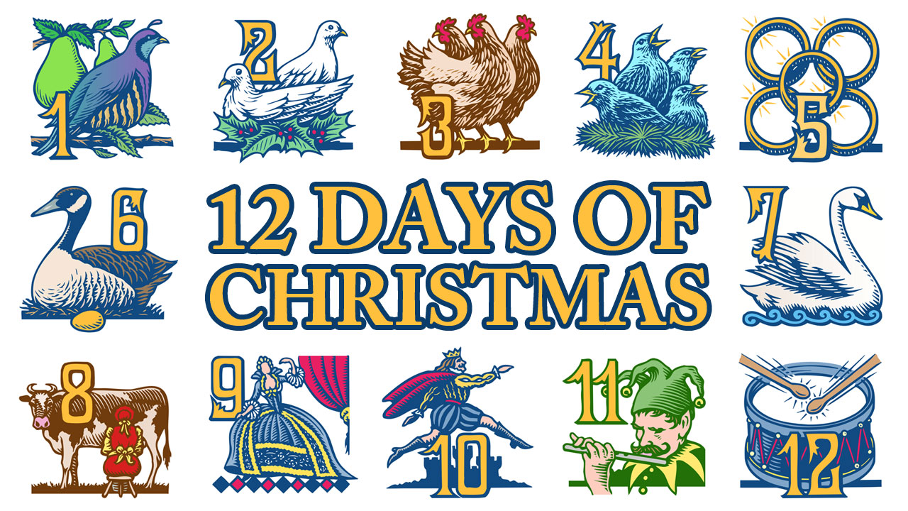
Traditionally, how many days of Christmas are there?
30 points

Slide 26
Draw a wreath
40 points

Slide 27
What do you do with ornaments? (Act)
50 points

Slide 28
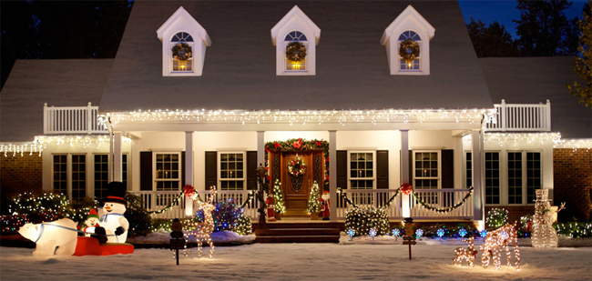

Slide 29
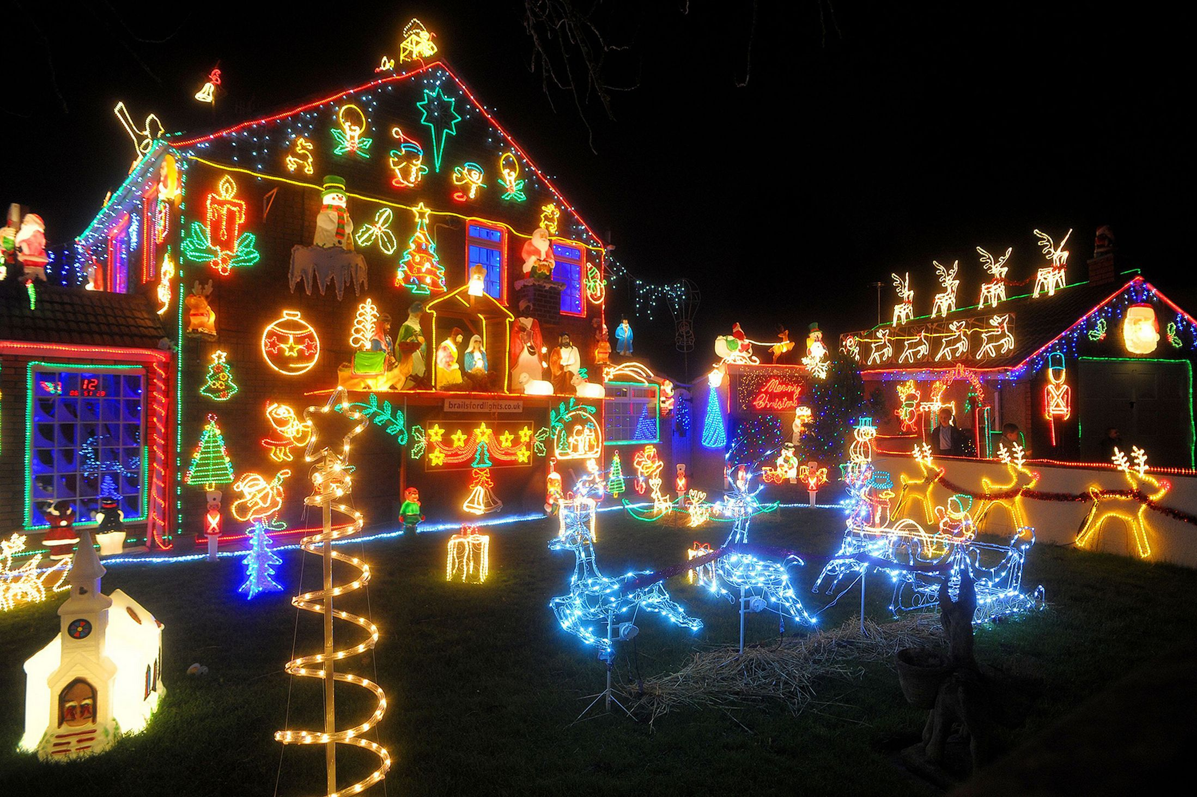

Slide 30
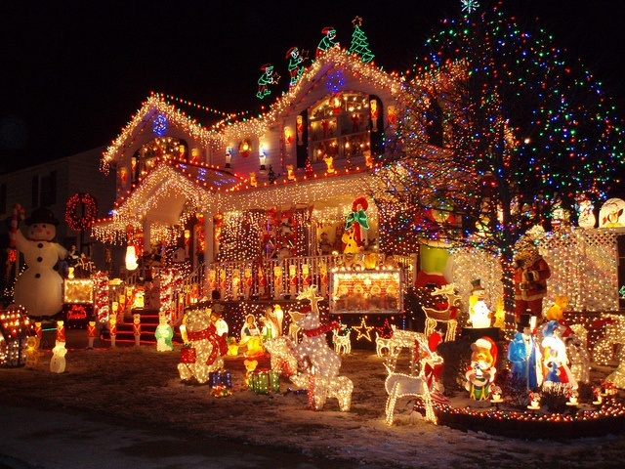

Slide 31
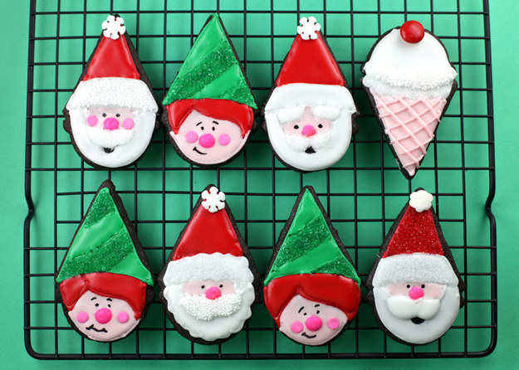
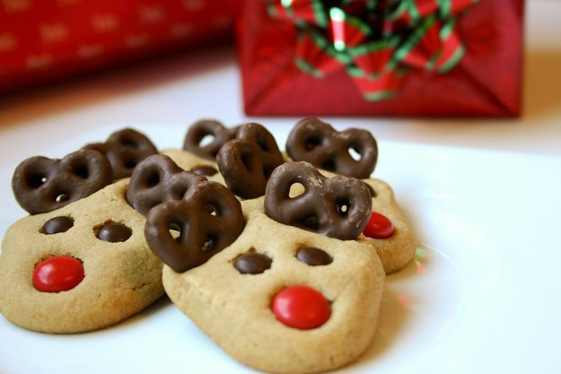
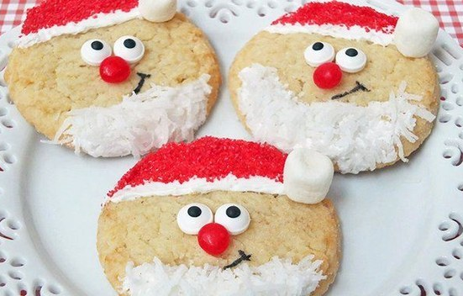
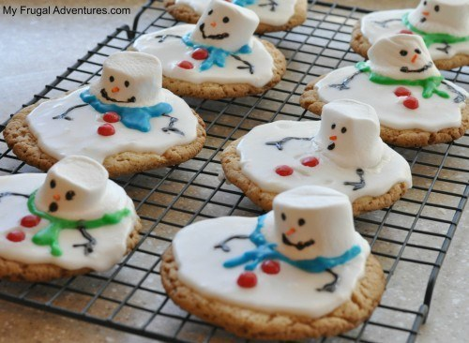

Slide 32
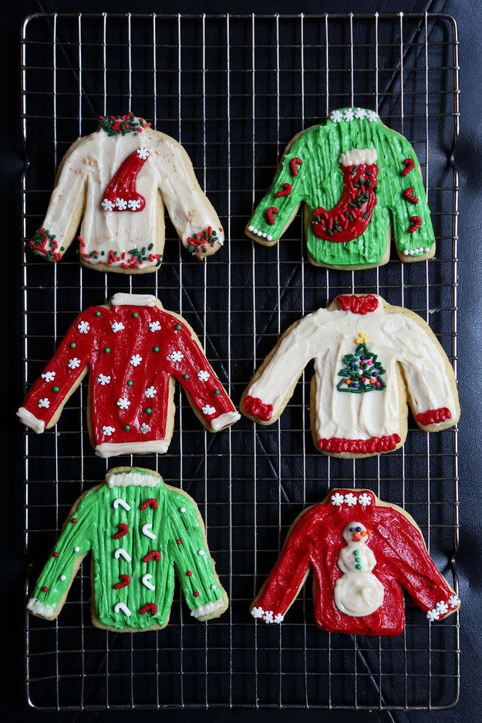
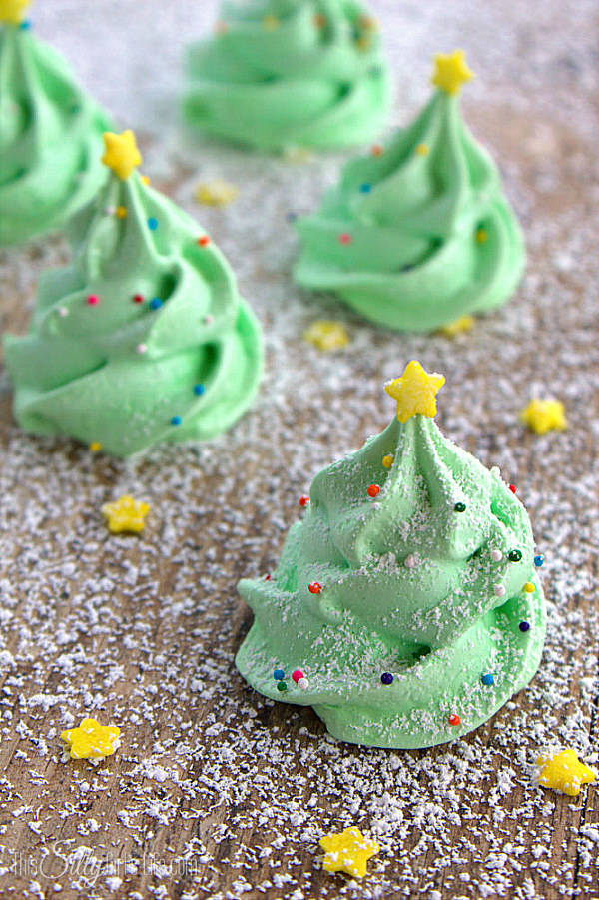

Slide 33
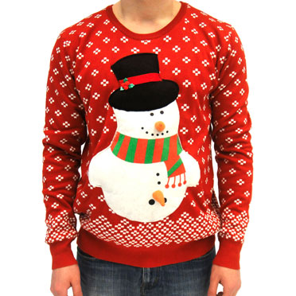
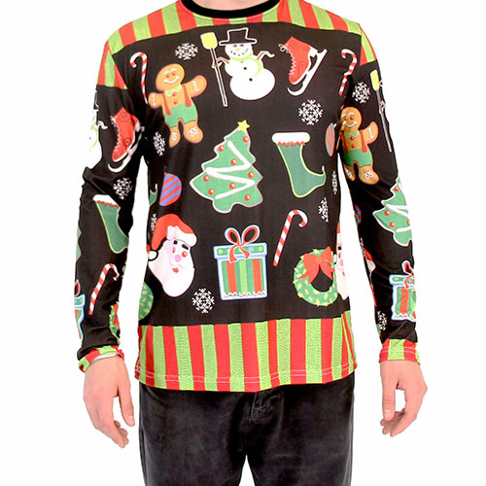
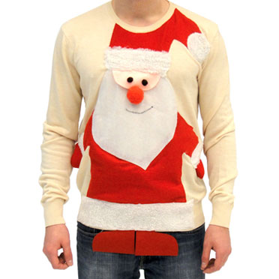

Slide 34
