Slide 1
Today is Monday, December 2nd, 2013.

Slide 2
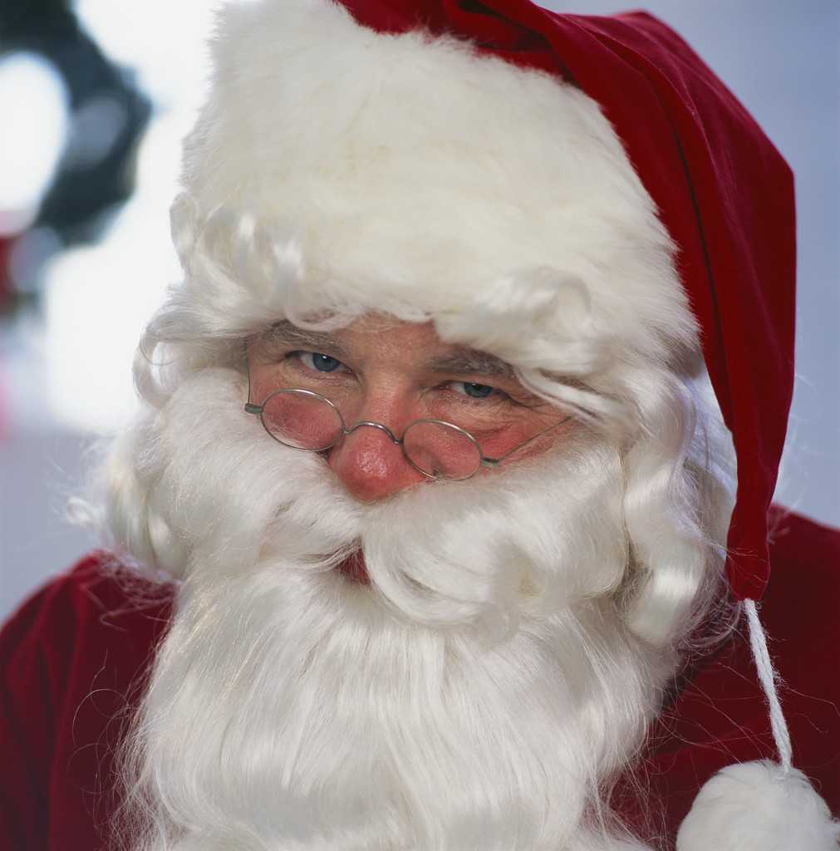
Sara’s House Party
Thursday, December 19th (12/19))

Slide 3
Sara chooses:
12/06

Slide 4
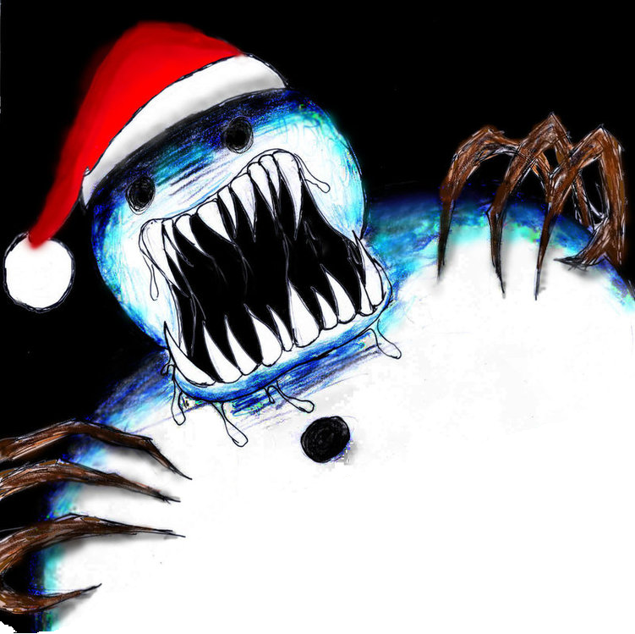
Do you like Christmas?

Slide 5
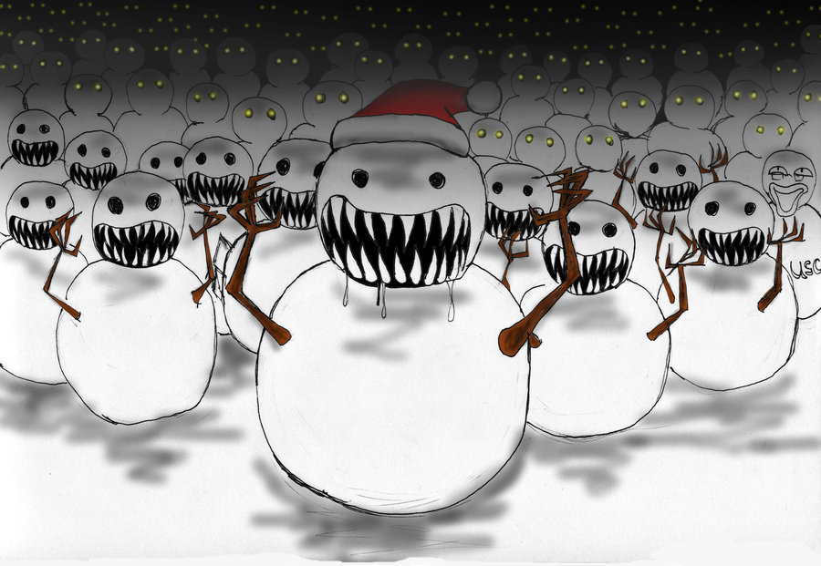
Sara doesn’t like Christmas.
Sara LOVES Christmas!

Slide 6
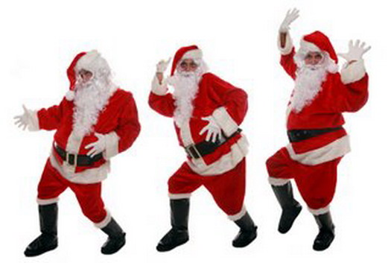
Sara had a Christmas party with her friends!

Slide 7
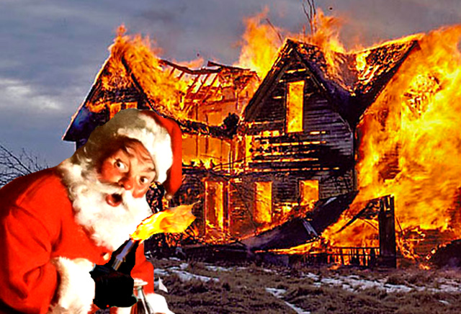
It was very fun!
But then…

Slide 8
there

Slide 9
was

Slide 10
a

Slide 11
MURDER!
(살인)

Slide 12
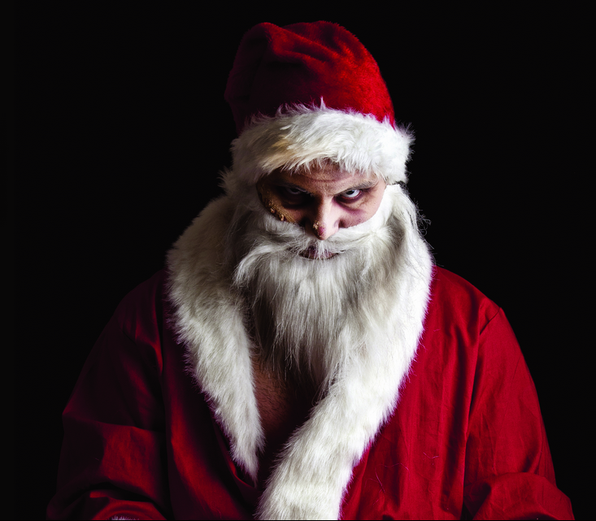
Now, Santa is…

Slide 13
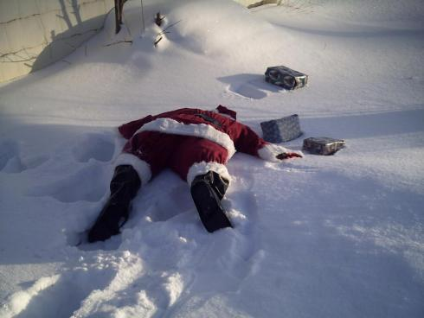
DEAD!

Slide 14
WHO is the killer (살인자)?
WHAT was the weapon (무기)?
WHERE was the
murder (위치)?

Slide 16
The
Suspects
(용의자)

Slide 17
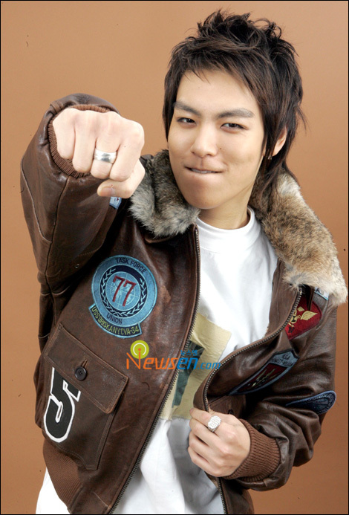
T.O.P.

Slide 18
Pororo

Slide 19
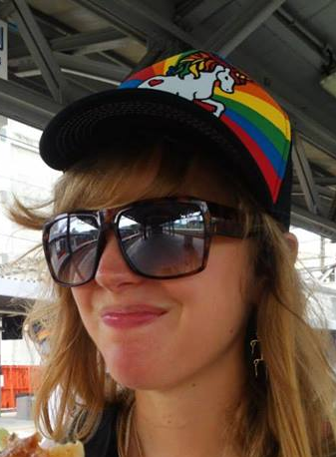
Sara

Slide 20
Hello Kitty

Slide 21
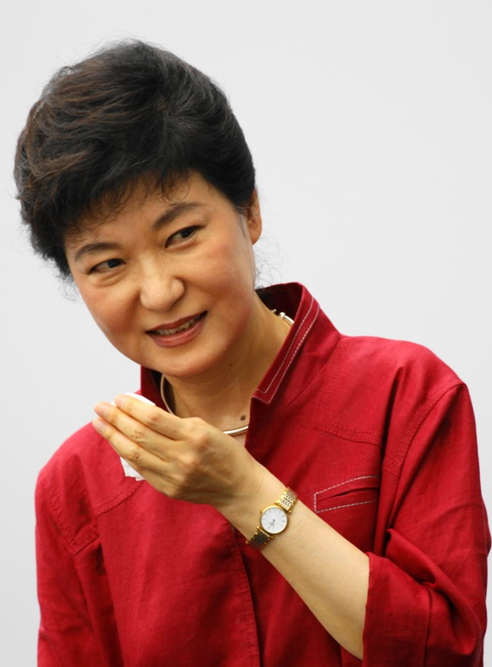
Park Geun Hye

Slide 22
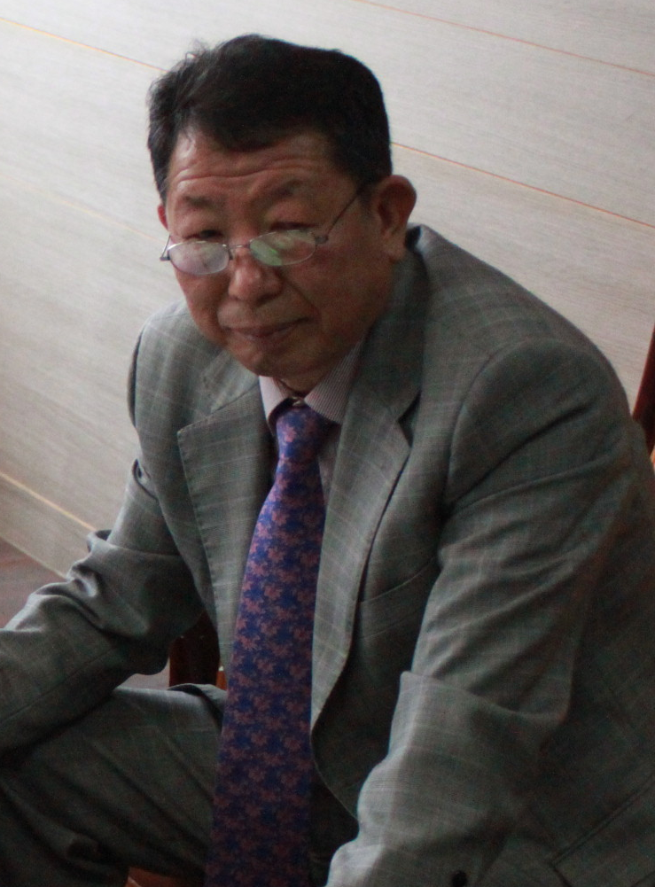
Principal

Slide 23
Six more suspects (용의자)!
Please say six people!

Slide 24
The
Rooms

Slide 25
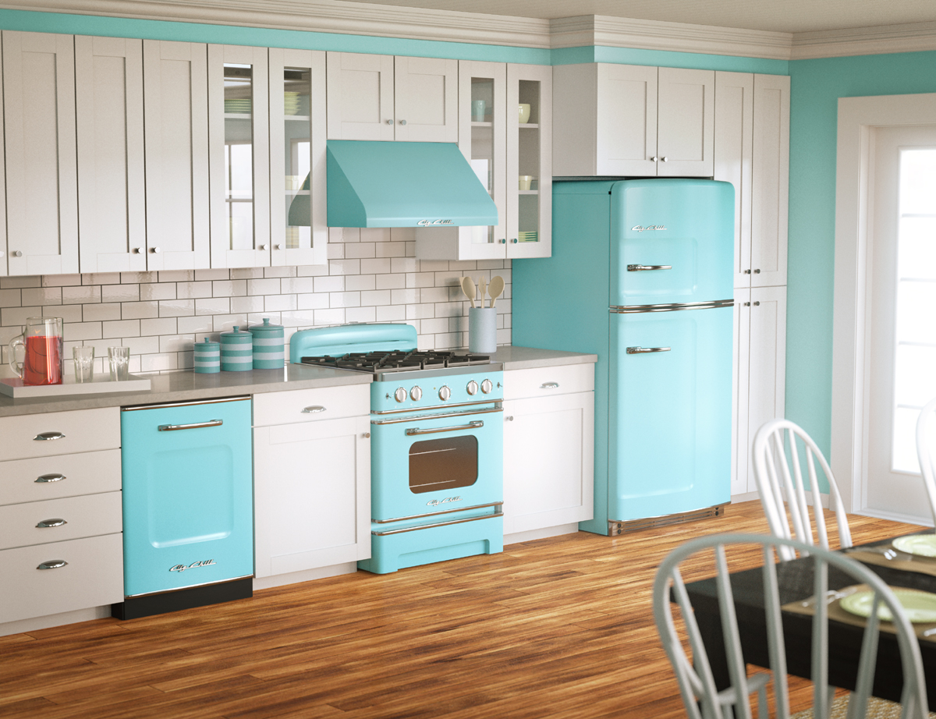
Kitchen

Slide 26
Bedroom

Slide 27
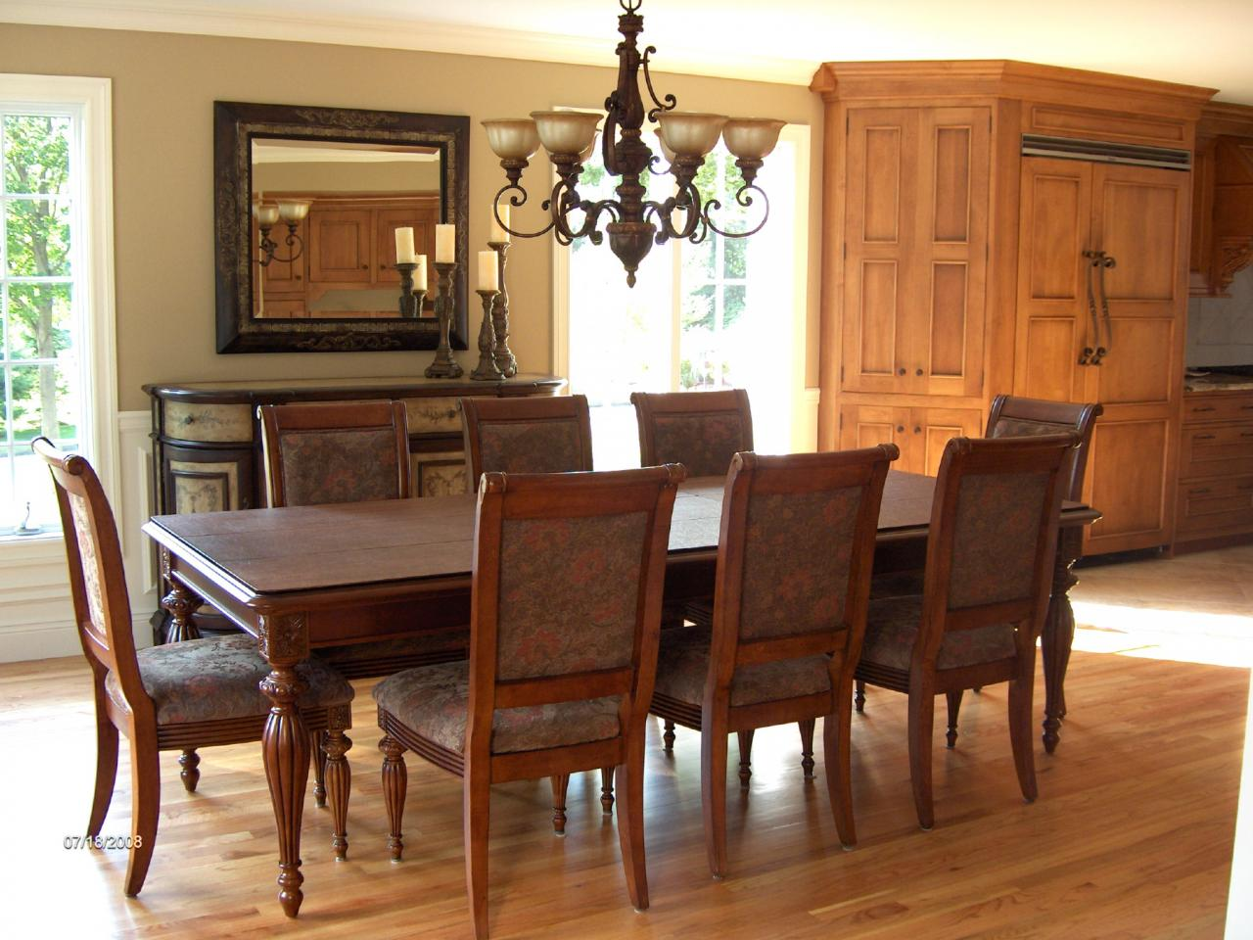
Dining Room

Slide 28
Bathroom

Slide 29
Library

Slide 30
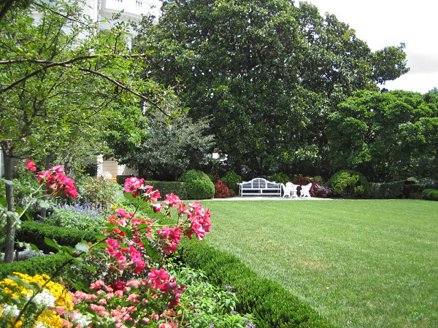
Garden

Slide 31
The
Weapons
(무기)

Slide 32
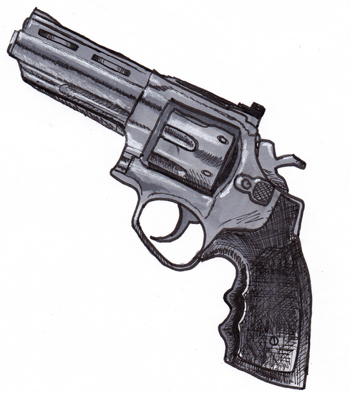
Gun

Slide 33
Baseball Bat

Slide 34
Wrench

Slide 35
Poison

Slide 36
Rope

Slide 37
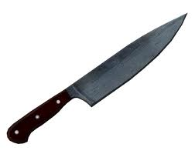
Knife

Slide 38
WHO is the killer (살인자)?
WHAT was the weapon (무기)?
WHERE was the
murder (위치)?

Slide 39
- Every team has cards.
- DO NOT show cards.

Slide 40
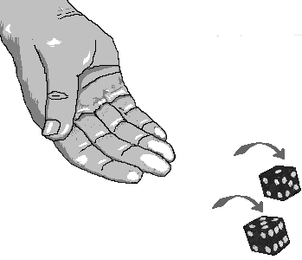
How to play:
Roll the dice (주사위 롤).
Number = Team
Ask three teams if they have cards.

Slide 41
Example Question:
(Team), (Team), and (Team):
Do you have (suspect), (room), or (weapon)?

Slide 42
Example Answer:
Yes, we have __________.
(Suspect)
(Room)
(Weapon)

Slide 43
Write _____ and _____
on your paper.

Slide 44
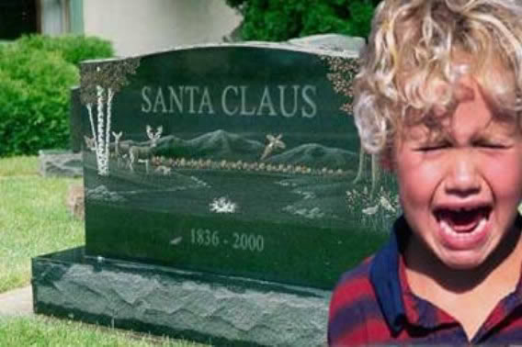
Who killed Santa?

Slide 45
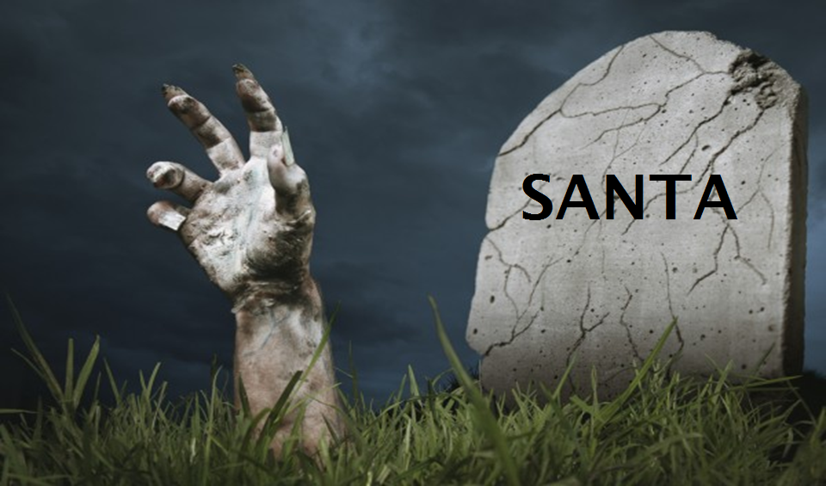
Play again?

