Slide 2
When is Thanksgiving?
The Last Thursday in November
추수감사절
(미국에서는 11월 넷째 목요일)
Thursday, November 27th
^{목요일 11월 27일}
in the USA!

Slide 3
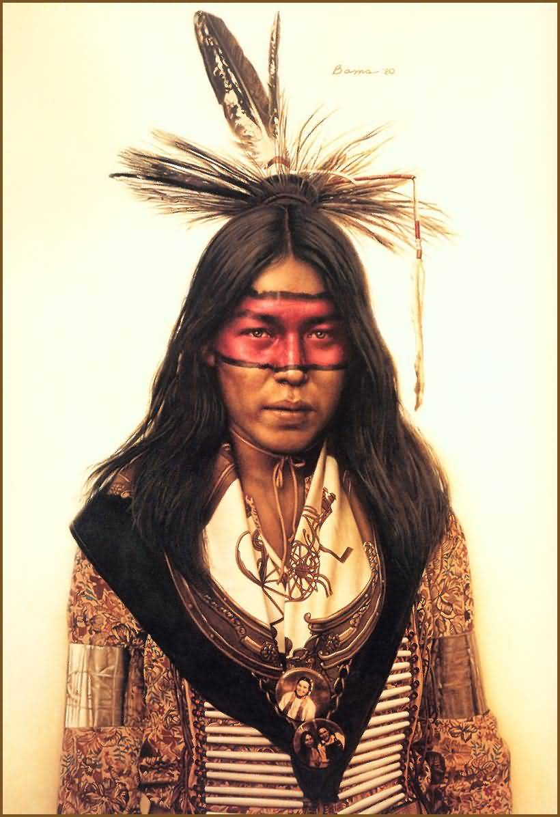
Native Americans (아메리카 원주민)
People who first lived
in the USA (토착민).

Slide 4
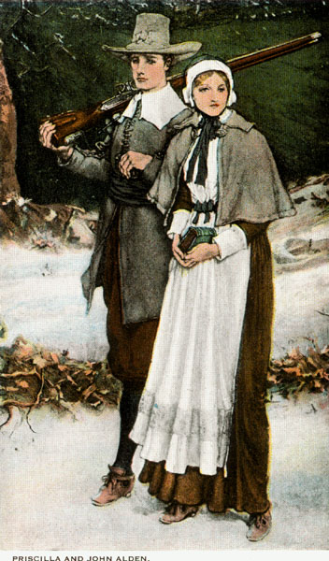
Pilgrim (순례자)
Hello. Can you help us?
Then, the pilgrims came to America. They needed help finding food!

Slide 5
Why do we celebrate Thanksgiving? 왜 추수감사절 기념해?
A long time ago…….
There were many Native Americans who lived in America.

Slide 6
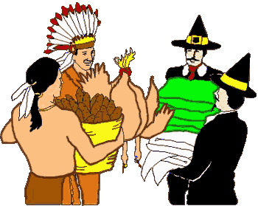
Native Americans
Pilgrims
The Native Americans
helped
the Pilgrims find food.

Slide 7
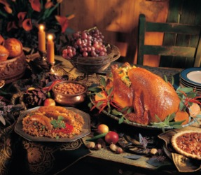
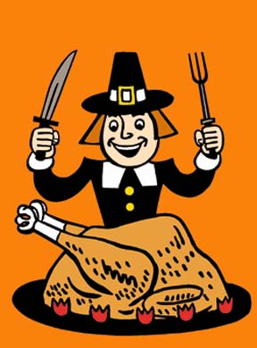
The pilgrims made dinner for the native Americans to say “Thank you!”

Slide 8
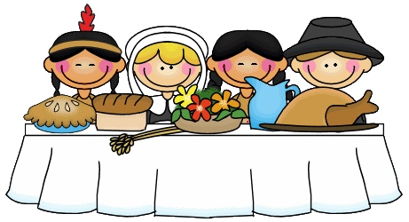
Wow! You’re welcome!
Thank you for your help!

Slide 9
Today… Thanksgiving is to say “Thank you” to family and friends!

Slide 10
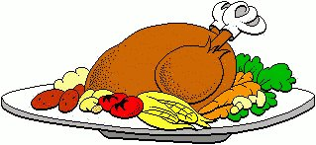
Thanksgiving Today
Today, we will study:
Traditional (전통적인) Thanksgiving Foods
Traditional Thanksgiving Activities (전통적인 놀이)

Slide 11
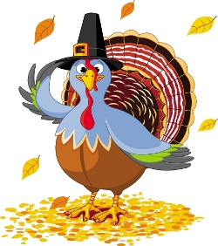
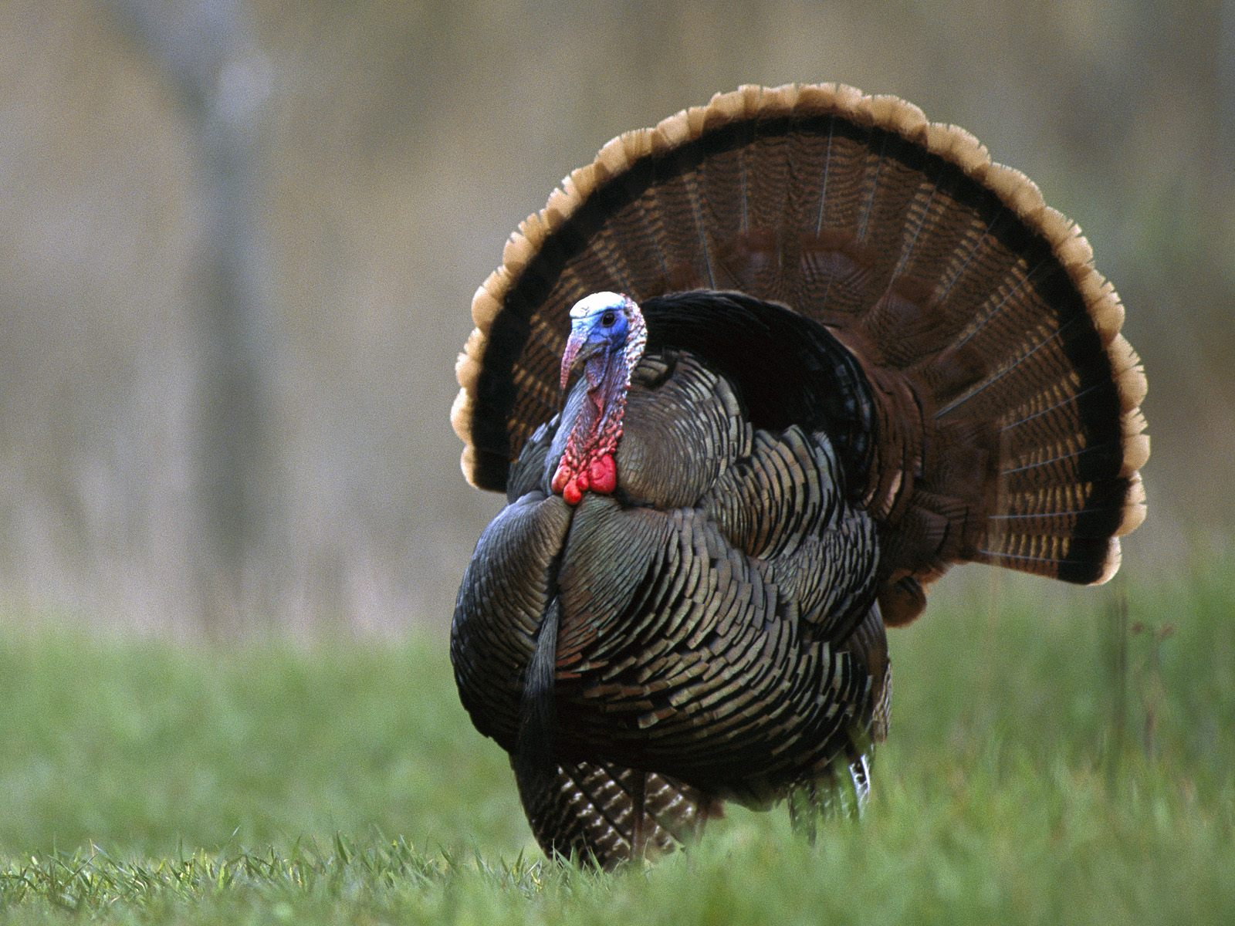
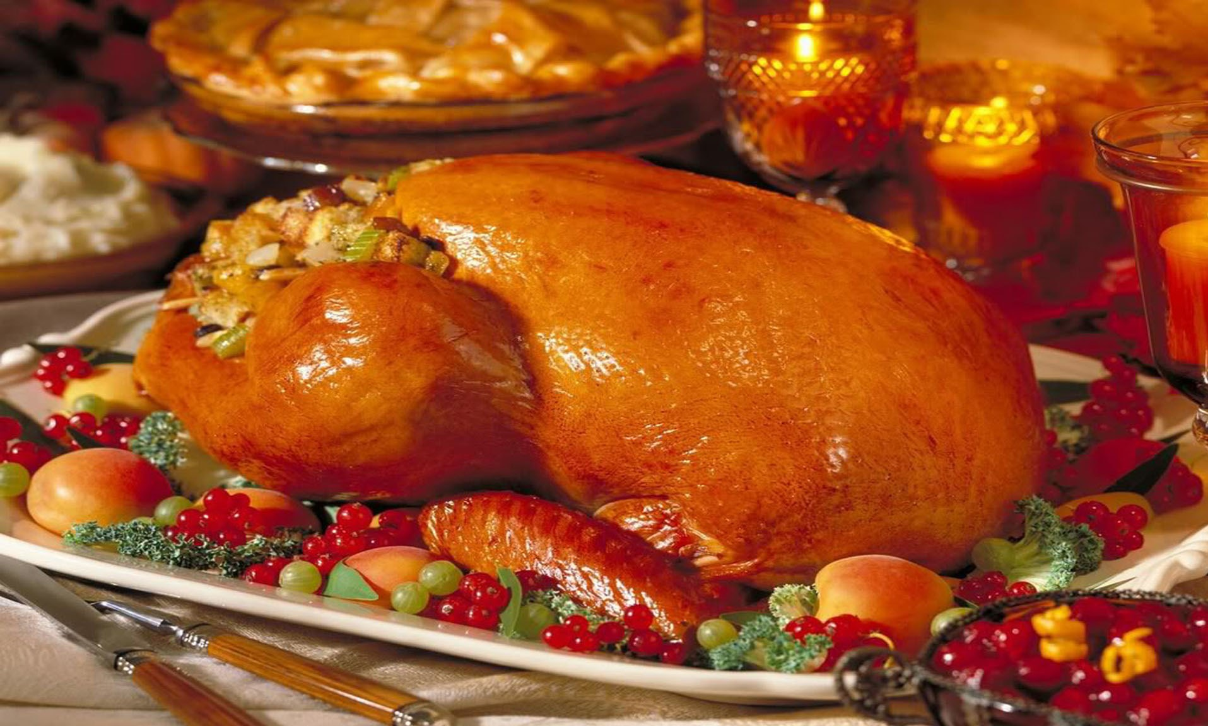
Traditional Food: Turkey (칠면조)
Thanksgiving decorations (장식들): cute cartoon turkeys

Slide 12
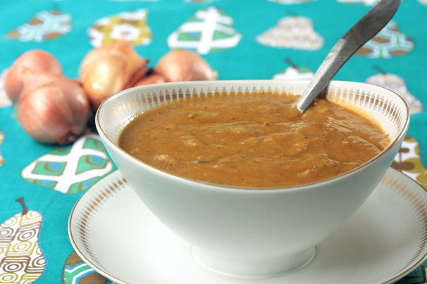
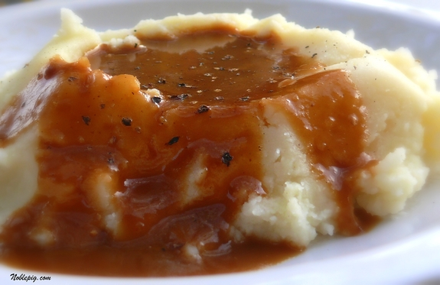
Gravy
The fat (지방) and juices from the turkey

Slide 13
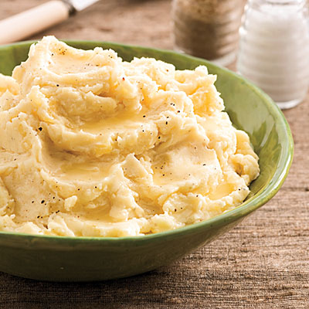
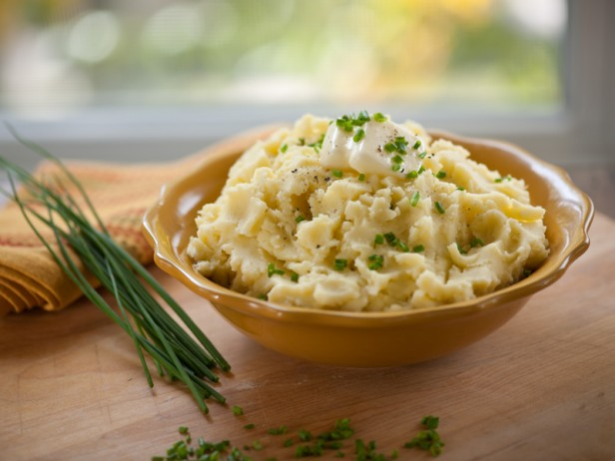
Mashed Potatoes (으깬 감자)
Boiled potatoes mashed with butter, salt, pepper, and milk or cream
재료: 삶은 감자, 버터, 소금, 후추, 우유 아니면 크림

Slide 14
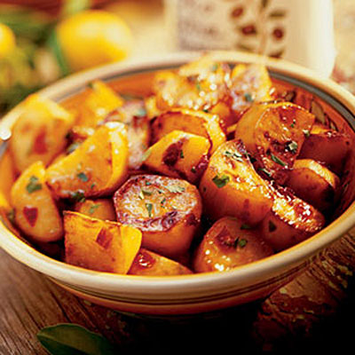
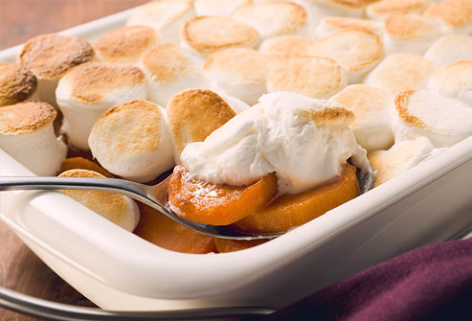
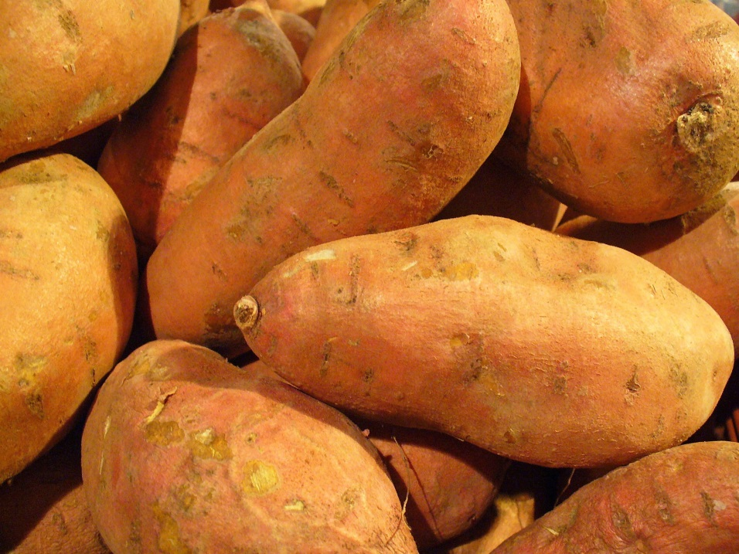
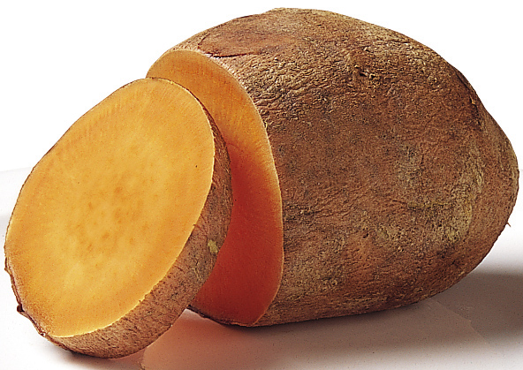
Sweet Potatoes (고구마)
Usually baked in an oven, sometimes served with marshmallows on top
재료: 구운 고구마, 황설탕 마시멜로

Slide 15
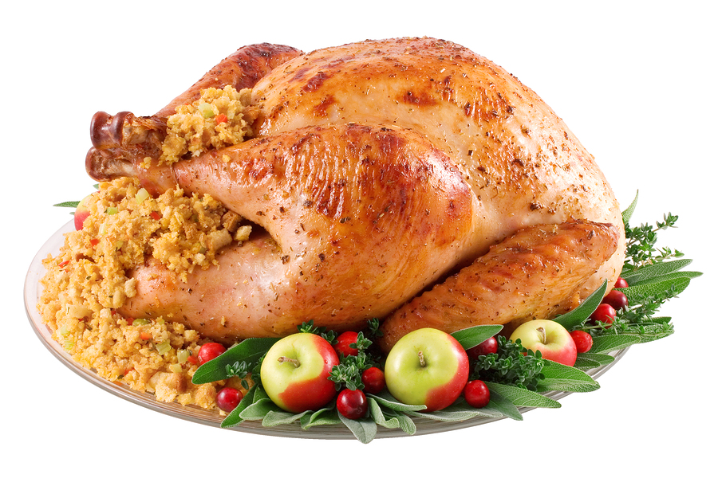
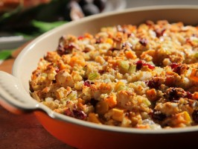
Stuffing
Small pieces of bread, vegetables, and meat mixed with egg and baked.
Traditionally, stuffing is put inside the turkey.
재료: 빵,야채 (당근, 양파, 셀러리), 베이컨, 계란

Slide 16
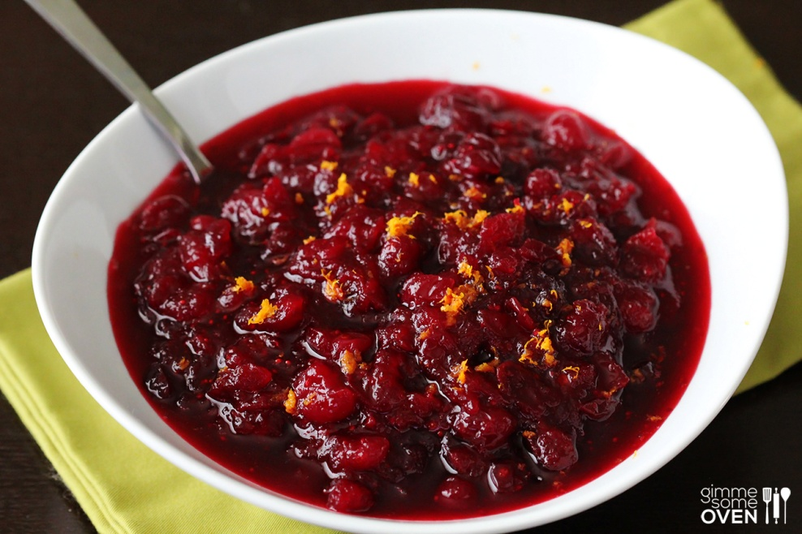
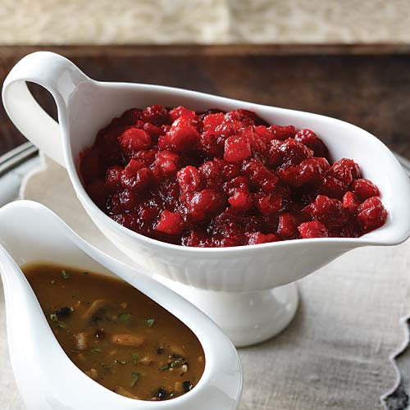
Cranberry Sauce (덩굴월귤 소스)
Cranberries boiled into a sauce.
재료: 덩굴월귤, 설탕, 물

Slide 17
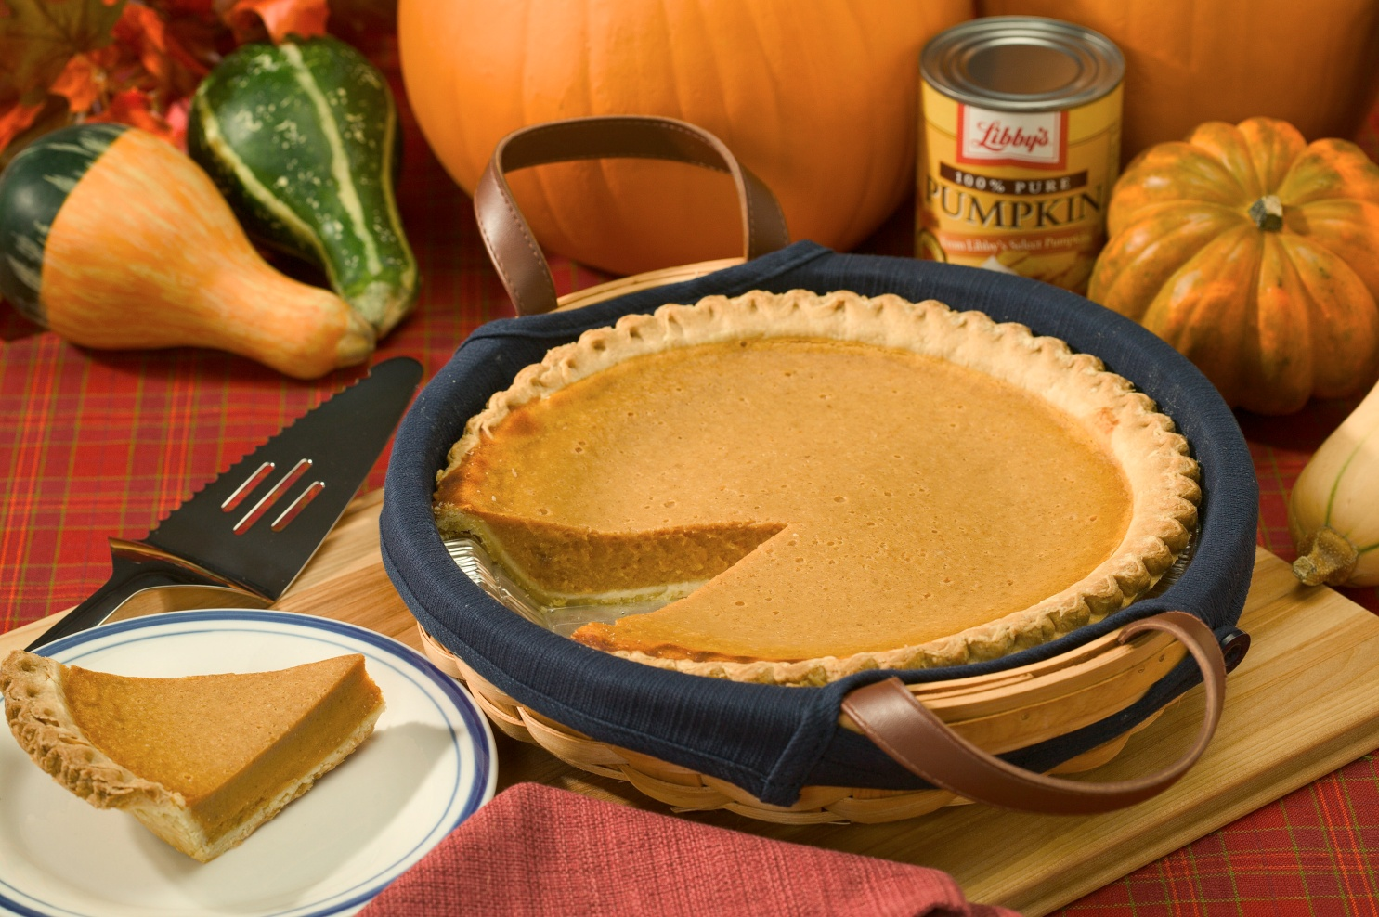
Pumpkin Pie
During Thanksgiving, all pies are really popular.
추수감사절 기간에는 모든 파이들이 정말
인기가 많아요.

Slide 18
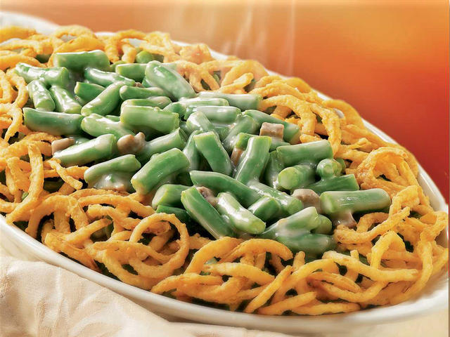
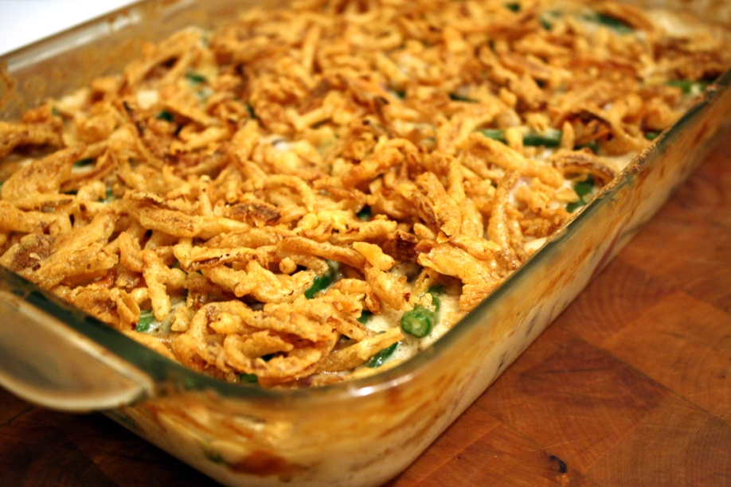
Green Bean Casserole (껍질콩 캐서롤)
Green beans with cream of mushroom soup and fried onions.
재료: 껍질콩, 버섯 크림 수프, 양파 튀김

Slide 19
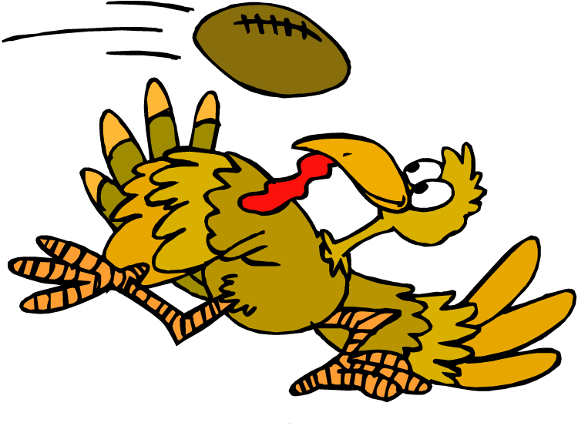
Traditional Activities 전통적인 놀이

Slide 20
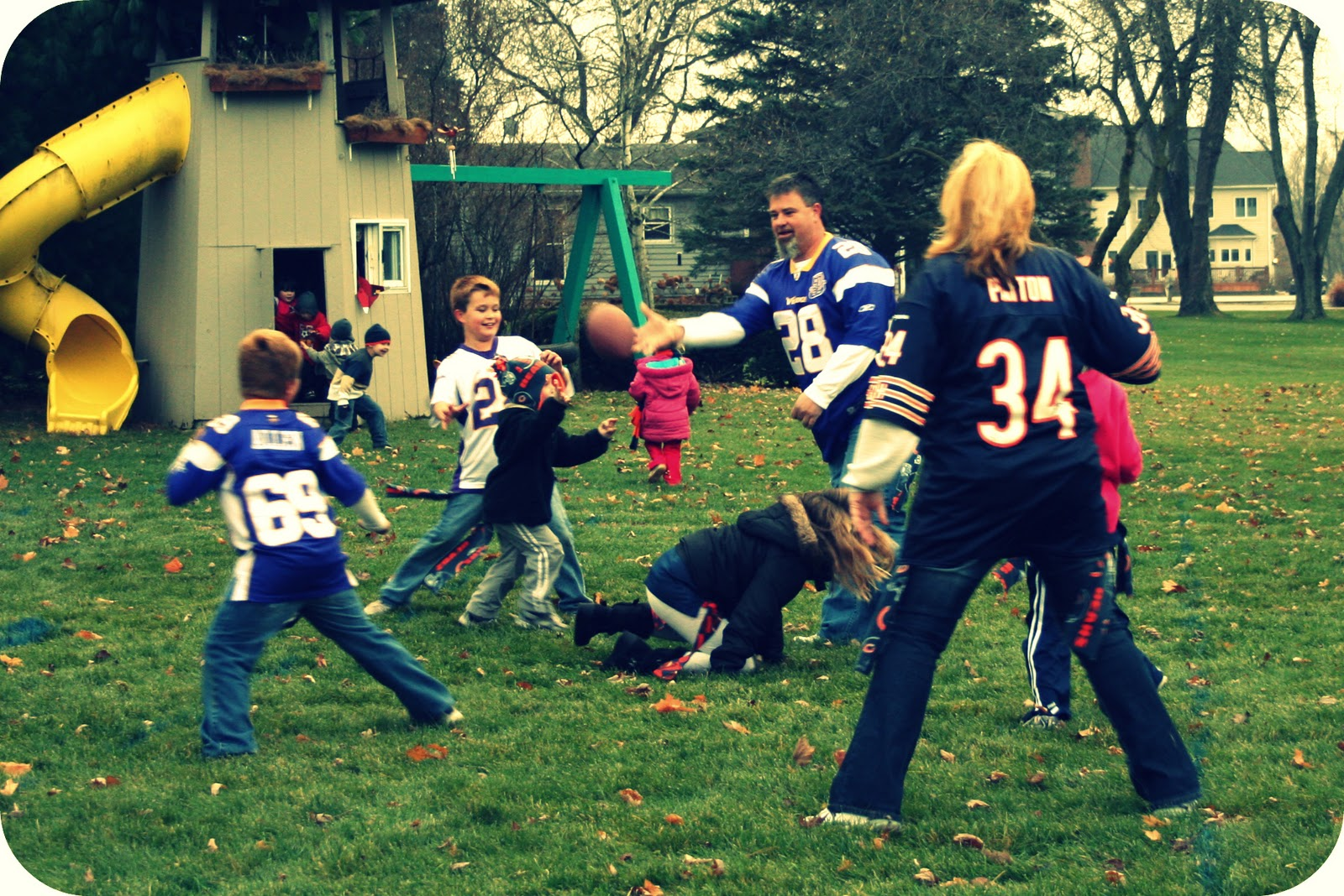
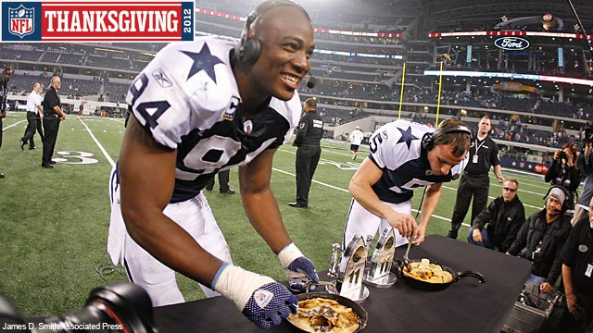
Football
Many families like to watch football on TV on Thanksgiving.
Or sometimes… 어떤 때는 …
they play!

Slide 21
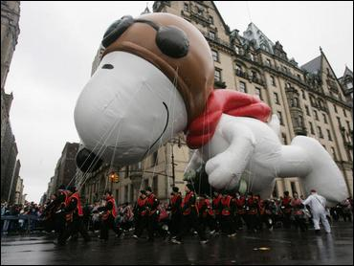
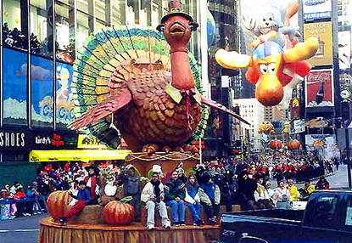
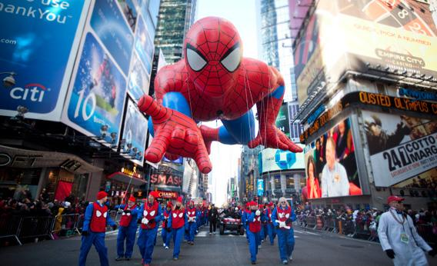
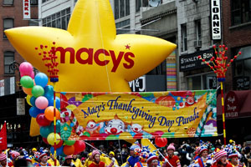
Thanksgiving Parade
Macy’s Thanksgiving Day Parade is in NYC and everyone watches it on TV.
http://youtu.be/wXQMbQtxLpg?t=35m54s

Slide 22
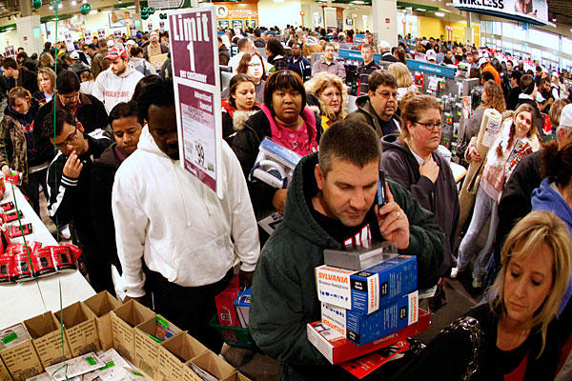
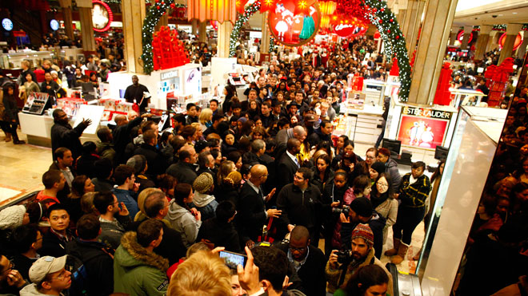
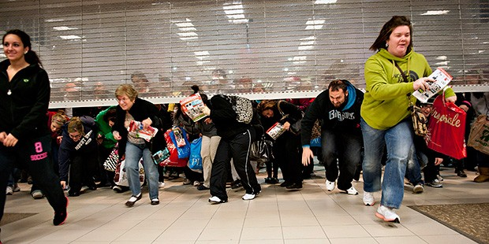
Black Friday
The day after Thanksgiving is called “Black Friday”
People start shopping for Christmas
Stores offer really big sales, and people wait in line for hours to get the best sales

Slide 23
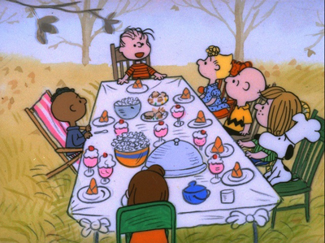
Thanksgiving Across America
Because there are so many different cultures in America, everyone’s Thanksgiving looks a little different
미국에는 다양한 문화들이 많아서 각 가족
들마다 추수감사절을 다르게 기념합니다.

Slide 24
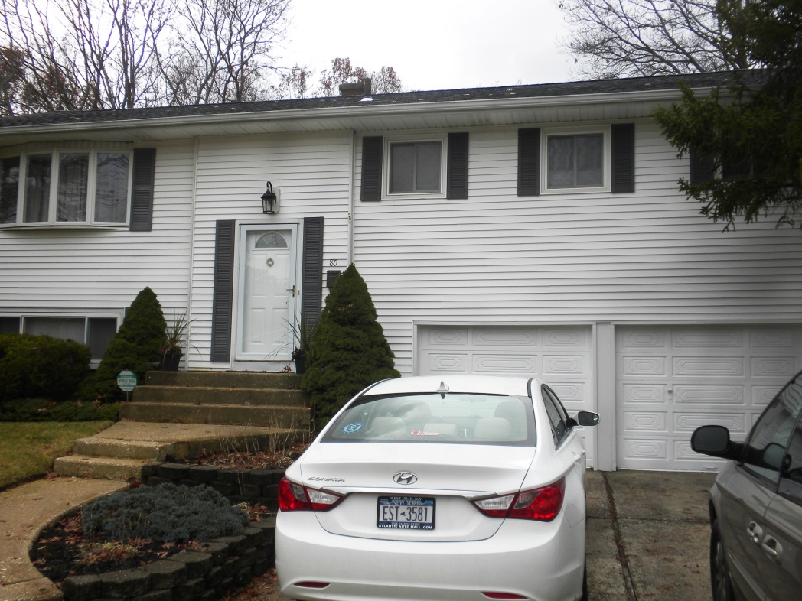
Kristen Teacher’s Thanksgiving
My House

Slide 25
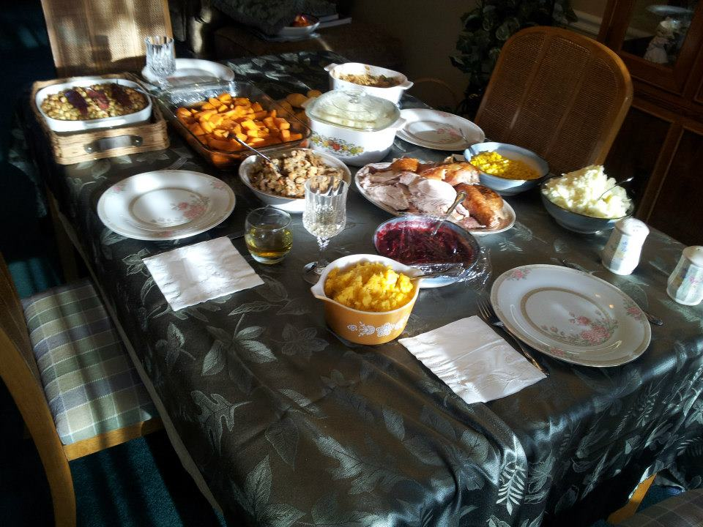
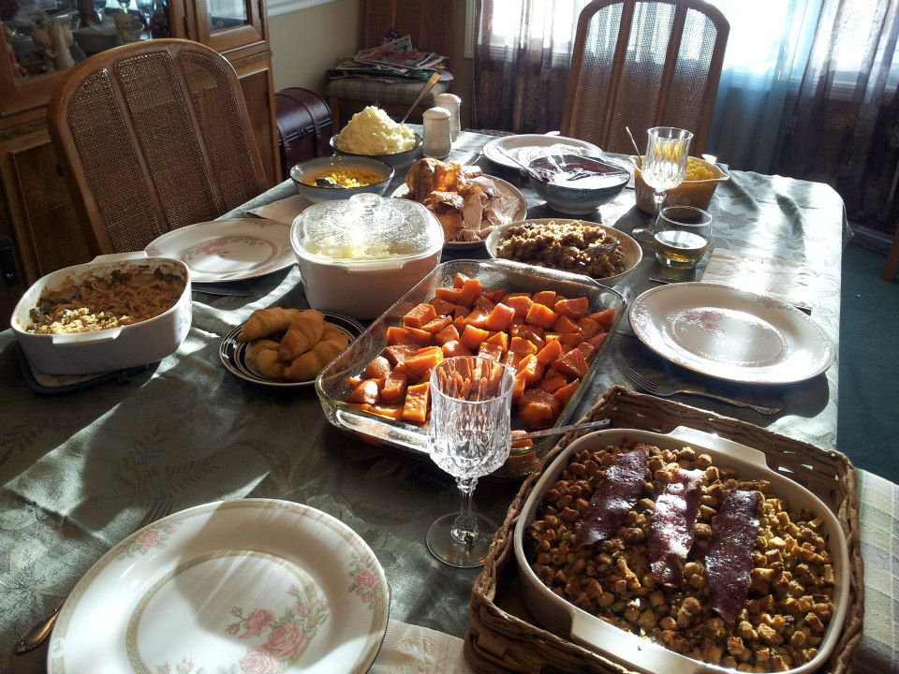
My Family’s Traditional Food

Slide 26
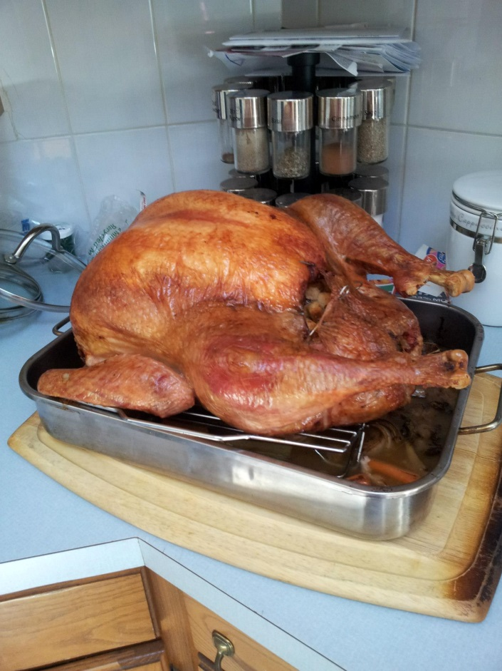
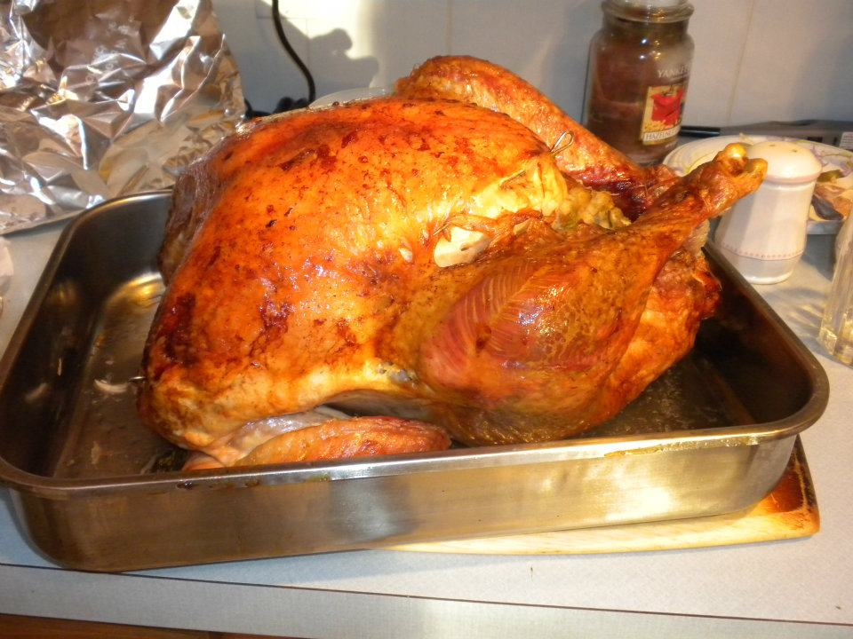
My Family’s Traditional Food
Turkey

Slide 27
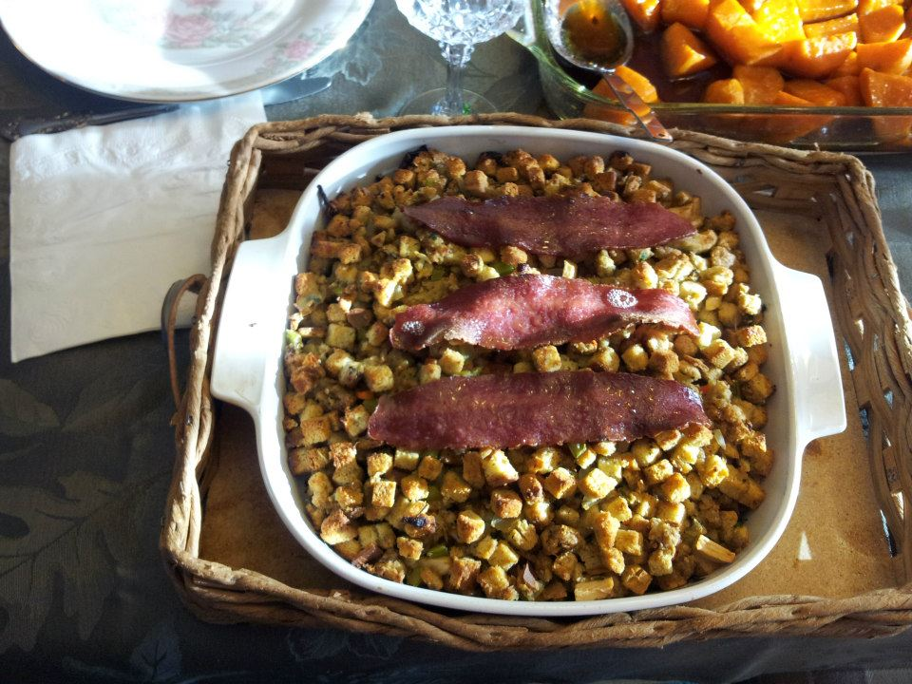
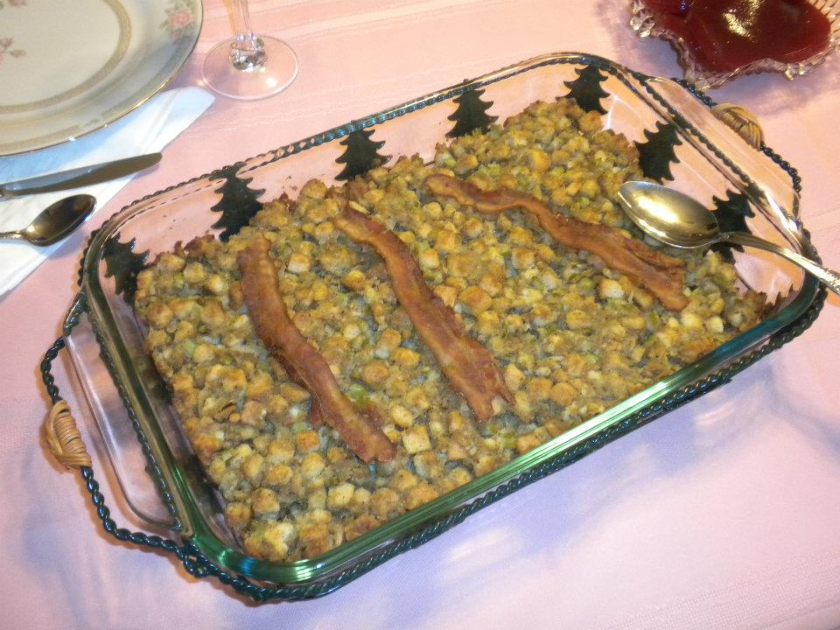
My Family’s Traditional Food
Stuffing

Slide 28
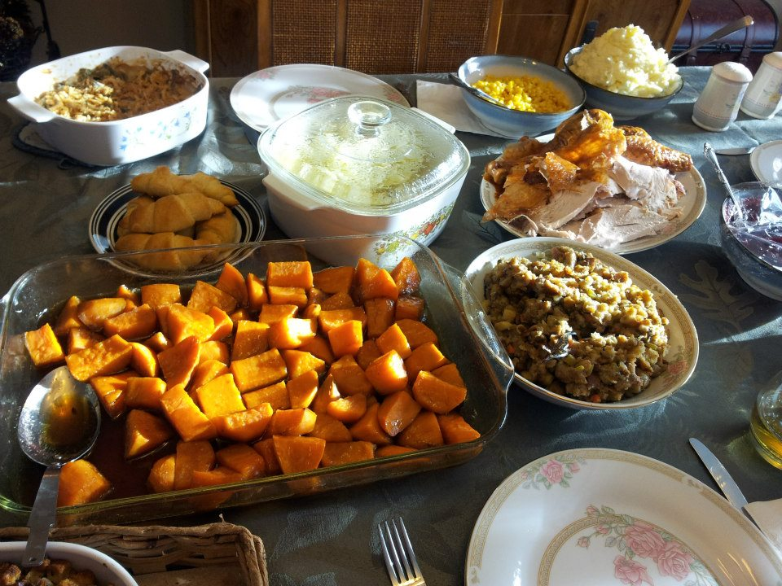
Corn
Mashed Potatoes
Cauliflower
Croissants
Stuffing
Sweet Potatoes

Slide 29
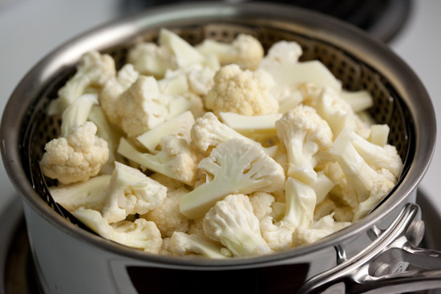
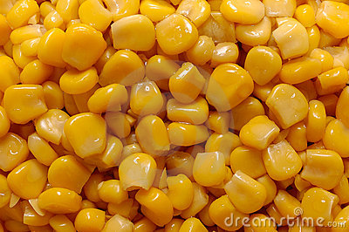
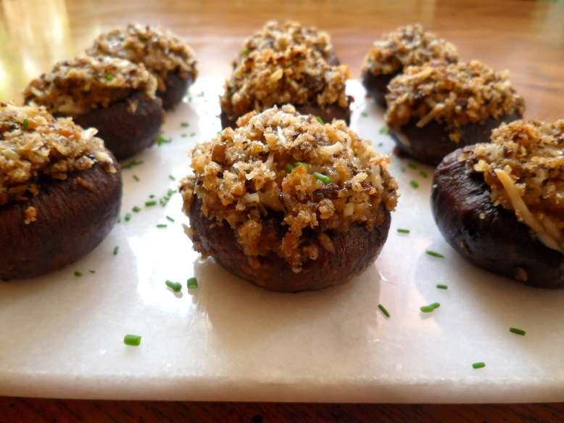
Vegetables (야채)
Corn (옥수수)
Cauliflower (콜리플라워)
Stuffed Mushrooms (버섯)
Green bean casserole(껍질콩 캐서롤)

Slide 30
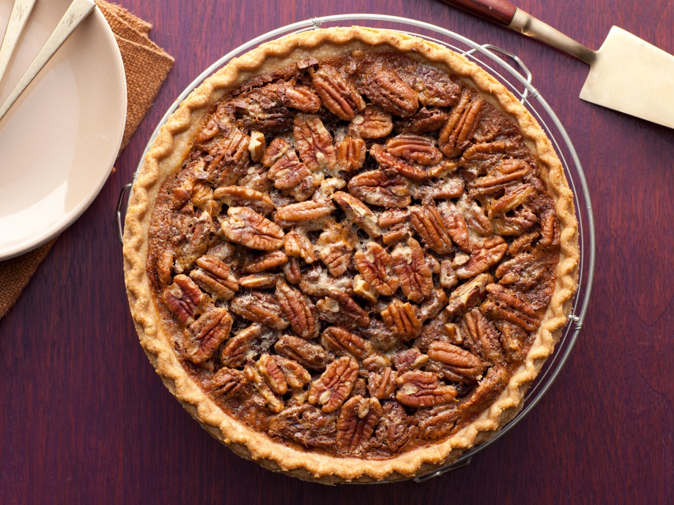
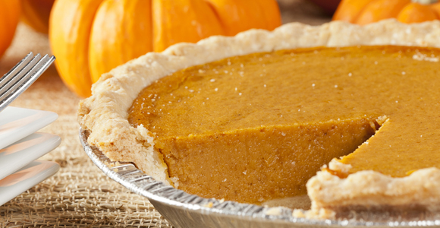
Dessert
Pecan Pie (피칸 파이)
Pumpkin Pie

Slide 31
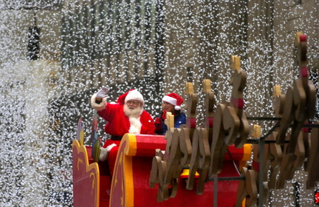
My Family’s Traditional Activities
Watch the Macy’s Thanksgiving Day Parade on TV

Slide 32
My Family’s Traditional Activities
Watch Christmas movies!

Slide 33
Thanksgiving Scavenger Hunt (물건 찾기 게임)

Slide 34
How to Play
Make teams of 4.
Find 10 pictures around the school.
Write their location (장소) on the worksheet (학습지). 학습지에 장소 써 와요.
Try to answer the bonus questions (보너스 질문) for more points.
The fastest team (빠른 팀) with the most points (가장 높은 점수) wins!

Slide 35
Points
Each picture found (+1)
Bonus questions (+more points)

Slide 36
Rules
Give the worksheet to Kristen teacher by 4:30pm (4시30분 까지).
Do not take the pictures, write the locations on your worksheet only. 사진 떼지 마요! 학습지에 장소 써 와요.
Write in English!

Slide 37
Classroom Names
중앙출입구 - Main entrance
체육관 - Gym
과학준비실 - Science Preparation Room
보건실 - Nurse’s Office
교사연구실 - Teacher’s Office
수석교사실 - The Head Teacher’s Room

Slide 38
Other locations
계단 – Stairs
엘리베이터 - Elevator
무대 - Stage
안에- Inside
밖에 - Outside
위에 - Above
밑에 - Below
1층 - 1st floor
2층 - 2nd floor
3층 - 3rd floor
4층 - 4th floor
5층 - 5th floor

Slide 39
Thanksgiving with
ANGRY BIRDS!

Slide 40
Today is Thanksgiving! I’m so happy!
I’m happy, too!
Let’s eat a lot of food.

Slide 41
Before we eat, let’s say what we are thankful for.

Slide 42
I’m thankful for my mom.

Slide 43
I’m thankful for my brother.

Slide 44
I’m thankful for my friends.

Slide 45
I’m thankful for my teachers.

Slide 46
I’m thankful for my dog.

Slide 47
I’m thankful for my family.

Slide 48
Thank you, everyone! Let’s eat!

Slide 49
What is “Being thankful”?
I’m thankful for… = …해서 감사합니다 or …해주셔서 감사합니다
I’m thankful for my mom.
어머니 한테 감사합니다.
I’m thankful for the food.
음식에게 감사합니다.

Slide 50
I’m thankful for __________
video games.

Slide 51
I’m thankful for __________
Angry Birds.

Slide 52
I’m thankful for _______
Bibimbap.

Slide 53
I’m thankful for ___
둘리.

Slide 54
I’m thankful for ________
Lotte World.

Slide 55
I’m thankful for ____
cats.

Slide 56
What are you thankful for?

Slide 57
I’m thankful for…
Let’s make a “turkey feather”
Trace your hand (종이 위에 너의 손을따라 그려줘요)
Cut (자르다)
Write “I am thankful for…”
Write 4 things you are thankful for.
Draw a picture (그림을 그려요)
Write your name and class number (반)

