Slide 1
Review

Slide 2
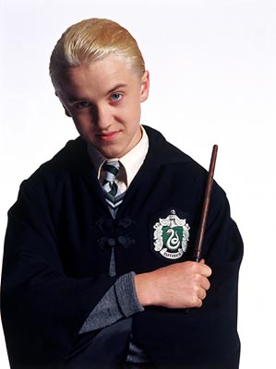

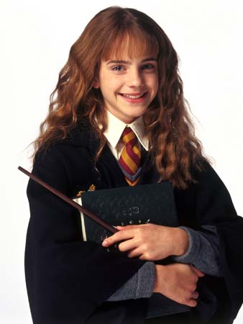
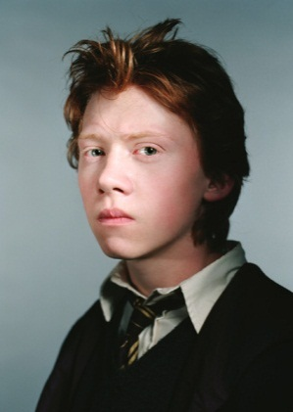
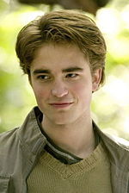
Malfoy
Harry Potter
Hermione
Ron
Cedric
잔인한
야망있는 / 얄망이 있는
  용기있는
  믿을 수 있는
똑똑한
열심히 일하는
외향적인
재미있는
배려하는
참을성 있늠
믿을 수 있는
Intelligent, courageous (brave), patient,
ambitious, cruel (mean), hardworking, trustworthy, funny, outgoing

Slide 3


Slide 4
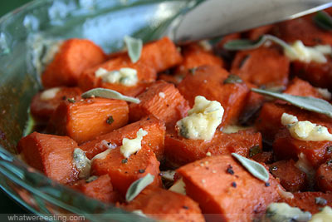
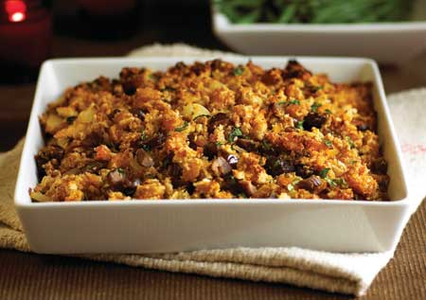
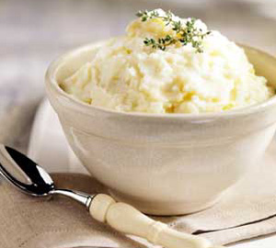
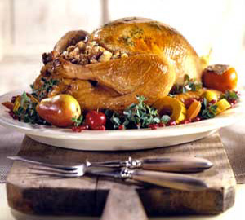
Thanksgiving Foods:
Sweet Potatoes
Stuffing
Turkey
Mashed Potatoes

Slide 5
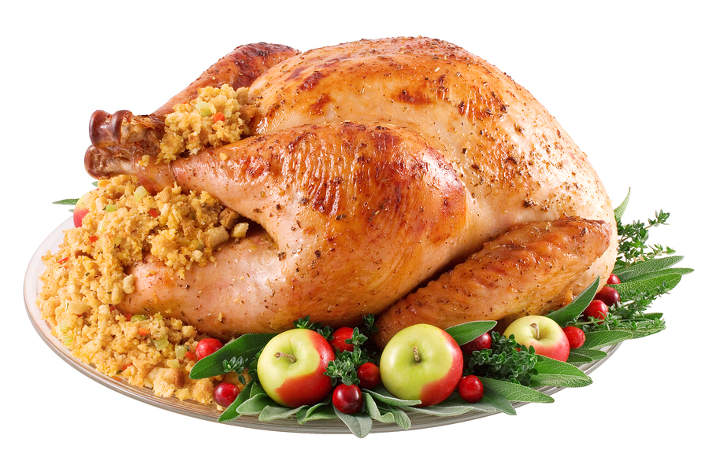
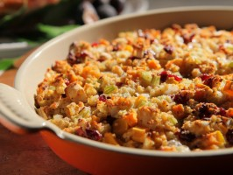
Stuffing
Bread, vegetables, and meat
Baked
Goes inside the turkey

Slide 6
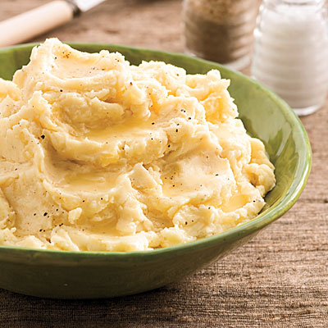
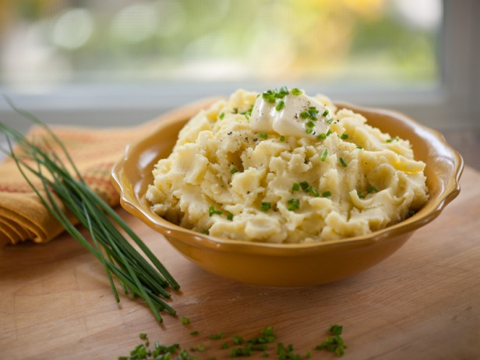
Mashed Potatoes
Potatoes with butter, salt, pepper, and milk

Slide 7
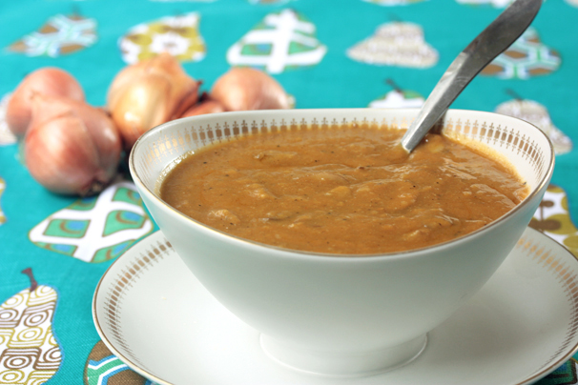
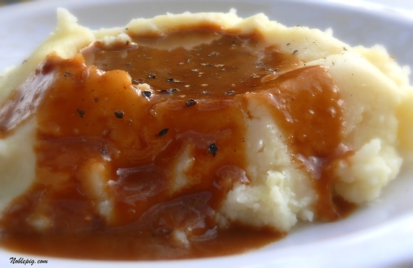
Gravy
Sauce for potatoes and turkey

Slide 8
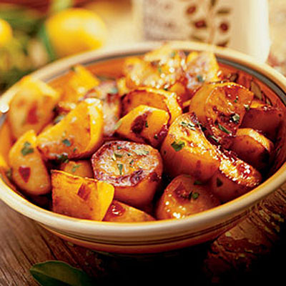
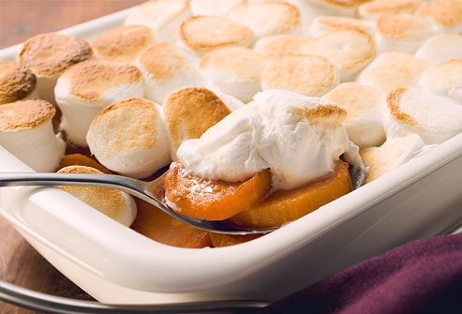
Sweet Potatoes
Orange color
Tastes sweet

Slide 9
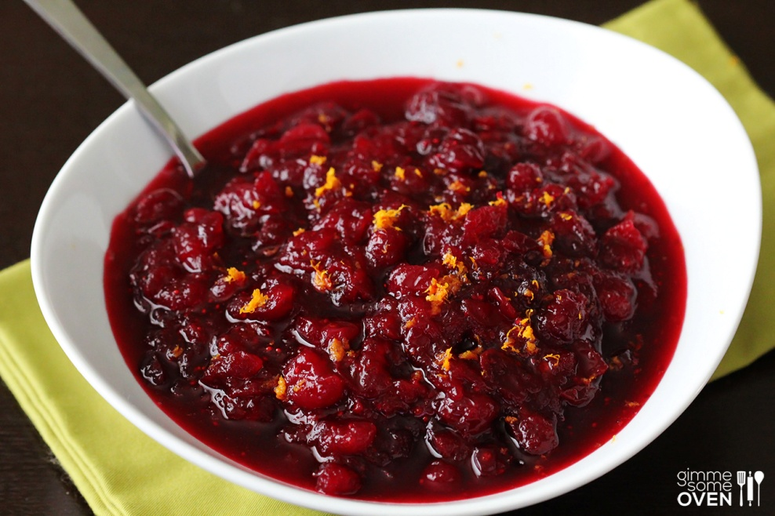
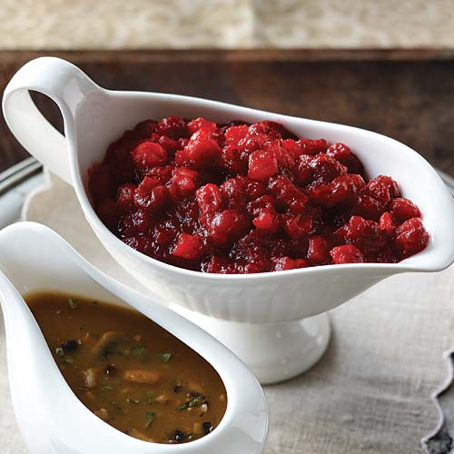
Cranberry Sauce
Red color (cranberries)
Sauce for turkey

Slide 10
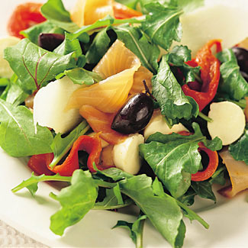
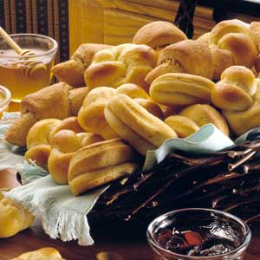
…more food…
Bread
Salad

Slide 11
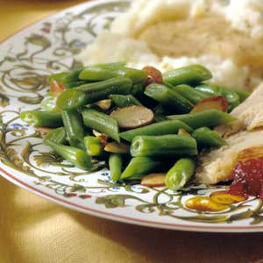
Green Beans

Slide 12
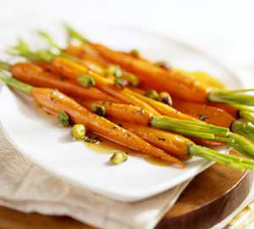
Carrots

Slide 13
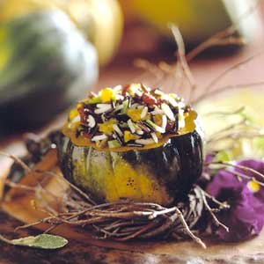
Rice

Slide 14
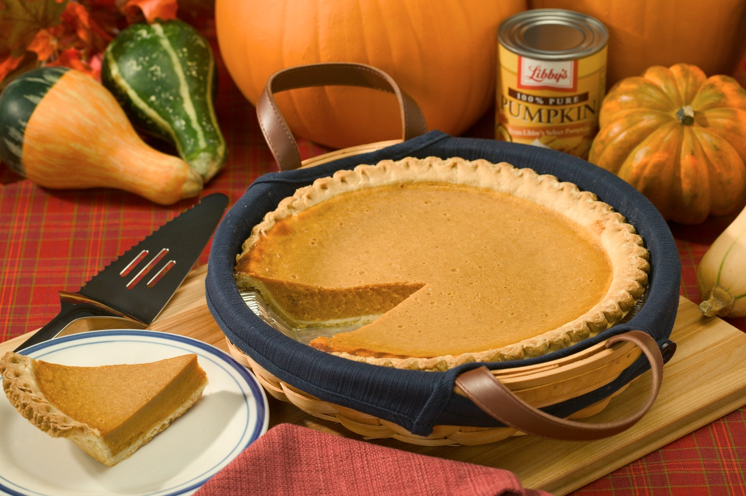
Pumpkin Pie
Dessert
Orange color
Tastes sweet

Slide 15
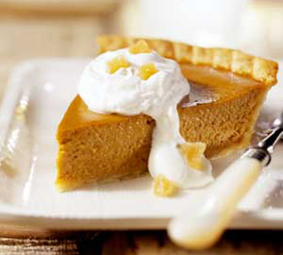
REVIEW!

Slide 16
SPEED QUIZ!
What color?
Meat, vegetable, or sauce?
Sweet or not sweet?

Slide 17
Turkey

Slide 18
Stuffing

Slide 19
Gravy

Slide 20
Sweet Potatoes

Slide 21
Cranberry Sauce

Slide 22
Bread

Slide 23
Mashed Potatoes

Slide 24
Green Beans

Slide 25
Carrots

Slide 26
Rice

Slide 27
Pumpkin Pie

Slide 28
Sweet Potatoes

Slide 29
Gravy

Slide 30
Turkey

Slide 31
Stuffing

Slide 32
Rice

Slide 33
Bread

Slide 34
Cranberry Sauce

Slide 35
Pumpkin Pie

Slide 36
Carrots

Slide 37
Green Beans

Slide 38
Mashed Potatoes

Slide 39
What are you thankful for?
Please write.
Things I am thankful for:
  1. Things I own
    (mp3, cell phone, computer, etc.)
  2. Things that are only in Korea
    (kimchi, norebang, bulgogi, TKD, etc.)
  3. People
    (Mom, teachers, friends, etc.)
  4. Things I cannot touch
    (love, friendship, air, etc.)

Slide 40
Circle the top 4.
For these 4, write:
  I am thankful for ______ because _______ .

