Slide 1
……
……
MYSTERY
……
……
………………
………………
………………
BOX
미스터리
박스
………………
What’s in the box?
박스 안에 뭐가 있을까요…?
Developed in 2011 by
J. Morken
Edited by Chris Deming
Notes:
This game uses the font, SYNCHRO LET. I recommend installing it if your computer doesn’t already have it.

Slide 2
-The Mystery Box may be good or bad
그 미스터리 박스는 좋을 수도 나쁠 수도 있습니다.

Slide 3
1
It may be good!
KEEP OR GIVE
The mystery box?
points
-Choose (선택하세요)
Keep box
박스 가져도 됩니다.
2) Give box to a different
team
다른 팀한테 줄 수 있습니다.

Slide 4
-1
Or, It may be bad!
points

Slide 5
Mystery Box
A
B
C
D
E
F
G
H
I
J
K
L
M
N
O
P
Q
R
S
T
U
V
W
X
Y
Z

Slide 6
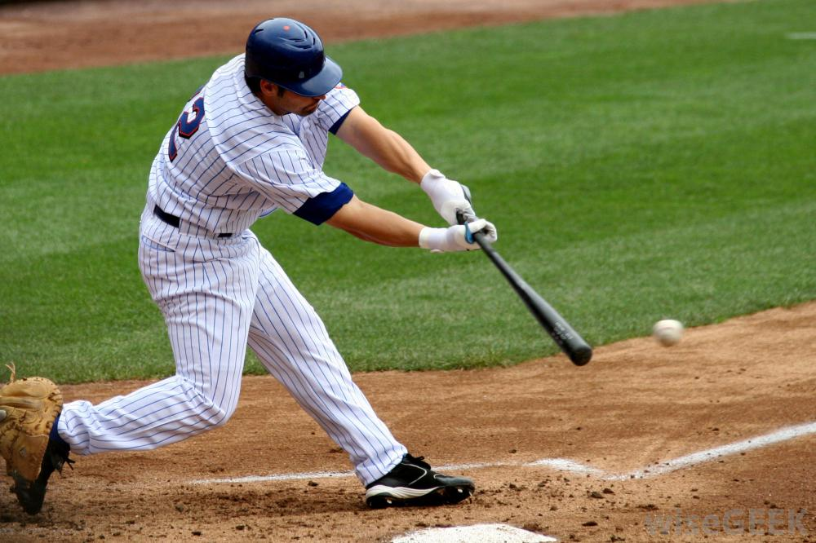
Let’s play ____.
+7
KEEP OR GIVE
The mystery box?
points
Let’s play baseball.

Slide 7
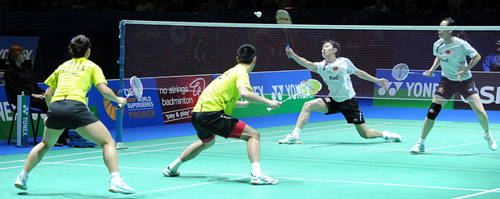
Let’s play ____.
+5
points
KEEP OR GIVE
The mystery box?
Let’s play badminton.

Slide 8
Translate
-4
가자
points
KEEP OR GIVE
The mystery box?
Let’s go.

Slide 9
Translate
+8
야구 하자.
KEEP OR GIVE
The mystery box?
points
Let’s play baseball.

Slide 10
Translate
+3
청소하다
KEEP OR GIVE
The mystery box?
points
Clean

Slide 11
Translate
Switch
같이
points!
KEEP OR GIVE
The mystery box?
Together

Slide 12
Translate
2X
같이 축구 하자.
points
KEEP OR GIVE
The mystery box?
Let’s play soccer together.

Slide 13
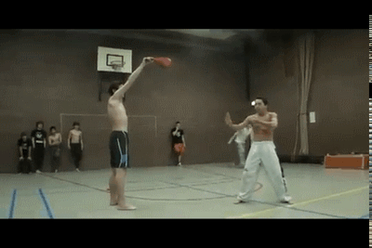
What’s this?
2X
KEEP OR GIVE
The mystery box?
points
Taekwondo

Slide 14
Reverse translate
Play rock, scissors paper with another team and switch points IF you win.
I’m hungry.
KEEP OR GIVE
The mystery box?
배고파.

Slide 15
Translate
-5
나도.
points
KEEP OR GIVE
The mystery box?
Me, too.

Slide 16
Translate
Choose another team to be
0
내일 같이 테니스 하자.
KEEP OR GIVE
The mystery box?
Let’s play tennis together tomorrow.

Slide 17
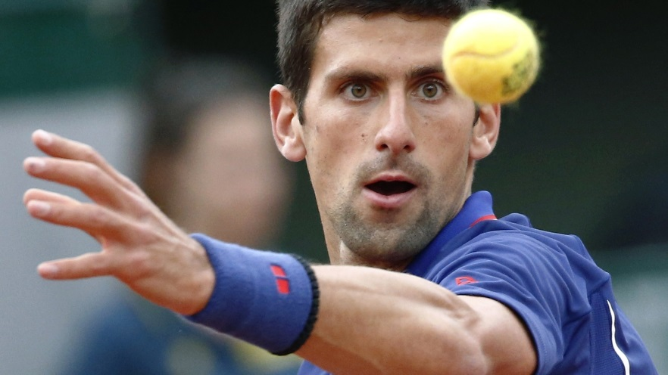
좋아하다
I ____ _____.
Me, _____.
You have
0
points
KEEP OR GIVE
The mystery box?
I like tennis
Me, too.

Slide 18
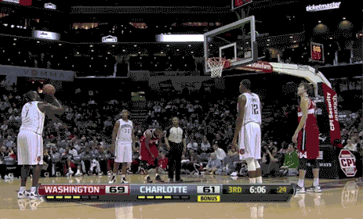
What’s this?
+10
points
KEEP OR GIVE
The mystery box?
Basketball

Slide 19
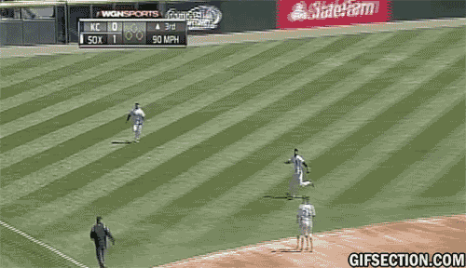
What’s this?
Change Points
KEEP OR GIVE
The mystery box?
Baseball

Slide 20
Let’s play soccer.
S____!
5
KEEP OR GIVE
The mystery box?
points
Sure!

Slide 21
Reverse Translate
+ 5
나도
KEEP OR GIVE
The mystery box?
points
Me, too.

Slide 22
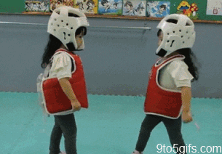
Let’s ___ ____ ____.
같이
-2
KEEP OR GIVE
The mystery box?
points
Let’s do taekwondo together.

Slide 23
Translate
+4
농구 좋아 해.
KEEP OR GIVE
The mystery box?
points
I like basketball.

Slide 24
Reverse Translate
+7
Together
KEEP OR GIVE
The mystery box?
points
같이

Slide 25
Translate
Your team’s
score is now
태권도 좋아해.
저도.
zero
KEEP OR GIVE
The mystery box?
I like taekwondo.
Me, too.

Slide 26
Reverse translate
Change
Like
points
KEEP OR GIVE
The mystery box?
좋아하다

Slide 27
같이 가자.
-2
points
KEEP OR GIVE
The mystery box?
Let’s go together.

Slide 28
Let’s play soccer.
Give another team 10 points!
Sorry, I c____.
KEEP OR GIVE
The mystery box?
Sorry, I can’t.

Slide 29
Translate
Your team +5 One other team +5
미안해.
KEEP OR GIVE
The mystery box?
Sorry

Slide 30
Reverse translate
Play Paper, rock, scissors with another team, and trade scores if you win
Sorry
KEEP OR GIVE
The mystery box?
미안해.

