Slide 1
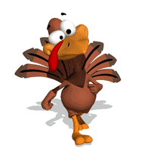
Thanksgiving
5th Grade

Slide 2
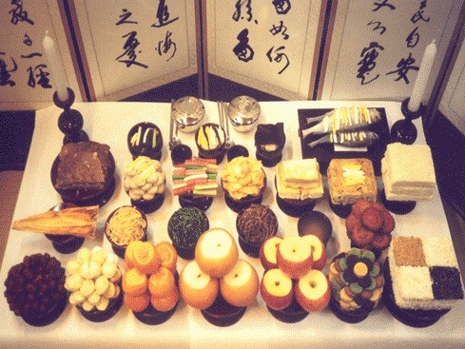
What Korean holiday is this weekend?
Chuseok (추석)

Slide 3
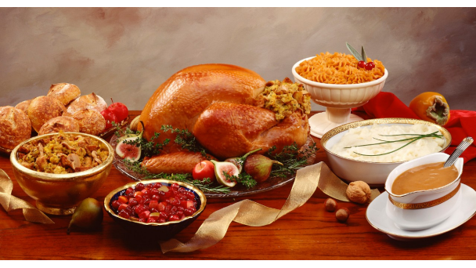
America has a similar holiday…
Thanksgiving

Slide 4
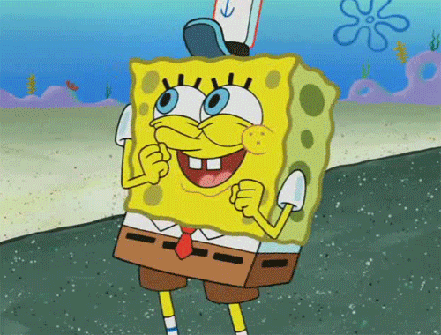
Today we will…
Learn the history of Thanksgiving
Learn what Americans do on Thanksgiving
Talk about being thankful

Slide 5

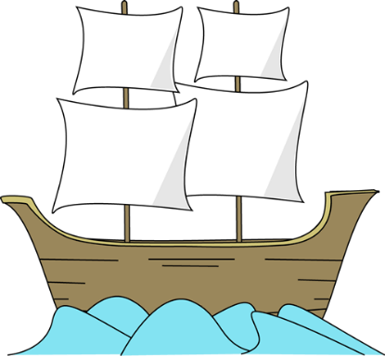
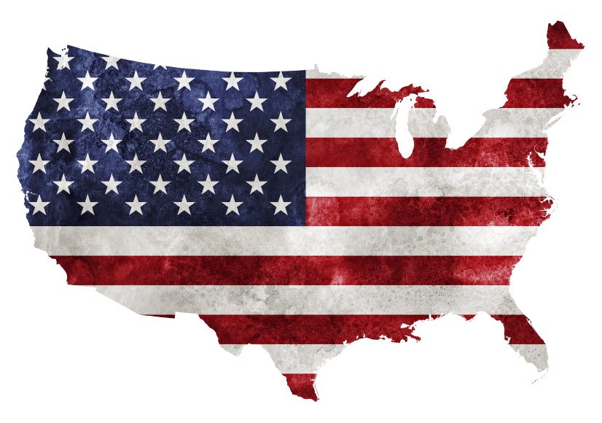
Thanksgiving: History
In 1620, some people from England called pilgrims went to America on a boat called the Mayflower.

Slide 6
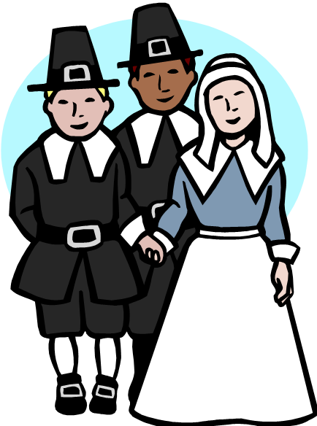
Thanksgiving: History
The pilgrims were very hungry, but they didn’t have any food.

Slide 7
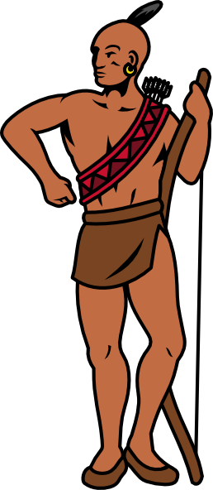
Thanksgiving: History
The people who lived in America, called Indians, helped the pilgrims.

Slide 8
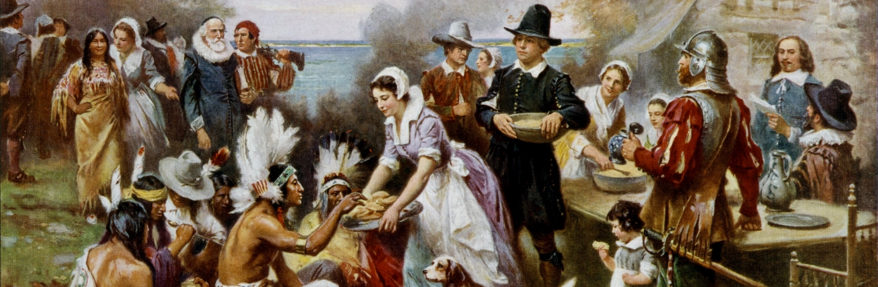
Thanksgiving: History
The Indians shared food with the pilgrims. They ate many different kinds of food together.

Slide 9
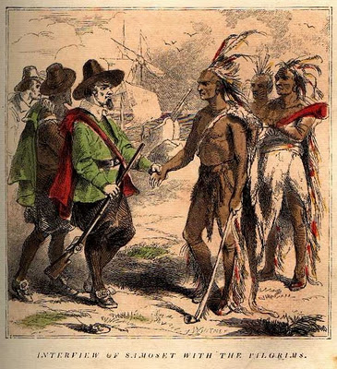
Thanksgiving: History
The pilgrims felt very happy and thankful because the Indians shared their food.

Slide 10
What does thankful mean?
“Full of thanks”
Saying thank you for what you have
감사하는
Thanksgiving =
giving
thanks

Slide 11
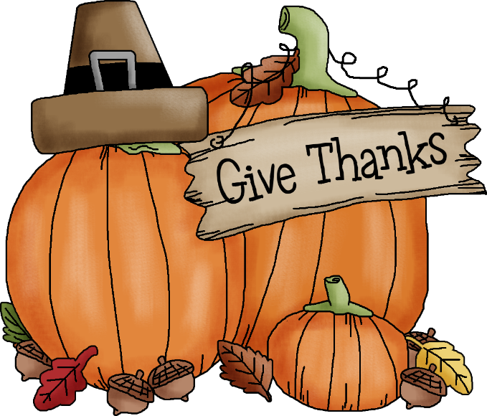
Now…
Thanksgiving is always in late November
It is always on Thursday
On Thanksgiving day, Americans remember the things we are thankful for

Slide 12
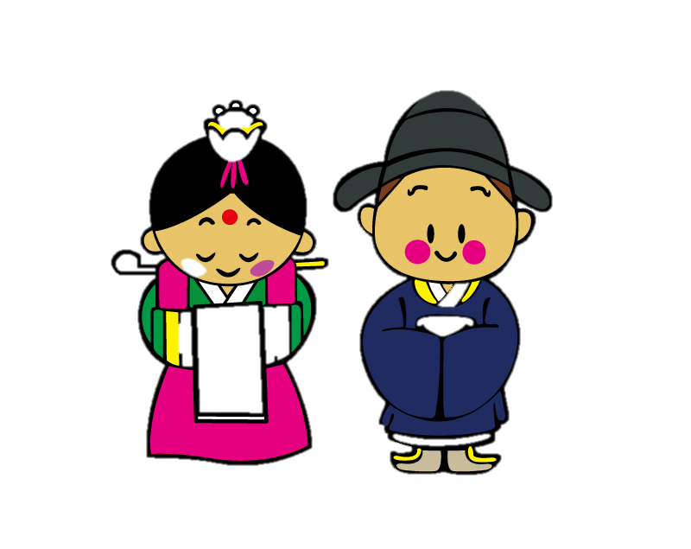
Thanksgiving traditions
What is tradition?
전통
For example, 한복 is traditional clothing for Koreans.

Slide 13
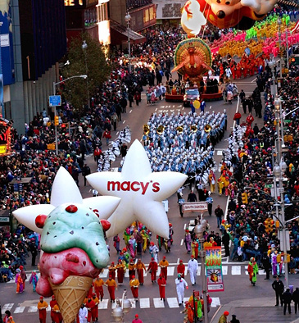
Thanksgiving traditions
In the morning, we watch the Macy’s Thanksgiving Day Parade (행렬)
Notes:
https://www.youtube.com/watch?v=HnuRYRlOqR4
https://www.youtube.com/watch?v=aj25w0u0-ic

Slide 14
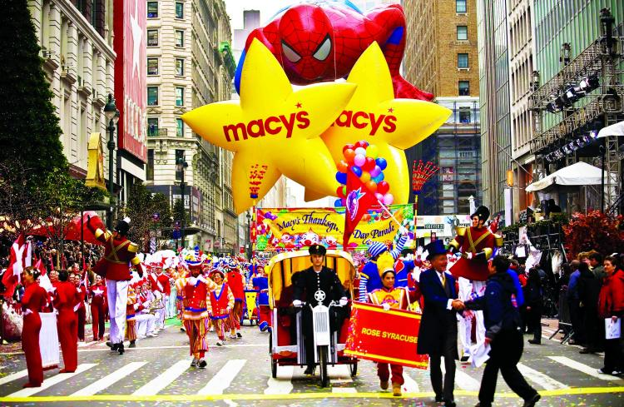
Macy’s Thanksgiving Day Parade
This parade started in 1924
It is in New York City
Notes:
https://www.youtube.com/watch?v=HnuRYRlOqR4
https://www.youtube.com/watch?v=aj25w0u0-ic

Slide 15
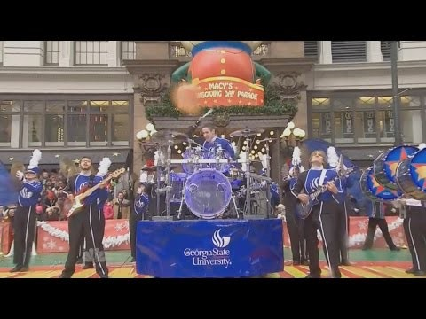
Macy’s Thanksgiving Day Parade
Let’s watch a little!
Georgia State University
2014 Marching Band Performance
Notes:
https://www.youtube.com/watch?v=HnuRYRlOqR4
https://www.youtube.com/watch?v=aj25w0u0-ic

Slide 16
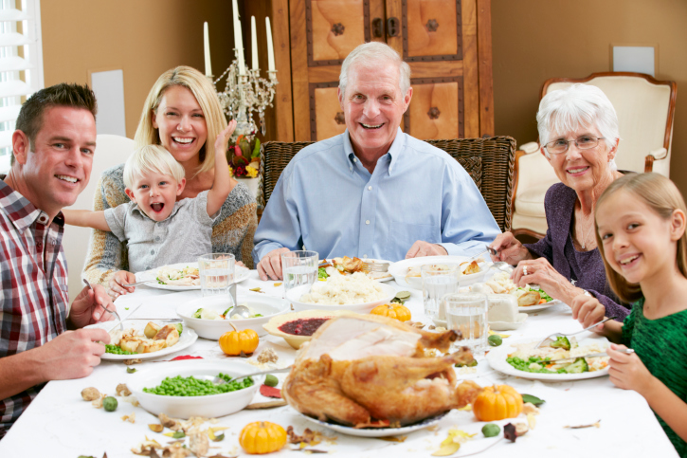
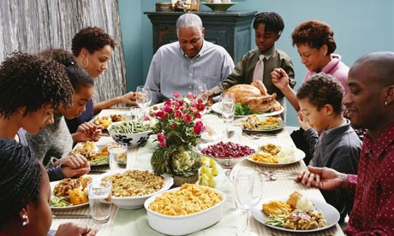
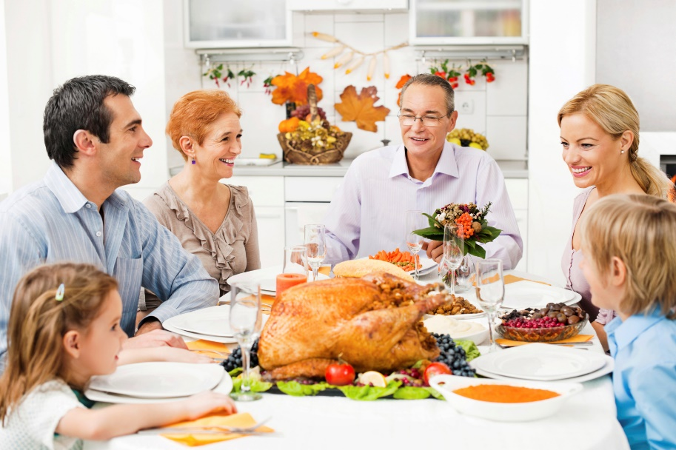
Thanksgiving traditions
Usually, people meet with their families and eat lots of food!

Slide 17
Guess the Thanksgiving foods!

Slide 18
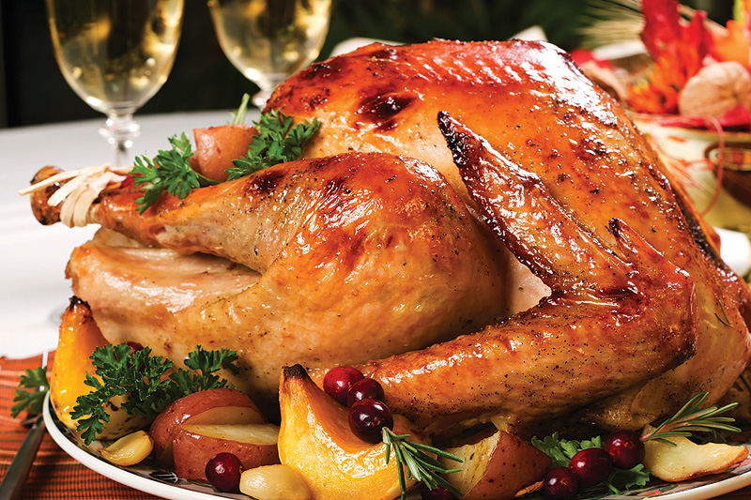
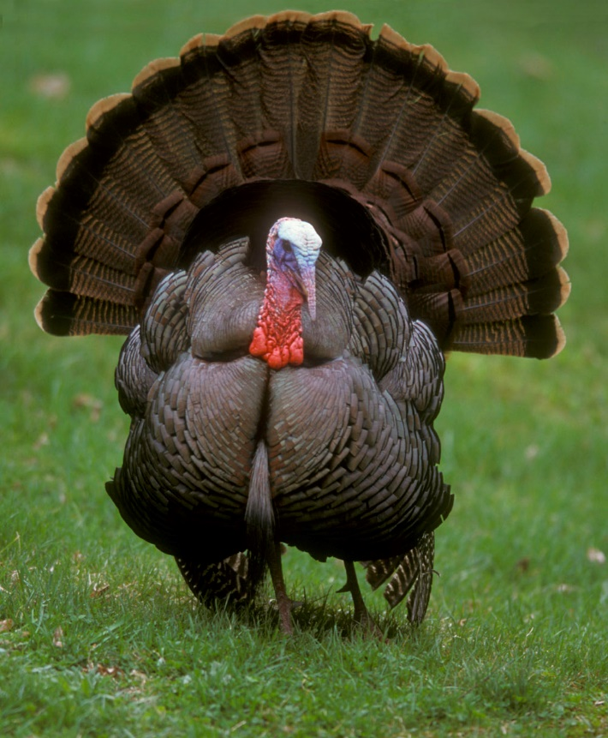
Turkey

Slide 19
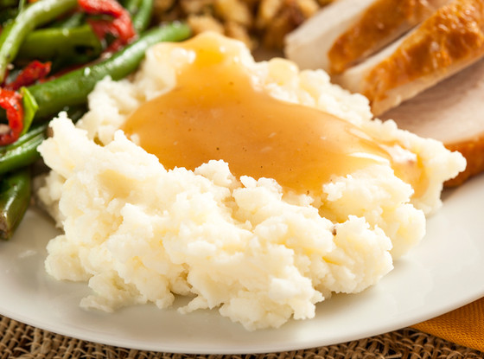
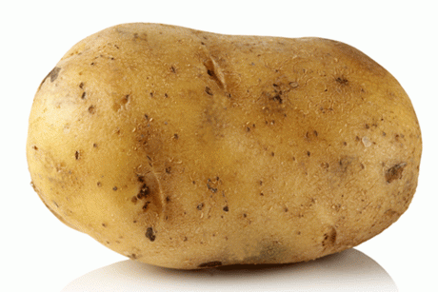
Mashed potatoes (with gravy)

Slide 20
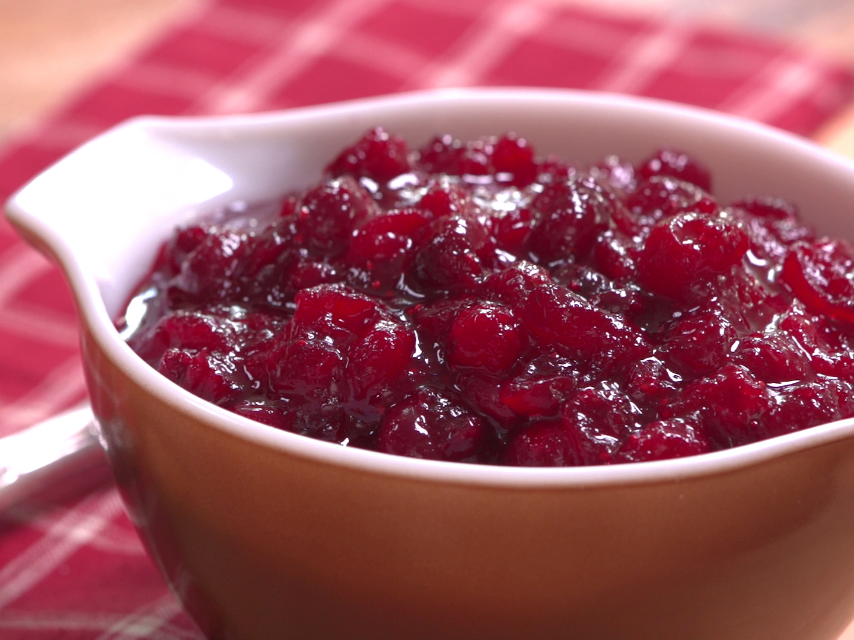
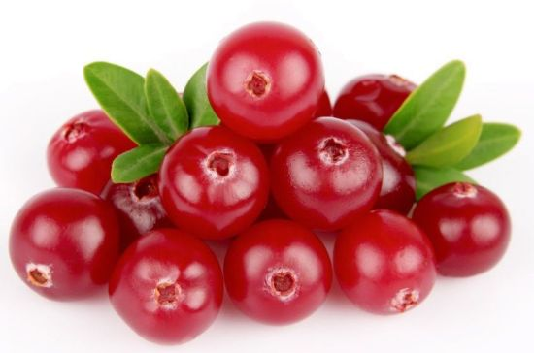
Cranberry sauce

Slide 21
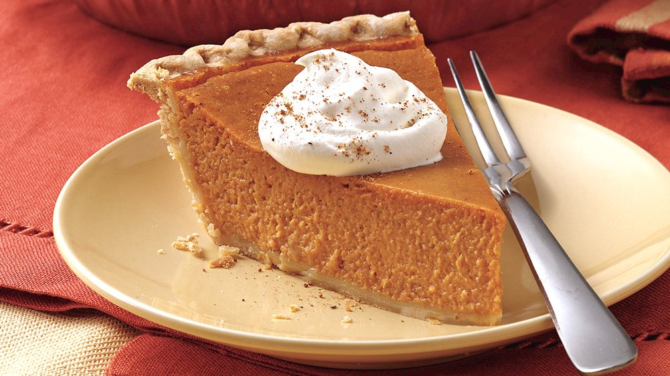
Pumpkin pie

Slide 22
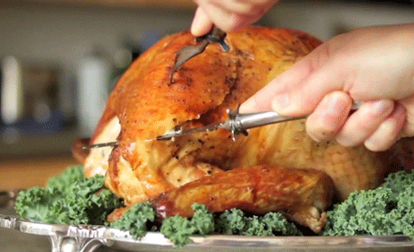
Thanksgiving traditions
We carve the turkey
(carve = slice, cut)

Slide 23
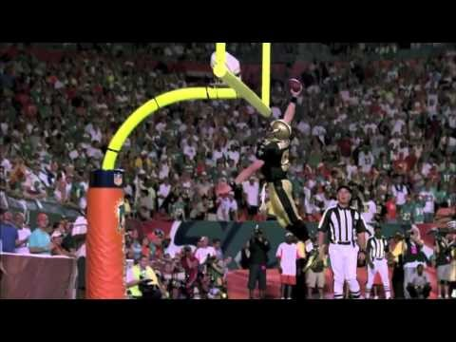
Thanksgiving traditions
After dinner, some people watch football
Notes:
https://www.youtube.com/watch?v=gl1n79s3vRw

Slide 24
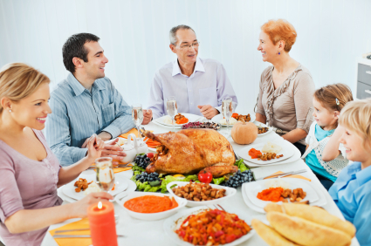
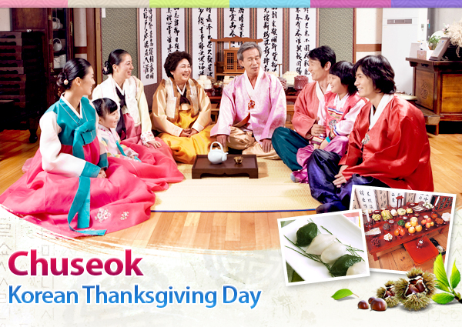
Let’s compare:
Thanksgiving and 추석
How are they similar?
How are they different?

Slide 25
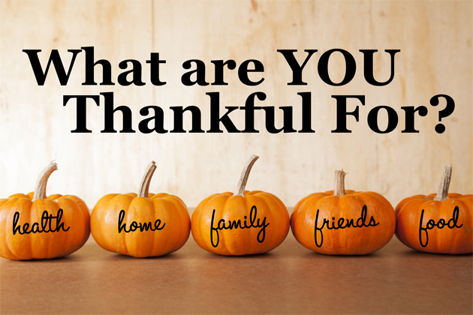
Daily Activity #4:

Slide 26
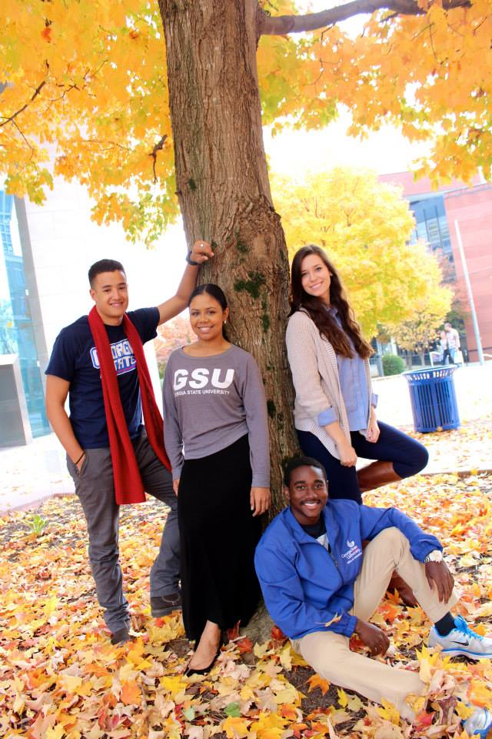
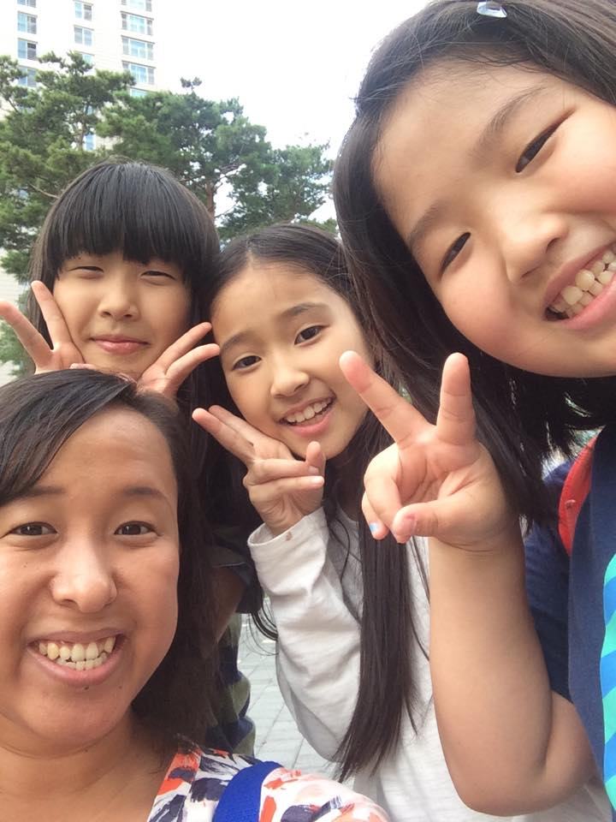
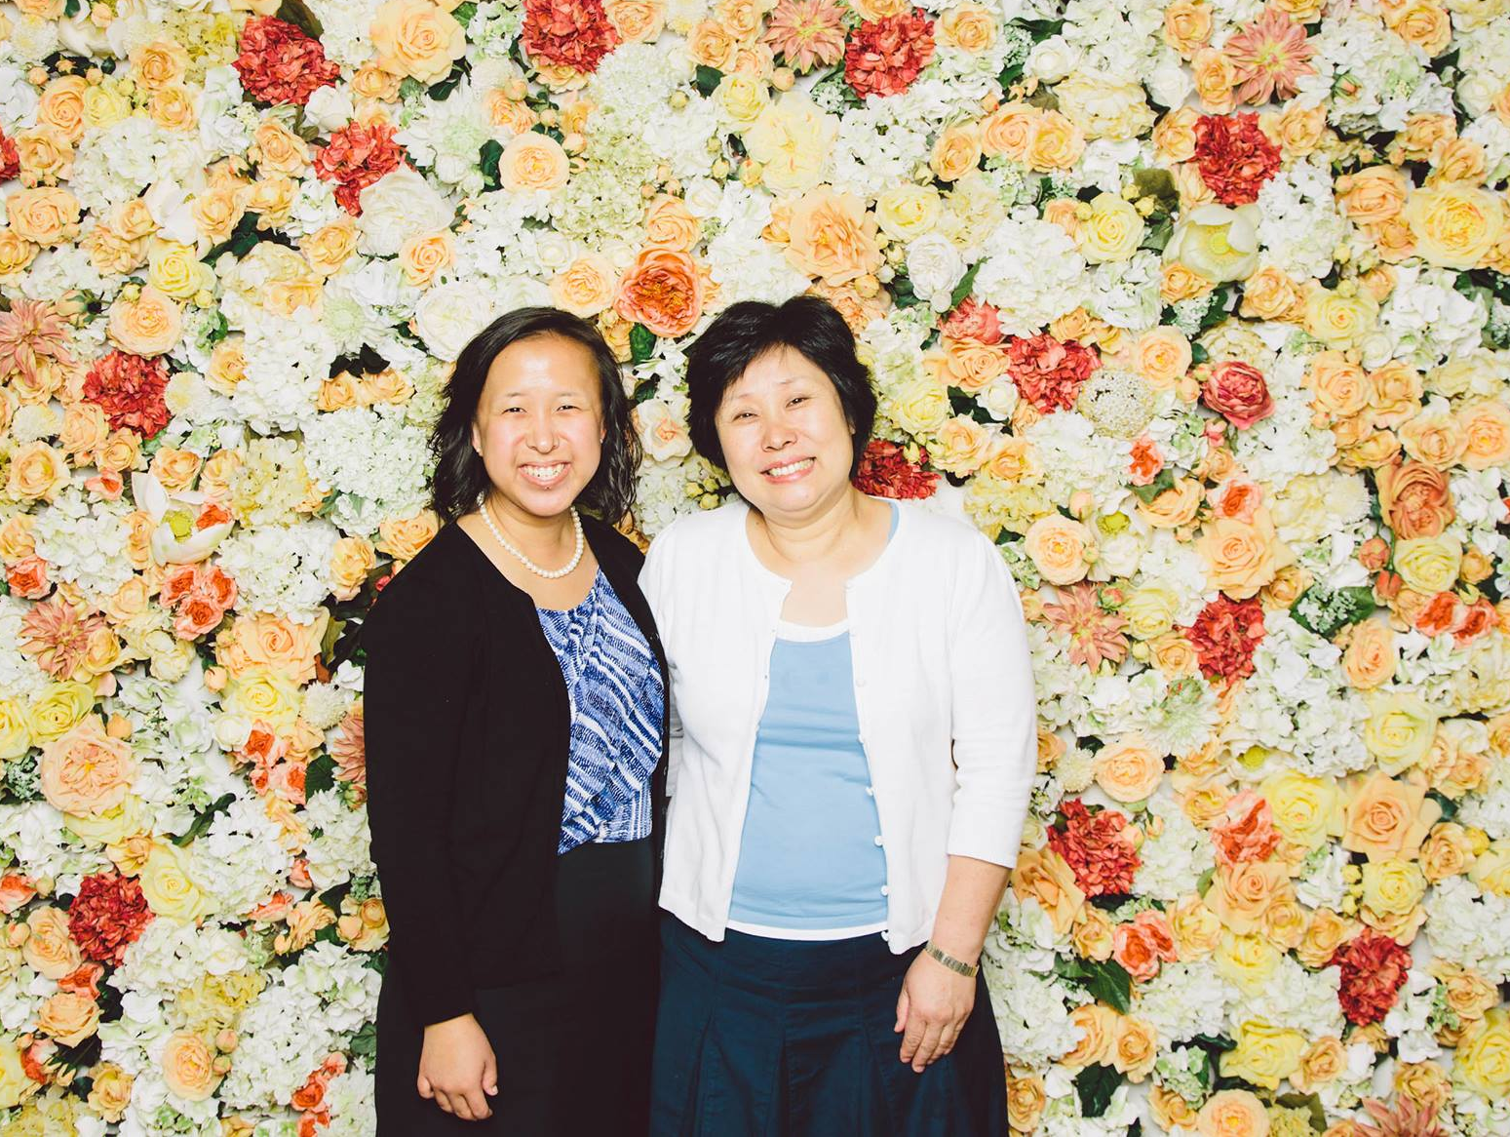
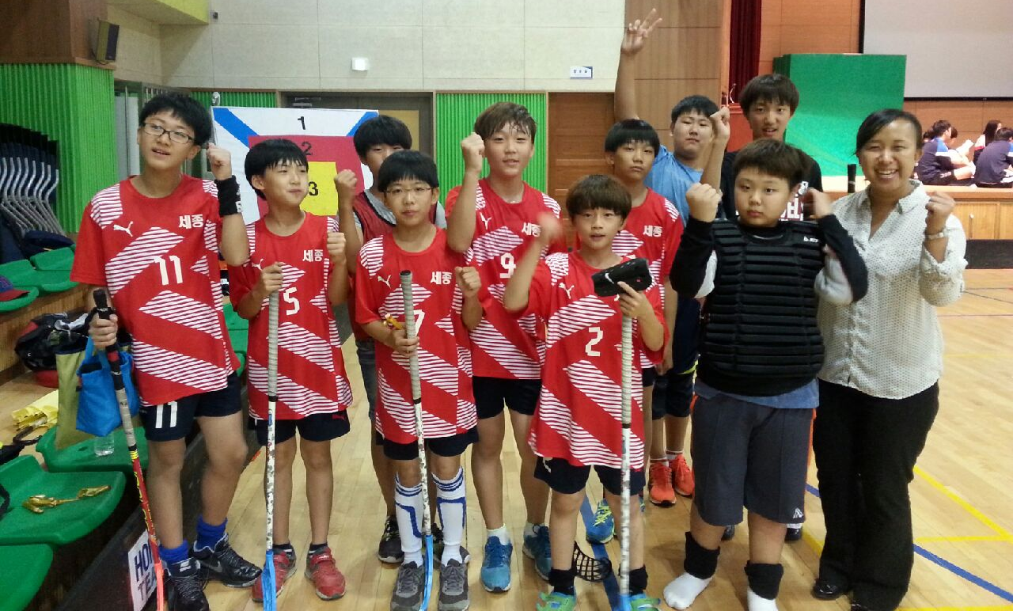
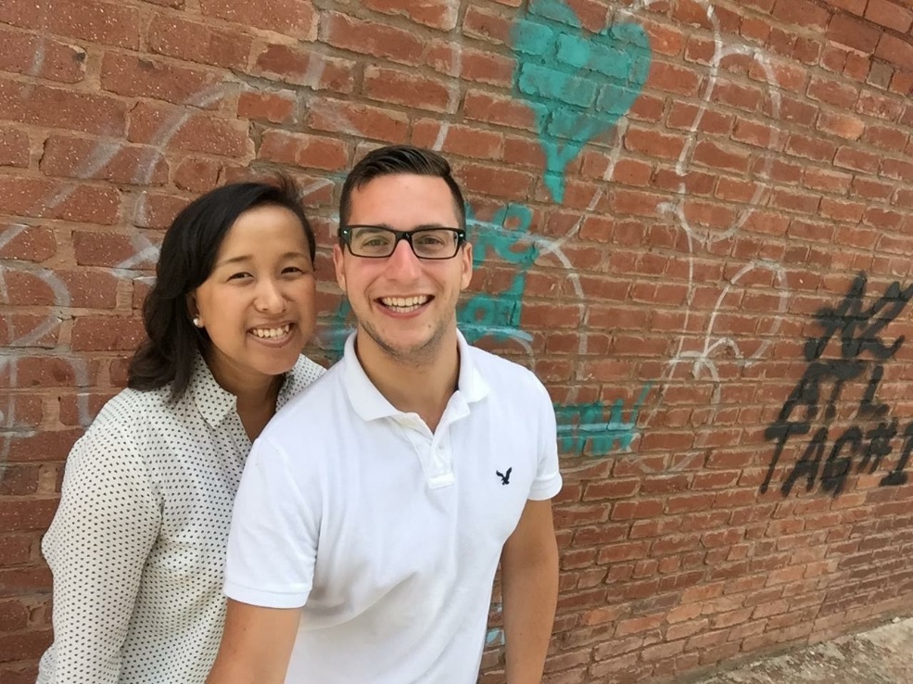
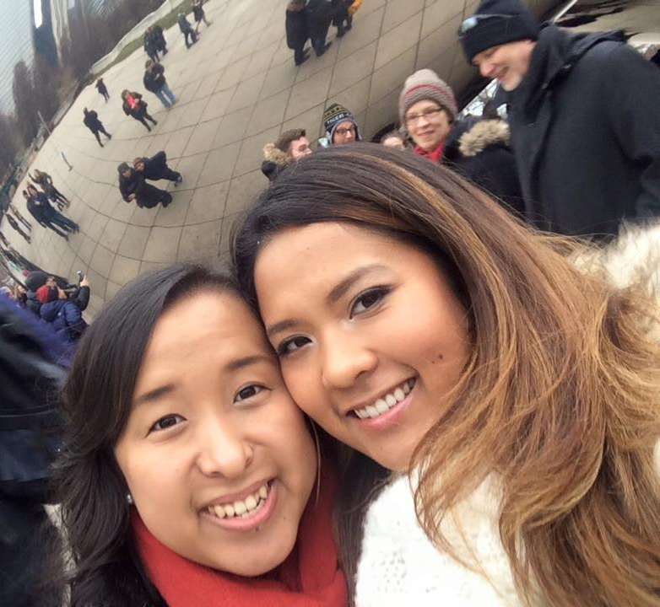
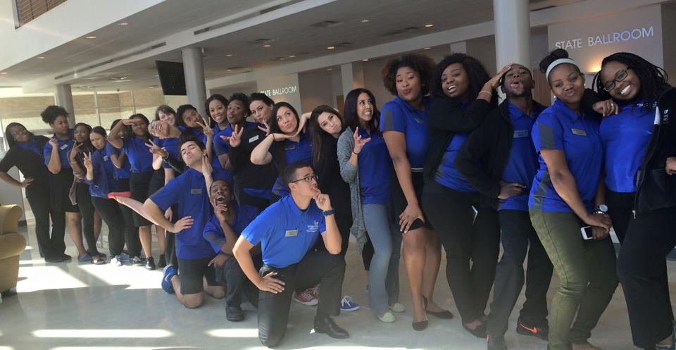

Slide 27
I’m thankful for…
My family and friends
My students (you!)
My job
Music
Air conditioning in summer!

Slide 28
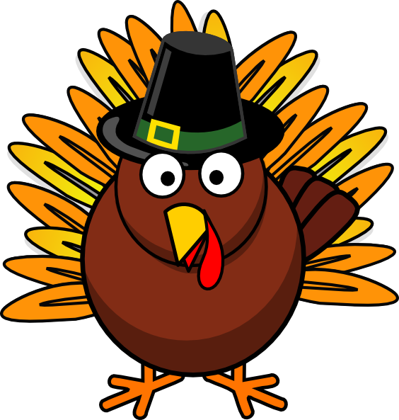
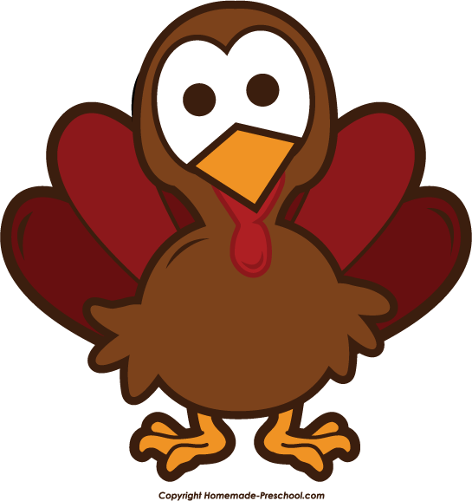
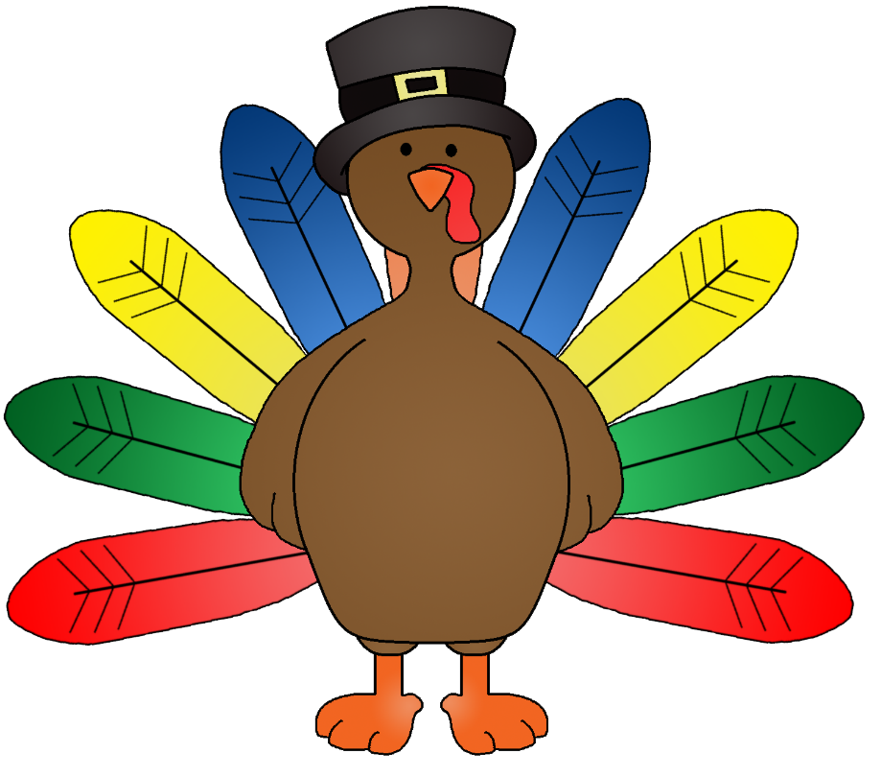
Let’s make thankful tree!

Slide 29
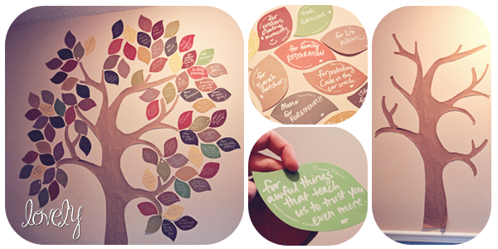
We are thankful for…

Slide 30
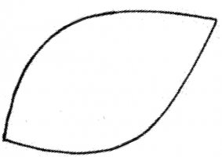
Friends
Family
Nature
Grace (이정현)
Grace (이정현)
Grace (이정현)
My dogs
My mom
My dad
Grace (이정현)
Grace (이정현)
Grace (이정현)
Books
Games
Skates
Grace (이정현)
Grace (이정현)
Grace (이정현)
Write 1 thing you are thankful for…

Slide 31
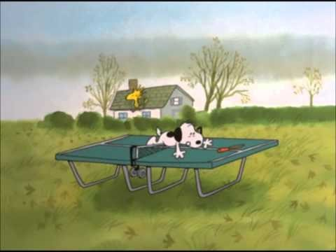
Let’s watch Charlie Brown!
“A Charlie Brown Thanksgiving” [1973]
Notes:
http://tvpot.daum.net/clip/ClipView.do?clipid=52487520

Slide 32
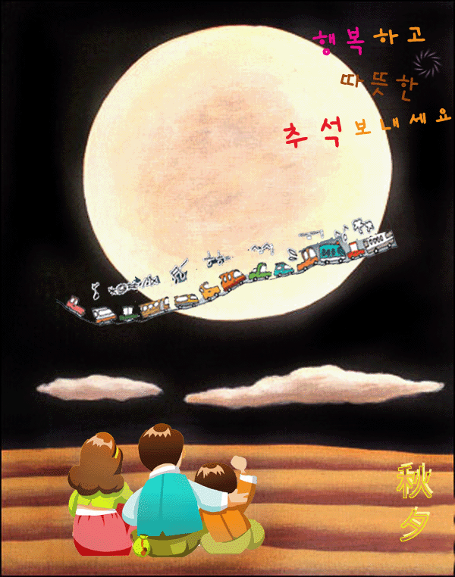
Enjoy 추석!

