Slide 1
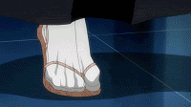
NINJA!
BATTLE
닌자 전쟁

Slide 2
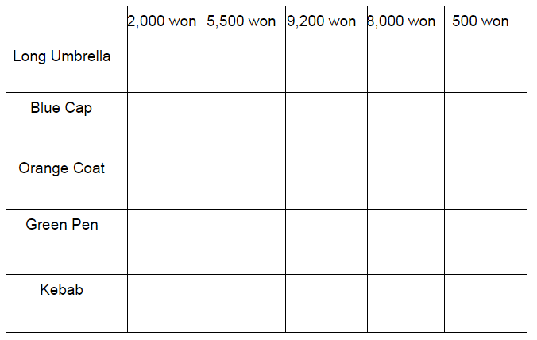
How to play (게임 방법)
The ninjas are at war!
닌자들은 전쟁중이에요!
Hide 5 ninjas, ready for the battle.
5명의 닌자를 숨기고, 전쟁을 준비하세요!

Slide 3
How to play
Teacher: Do you like this _______?
Students: Yes, I like it! How much is it?
Teacher: It’s _______ won.

Slide 4
How to play
The most ninjas alive after 10 rounds WINS!
10번의 게임 후에 가장 많은 닌자가 살아있으면 승리!

Slide 5
Let’s start!
Write your class, number and name.
(학반,번호,이름을 쓰세요.)
Hide your ninjas. (닌자를 숨기세요.)
Draw your ninjas, like this: (닌자를 아래와 같이 그리세요.)

Slide 6
 | 2,000 won | 5,500 won | 9,200 won | 8,000 won | 500 won
Long Umbrella
Blue Cap
Orange Coat
Green Pen
Kebab

